Slide 1
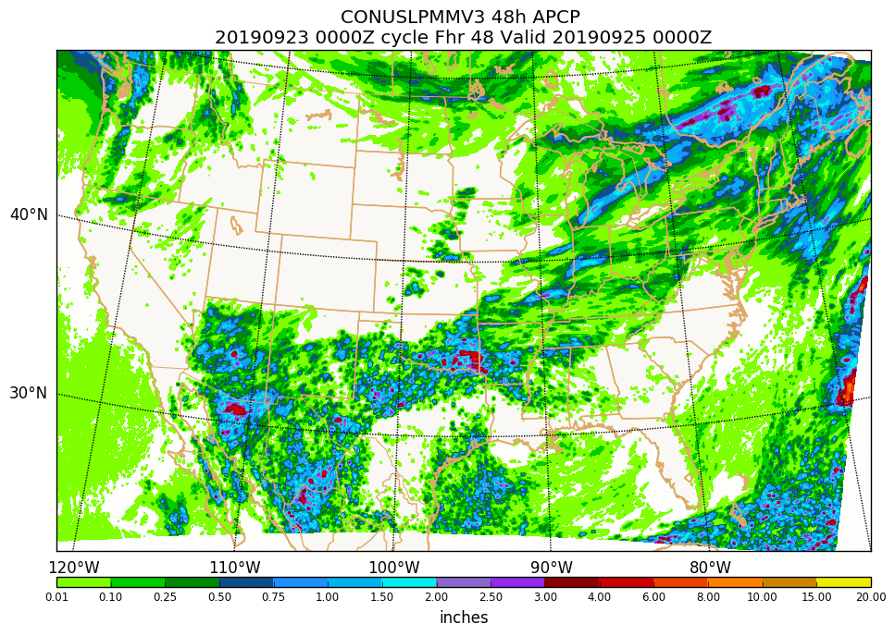
HREF upgrade plans for the next year
September 26, 2019 MEG Meeting
Matthew.Pyle@noaa.gov

Slide 2
Outline
An overview – what is HREF?
Description of changes planned for HREFv3
Membership changes – a first step toward FV3
Some product additions and tweaks made in response to user requests
New Ensemble Agreement Scale (EAS) probabilities and related issues (from an R2O project)
New local probability matched mean (from an R2O project)
Current status and planned timeline for the HREFv3 implementation.

Slide 3
High Resolution Ensemble Forecast (in operational HREFv2 form)
Combines multiple ~3 km models (HiresW and NAM nest) and their older, time-lagged runs into an 8-member system for ensemble product generation.
Ensemble spread driven by dynamical core (ARW/NMMB) and analysis (RAP/NAM) differences, and also through physics diversity.
Has heritage in the SPC SSEO in terms of membership and products (e.g., hourly max fields and neighborhood max probabilities).
Provides guidance to 36 h for severe weather, aviation, QPF, winter weather, and general forecasting applications.

Slide 4
HREFv2 CONUS membership
-12
0
+12
+24
+36
HiresW – ARW
(RAP init)
HiresW – NMMB
(RAP init)
HIRESW - “mem2” ARW
(NAM init)
NAM NEST - NMMB
(NAM init) **CONUS ONLY**
Time-lagged data slightly downweighted –
12 h old cycle given 75% weighting in mean fields

Slide 5
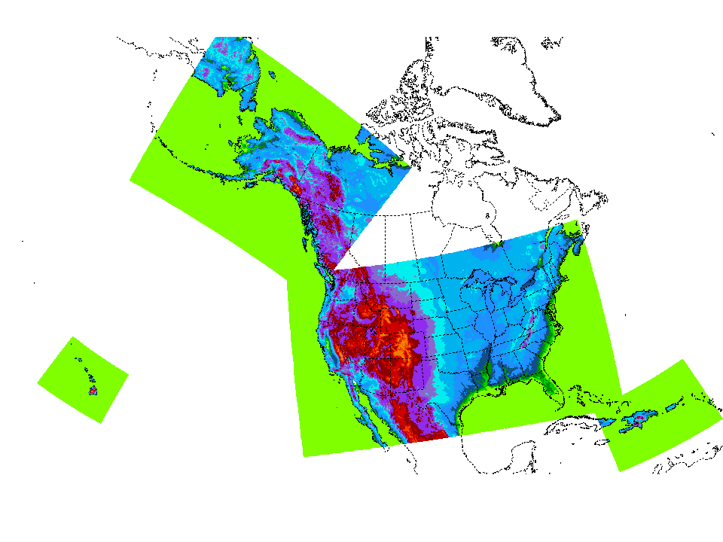
HREF domain coverage
06Z, 18Z
00Z, 12Z
00Z, 06Z, 12Z, 18Z
06Z, 18Z

Slide 6
Plans for HREFv3
Add regional 3 km FV3 and HRRR runs as new members (with time-lagged members of each), and eliminate the HiresW-NMMB members.
Likely product additions and modifications:
The Ensemble Agreement Scale (EAS) probability type will be introduced for select PQPF and snow products
Probabilities of QPF exceeding Average Recurrence Intervals (e.g., a 100 year event) and FFG (1 h, 3 h, and 6 h periods)
Local Probability Mean (LPM) for QPF
Extend forecast range from 36 h to 48 h

Slide 7
48 h HREFv3 membership (00/12Z CONUS)
-12
0
+12
+24
+36
+48
HiresW – ARW
(RAP init)
FV3 - CAM
(FV3GFS init??)
HIRESW - “mem2” ARW
(NAM init)
NAM NEST - NMMB
(NAM init) **CONUS ONLY**
HRRR - ARW
(HRRR init) **CONUS/AK ONLY**
Forecast range for HRRRv4 TBD, but > 36 h

Slide 8
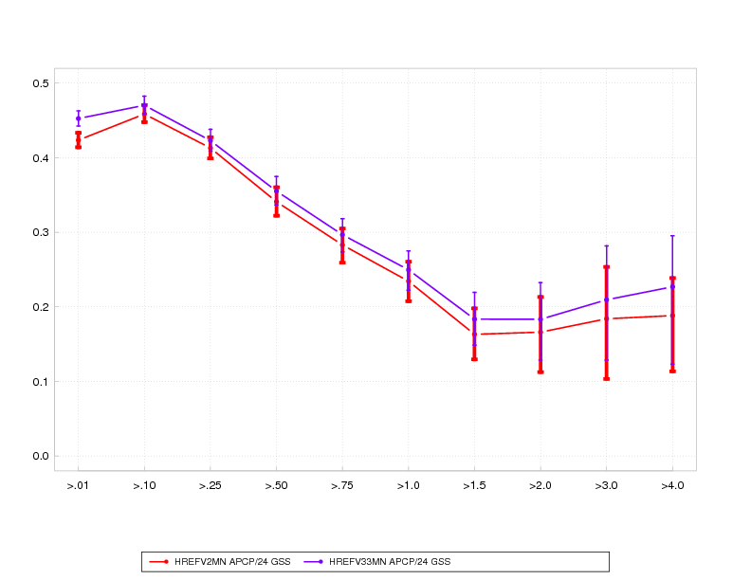
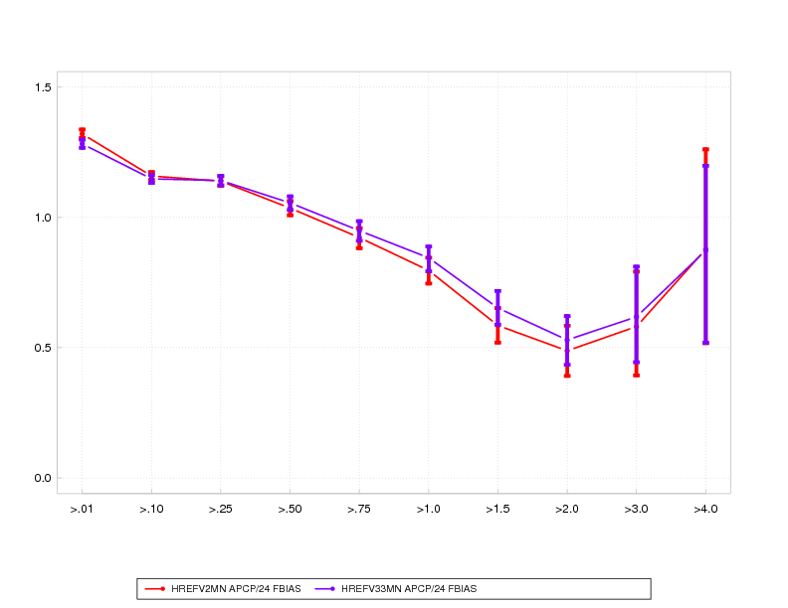
Mid April – mid Sept 2019
24 h QPF stats
CONUS-wide stats computed on 12 km grid
GSS/ETS
.01” .25” 1” 2” 4”
HREFv2 mean
HREFv3 mean
bias=1
bias
Differences in mean skill entirely due to membership changes
.01” .25” 1” 2” 4”

Slide 9
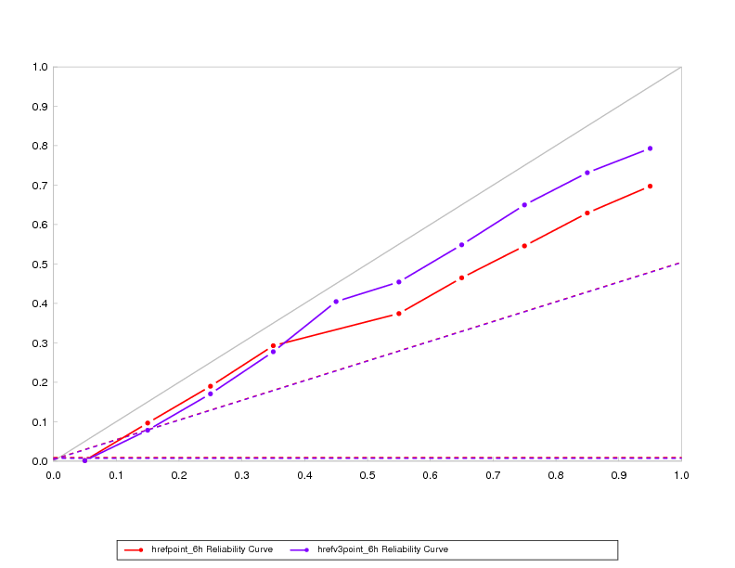
PQPF reliability, 0.5” / 6 hour
2/23/2019 to date (with gaps)
underconfident
observed freq
overconfident
forecast prob
HREFv2 point probability
HREFv3 point probability
Perfect reliability line

Slide 10
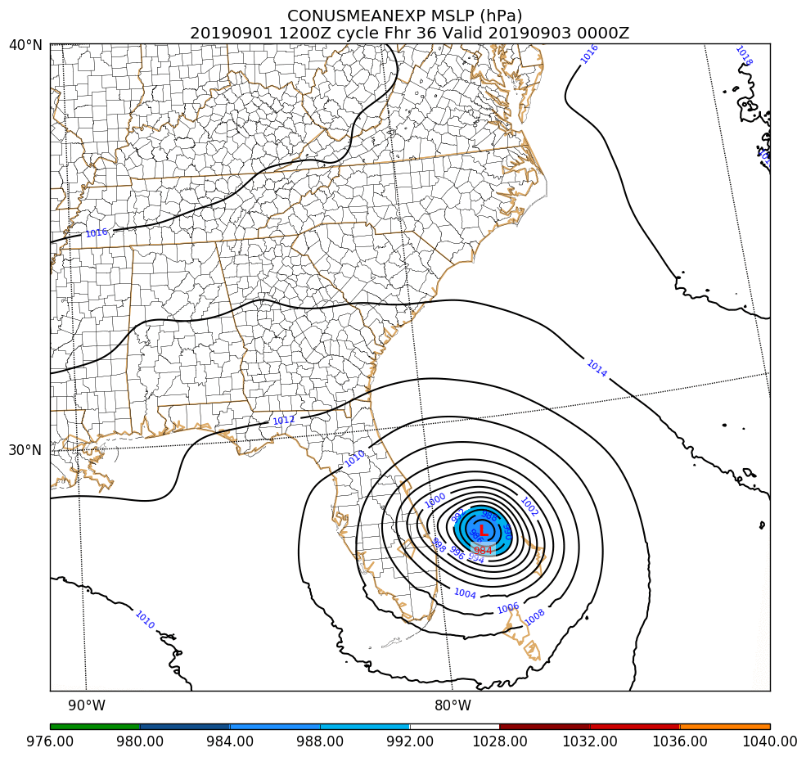
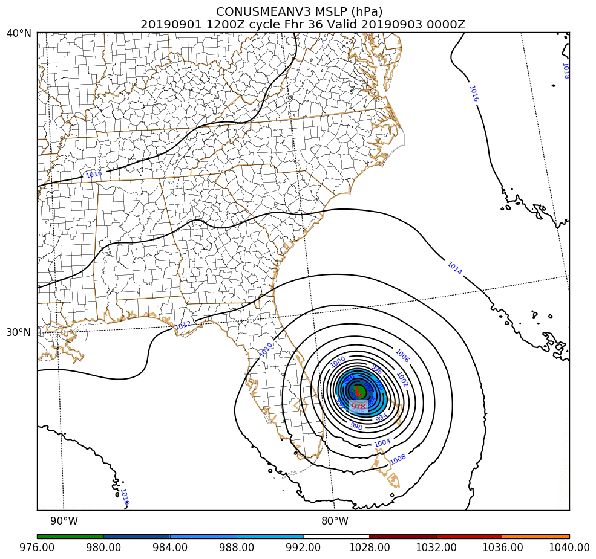
Representations of Dorian
36 h forecasts valid 0903/00Z
(when actual min SLP ~941 hPa)
Ops HREFv2
Para HREFv3
min SLP ~984 hPa
min SLP ~978 hPa
Improvement mainly from elimination of erroneously westward HRW-NMMB members

Slide 11
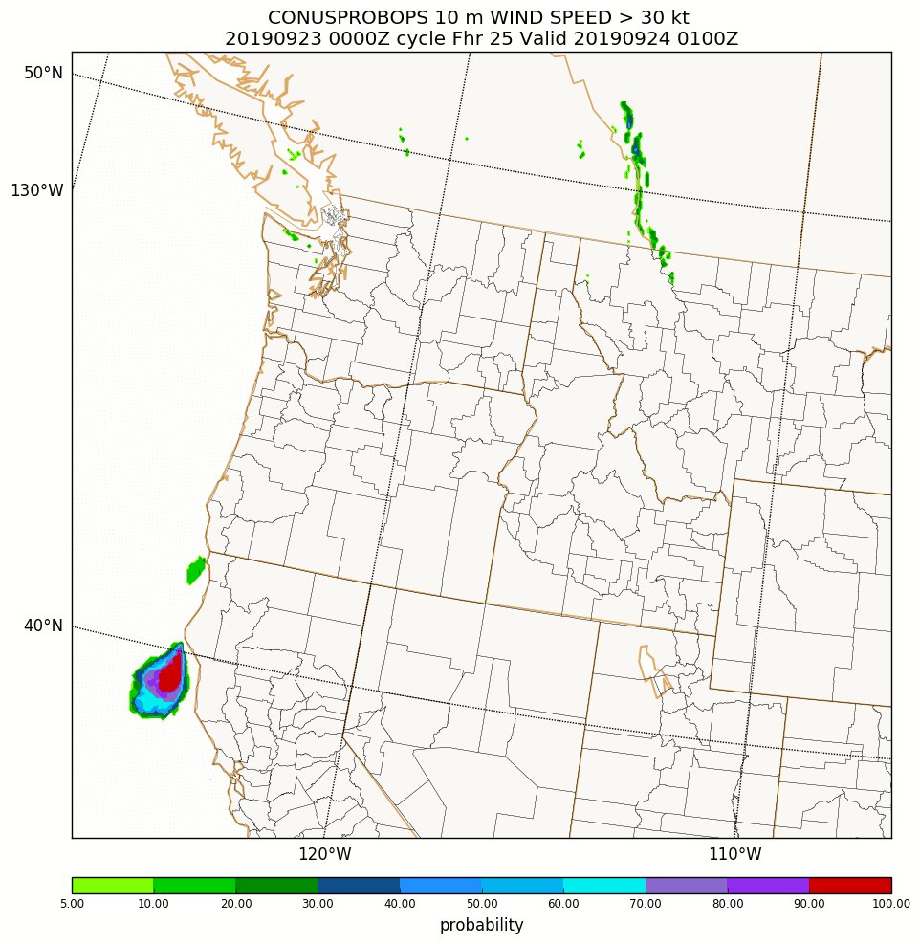
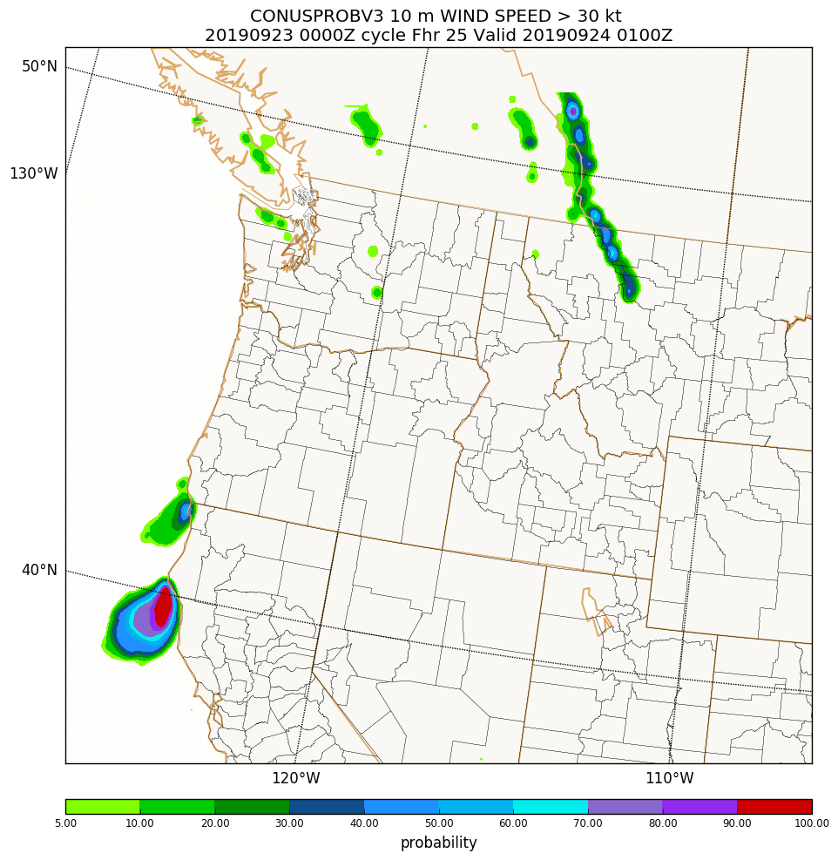
In the HREFv2 evaluation in 2017, an issue was raised about muted 10 m wind speed probabilities. Testing changes with HREFv3 to help boost the signal.
Prob of 10 m wind speed > 30 kt
Ops HREFv2
Para HREFv3
Instantaneous wind speed
point probabilities
Hourly maximum wind speed
10 km radius neighborhood probabilities

Slide 12
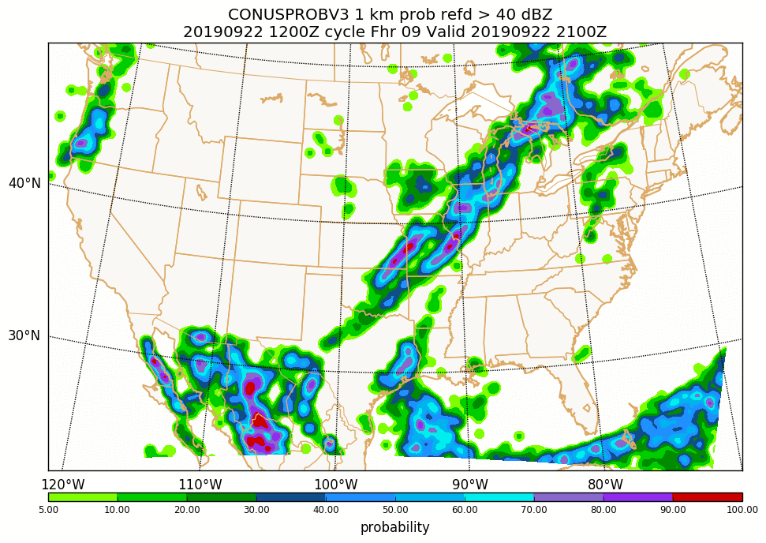
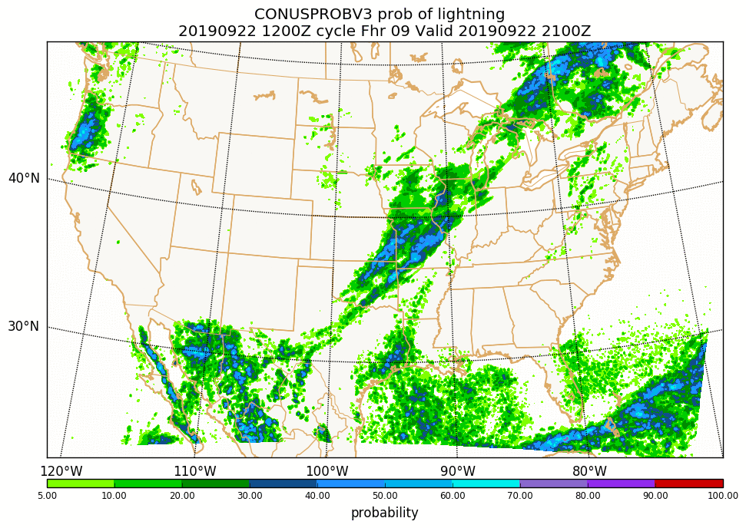
Another possible new product – a “general thunder” field
Prob 1 km AGL REFD > 40 dBZ
*NEW* Prob of lightning/thunder
Is not a lightning strike density type product – just a broad sense of where convective storms might be, including non-severe showers.
Notes:
4.2-0-17 192 (lightning) currently – consider making it 4.2-0-19 3 (thunderstorm probability)???

Slide 13
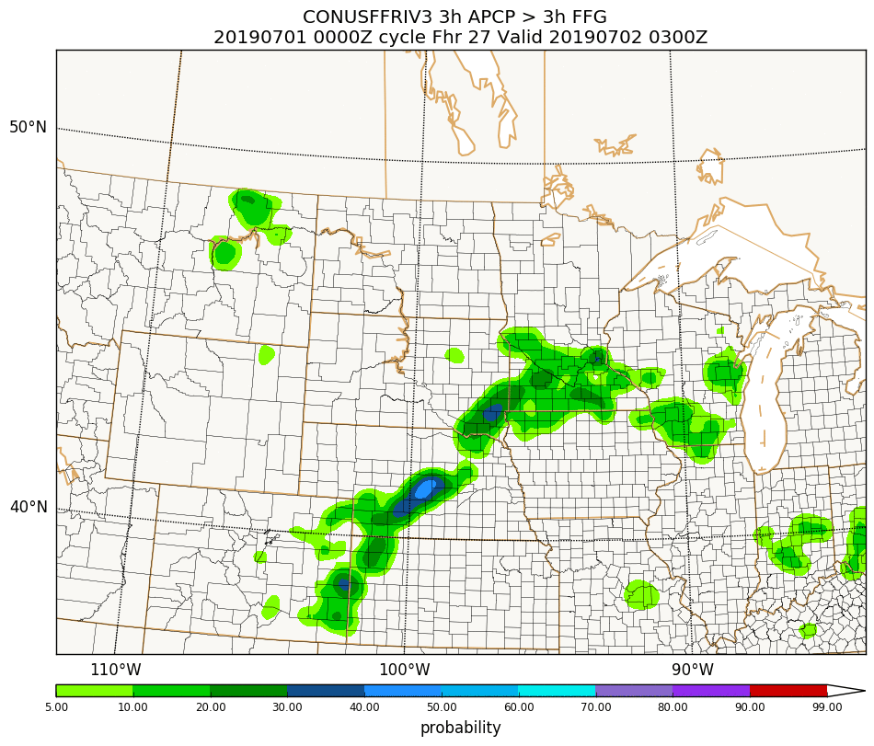
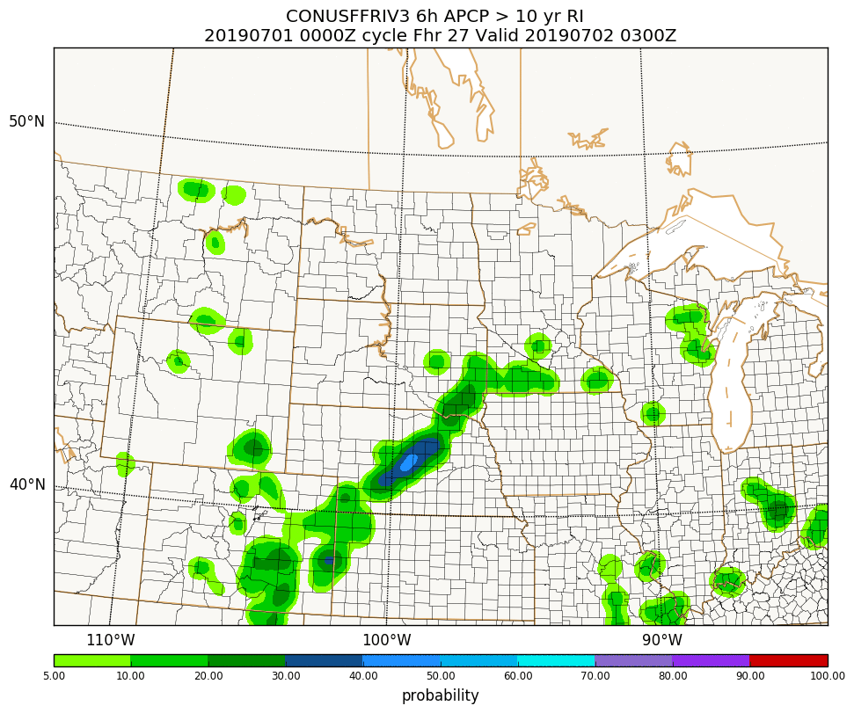
New flash flood type products for HREFv3
Prob 3 h QPF > 3 h FFG
Prob 6 h QPF > 10 yr ARI
1 h, 3 h and 6 h FFG
currently 2, 5, 10, and 100 year ARI for 6 and 24 h accumulations

Slide 14
HREF probabilities
How probabilities are defined is an important aspect of high resolution ensembles, and one that it is getting more complicated with the introduction of EAS probabilities.
Therefore, it is worth a moment to review the three types of probabilities that will be included in HREFv3, and where they are best applied.

Slide 15
Neighborhood maximum probabilities
Point probabilities
The simplest form of probability – at each grid point, which percentage of members exceed a threshold?
Best for more continuous fields where a threshold might be exceeded over a large region (e.g., probability of T < 0 C, CAPE > 500 J/kg)
Ensemble Agreement Scale (EAS) probabilities (new)
Based on fractional coverage exceeding a threshold within a 10-100 km radius, using a smaller radius when members agree closely, and a larger radius when they are less similar. (Dey et al. 2016; Blake et al. 2018)
Has the appearance of an intelligently smoothed point probability. Will be used for select QPF and snow fields in HREFv3.
Accounts for forecast displacement between members by searching over a local neighborhood of points, and only evaluating the neighborhood maximum value.
Following SPC, the neighborhood extends 40* km out from a point, and the probabilities are smoothed. Provides a smooth, spatially broad signal, and best for rarely exceeded thresholds.

Slide 16
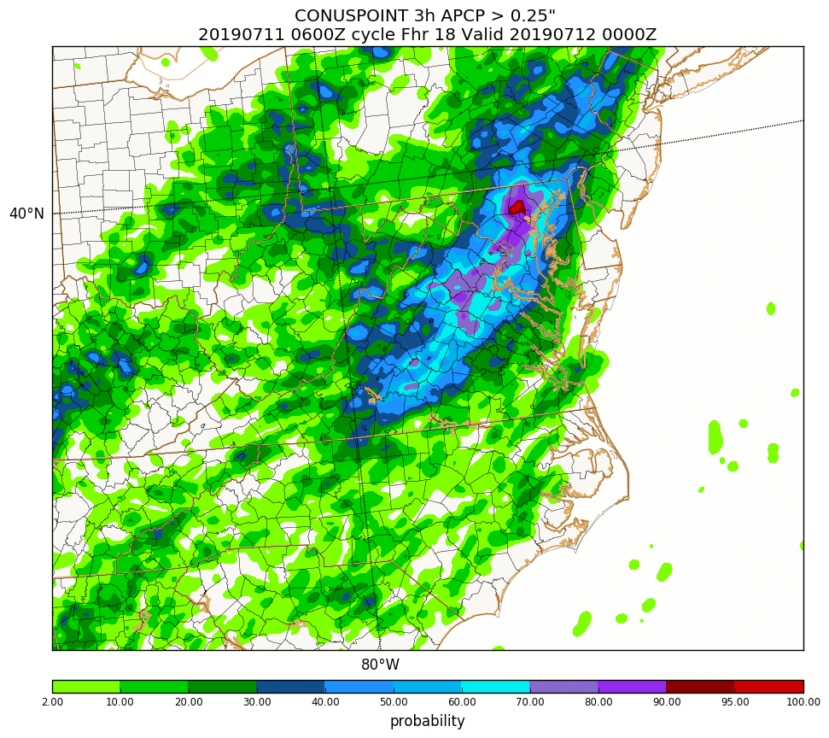
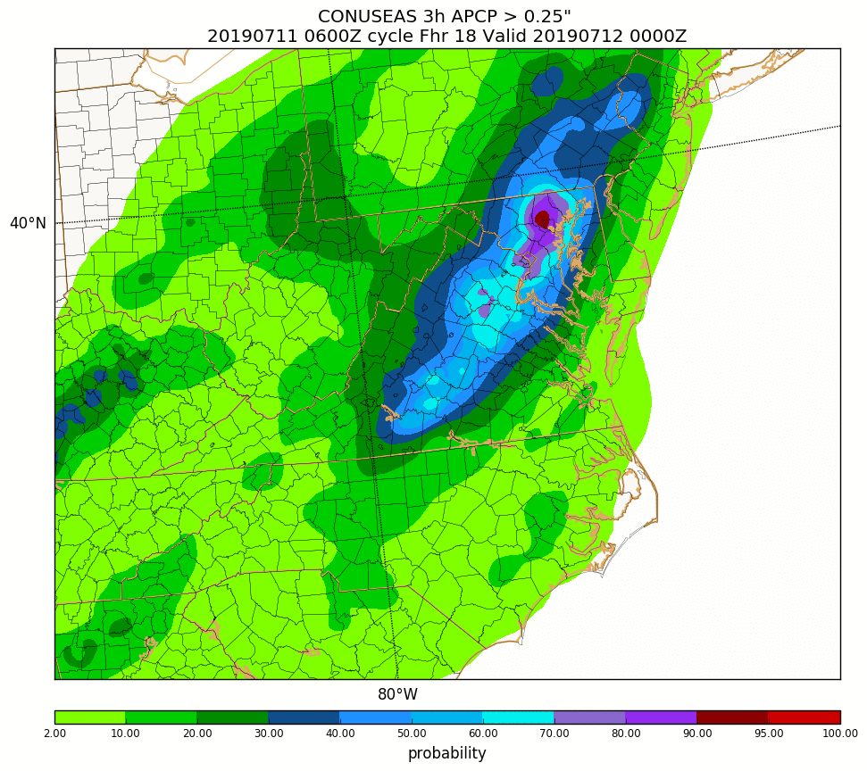
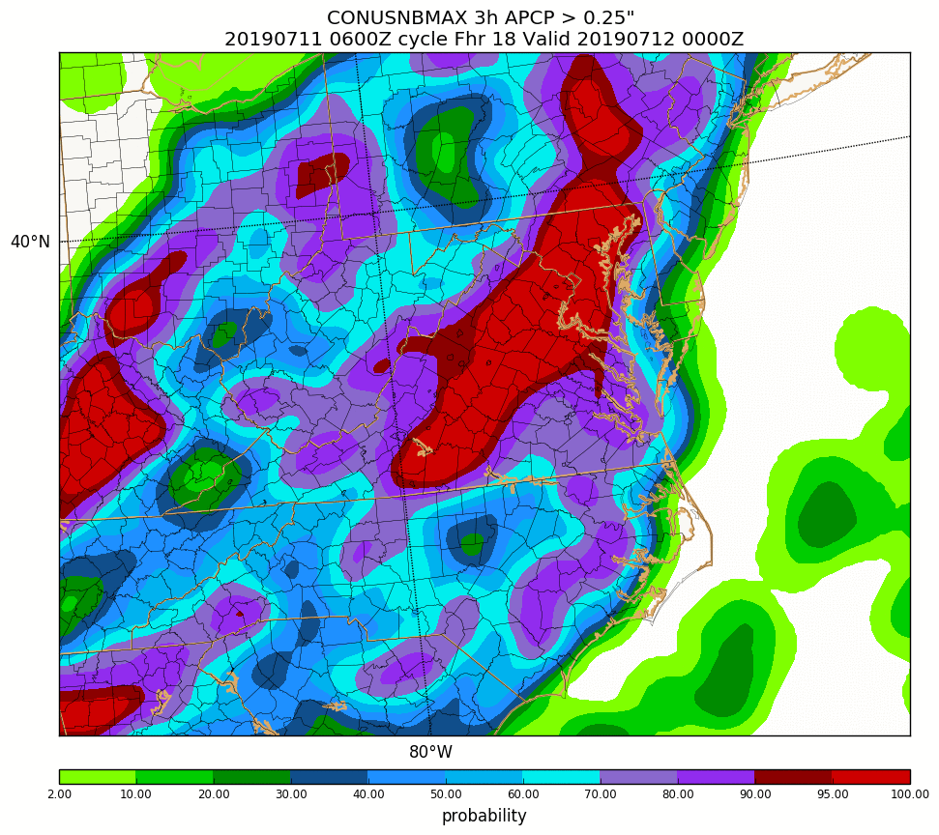
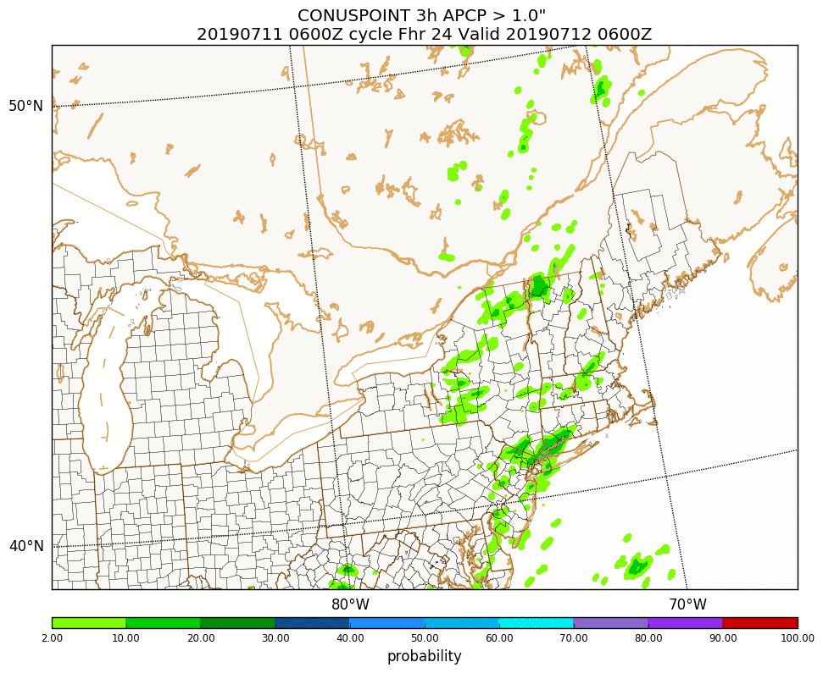
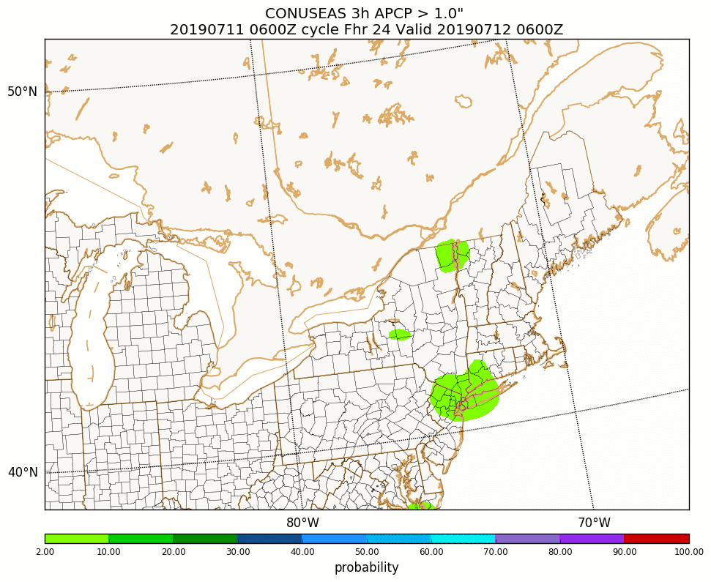
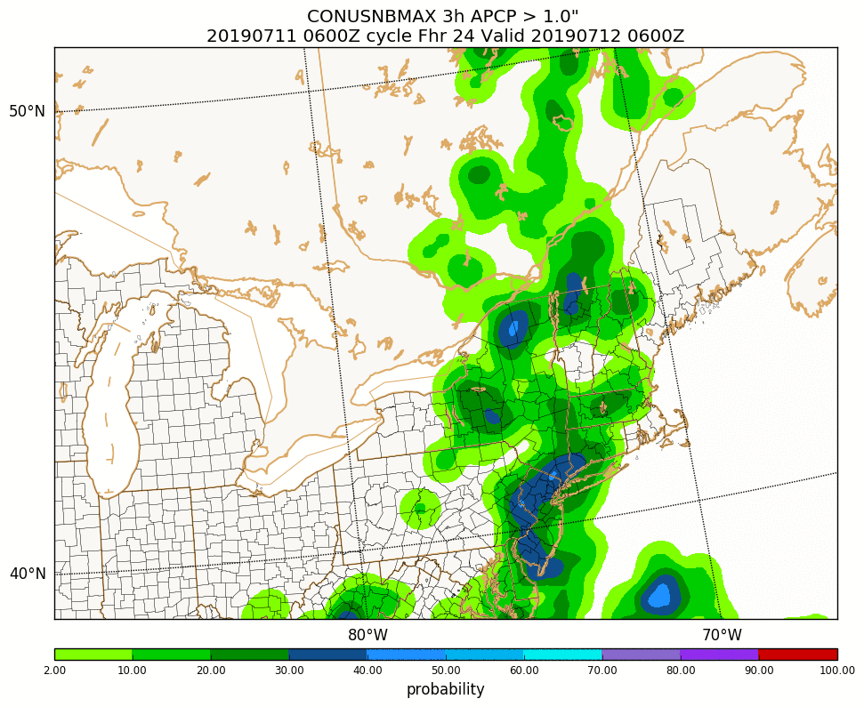
3 h QPF probabilities
Point
EAS
Neighborhood
0.25”/ 3h
VT 0712/00
Point
EAS
Neighborhood
1.0”/ 3h
VT 0712/06

Slide 17
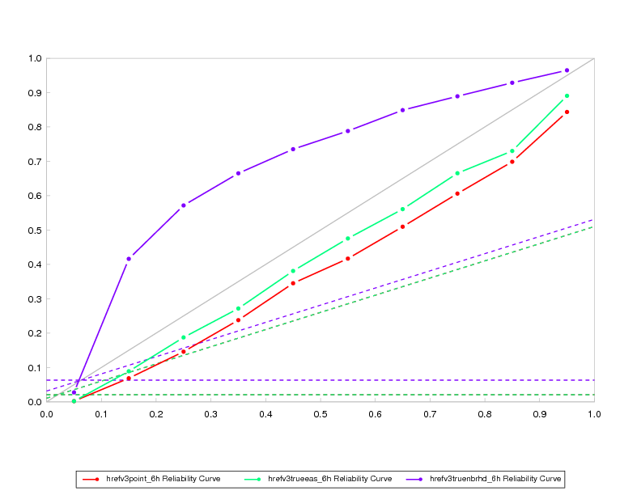
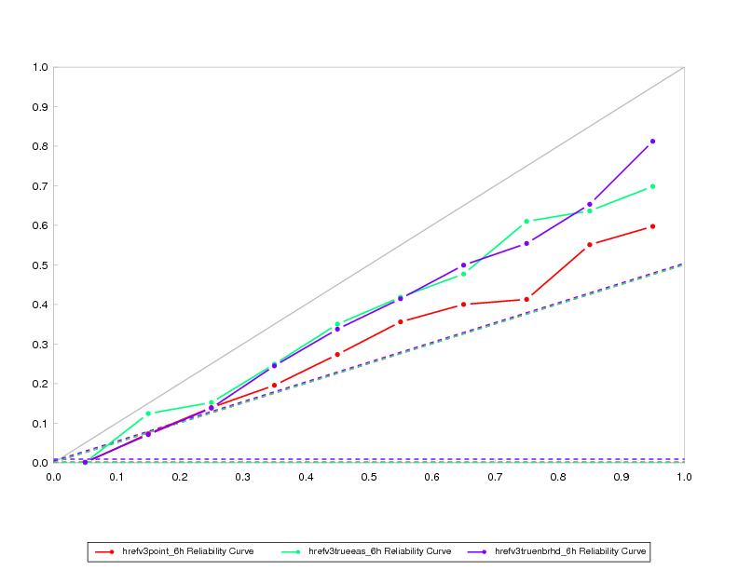
PQPF reliability diagrams for HREFv3 membership
late Feb to mid Sept 2019 (with gaps)
0.25” / 6 hour
1.0” / 6 hour
underconfident
underconfident
observed freq
observed freq
overconfident
overconfident
forecast prob
forecast prob
Perfect reliability line
NOTE: neighborhood probs verified against “neighborhood” obs – easier to verify well
Point probability
Neighborhood maximum probability
EAS probability

Slide 18
How widely to use EAS probabilities?
EAS probabilities work best for more commonly achieved thresholds, while neighborhood maximum (NBMAX) probabilities can highlight the potential for rarer, heavier events (Schwartz and Sobash, 2017 MWR review article discusses related themes).
Current HREFv3 plan is to use EAS probs up to a certain threshold, and NBMAX probs at higher thresholds.
Also currently plan to have some overlap (produce both EAS and NBMAX at a few intermediate thresholds) – but what gets distributed over SBN?
Notes:
Some old thoughts on how high EAS probs will go:
to 0.25” or 0.5” for 3h
to 0.5” or 1.0” for 6 h
to 1” for 12 h
to 1” for 24 h

Slide 19
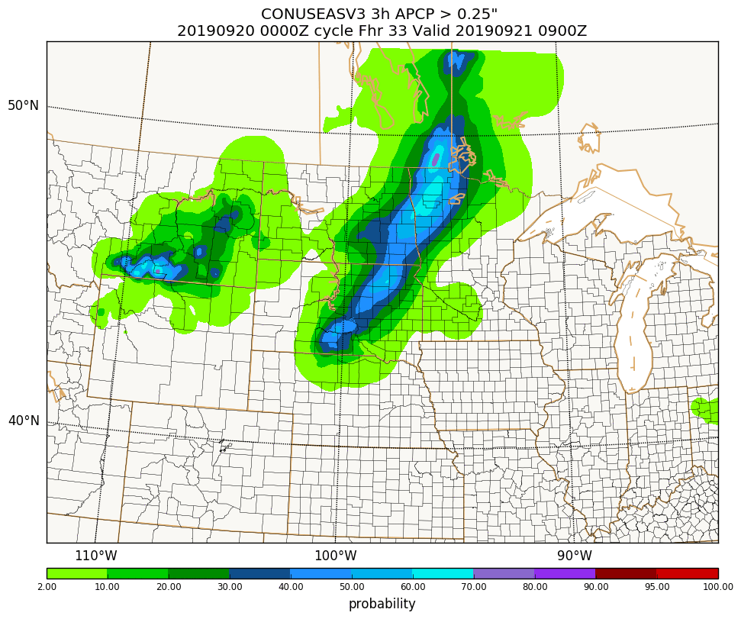
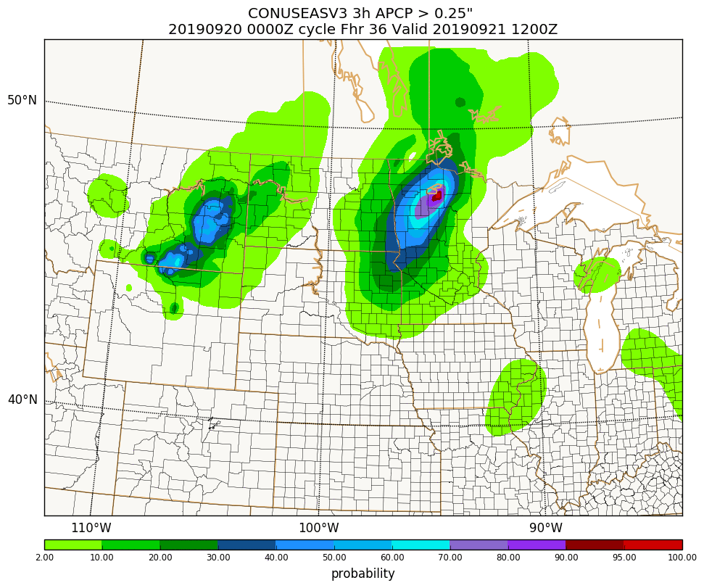
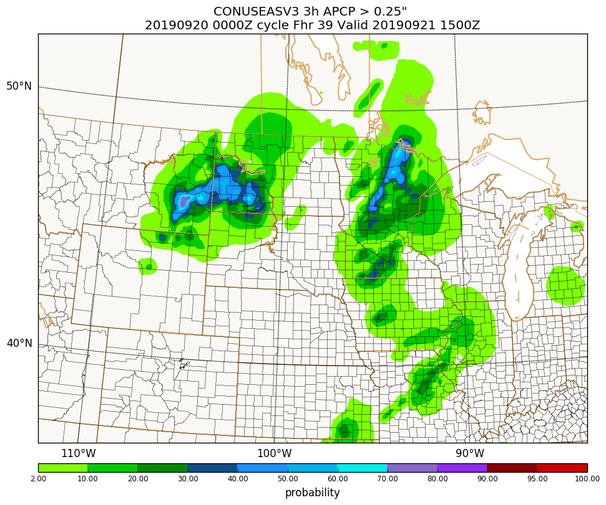
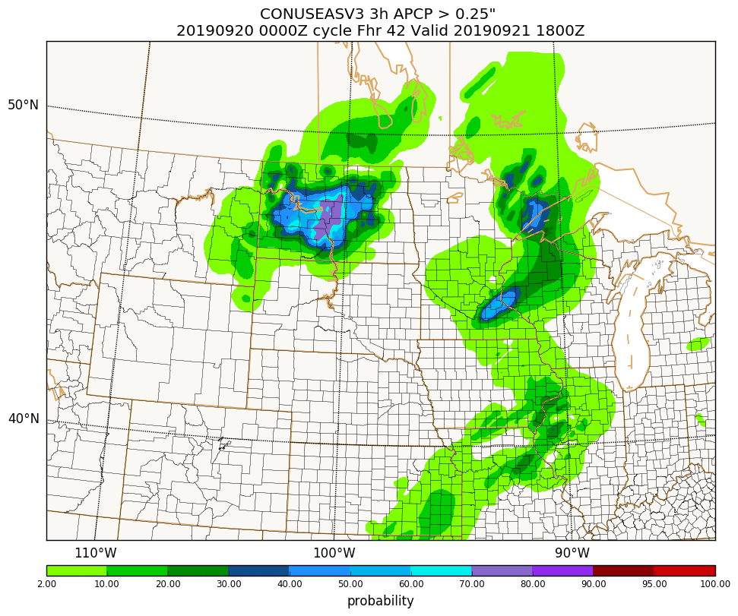
Probabilistic guidance (especially EAS) changes character as number of members drops in the f36-f48 range
f33
f36
3 h EAS prob @ f36
3 h QPF > 0.25”
(10 members)
(10 members)
Less smooth with fewer members – easier to get agreement
This transition should be damped a bit with longer HRRRv4 runs
f39
f42
(6 members)
(6 members)

Slide 20
Local probability matched (LPM) means
Another new product that has come from the research community (and been refined and vetted through testing in FFaiR experiments) is the LPM mean courtesy of CAPS.
Unlike a traditional probability matched (PM) mean which is computed at once over the full domain, this LPM approach computes the PM mean over numerous sub-domain patches.
As the name implies, it is more local, and thus less ambiguous than the PM mean about the source location for the precipitation value being applied at a point.
Notes:
Several thousand overlapping 6x6 point patches for CONUS

Slide 21
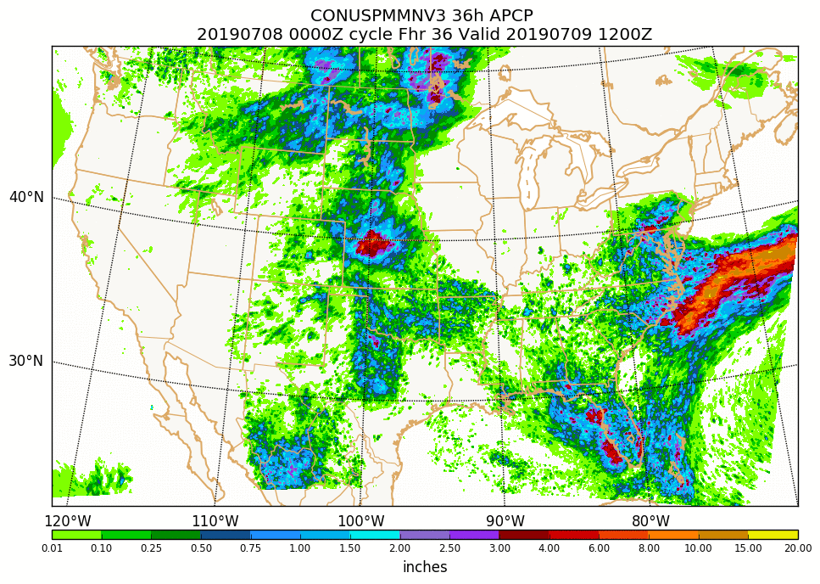
PM Mean

Slide 22
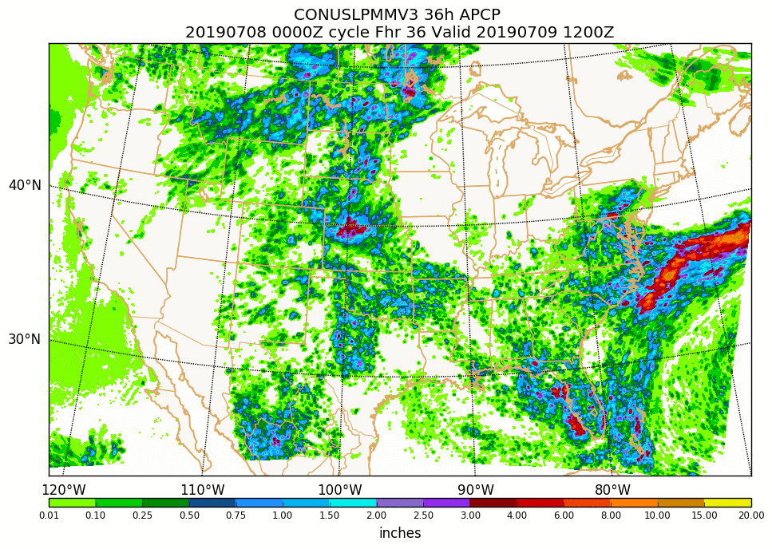
LPM Mean

Slide 23
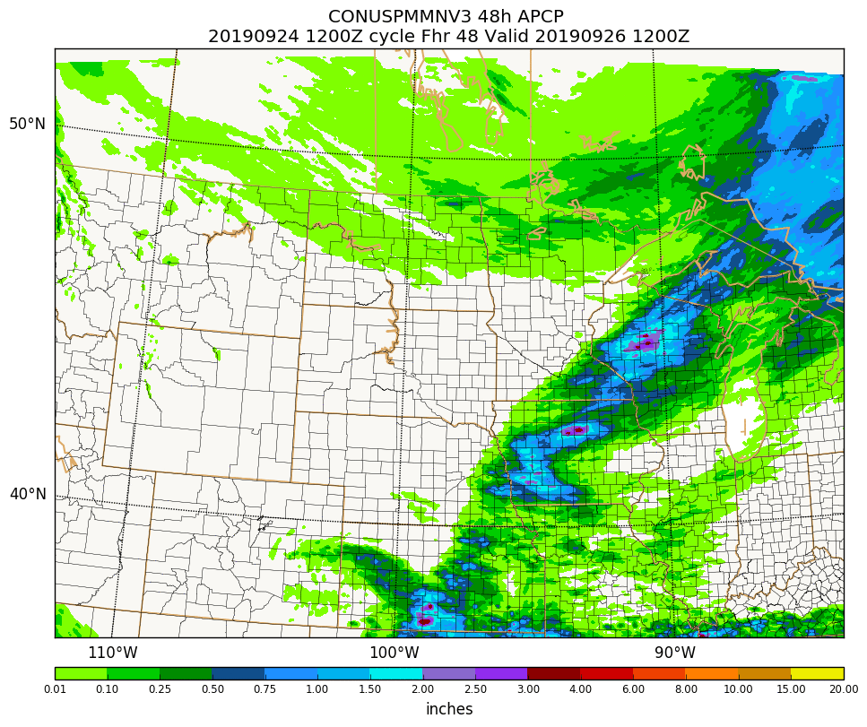
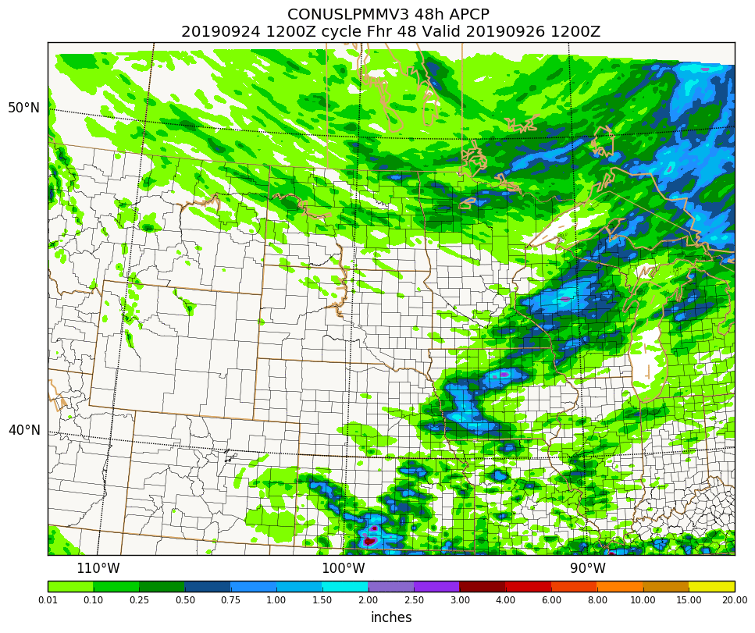
PM Mean
LPM Mean
While the reduction in spatial extent of heavy rain is often the most striking difference between PM and LPM, the LPM can also boost structure and amounts away from heavy rain.

Slide 24
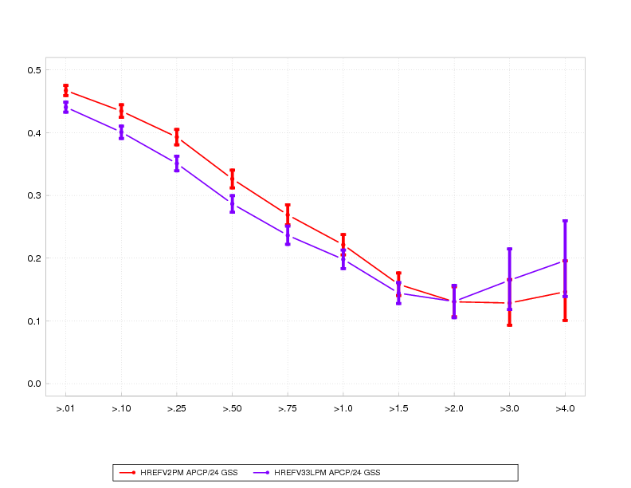
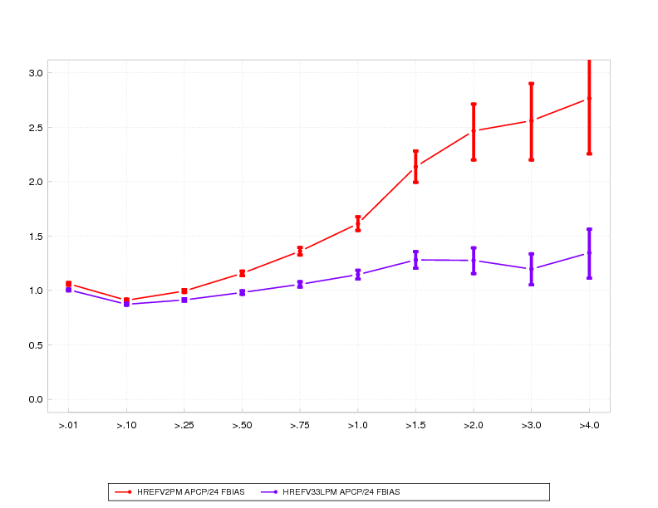
May – Sept 2019
24 h QPF stats
CONUS-wide stats computed on 12 km grid
GSS
HREFv2 PM
.01” .25” 1” 2” 4”
HREFv3 LPM
3.0
LPM bias performance is remarkable – but GSS generally worse than PM.
2019 FFaIR participants subjectively preferred LPM to PM for all ensemble systems
Want to evaluate from an FSS perspective…
bias
bias=1
.01” .25” 1” 2” 4”

Slide 25
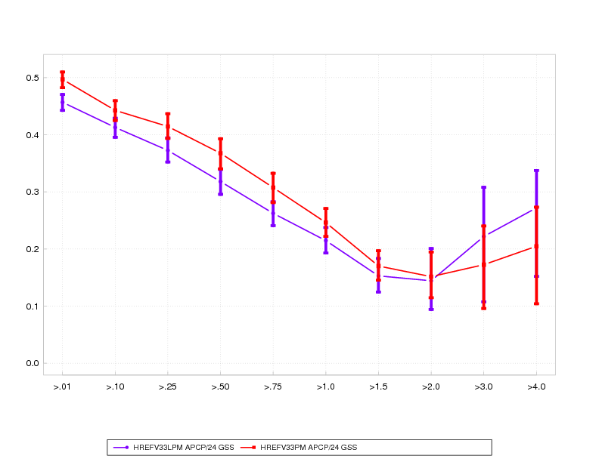
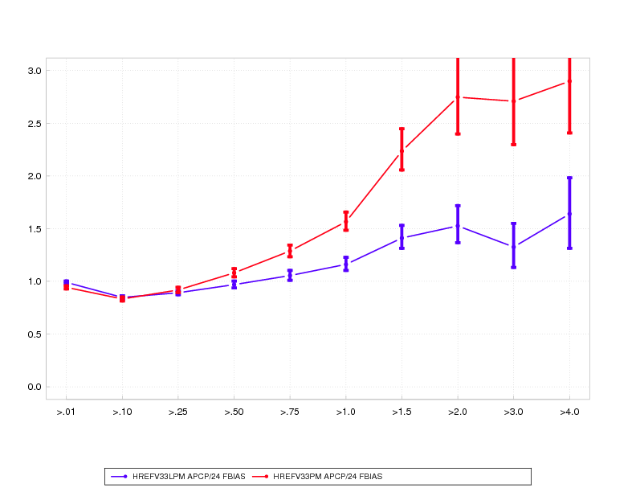
Aug – Sept 2019
24 h QPF stats
CONUS-wide stats computed on 12 km grid
GSS
HREFv3 PM
.01” .25” 1” 2” 4”
HREFv3 LPM
3.0
bias
bias=1
.01” .25” 1” 2” 4”

Slide 26
HREFv3 status and implementation plan
Currently making routine real-time runs over all domains, but still making tweaks.
No plans for retrospective testing – the new regional FV3 member remains a work in progress, and timelines are short and strict – only a real-time parallel.
Code freeze currently scheduled for mid-February 2020, with the EMC-run evaluation parallel to begin around that time, and with evaluations scheduled to wrap up by early May 2020.
Assuming approvals are given and all goes well, implementation hopefully in August-September 2020.

Slide 27
HREFv3 status and implementation plan
Will share the information from the last slide in greater detail to the MEG mailing list in the next week or so, along with an HREF user survey (we need input on a few items).
HREFv3 graphics – currently just showing the parallel. Side by side prod/parallel plots coming in the future.
https://www.emc.ncep.noaa.gov/mmb/mpyle/hrefv3/00_exp/main_conus.php
https://www.emc.ncep.noaa.gov/mmb/mpyle/hrefv3/12_exp/main_conus.php
+ main_hi.php for 00Z and 12Z
https://www.emc.ncep.noaa.gov/mmb/mpyle/hrefv3/06_exp/main_ak.php
https://www.emc.ncep.noaa.gov/mmb/mpyle/hrefv3/18_exp/main_ak.php
+ main_pr.php at 06Z/18Z

Slide 28
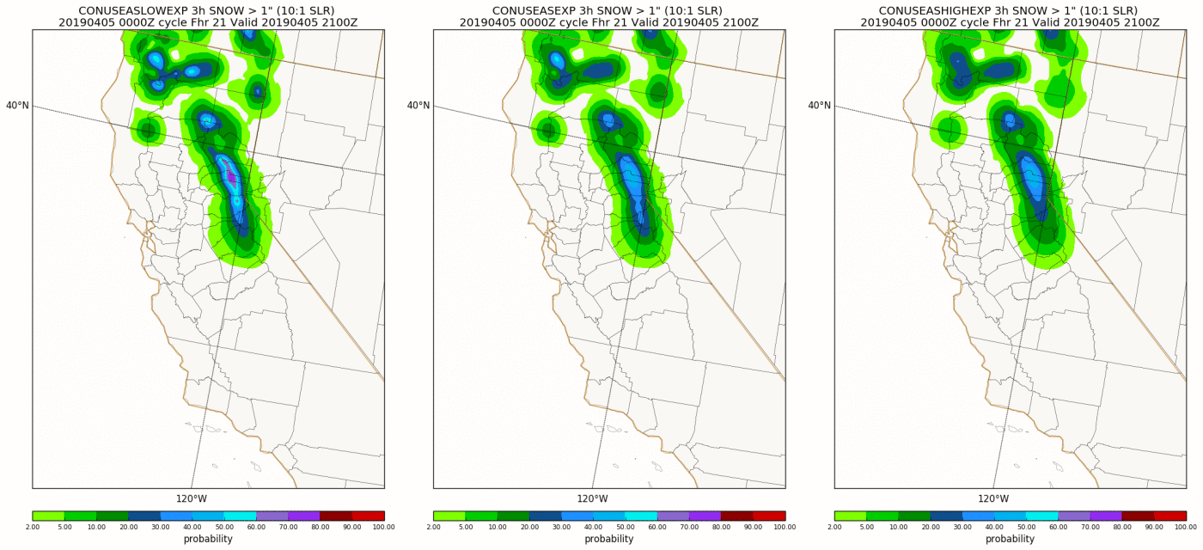
Smoothing testing with EAS probabilities
3 h snowfall > 1”
Lighter smoothing
Heavier smoothing
Heavier smoothing tended to verify slightly better for QPF, but decided to go forward with the lighter smoothing option – greater detail over topography. Biggest impact for snow, but generally less impactful away from topography.

Slide 29
Future plans
Implementing the HREFv3 upgrade described here - adding HRRR and FV3 and making multiple product tweaks - hopefully operational by late 2020.
The longer-term goal (sometime in 2020s) is to shift to a single core (FV3), high-resolution ensemble:
a “proper” ensemble where all members are equally likely.
Needed for high-resolution ensemble DA approaches.
In line with broader NOAA vision of unifying around FV3 model.
Easier to manage and modify.
….but the multi-everything HREF approach has proven tough to beat.

Slide 30
48 h HREFv3 membership (06/18Z CONUS)
-12
0
+12
+24
+36
+48
HiresW – ARW
(RAP init)
FV3 - CAM
(FV3GFS init)
HIRESW - “mem2” ARW
(NAM init)
NAM NEST - NMMB
(NAM init) **CONUS ONLY**
HRRR - ARW
(HRRR init) **CONUS/AK ONLY**
4 members from f42 to f48

