Slide 1
Convective Detrainment Experiments with HWRF: A NEST EVALUATION
Eric Aligo, Brad Ferrier and Young Kwon

Slide 2
KATIA 2011083106
More drying and warming with ncloud=1
Same patterns in two other cases evaluated

Slide 3
IRENE 2011082518 f00-f90
25 times more grid-scale than convective rainfall
Heaviest grid-scale rainfall in eye wall region
Up to 1” more convective rainfall with ncloud=0
4-8” less grid-scale rainfall in eye wall region with ncloud=0

Slide 4
KATIA 2011083100 f00-f126
1-2” more convective rainfall with ncloud=0
Heaviest convective rainfall outside of eye wall region
4-8” more grid-scale rainfall in eye wall with ncloud=0
8” less grid-scale rain due to northward displacement of peak rain in eye wall

Slide 5
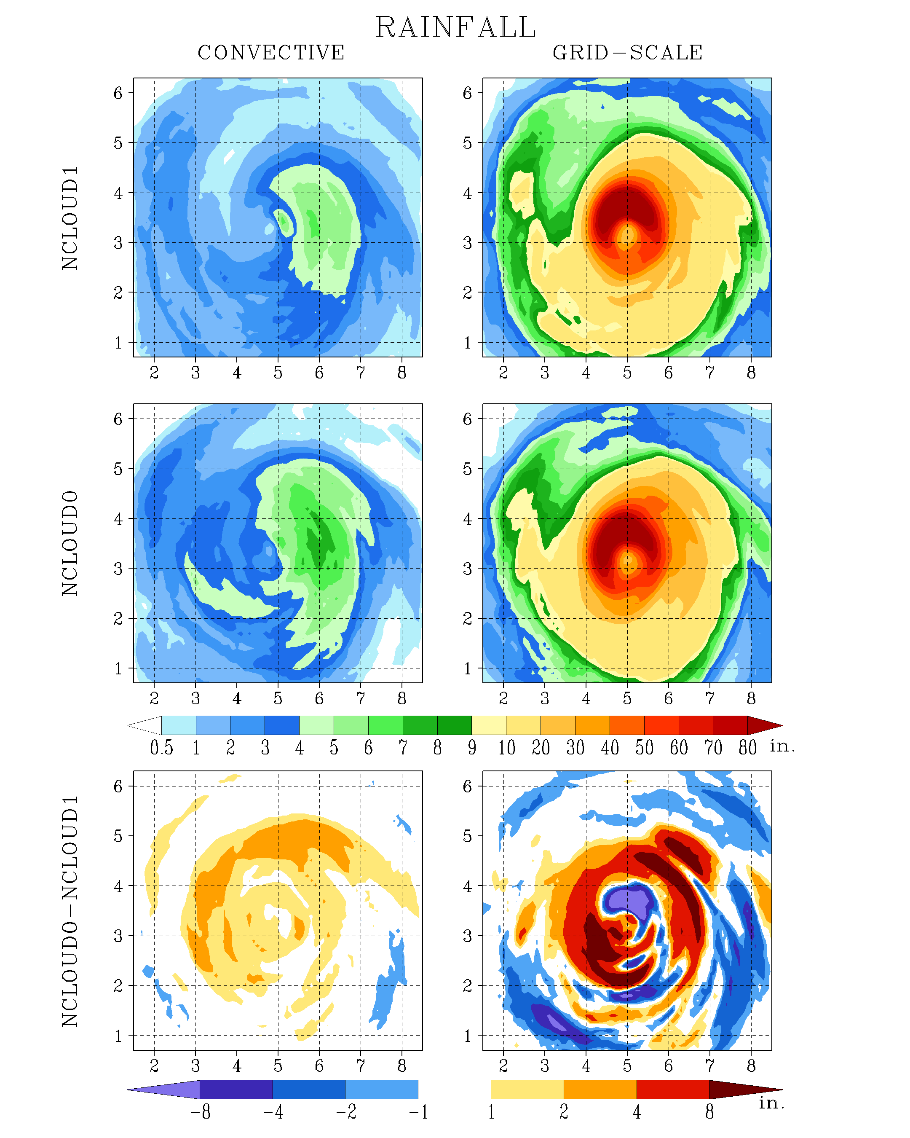
KATIA 2011083100 f00-f126
1-2” more convective rainfall with ncloud=0
Heaviest convective rainfall outside of eye wall region
4-8” more grid-scale rainfall in eye wall with ncloud=0
8” less grid-scale rain due to northward displacement of peak rain in eye wall

Slide 6
KATIA 2011083106 f00-f126
Up to 4” more convective rainfall in ncloud=0 runs
4-8” more grid-scale rainfall with ncloud=0 in eye wall region
8” less grid-scale rain due to southward displacement of peak rain
8” less grid-scale rain where convective rain is located
Results from Katia are different from Irene in eye wall region

Slide 7
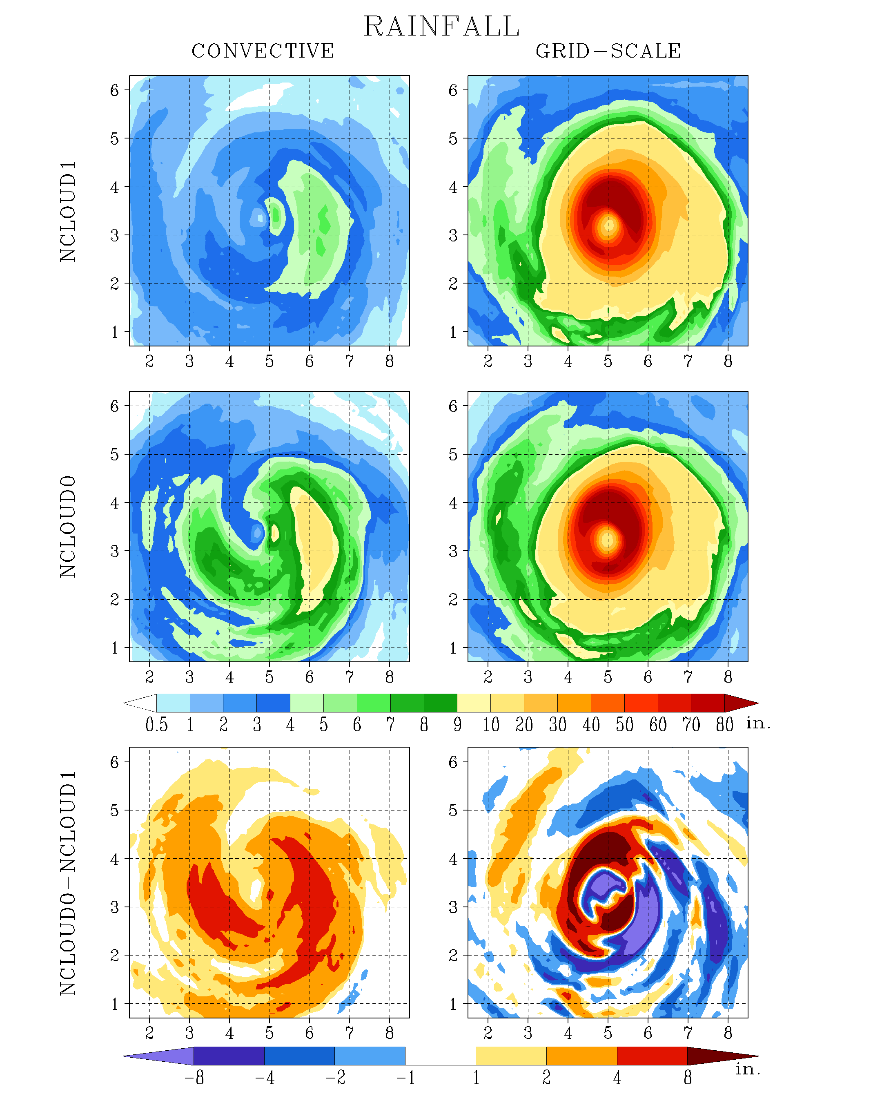
KATIA 2011083106 f00-f126
Up to 4” more convective rainfall in ncloud=0 runs
4-8” more grid-scale rainfall with ncloud=0 in eye wall region
8” less grid-scale rain due to northward displacement of peak rain
8” less grid-scale rain where convective rain is located
Results from Katia are different from Irene in eye wall region

Slide 8
KATIA 2011083106 f00-f126
Up to 4” more convective rainfall in ncloud=0 runs
4-8” more grid-scale rainfall with ncloud=0 in eye wall region
8” less grid-scale rain due to southward displacement of peak rain
8” less grid-scale rain where convective rain is located
Results from Katia are different from Irene in eye wall region

Slide 9
KATIA 2011083106
With ncloud=1:
Less heating
More ice deposition
Cloud water evaporation
Equivalent to amount of detrained cloud water
More rain evaporation
More melting ice
Less rain freezing

Slide 10
KATIA 2011083106
With ncloud=1:
Less heating
More ice deposition
Cloud water evaporation
Equivalent to amount of detrained cloud water
More rain evaporation
More melting ice
Less rain freezing

Slide 11
Cloud water condensation in eye wall of nearly 70 mm 3h⁻¹ on average
No cloud water evaporation in ncloud=0 runs
Cloud water evaporation in rain bands and outside of eye wall with ncloud=1
Averaged from f00-f126 except f00-f90 in Irene

Slide 12
KATIA 2011083106
With ncloud=1:
Less heating
More ice deposition
Cloud water evaporation
Equivalent to amount of detrained cloud water
More rain evaporation
More melting ice
Less rain freezing

Slide 13
Strongest heating in eye wall of 8-16 K s ⁻¹ on average
No cooling in ncloud=0
Cooling outside of eye wall of 0.25-0.5 K s⁻¹ in ncloud=1 run
Averaged from f00-f126 except f00-f90 in Irene

Slide 14
Tighter eye with Katia
In all cases, strongest upward ascent occurred in concert with heaviest grid-scale rainfall
Averaged from f00-f126 except f00-f90 in Irene

Slide 15
Area of upward ascent displaced farther away from the eye compared to upward ascent in the lower troposphere
Peak upward ascent on eastern side, where peak convective rain occurred
Does the lower-level averaged ascent drive the liquid-phase microphysics, while the upper-level ascent drive the ice-phase physics?
Averaged from f00-f126 except f00-f90 in Irene

Slide 16
In nest:
Lower PW values in in and near eye wall in all cases in ncloud=1
Progressively higher PW values farther away from system in ncloud=1
Not seen in Irene
In parent:
A trend of higher PW values in ncloud=1
Averaged from f00-f126 except f00-f90 in Irene

Slide 17
Summary
Heaviest grid-scale rainfall confined to eye wall region
Convective rainfall associated with rain bands and outside of eye wall region
More convective rainfall in nest in ncloud=0, not surprisingly
Microphysics heating and condensation concentrated around eye wall
Cloud water evaporation and cooling in rain bands and outside of eye wall in ncloud=1
Overall larger PW outside hurricane environment in parent with ncloud=1
Similar in nest except for Irene
Smaller PW along hurricane track in parent noticeable only in Irene with ncloud=1

