Slide 1
FY15 HWRF Baseline Verification and Outlier Analysis

Slide 2
Acronym
H15B: FY15 HWRF baseline, 18/6/2km resolution, L61, input: T1534L64 GFS (Spectral file for IC, pressure level GRIB2 files for BC)
H214: 2014 version of operational HWRF, 27/9/3km resolution, L61, input: T574 L64 GFS (Spectral files for both IC and BC);
H14Z: 2014 version of HWRF, 27/9/3km resolution using T1534L64 GFS (Spectral files for both IC and BC);
PRD1: Operational GFS since 2012, re-run for storms before 2011;
GFS2: new GFS T1534L64.

Slide 3
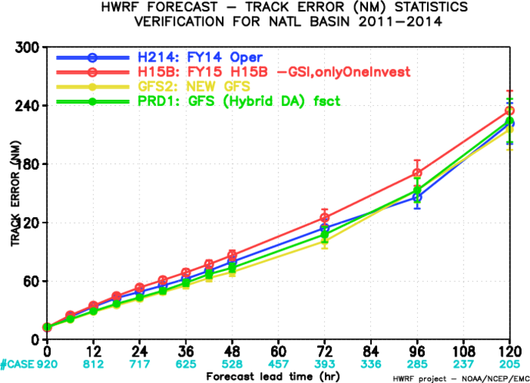
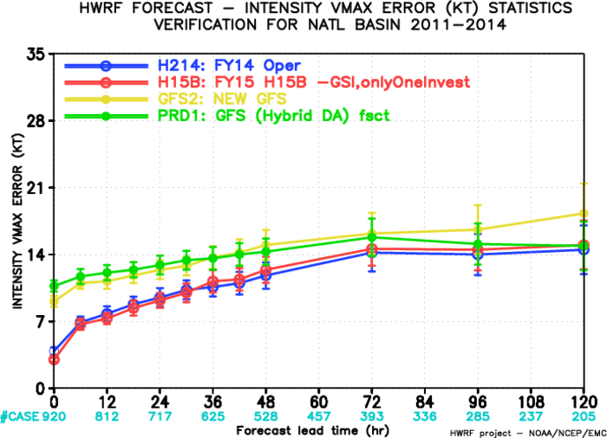
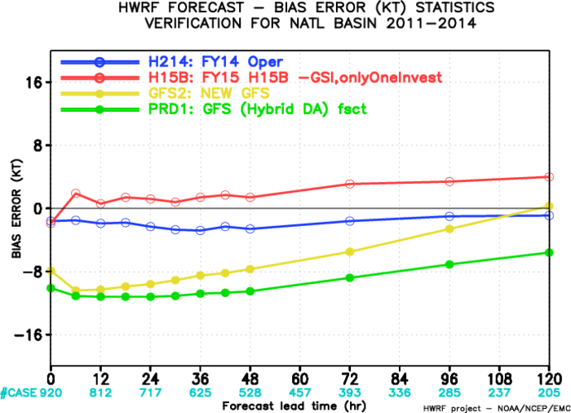
Track/Intensity Verification for 2011-2014 ALStorms

Slide 4
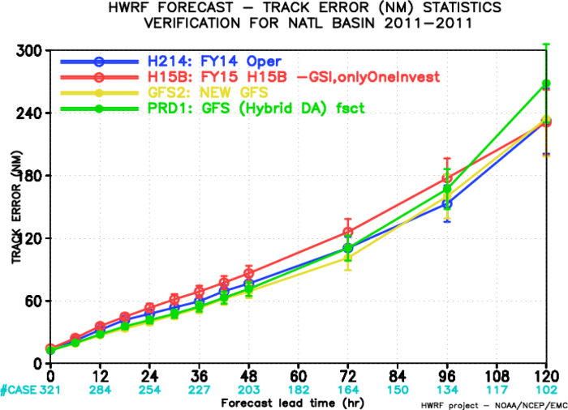
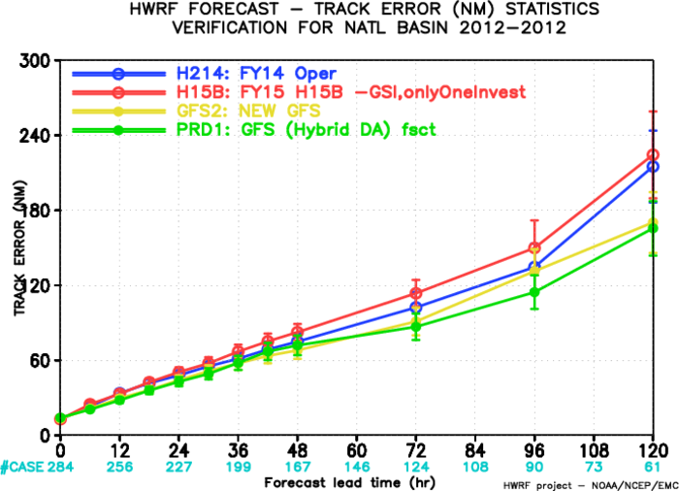
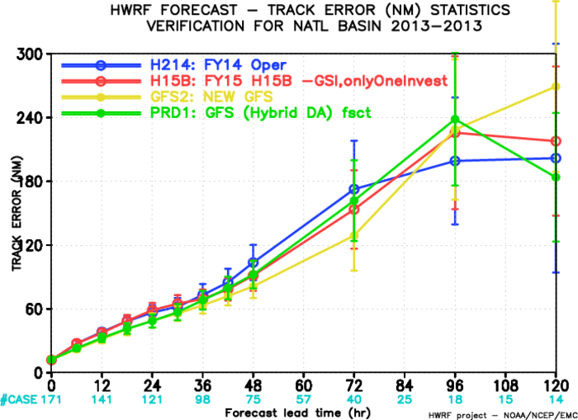
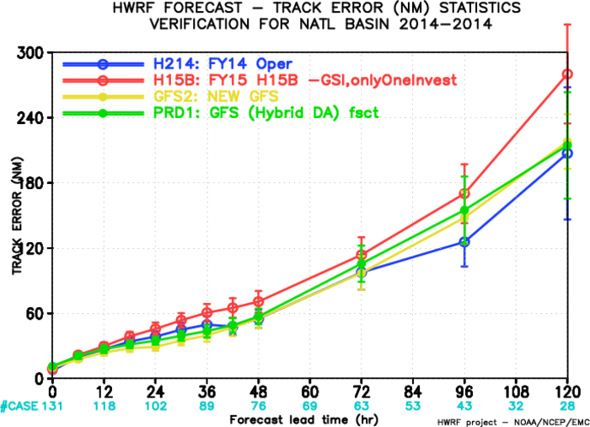
Track Verification for AL Storms at individual Year
2011
2012
2013
2014
improved

Slide 5
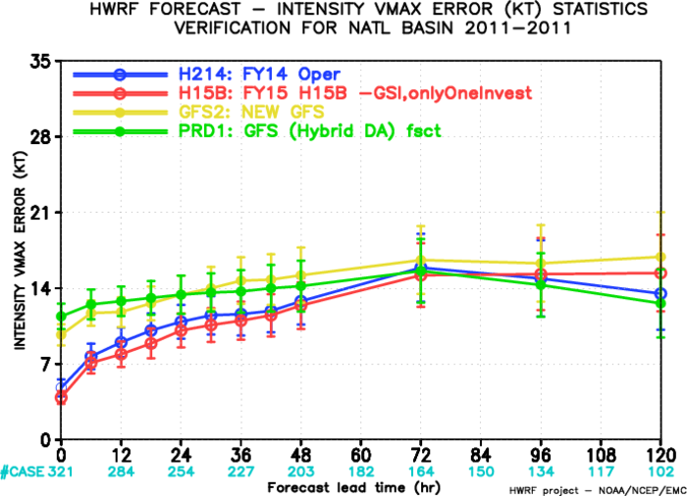
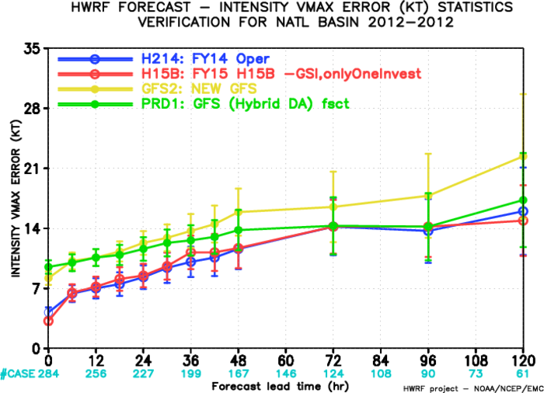
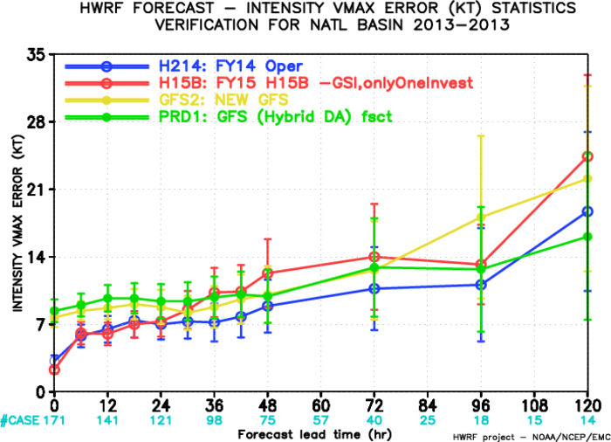
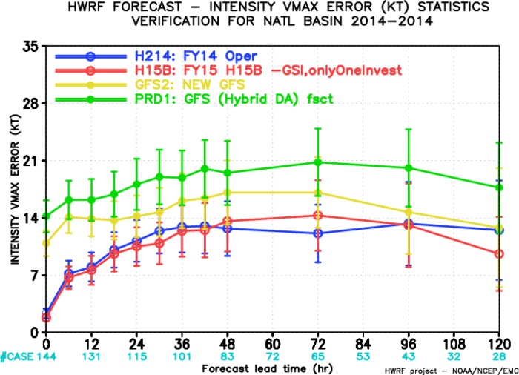
Intensity Verification for AL Storms at individual Year
2012
2011
2014
2013
degraded

Slide 6
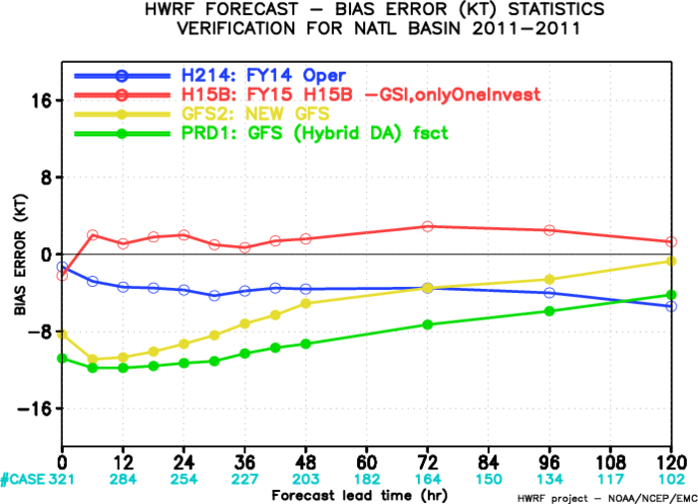
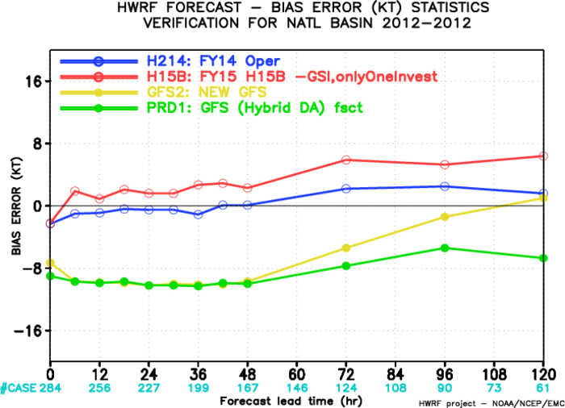
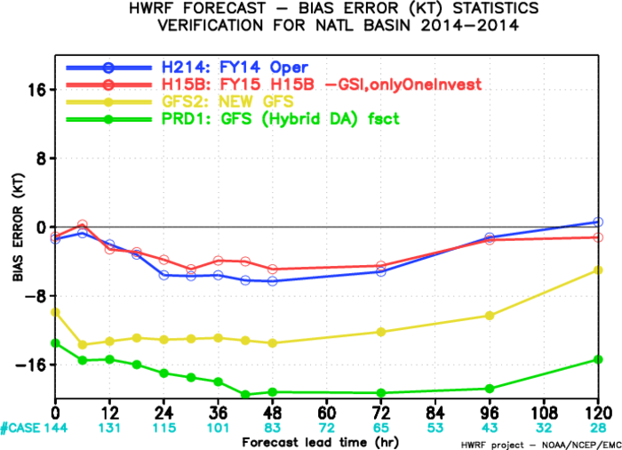
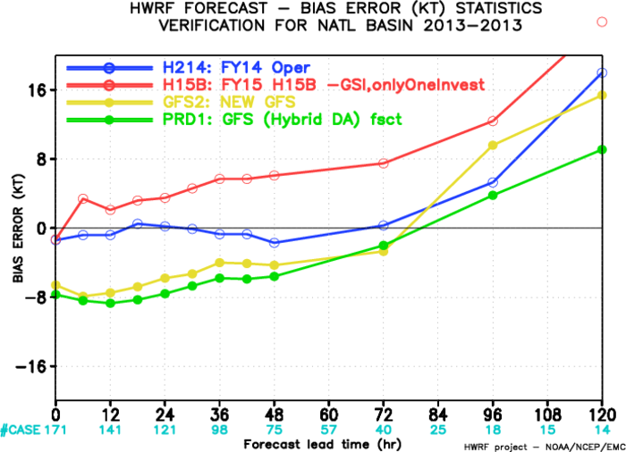
Intensity Bias for AL Storms at individual Year
2011
2012
Stronger storms in H15B
2013
2014

Slide 7
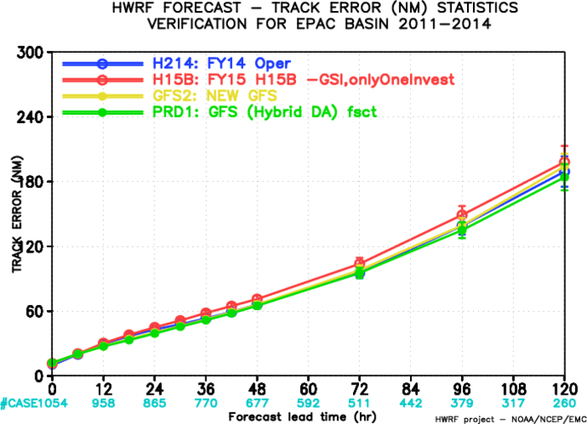
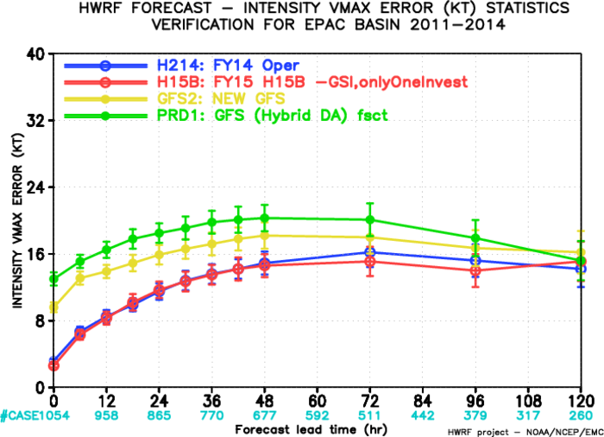
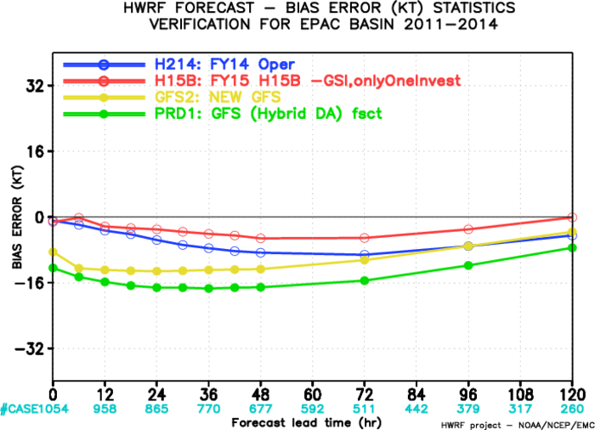
Track/Intensity Verification for 2011-2014 EP Storms

Slide 8
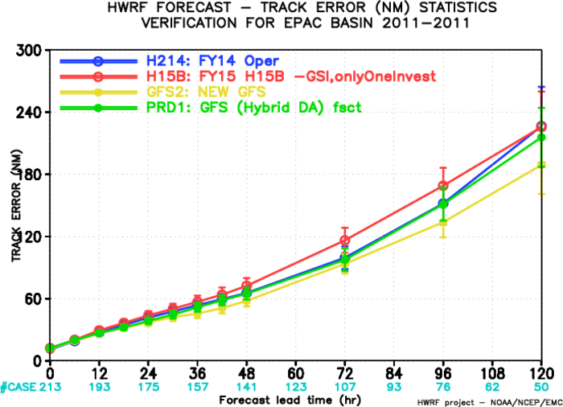
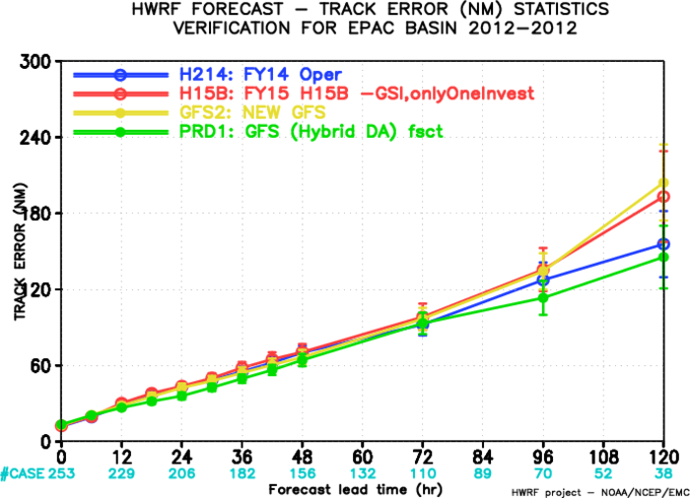
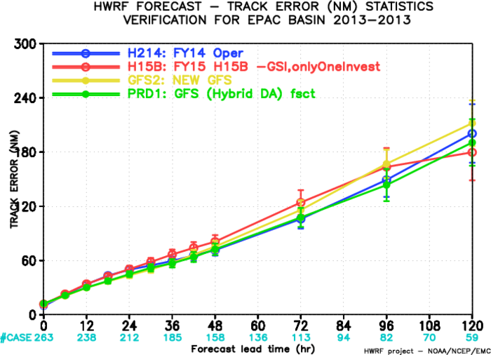
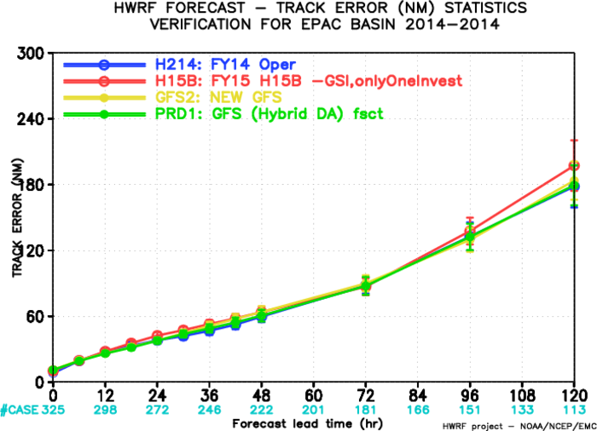
Track Verification for EP Storms at individual Year
2011
2012
New GFS degraded
New GFS degraded
2013
2014

Slide 9
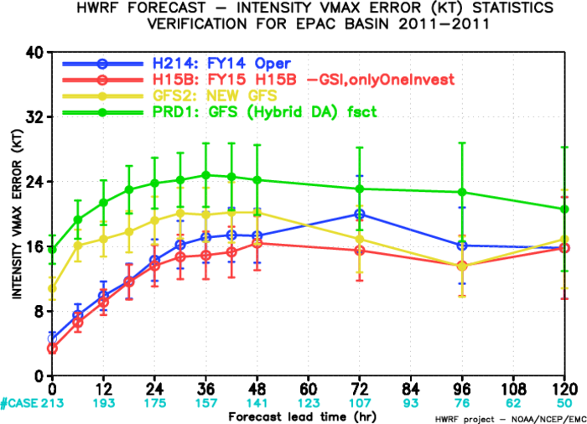
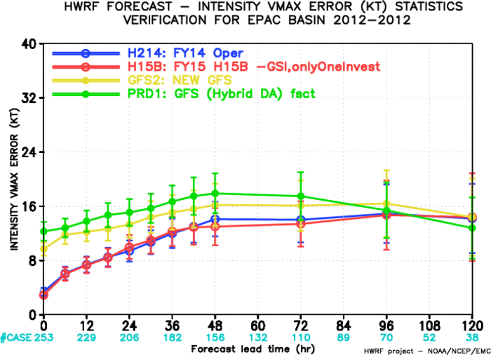
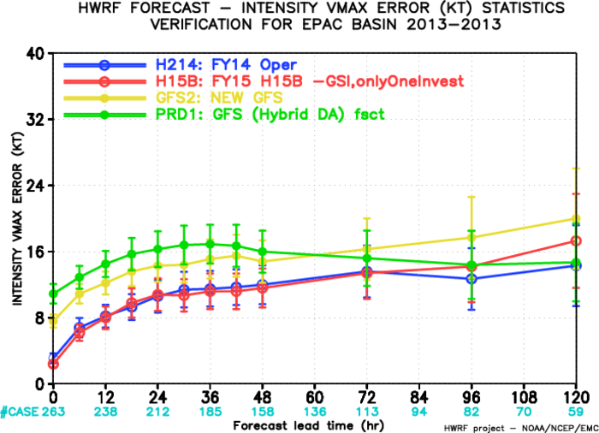
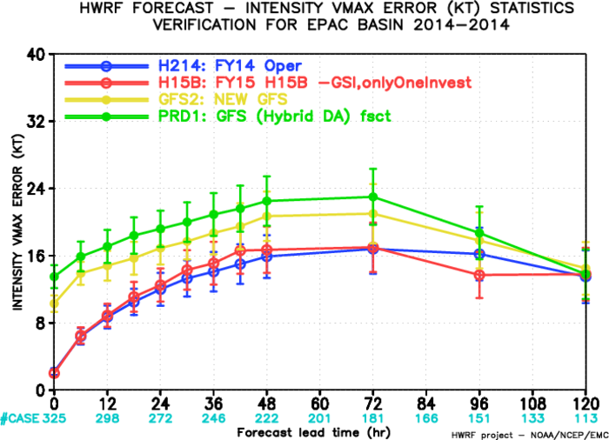
Intensity Verification for EP Storms at individual Year
2012
2011
2013
2014

Slide 10
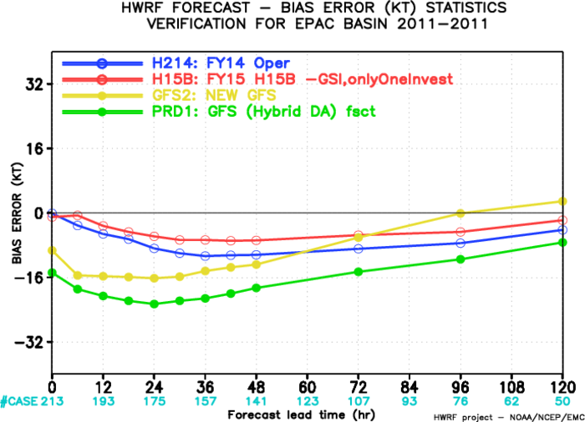
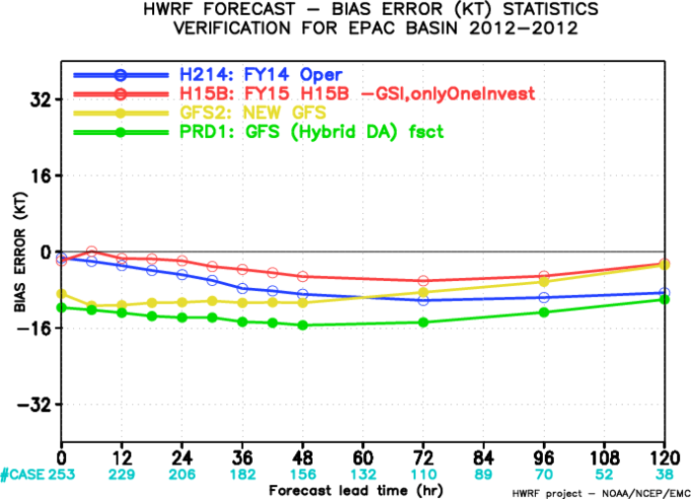
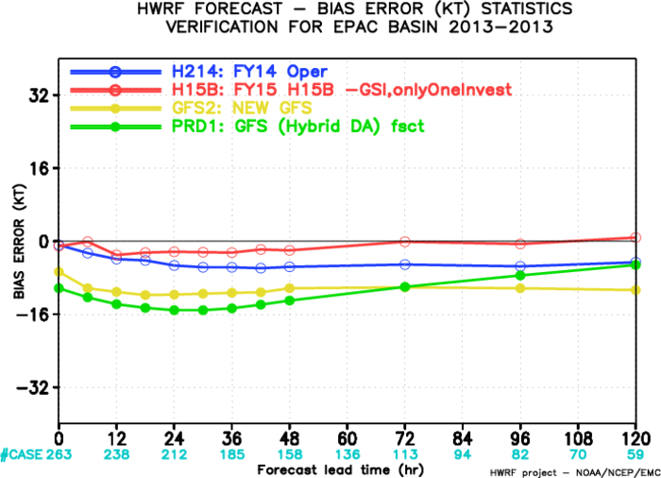
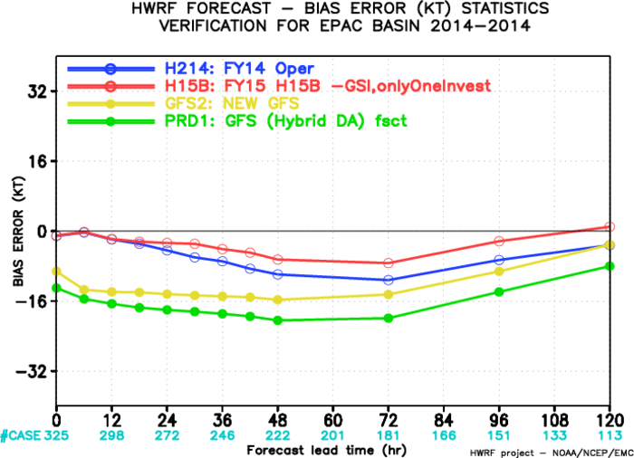
Intensity Bias for EP Storms at individual Year
2011
2012
2013
2014

Slide 11
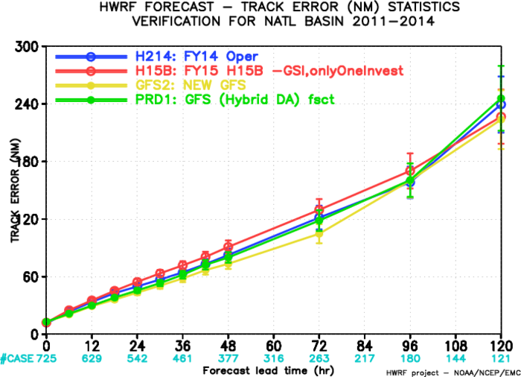
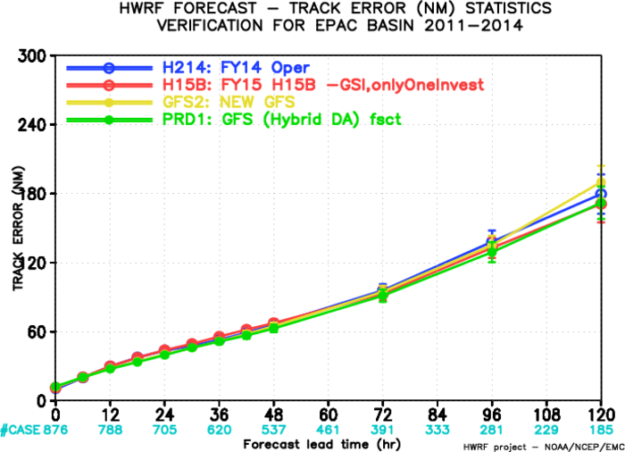
Track Verification (Bad Storms removed)

Slide 12
Possible reasons for H15B Track Forecast Degradation
Because of scripting errors, early H15B runs used 26 vertical levels GFS GRIB files instead of 47 to generate BC. This may cause track degradations at later forecast hours;
Only one INVEST is being cycled in H15B, while all INVEST were being cycled in H214;
Discontinuity at boundary between ghost D2 and D1;
New GFS Impact;
Physics impact because of resolution increasing (27/9/3km vs 18/6/2km). Will address this in physics upgrades.
No inner core DA in H15B;

Slide 13
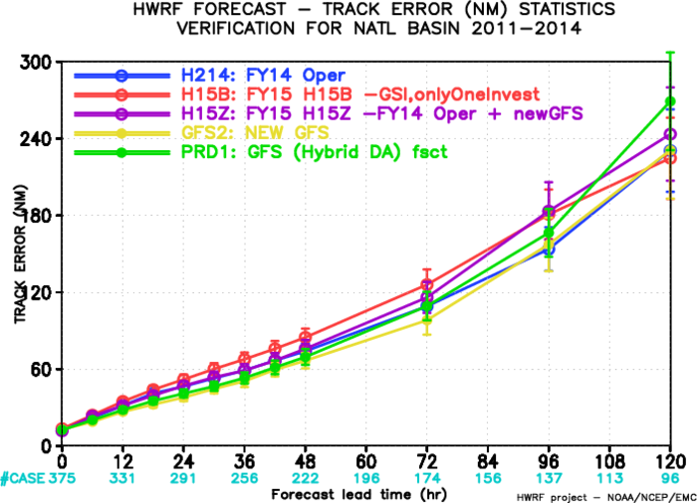
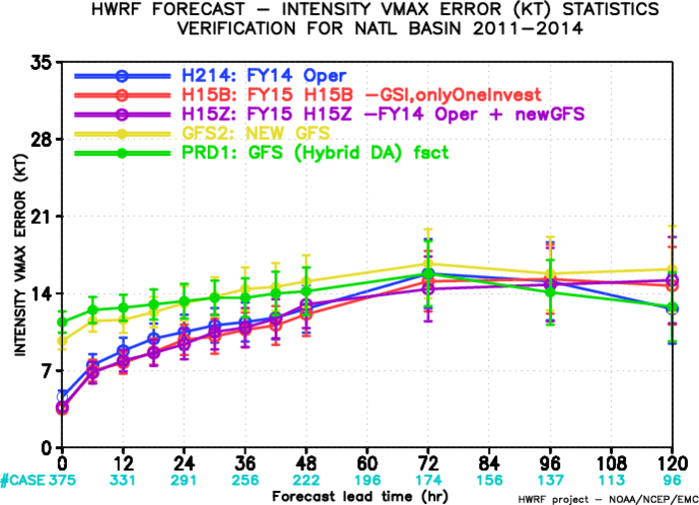
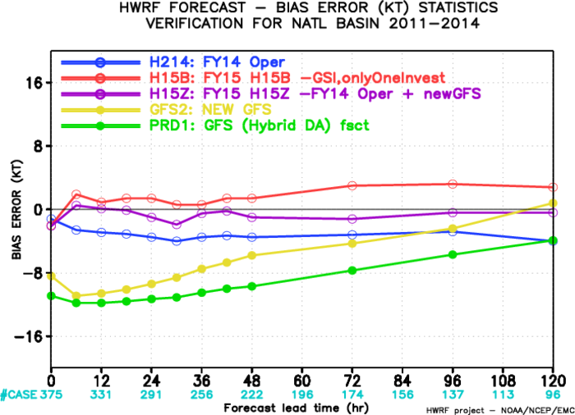
Track/Intensity Verification for 2011-2014 AL Storms
Pure new GFS Impact on HWRF:
H15Z vs. H214
H15Z track is degraded over H214 after day 3, even if new GFS track is better than old GFS.

Slide 14
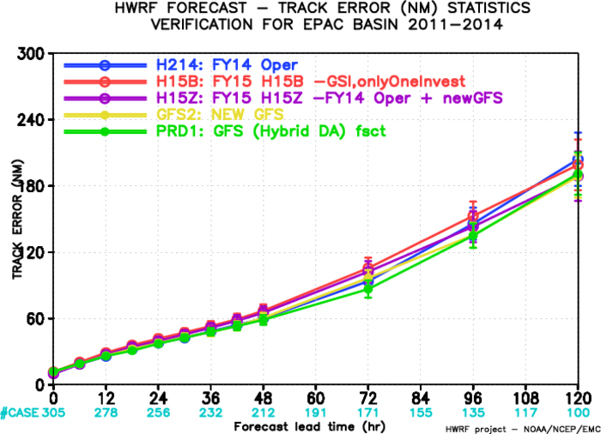
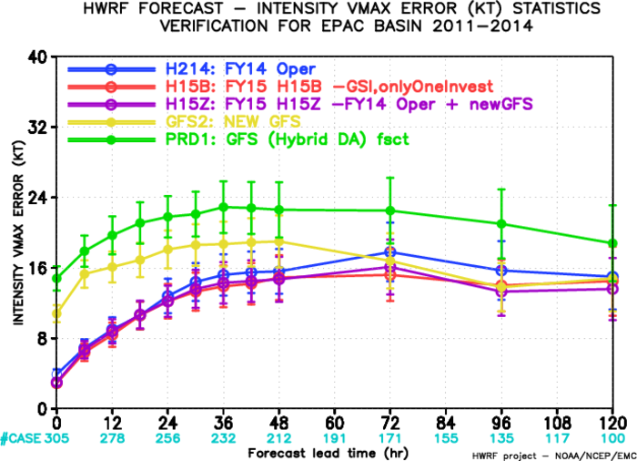
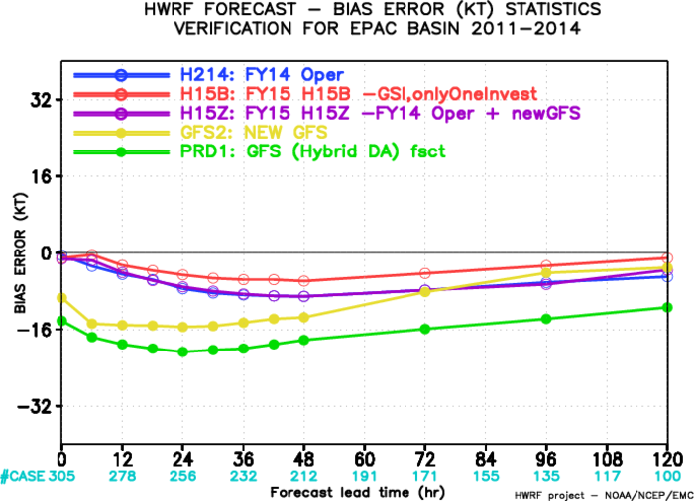
Track/Intensity Verification for 2011-2014 EP Storms
Pure new GFS Impact on HWRF:
H15Z vs. H214
H15Z track is improved over H214 after day 3, while new GFS track is degraded compared to old GFS.

Slide 15
Track Improvement/Degradation at 96h, Weighted by Sample Numbers (H15B vs H214) for AL
H15B-H214
Improvement: <0
Degradation: >0
Storms that need to be improved.

Slide 16
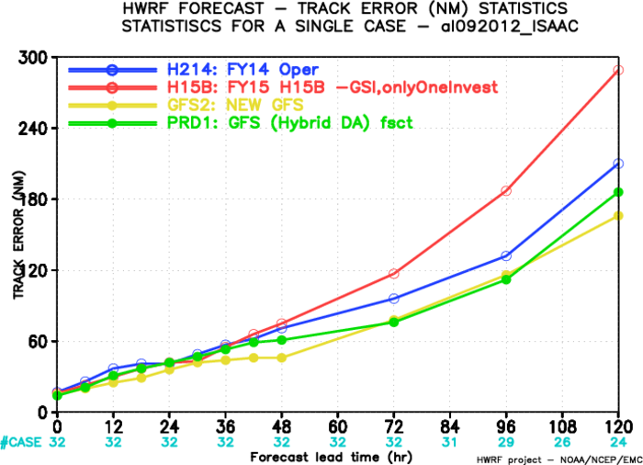
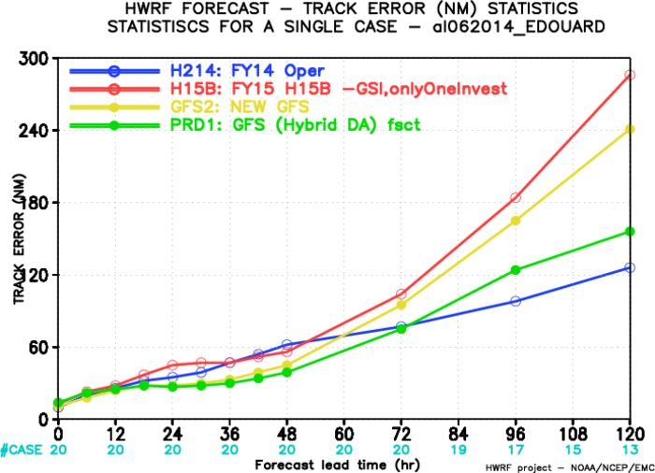
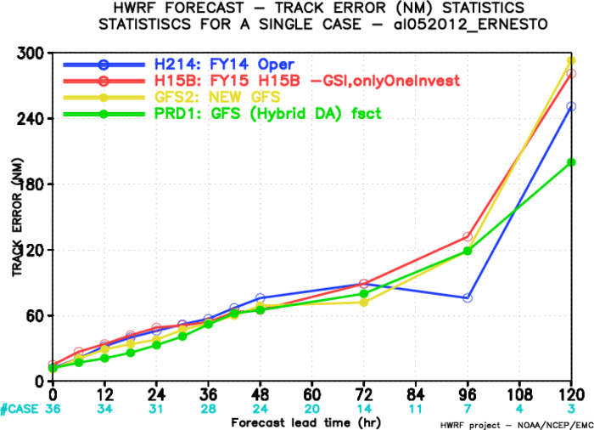
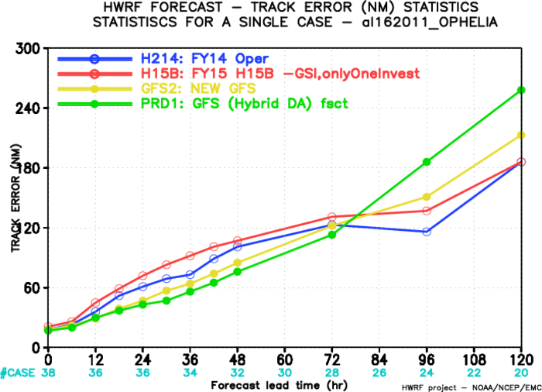
Worst Degraded Track Forecast Storms, AL
2012,09L
2014,06L
2012,05L
2011,16L

Slide 17
Track Improvement/Degradation at 96h, Weighted by Sample Numbers (H15B vs H214) for EP
H15B-H214
Improvement: <0
Degradation: >0
Storms that need to be improved.

Slide 18
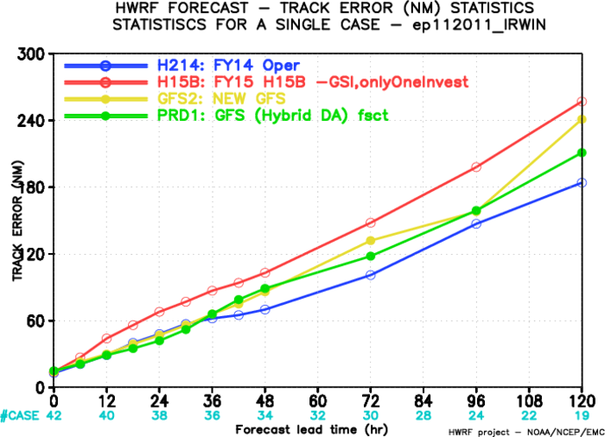
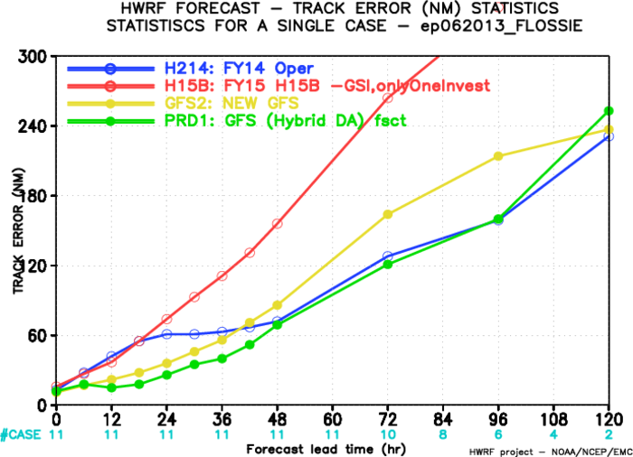
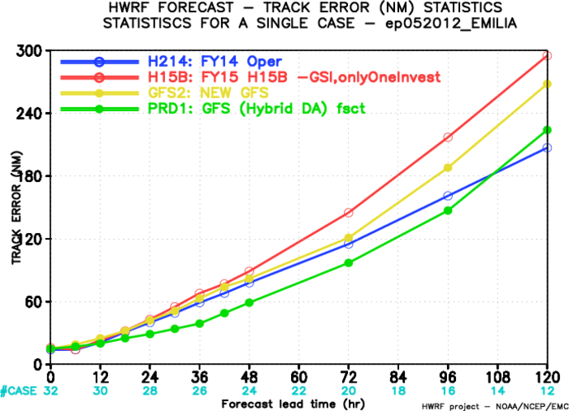
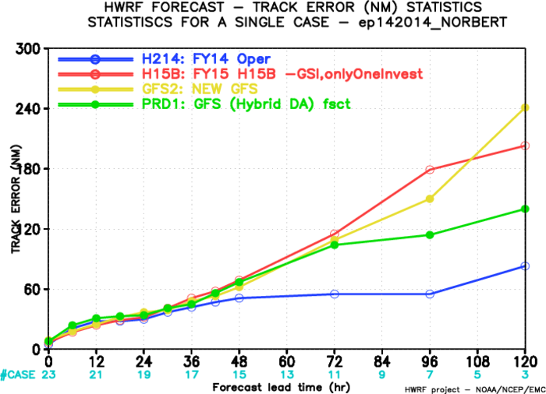
Worst Degraded Track Forecast Storms, EP
2011, 11E
2013,05E
2014, 14E
2012,05E

Slide 19
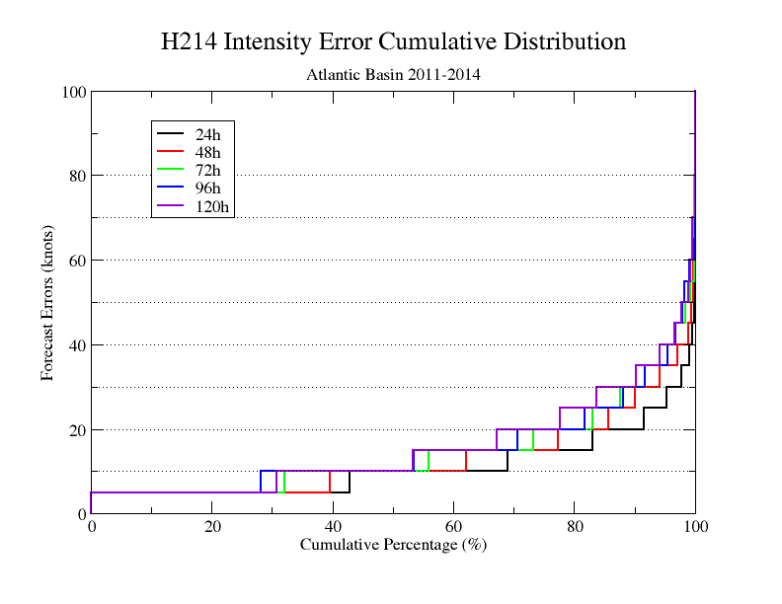
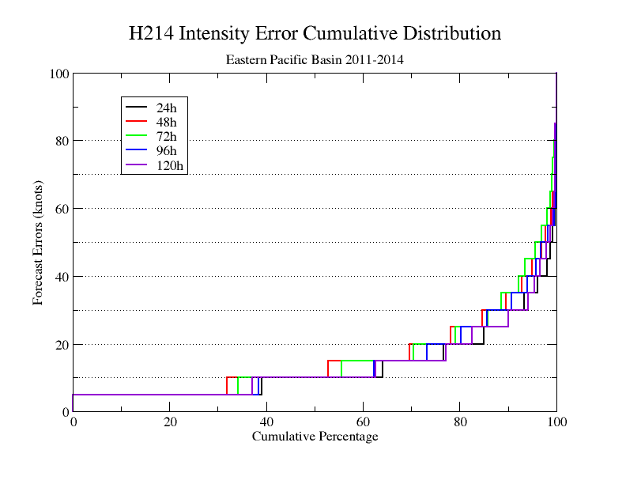
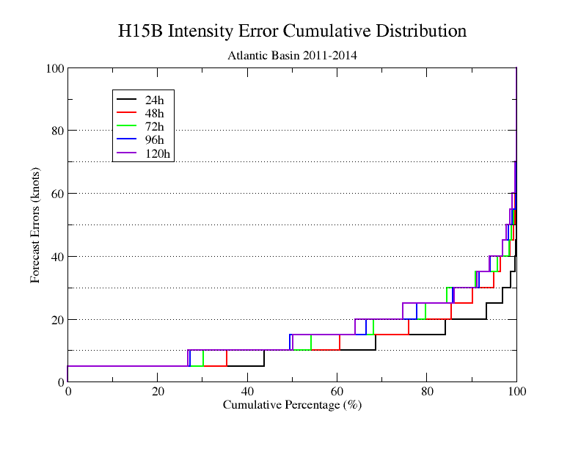
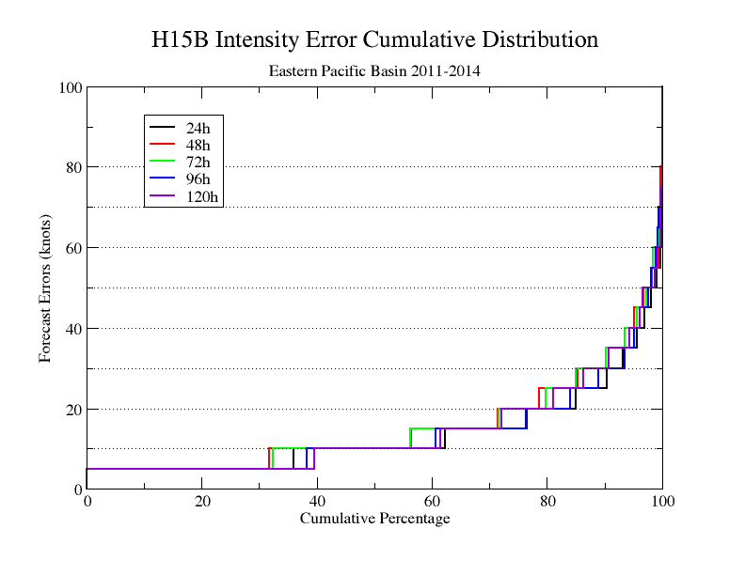
Comparison of Cumulative Distributions between H214 and H15B
H214 AL
H214 EP
H15B AL
H15B EP

Slide 20
Intensity Outlier Analysis (H15B vs H214)

Slide 21
Comparison of Cumulative Distributions between H214 and H15B (AL)
24h
48h
H15B better
H15B similar
96h
72h
H15B worse
H15B worse

Slide 22
Comparison of Cumulative Distributions between H214 and H15B (EP)
24h
48h
H15B similar
H15B better
72h
96h
H15B better
H15B better

Slide 23
Comparison of Cumulative Distributions between H15Band H214 (AL)

Slide 24
Comparison of Cumulative Distributions between H15B and H14Z (EP)

Slide 25
Intensity Improvement/Degradation of H15B over H214 for AL
3 identified busted storms, 2011, 17L and 2012 12L and 13L are improved
H15B-H214
Improvement: <0
Degradation: >0

Slide 26
Intensity Improvement/Degradation of H15B over H214 for EP
H15B-H214
Improvement: <0
Degradation: >0

Slide 27
Intensity Improvement/Degradation of H15B over H214 for EP
H15B-H214
Improvement: <0
Degradation: >0

Slide 28
Intensity Improvement/Degradation of H15B over H14Z for AL
H15B-H14Z
Improvement: <0
Degradation: >0

Slide 29
Intensity Improvement/Degradation of H15B over H14Z for EP
H15B-H14Z
Improvement: <0
Degradation: >0

Slide 30
Intensity Improvement/Degradation of H15B over H214 for AL
(TDR Storms Only)
H15B-H214
Improvement: <0
Degradation: >0

Slide 31
Intensity Improvement/Degradation at 96h, Weighted by Sample Numbers (H15B vs H214) for AL
H15B-H214
Improvement: <0
Degradation: >0

Slide 32
Intensity Improvement/Degradation at 96h, Weighted by Sample Numbers (H15B vs H214) for EP
H15B-H214
Improvement: <0
Degradation: >0

Slide 33
All stats plots for FY15 Baseline (H15B) can be found at:
http://www.atmos.umd.edu/~zhang/HWRF/

