Slide 1
FY15 HWRF Baseline/Physics Verification

Slide 2
Acronym
H15B3/H15E: FY15 HWRF baseline, 18/6/2km resolution, L61, input: T1534L64 GFS (Spectral file for both IC and BC)
H214: 2014 version of operational HWRF, 27/9/3km resolution, L61, input: T574 L64 GFS (Spectral files for both IC and BC);
H15Z: H214 driven by New GFS (Only 2011/2014 samples available)
H15W: H15E + all physics upgrades;
H15V: H15W + rolled back Cd/Ch;
H15U: H15W + new Cd with old Ch;
H15T: H15E + upgraded Data Assimilation procedure.

Slide 3
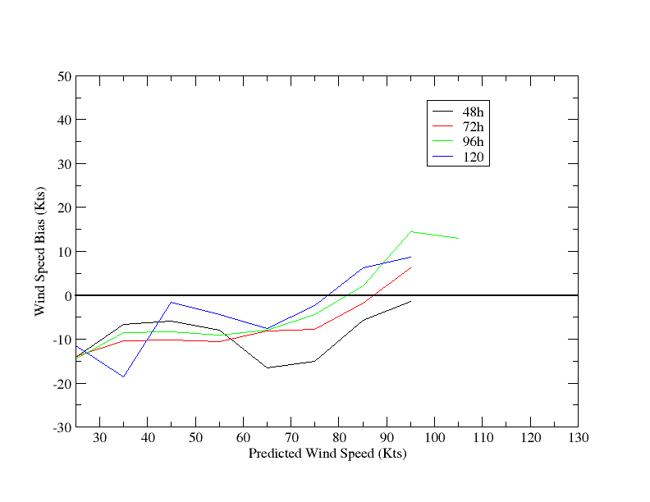
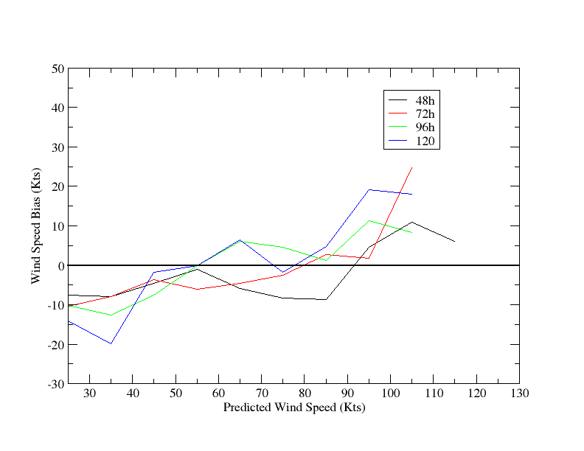
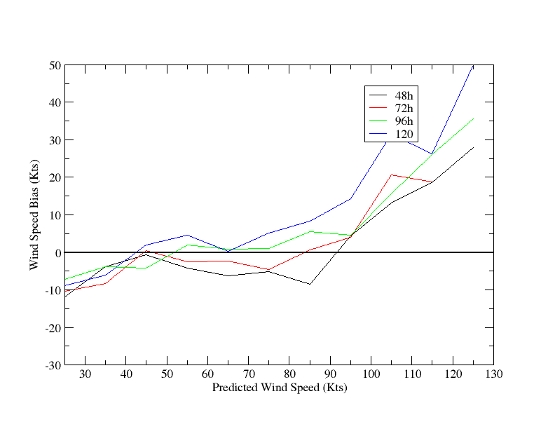
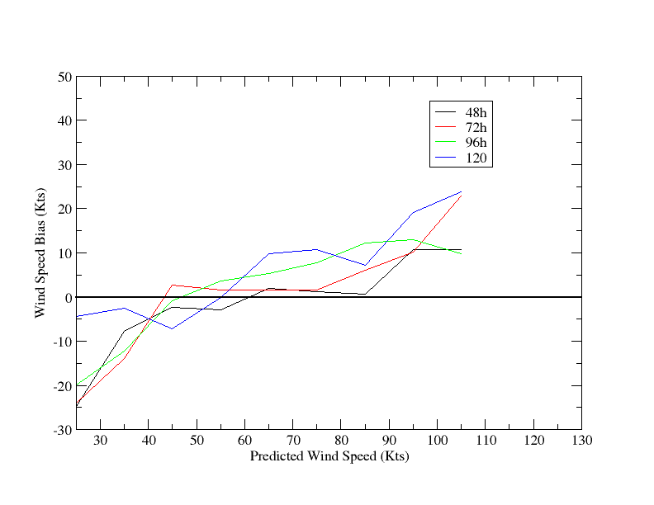
Intensity Bias as Predicted Wind Speed
H214
H15B
H15W
H15V

Slide 4
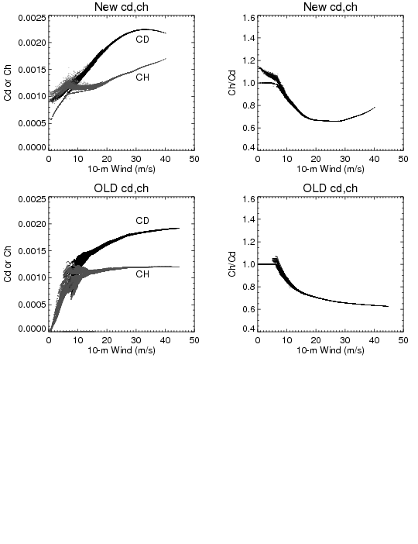
Comparisons of new/old Cd/Ch

Slide 5
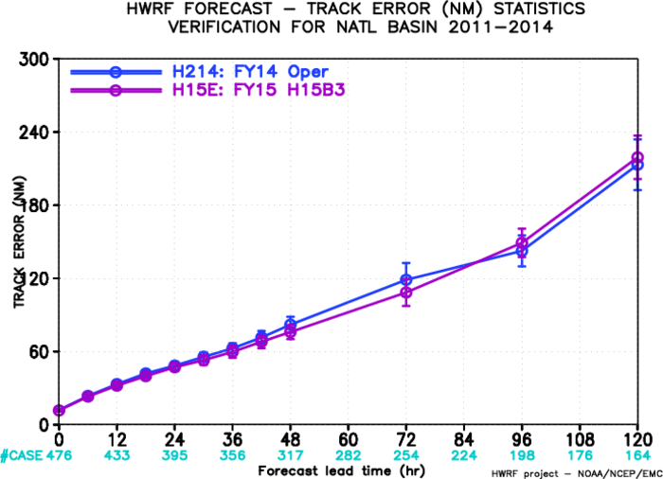
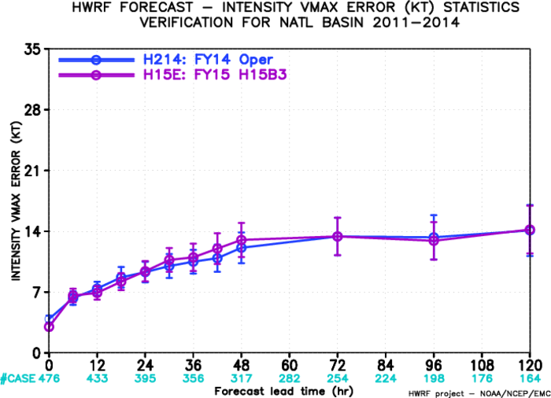
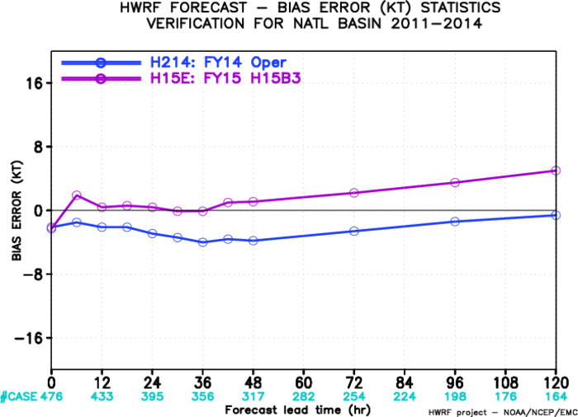
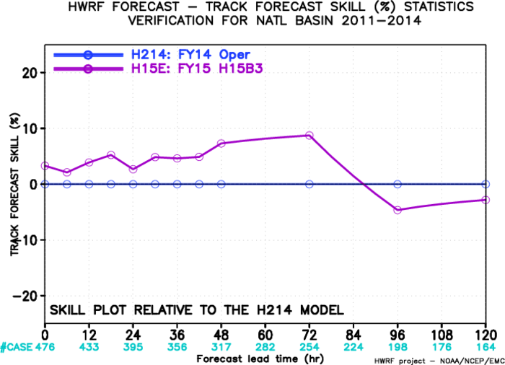
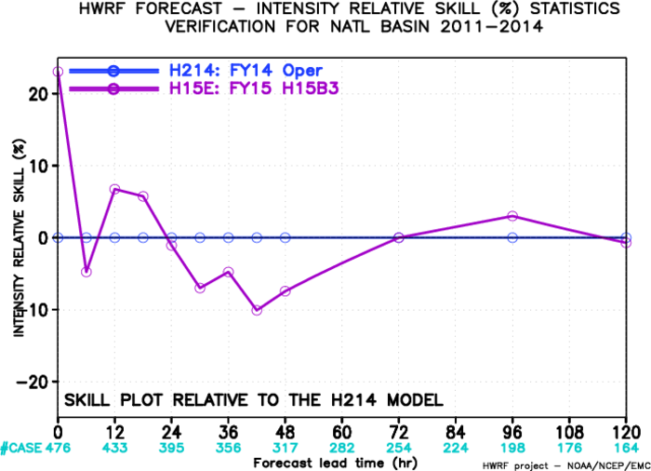
Impact of New GFS, AL
Track: degraded,
Intensity: neutral,
Bias: strong at later times??

Slide 6
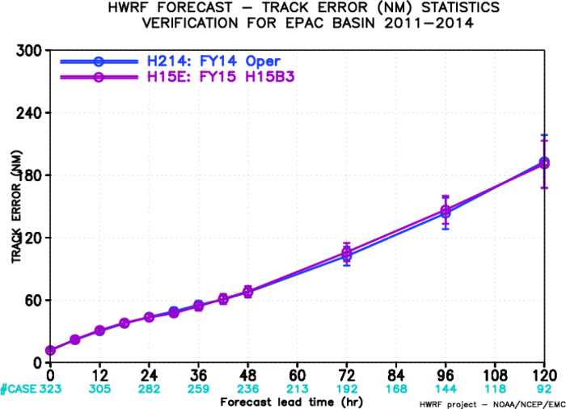
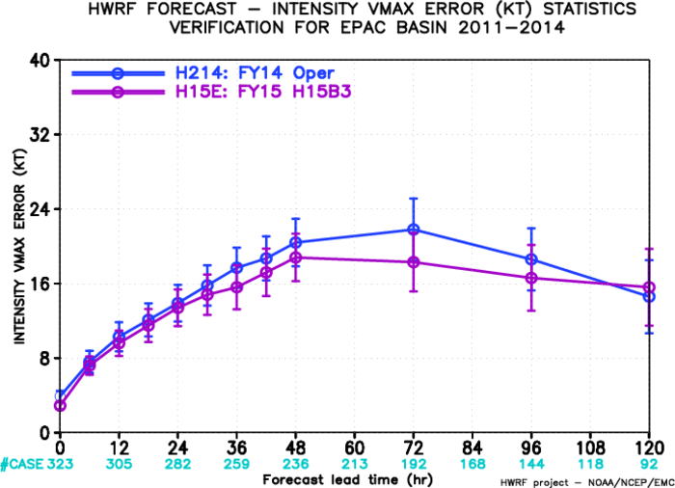
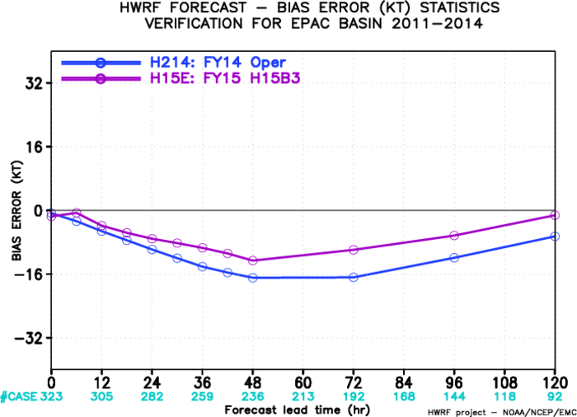
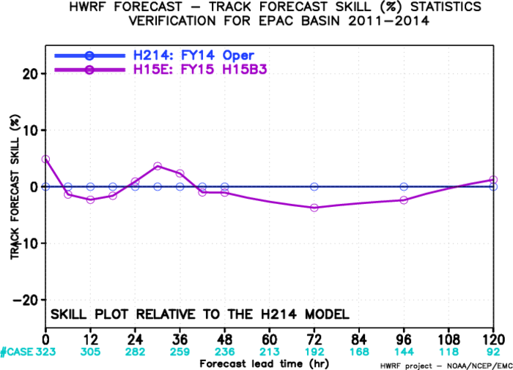
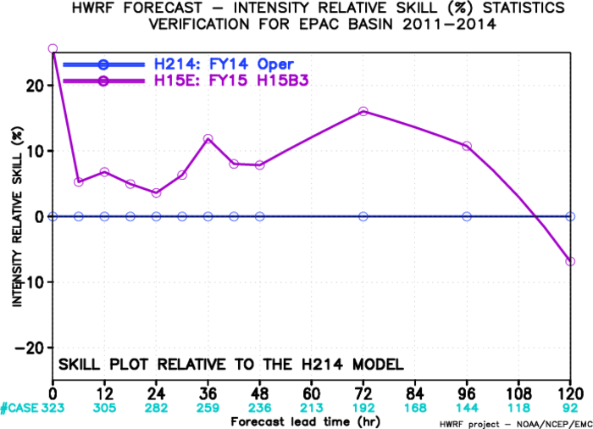
Impact of New GFS, EP
Track: neutral,
Intensity: improved
Bias: Improved

Slide 7
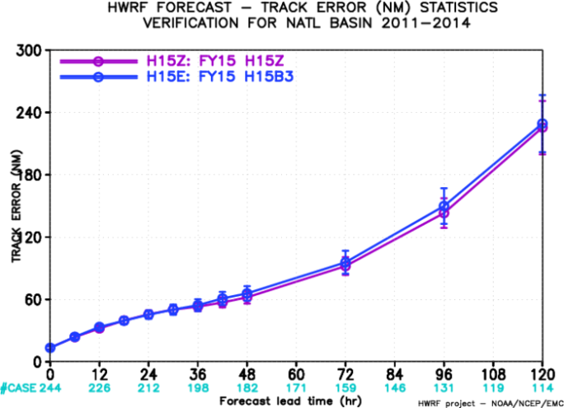
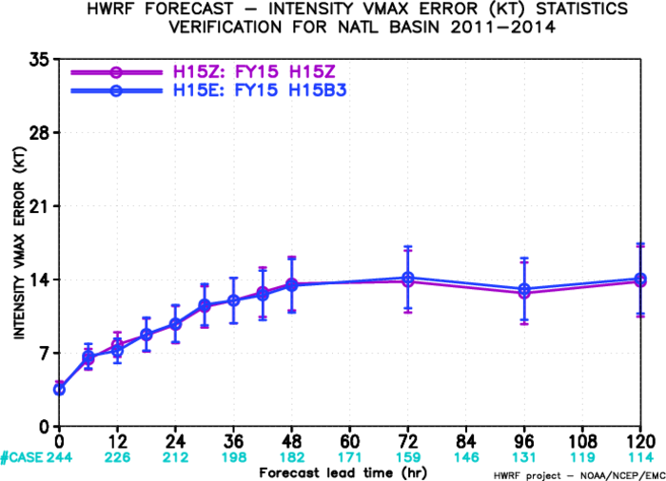
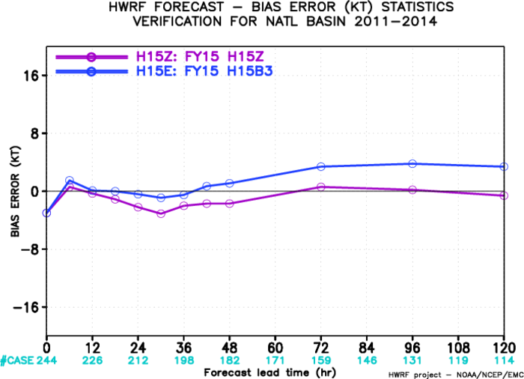
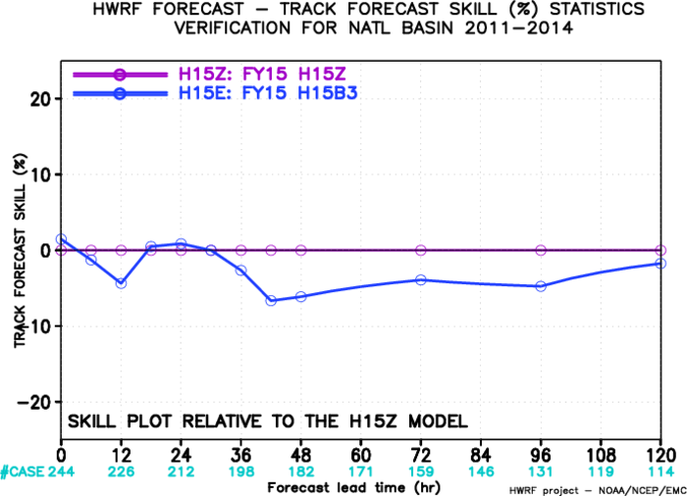
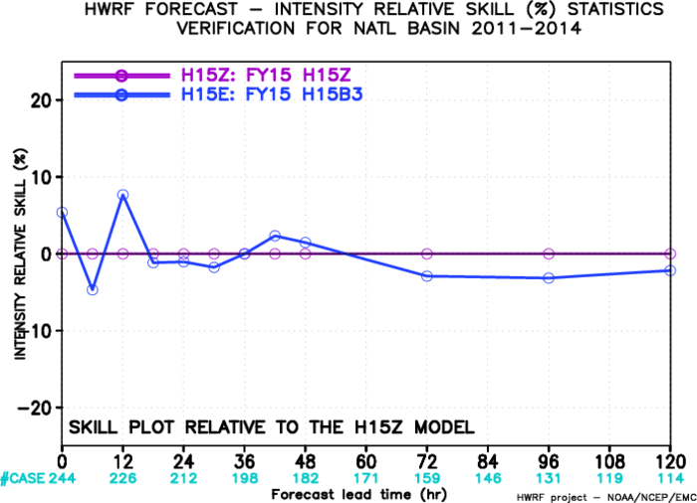
Impact of Resolution, AL
Track: neutral,
Intensity: neutral
Bias: too strong

Slide 8
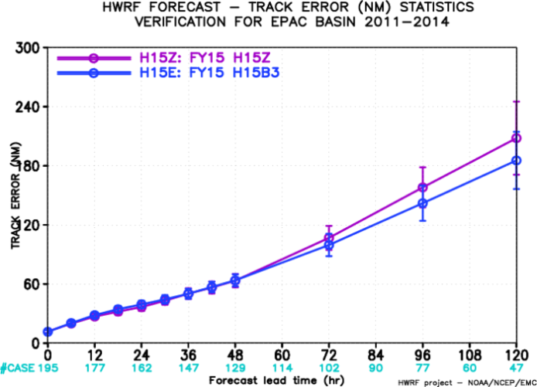
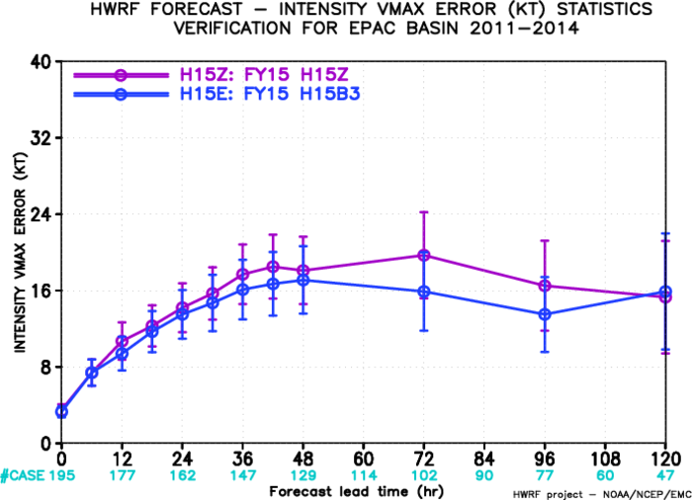
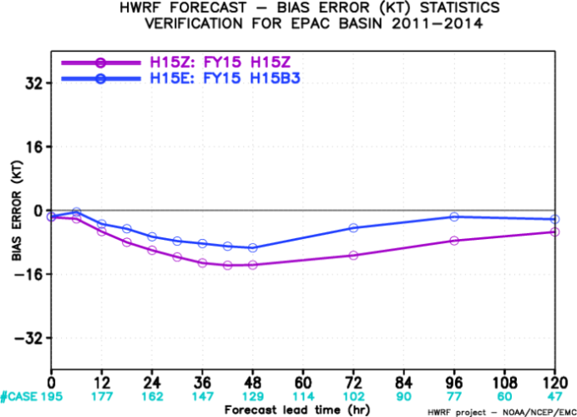
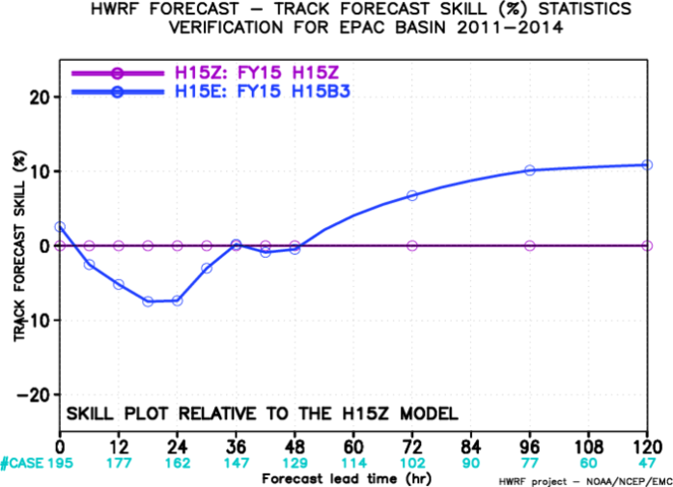
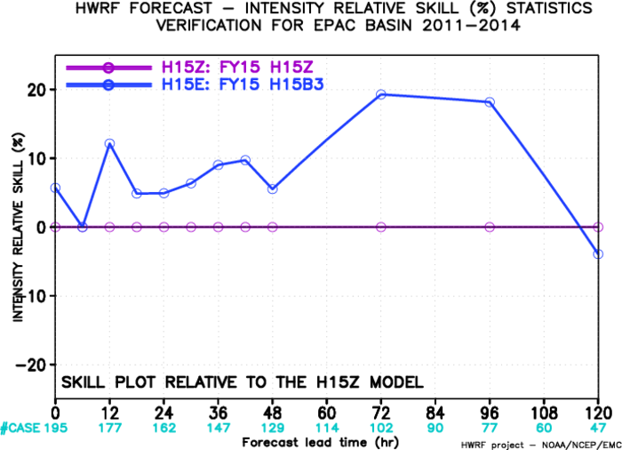
Impact of Resolution, EP
Track: improved,
Intensity: improved
Bias: Improved

Slide 9
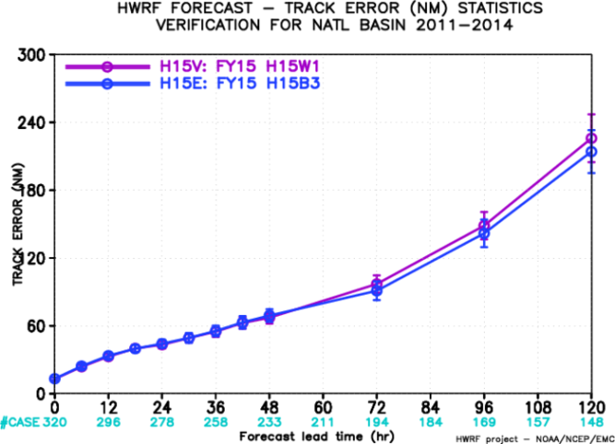
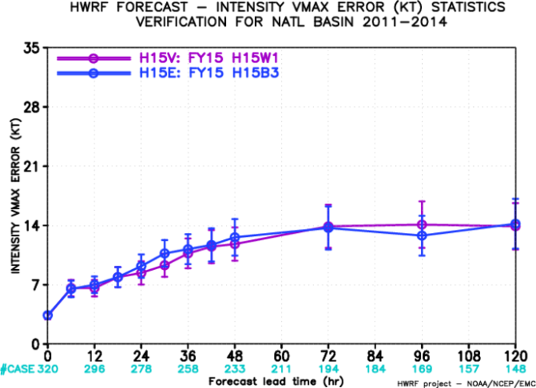
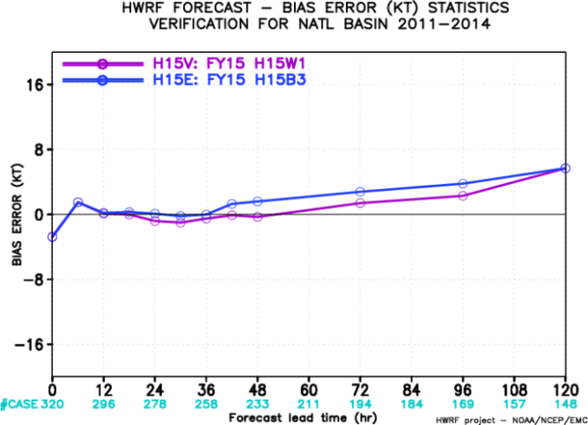
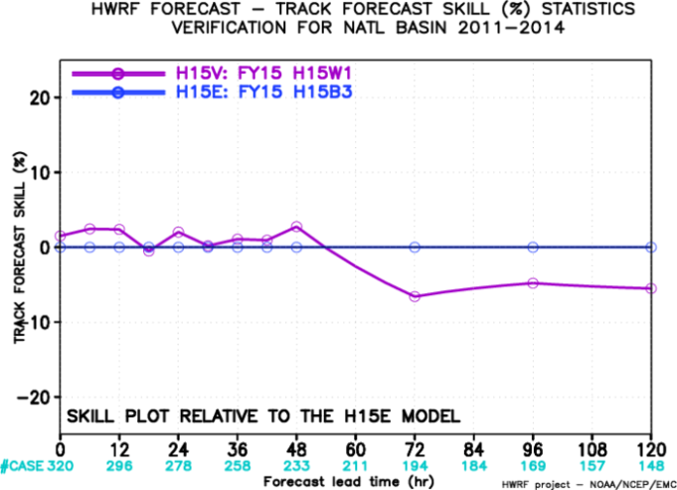
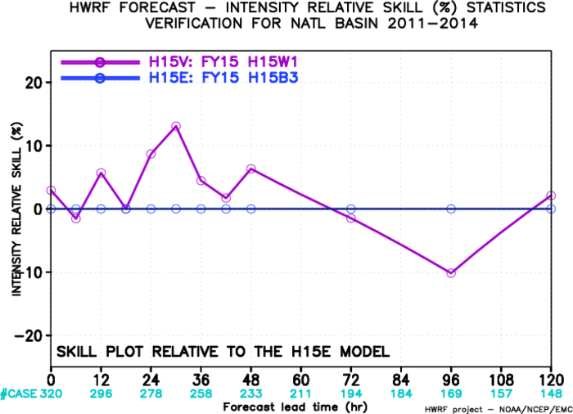
Impact of Physics Upgrades, AL
Track: neutral,
Intensity: neutral
Bias: Improved, Still have large bias

Slide 10
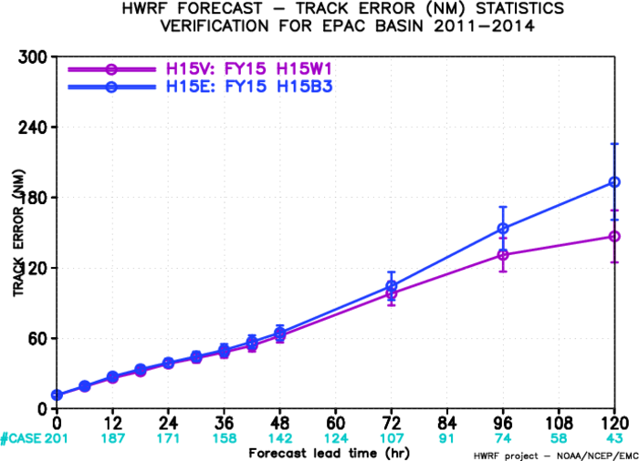
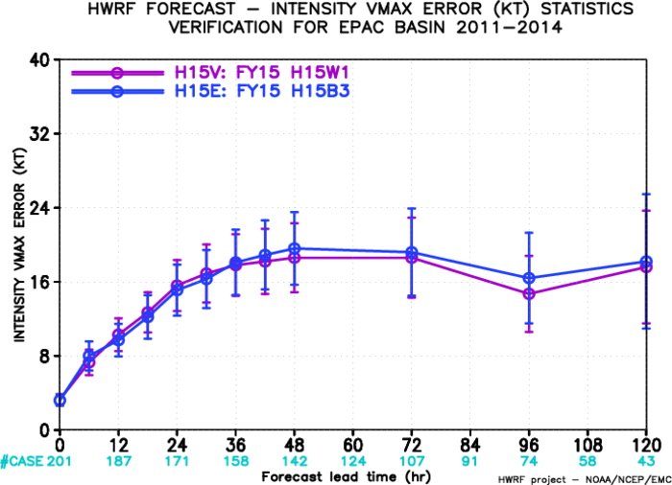
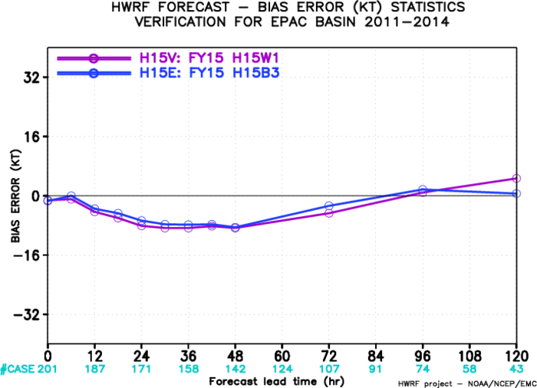
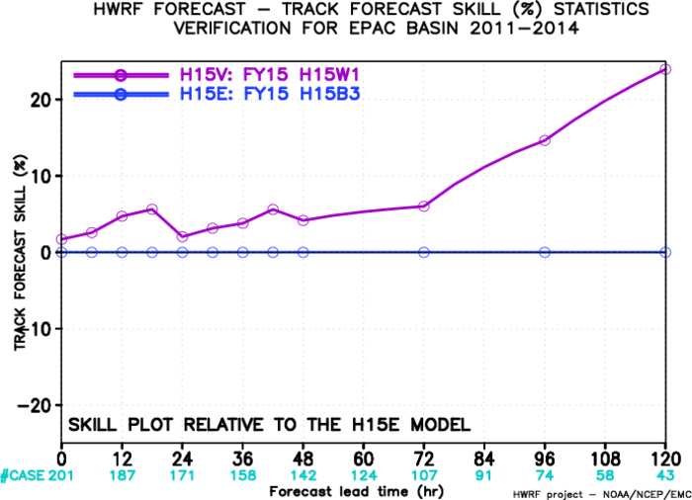
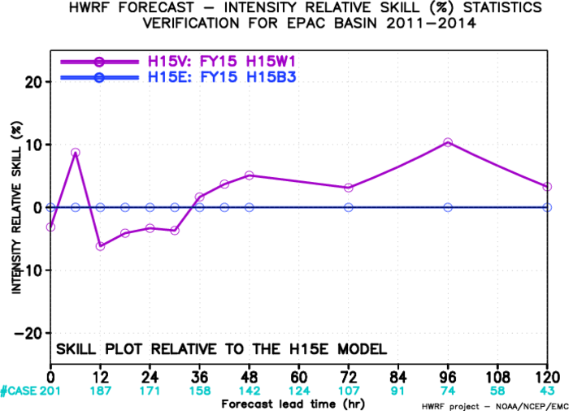
Impact of Physics Upgrades, EP
Track: greatly improved;
Intensity: neutral/improved
Bias: neutral

Slide 11
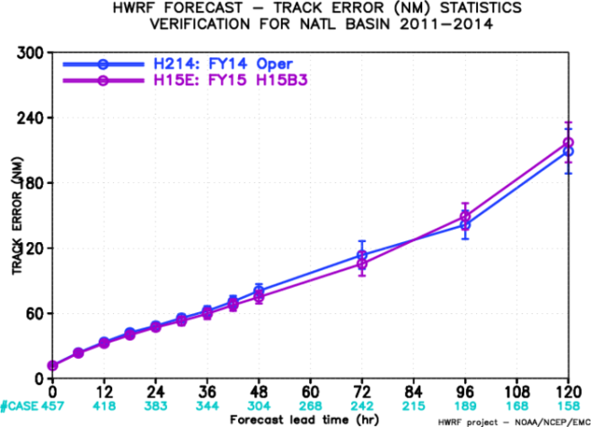
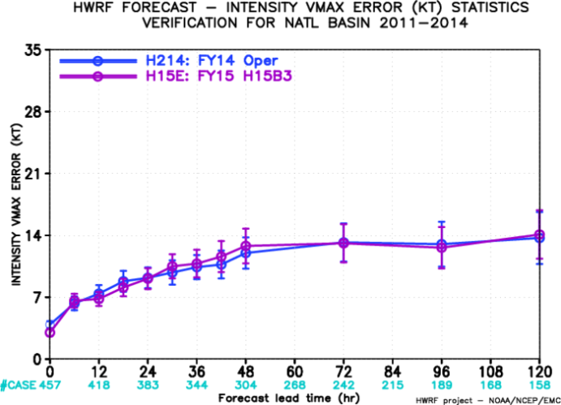
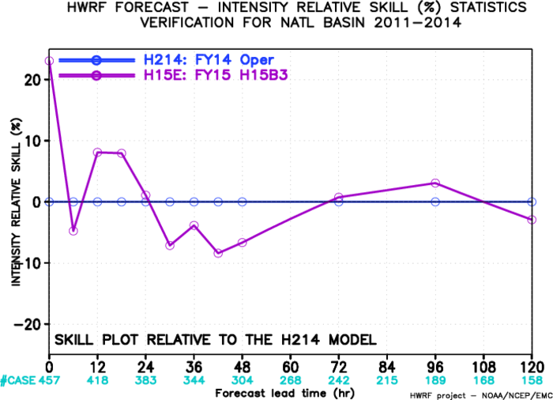
Impact of GFS/HWRF Resolution Increase, AL
Track: neutral,
Intensity: neutral
Bias: over-intensify at later hours

Slide 12
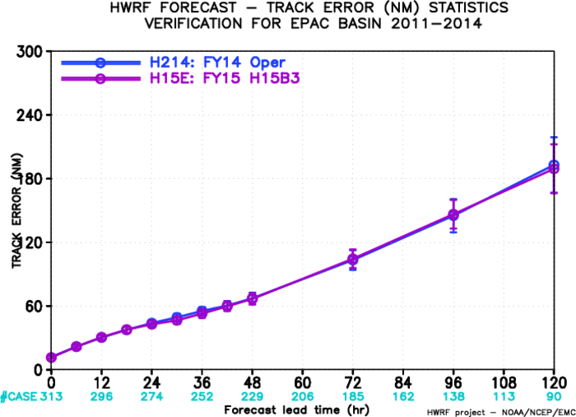
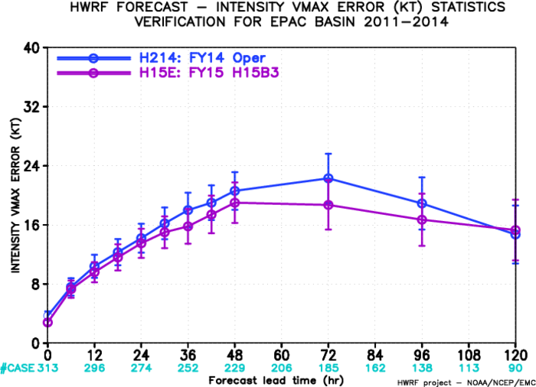
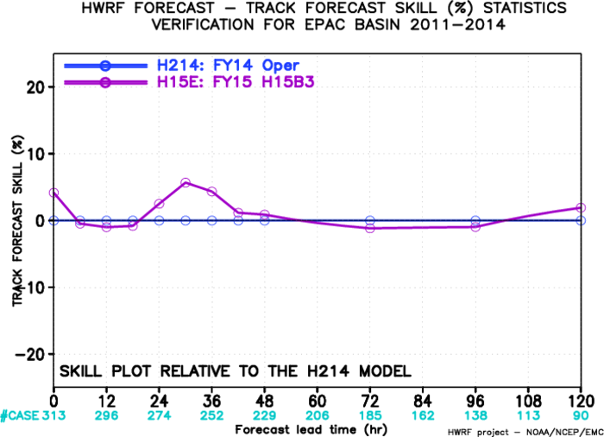
Impact of GFS/HWRF Resolution Increase, EP
Track: Improved,
Intensity: improved
Bias: Improved

Slide 13
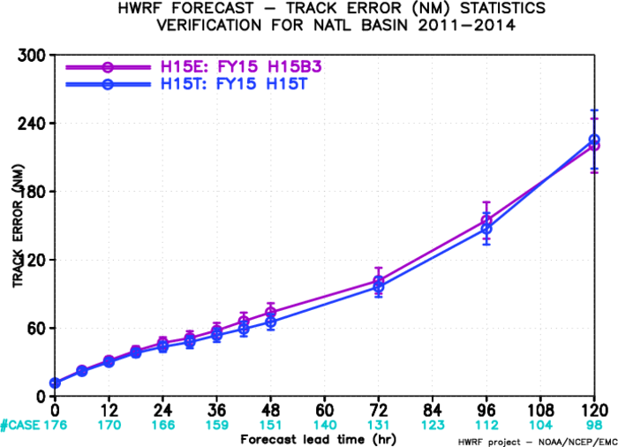
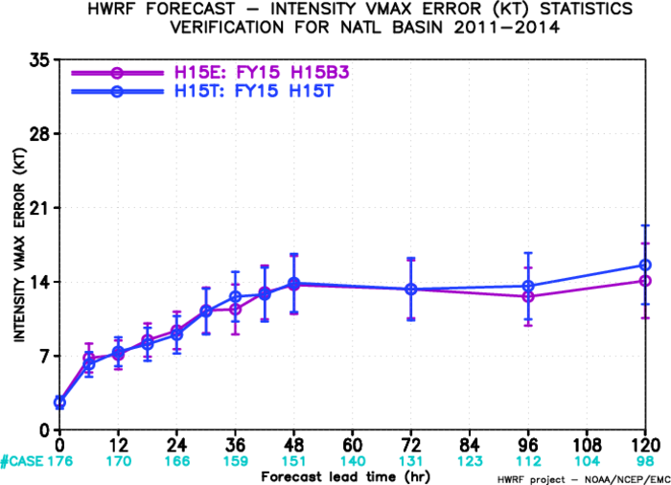
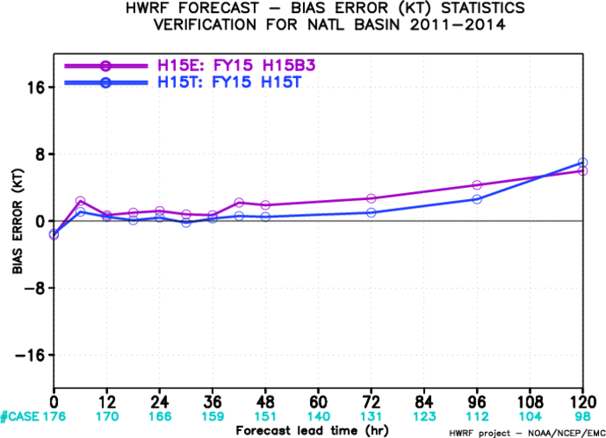
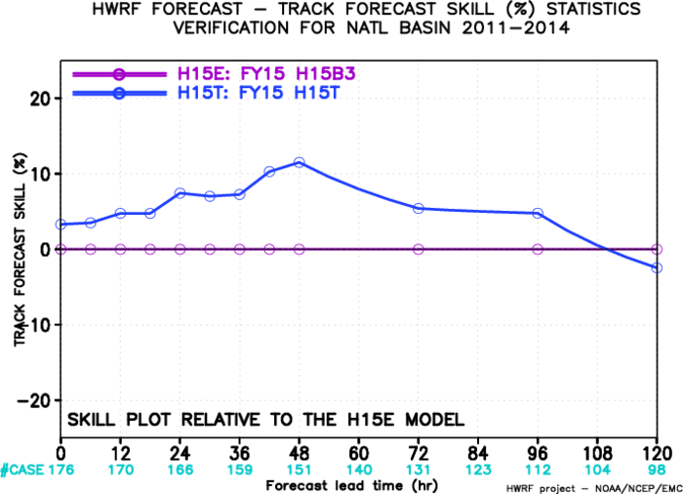
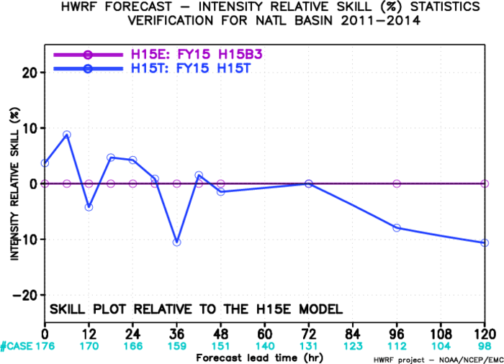
Impact of DA, AL
Track: Improved
Intensity: neutral
Bias: Improved

Slide 14
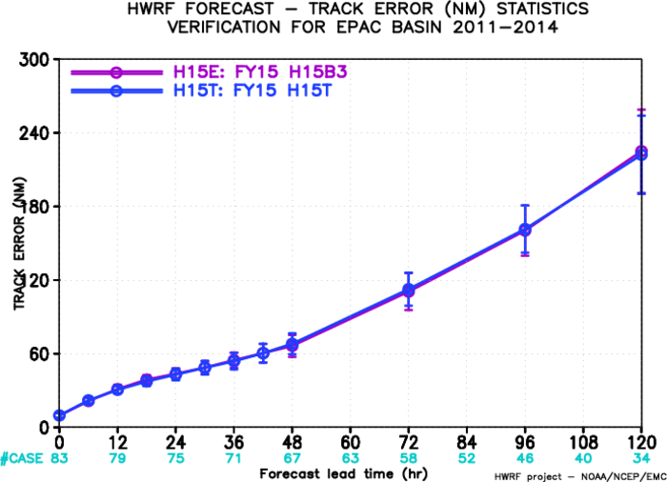
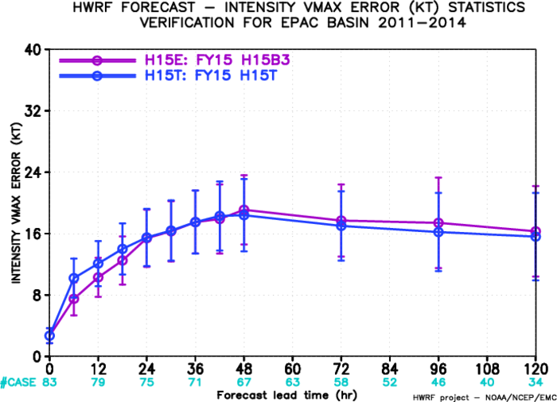
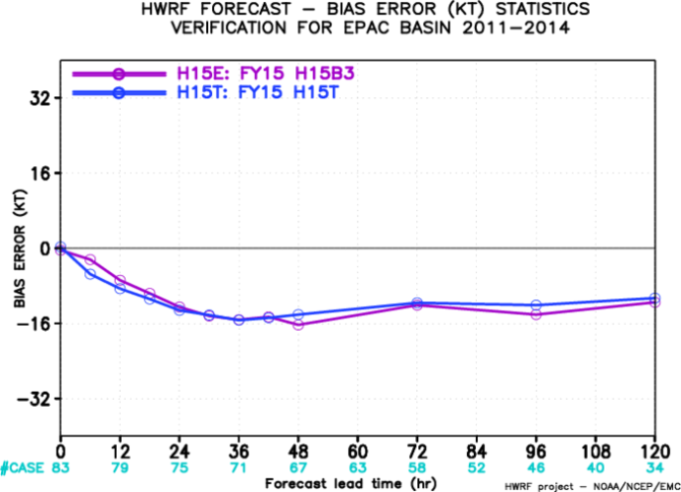
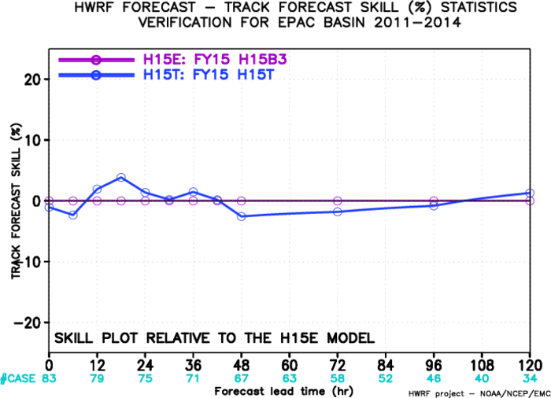
Impact of DA, EP
Track: neutral
Intensity: neutral
Bias: neutral

Slide 15
There are not many samples for H15U (new Cd old Ch), but initial analysis indicates that H15V (old Cd/Ch) is expected to be better than H15V. Strong positive bias at later forecast hours is much reduced.

Slide 16
New look of HWRF Webpage:
http://www.emc.ncep.noaa.gov/gc_wmb/vxt/HWRF_new10_edit

