Slide 1
FY15 HWRF Baseline Verification

Slide 2
Bug in H15B Pre-process Code
With bug, dx=dy=0.13 (due to precision problem, should be 0.135)
Bug fixed, dx=dy=0.135

Slide 3
Acronym
H15B3/H15E: FY15 HWRF baseline, 18/6/2km resolution, L61, input: T1534L64 GFS (Spectral file for IC, pressure level GRIB2 files for BC)
H214: 2014 version of operational HWRF, 27/9/3km resolution, L61, input: T574 L64 GFS (Spectral files for both IC and BC);
H15W: H15E + all physics upgrades;
H15T: H15E + upgraded Data Assimilation procedure.

Slide 4
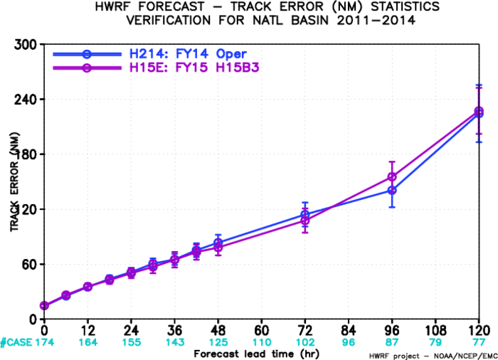
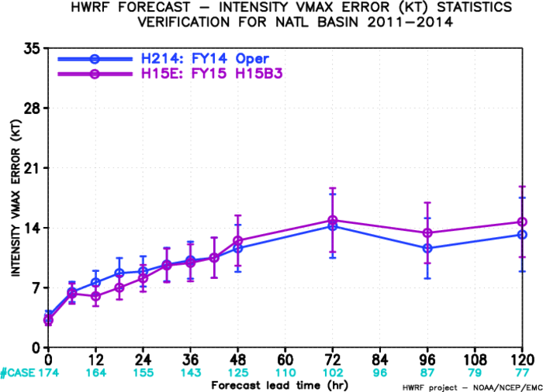
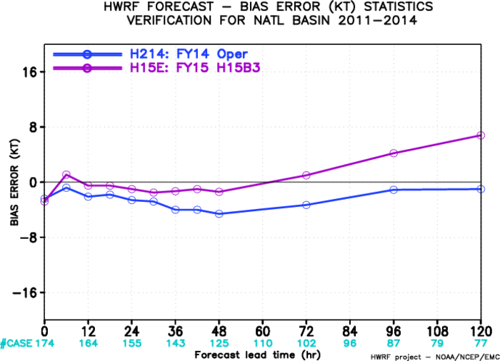
H15B3 vs H214 AL
Track forecast is improved before day 3;
Intensity forecast error is reduced up to day 2;
More improvements are expected.

Slide 5
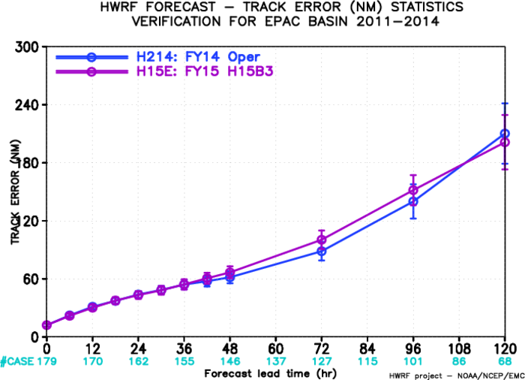
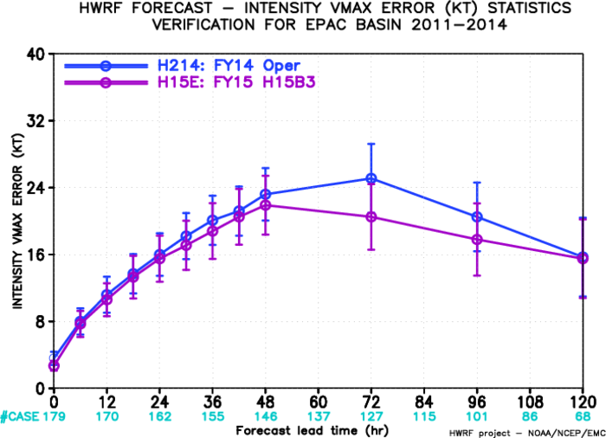
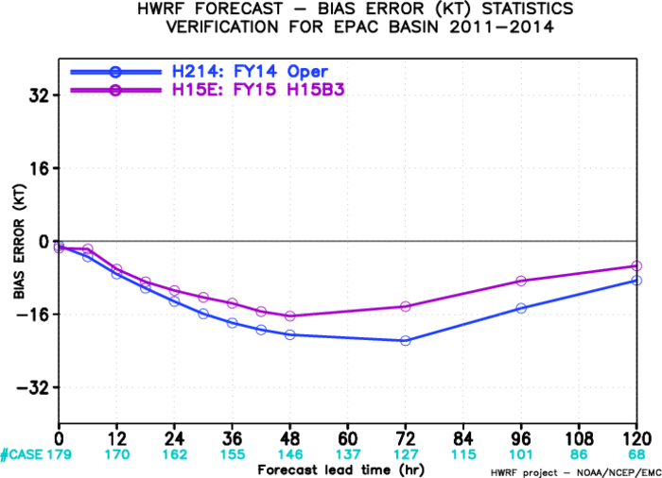
H15B3 vs H214 EP
Track forecast is degraded after day 3
Intensity forecast is improved;
Bias is improved;
More improvements are expected.

Slide 6
Track Improvement/Degradation at 72h, Weighted by Sample Numbers (H15E vs H214) for AL
H15E-H214
Improvement: <0
Degradation: >0

Slide 7
Intensity Improvement/Degradation at 72h, Weighted by Sample Numbers (H15E vs H214) for AL
H15E-H214
Improvement: <0
Degradation: >0
More number of storms improved than degraded

Slide 8
Track Improvement/Degradation at 72h, Weighted by Sample Numbers (H15E vs H214) for EP
H15E-H214
Improvement: <0
Degradation: >0

Slide 9
Intensity Improvement/Degradation at 72h, Weighted by Sample Numbers (H15E vs H214) for EP
H15E-H214
Improvement: <0
Degradation: >0
Intensity forecasts are improved for most of the storms

Slide 10
HWRF Upgrade Plan for 2015 Implementation
Multi-season Pre-Implementation T&E
 | Model upgrades | Physics and DA upgrades |  |  |  | Combined
 | Baseline (H15B) | NOAH LSM (H15W) | Upgraded Ferrier (H15W) | RRTMG/ PBL/ Surface Physics (H15W) | Data Assimilation* (H15T) | H215
Descriptions | 1.Resolution increase: 18/6/2km w/ same domain size; 2. Python scripts 3. New GFS T1534 4. Init improvement, GFS vortex filter | NOAH LSM (w/ Ch cap over land) | Separate species, w/o advection | 1.Radiation 2.Variable α 3.Scale-aware partial cloudness scheme | Hybrid GSI/HWRF-EPS based DA | Baseline + NOAH/LSM +newMP+RRTMG
Cases | Four-season 2011-2014 simulations in ATL/EPAC, cases (~3000) | Priority cases | Priority cases | Priority cases | Only TDR cases for 2011-2014 | Four 2011-2014 retrospectives ~3000 simulations in ATL/EPAC
Platforms | Jet | WCOSS | Jet | Jet/Zeus | Jet | Jet/WCOSS/Zeus
The plan is based on the assumption that 2015 operational HWRF system will have 3x computer resources as current system on WCOSS within HWRF operational time windows.
* DA experiment requires additional computer resources outside current operational time window.

Slide 11
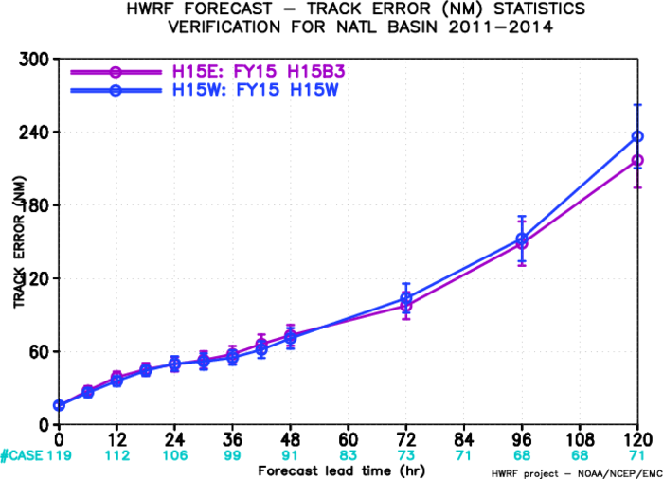
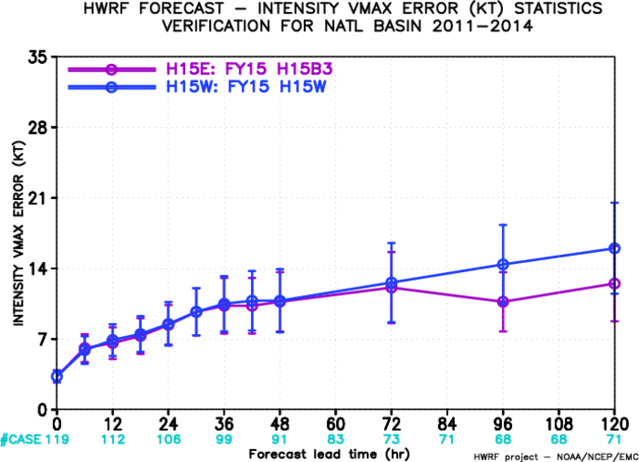
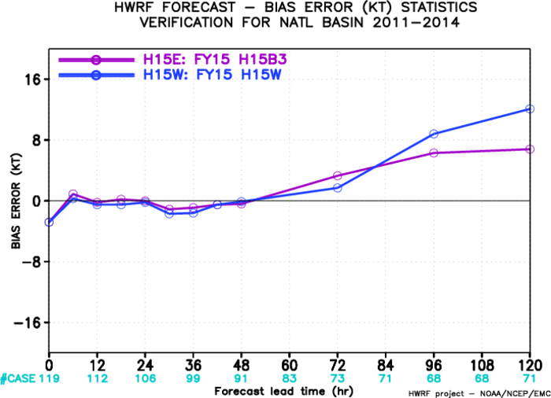
H15B3 vs H15W AL
More tunings in physics upgrades needed.

Slide 12
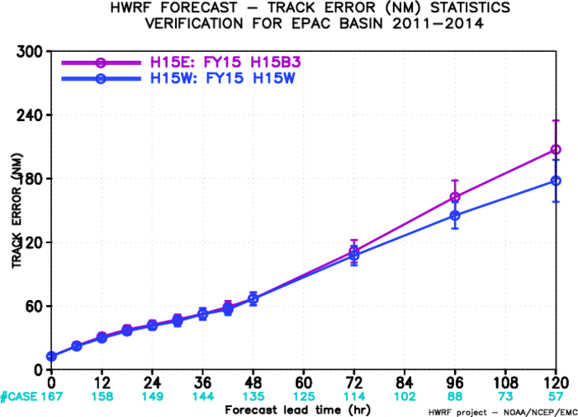
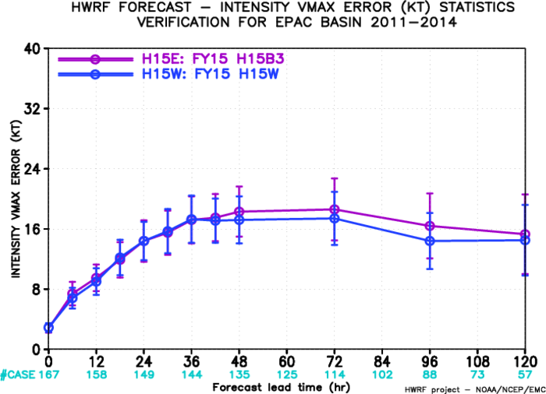
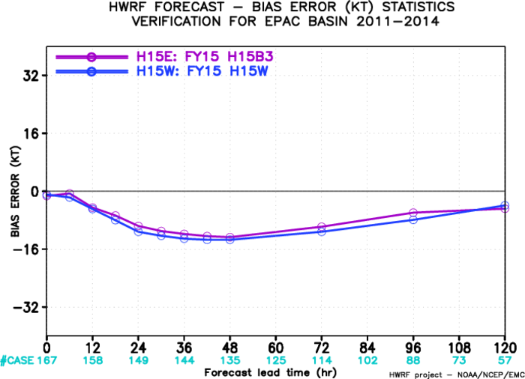
H15B3 vs H15W EP
Both track and intensity forecasts are improved.

Slide 13
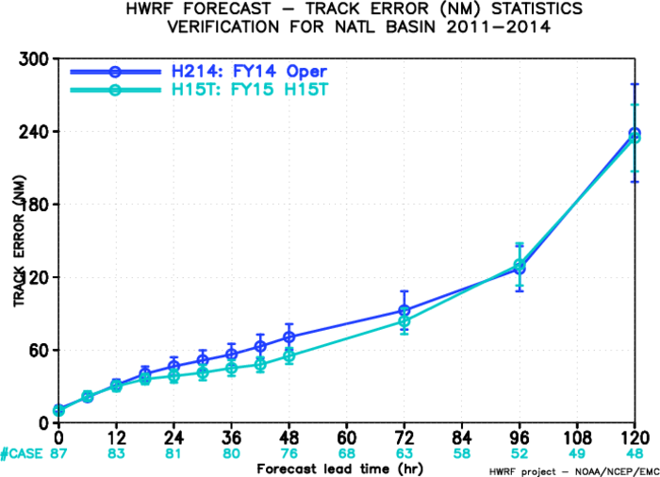
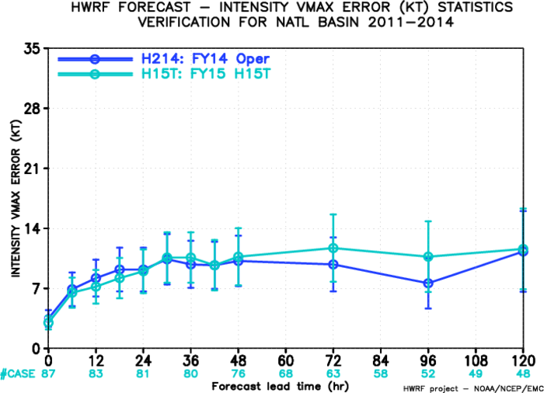
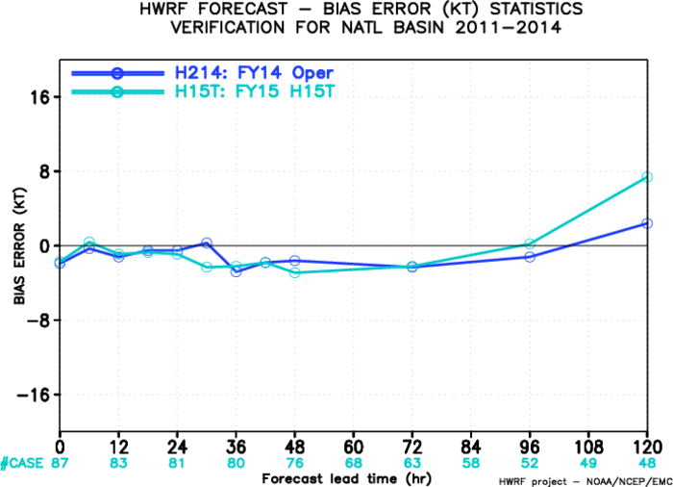
H15T vs H214 AL
Improved at all time levels
DA experiment:
1. address discontinuity in the initial condition between forecast domains
2. Run GSI on d2 analysis domain and add analysis increment to d3, when TDR data are not available. Run GSI on both d2 and d3 analysis domains, when TDR data are available.
3. Turn on satellite DA on d3 analysis domain
4. Added the assimilation of MSLP data

Slide 14
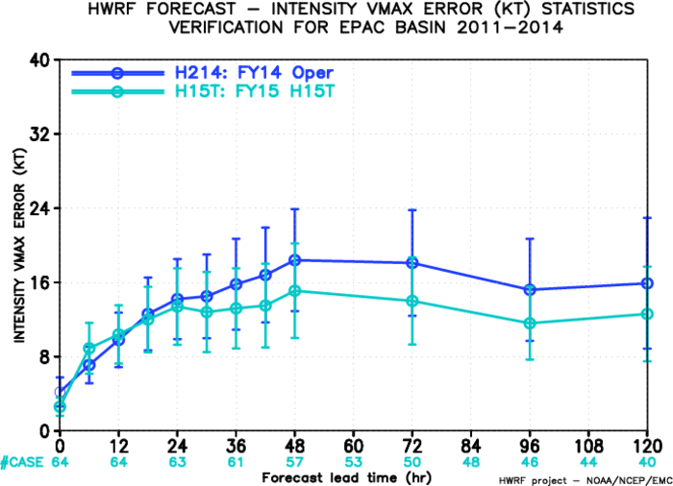
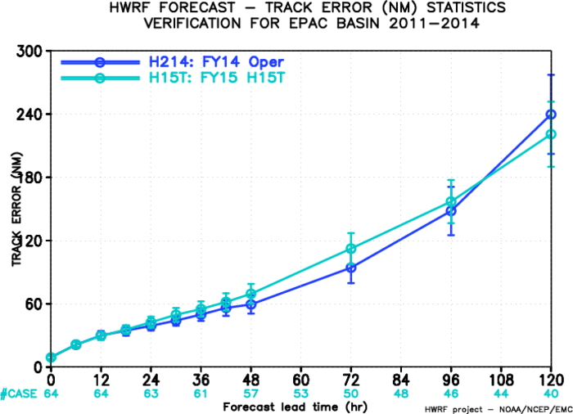
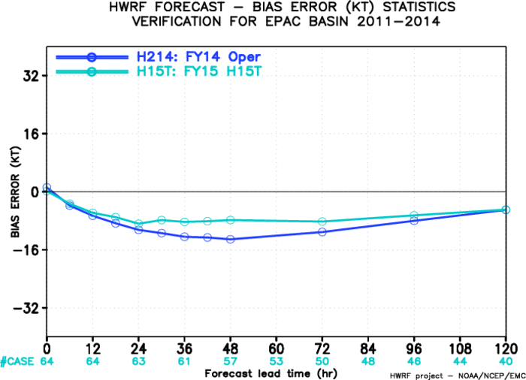
H15T vs H214 EP
Even though track forecasts are degraded, H15T has much better intensity forecasts.

