Slide 1
IAU alike Initilization Applied to HWRF for Hurricane Forecast
HWRF configuration:
Used output from Qingfu’s vortex initialization to GFS analysis as reference (gfsinit/relocate.stage3).
Did GSI analysis in HWRF for D01 domain and D03 ghost domain, with satellite observations always on, and GSI blending off.
Calculated the difference between GSI analysis and gfsinit/relocate.stage3
Ran IAU from Qingfu’s IC. The IC is equivalent to NoGSI configuration.
Spread the IAU alike difference into 0.0-0.5 hour window.
STORMS: 01-11L 2015; 01-09L 2014; 02L, 04L, 09L, 11-13L, 18L 2012 So far total 136 cycles.
IAU HWRF has smaller first 24 hour intensity Vmax error than H215 when I calculated the stats Tuesday night. Yesterday morning, it was about same. But this morning, IAU HWRF is already worse than H215. So maybe we should turn on GSI blending for strong storms.

Slide 2
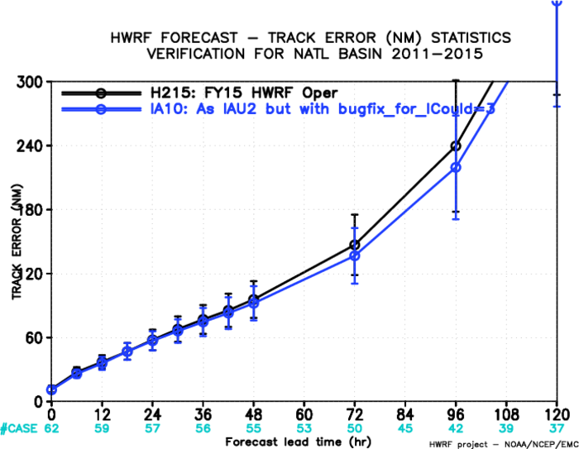
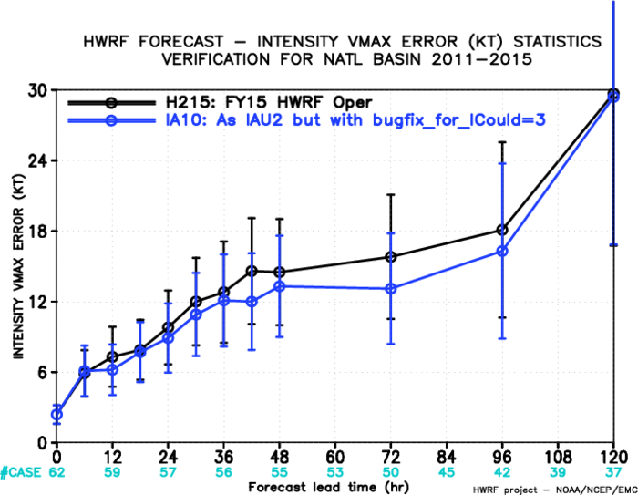
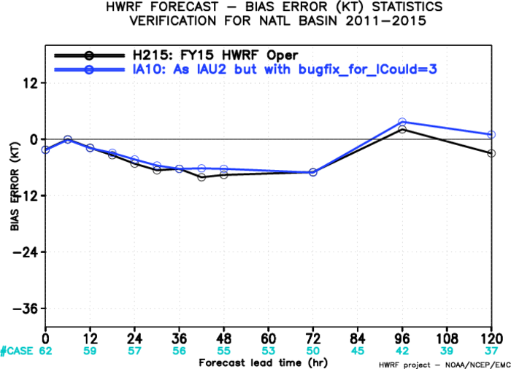
All available cycles by 11:30pm 12/15/2015

Slide 3
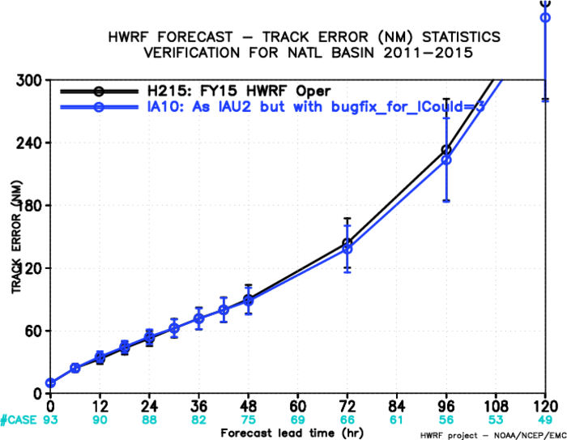
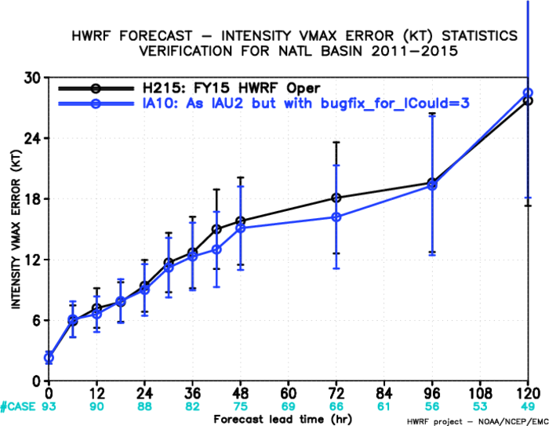
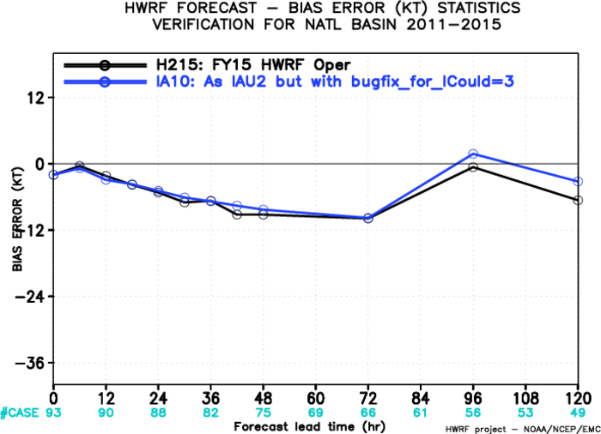
All available cycles by 2:30PM 12/16/2015

Slide 4
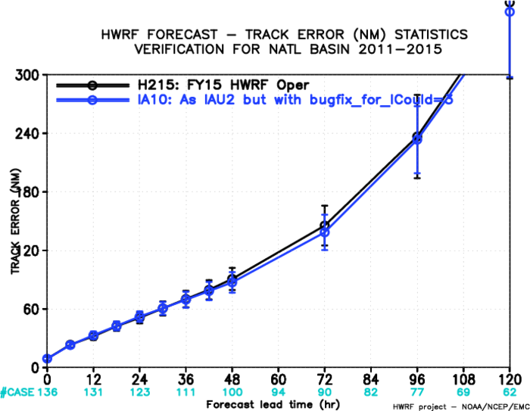
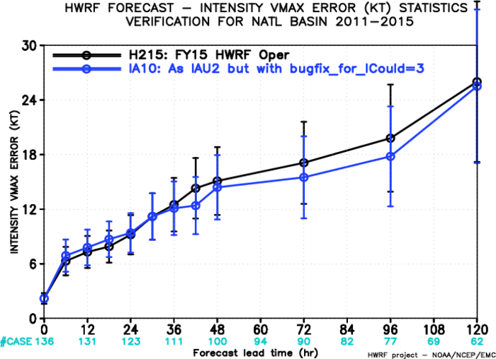
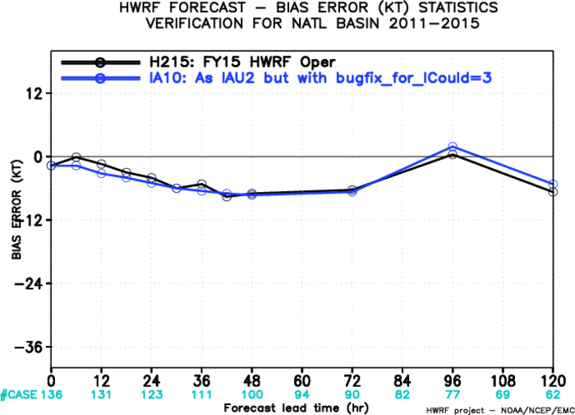
All available cycles by 11:00am 12/17/2015

