Slide 1
CIMSS research progress on the assimilation of advanced infrared and microwave sounder radiances in regional NWP for improving TC forecasts
Jun Li, Jinlong Li, Pei Wang, Hyojin Han, Agnes Lim
CIMSS/UW-Madison
and
Tim Schmit
ASPB/CoRP/STAR/NESDIS
10 December 2015
Presented by Jun Li at HWRF team weekly meeting
Acknowledgement:
JPSS PGRR, GOES-R HIW for funding support; Mark DeMaria, Jack Beven and Vijay Tallapragada for guidance

Slide 2
Outlines
CIMSS real time SDAT (satellite data assimilation for TC forecasts) system as research testbed for improving the utilization of satellite data in regional NWP
Research progress on IR/MW sounder radiance assimilation with SDAT
  IR sounder sub-pixel cloud characterization for improving radiance assimilation
  Assimilation of IR sounder thermodynamic information in partly cloud cover
  MW sounder cloud-screening for radiance assimilation
SDAT real time demonstration and application
  Performs on 2015 hurricane season
Future plan on using HWRF

Slide 3
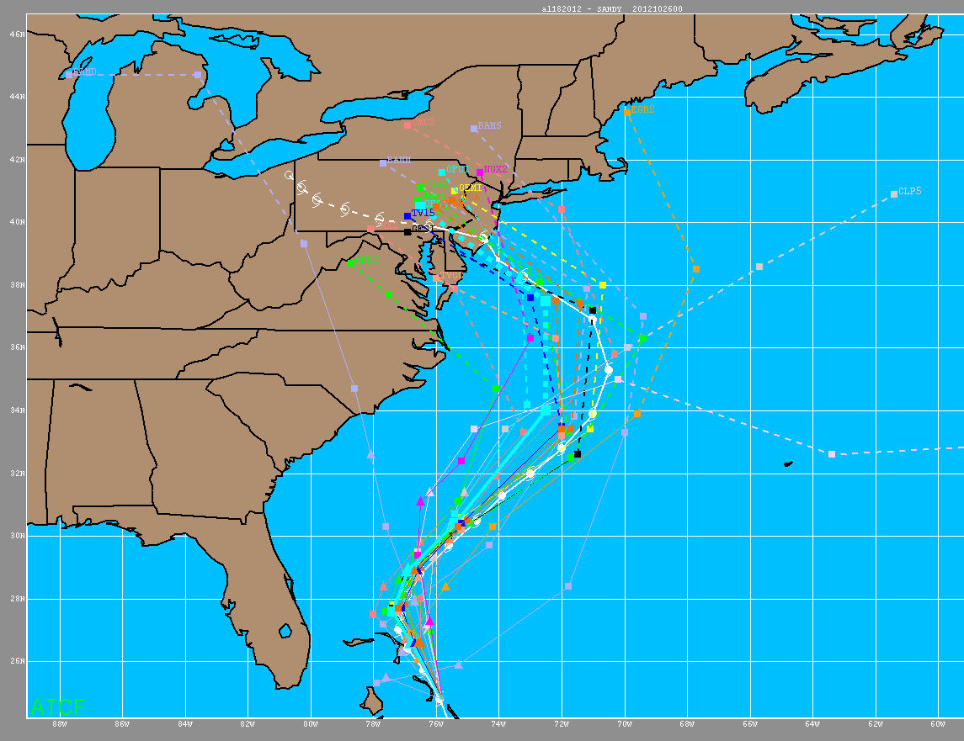
Satellite Data Assimilation for Tropical storms (SDAT)
(http://cimss.ssec.wisc.edu/sdat)
Real time SDAT
(http://cimss.ssec.
wisc.edu/sdat)
Research path (R2U)
SDAT forecasts at SSEC
Improving utilization of satellite data
Possible near real time (NRT) applications
Potential for operational NWP models:
GFS
HWRF
HRRR
Research testbed for improving the utilization of GOES-R/JPSS data (Sounder, ABI, radiances, TPW, AMVs, Clouds)
R2O Research
Refining the Operational Path
3
Notes:
GOES-R high impact weather funding for
Weather Research and Forecasting (WRF)

Slide 4
Assimilation System and NWP Model for SDAT
Gridpoint Statistical Interpolation (GSI) v3.3:
- Unified variational data assimilation system for both global and regional applications
- Developed by NOAA NCEP based on the operational Spectral Statistical Interpolation analysis system.
- The core of the NDAS for NAM, GDAS for GFS at NOAA, and various operational systems.
Weather Research and Forecasting Model (WRF) v3.6:
- Next-generation mesoscale numerical weather prediction system
- Developed by NCAR, NOAA, AFWA, NRL, OU, and FAA.
- Applicable for both meteorological research and numerical weather prediction.
- 27 km for online real time SDAT (12 km for offline experiments).
Community Radiative Transfer Model (CRTM) for DA:
- Fast radiative transfer model for calculation of radiances for satellite IR or MW radiometers.
- Developed by JCSDA as an important component in the NOAA/NCEP data analysis system.
- Implemented into GSI system as its radiative transfer model.

Slide 5
Satellite Data Assimilation for Tropical cyclone forecast (SDAT)
http://cimss.ssec.wisc.edu/sdat
GDAS/GFS data
GSI/WRF Background & boundary preprocessing
Conventional obs data
GSI background at time t-t0 hrs
Data preparation
Radiance obs data
GSI analysis at time t-t0 hrs
WRF boundary
update
JPSS and other satellite DP data
WRF 6 hours forecast
Analysis and forecast
Bufr conversion
cycle above process to time t
GSI background at time t
CIMSS rtv (sounding, pw, winds, clouds)
Satellite standard DP (soundings, tpw, winds)
GSI analysis at time t
update
IMAPP/CSPP data transfer
WRF 72 hours final forecast
Diagnosis, plotting and validation
WRF post-processing
Data archive

Slide 6
Outlines
CIMSS real time SDAT (satellite data assimilation for TC forecasts) system as research testbed for improving the utilization of satellite data in regional NWP
Research progress on IR/MW sounder radiance assimilation with SDAT
  IR sounder sub-pixel cloud characterization for improving radiance assimilation
  Assimilation of IR sounder thermodynamic information in partly cloud cover
  MW sounder cloud-screening for radiance assimilation
SDAT real time demonstration and application
  Performs on 2015 hurricane season
Future plan on using HWRF

Slide 7
Research finding 1: IR sounder sub-pixel cloud detection with collocated imager cloud mask improves radiance assimilation
AIRS with MODIS
CrIS with VIIRS
IASI with AVHRR

Slide 8
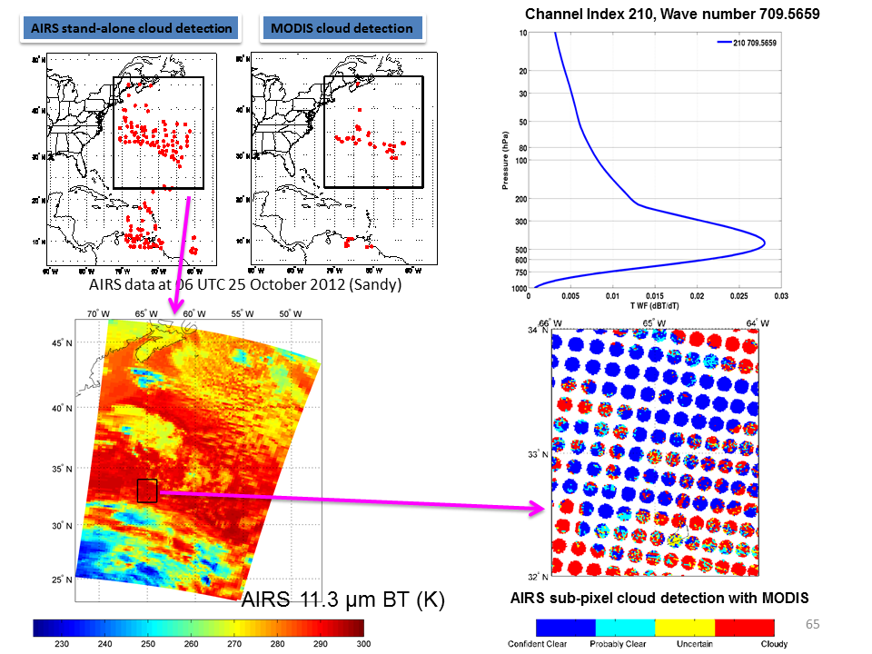
Q: How does cloud detection impact IR sounder assimilation?
A: Accurate cloud detection is critical for radiance assimilation in NWP
Wang et al. (2014, GRL)

Slide 9
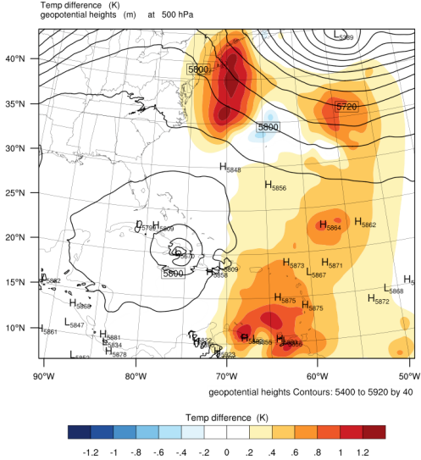
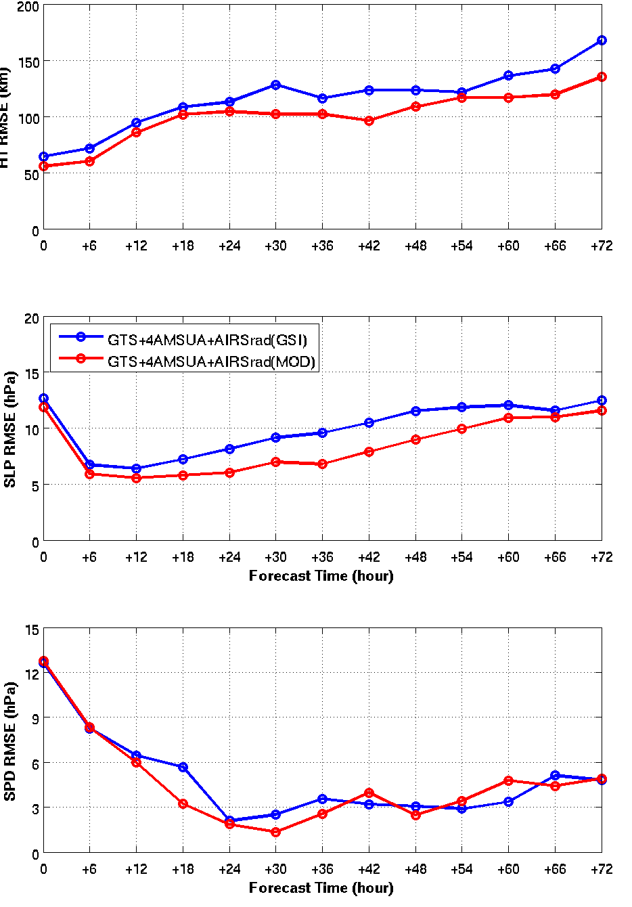
Hurricane Sandy (2012) forecast RMSE
(m/s)
500 hPa temperature analysis difference (AIRS(MOD) - AIRS(GSI))
Hurricane Sandy (2012)
Assimilation : Oct 25 06z to Oct 27 00z, 2012
Forecasts: Oct 25 06z to Oct 30 00z, 2012
Assimilation every 6 hour
72-hour forecasts of Sandy from 06z 25 to 00z 30 Oct, 2012

Slide 10
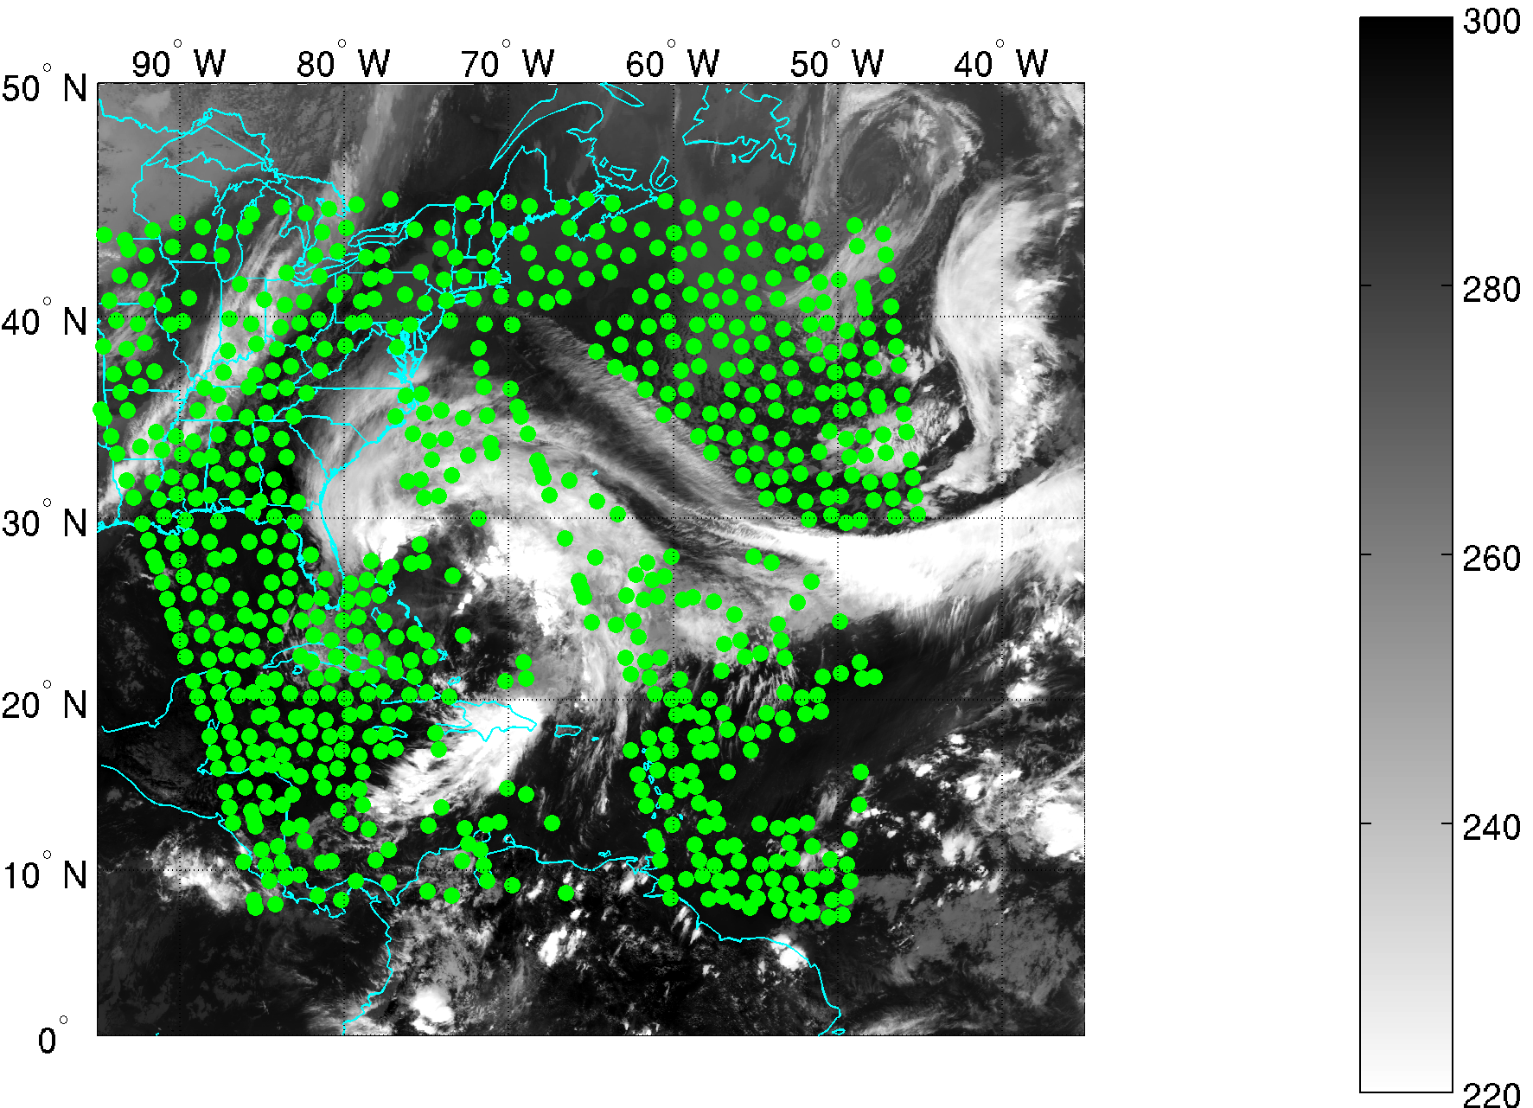
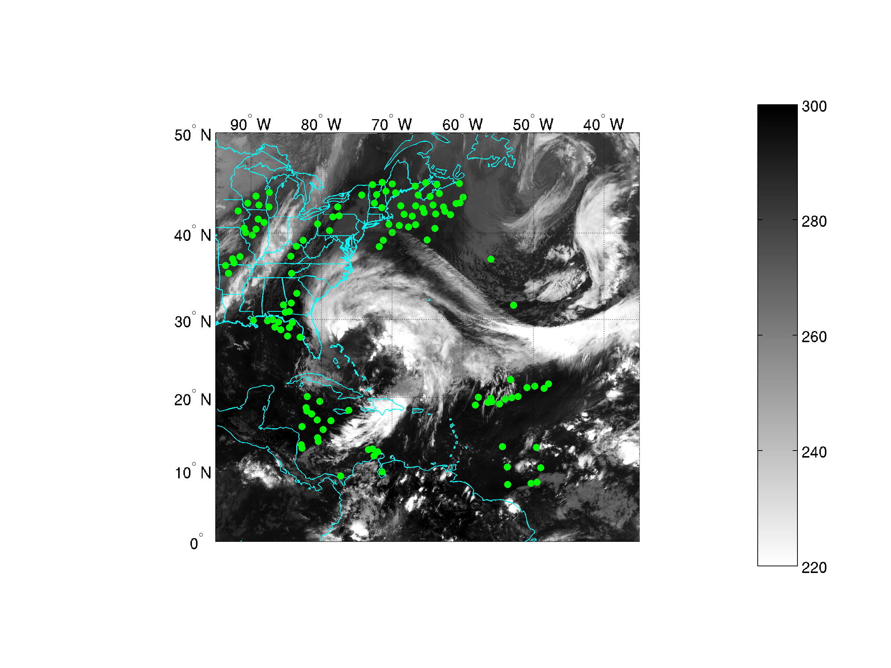
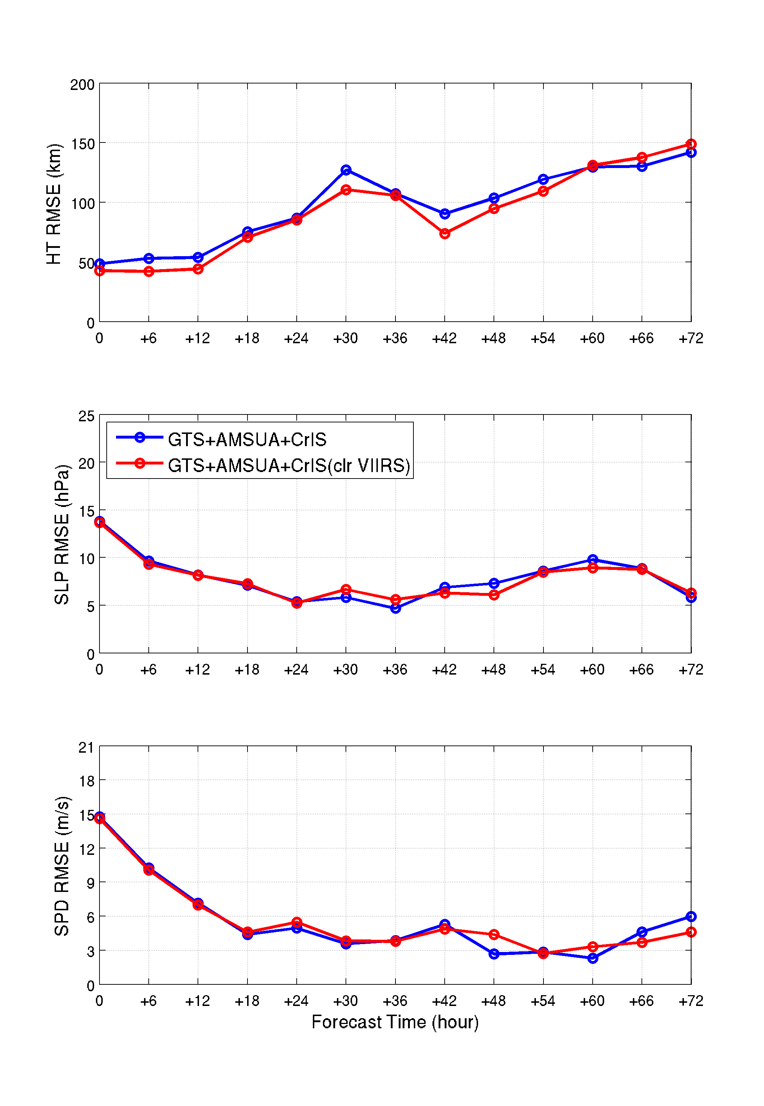
CrIS clear locations from GSI
For CrIS: How does clear location detection affect CrIS radiance assimilation?
CrIS clear locations (green) overlaying on GOES-13 11 µm BT (B/W)
2012-10-26 18z
CrIS clear from VIIRS cloud mask
Forecast Time (hour)
CrIS channel 71, 693.75 cm⁻¹

Slide 11
Research finding 2: Cloud-clearing could be an alternative approach for assimilating IR sounder thermodynamic information in partly cloudy skies:
Based on accurate clear location detection
Needs additional information to help. Three cloud-clearing approaches ongoing:
  Imager-based IR sounder CCRs (CIMSS approach, keep IR sounder single FOV)
  MW-based CCRs (NUCAPS approach, degraded to MW footprint)
  Background-based CCRs (EMC approach, degraded to MW footprint)

Slide 12
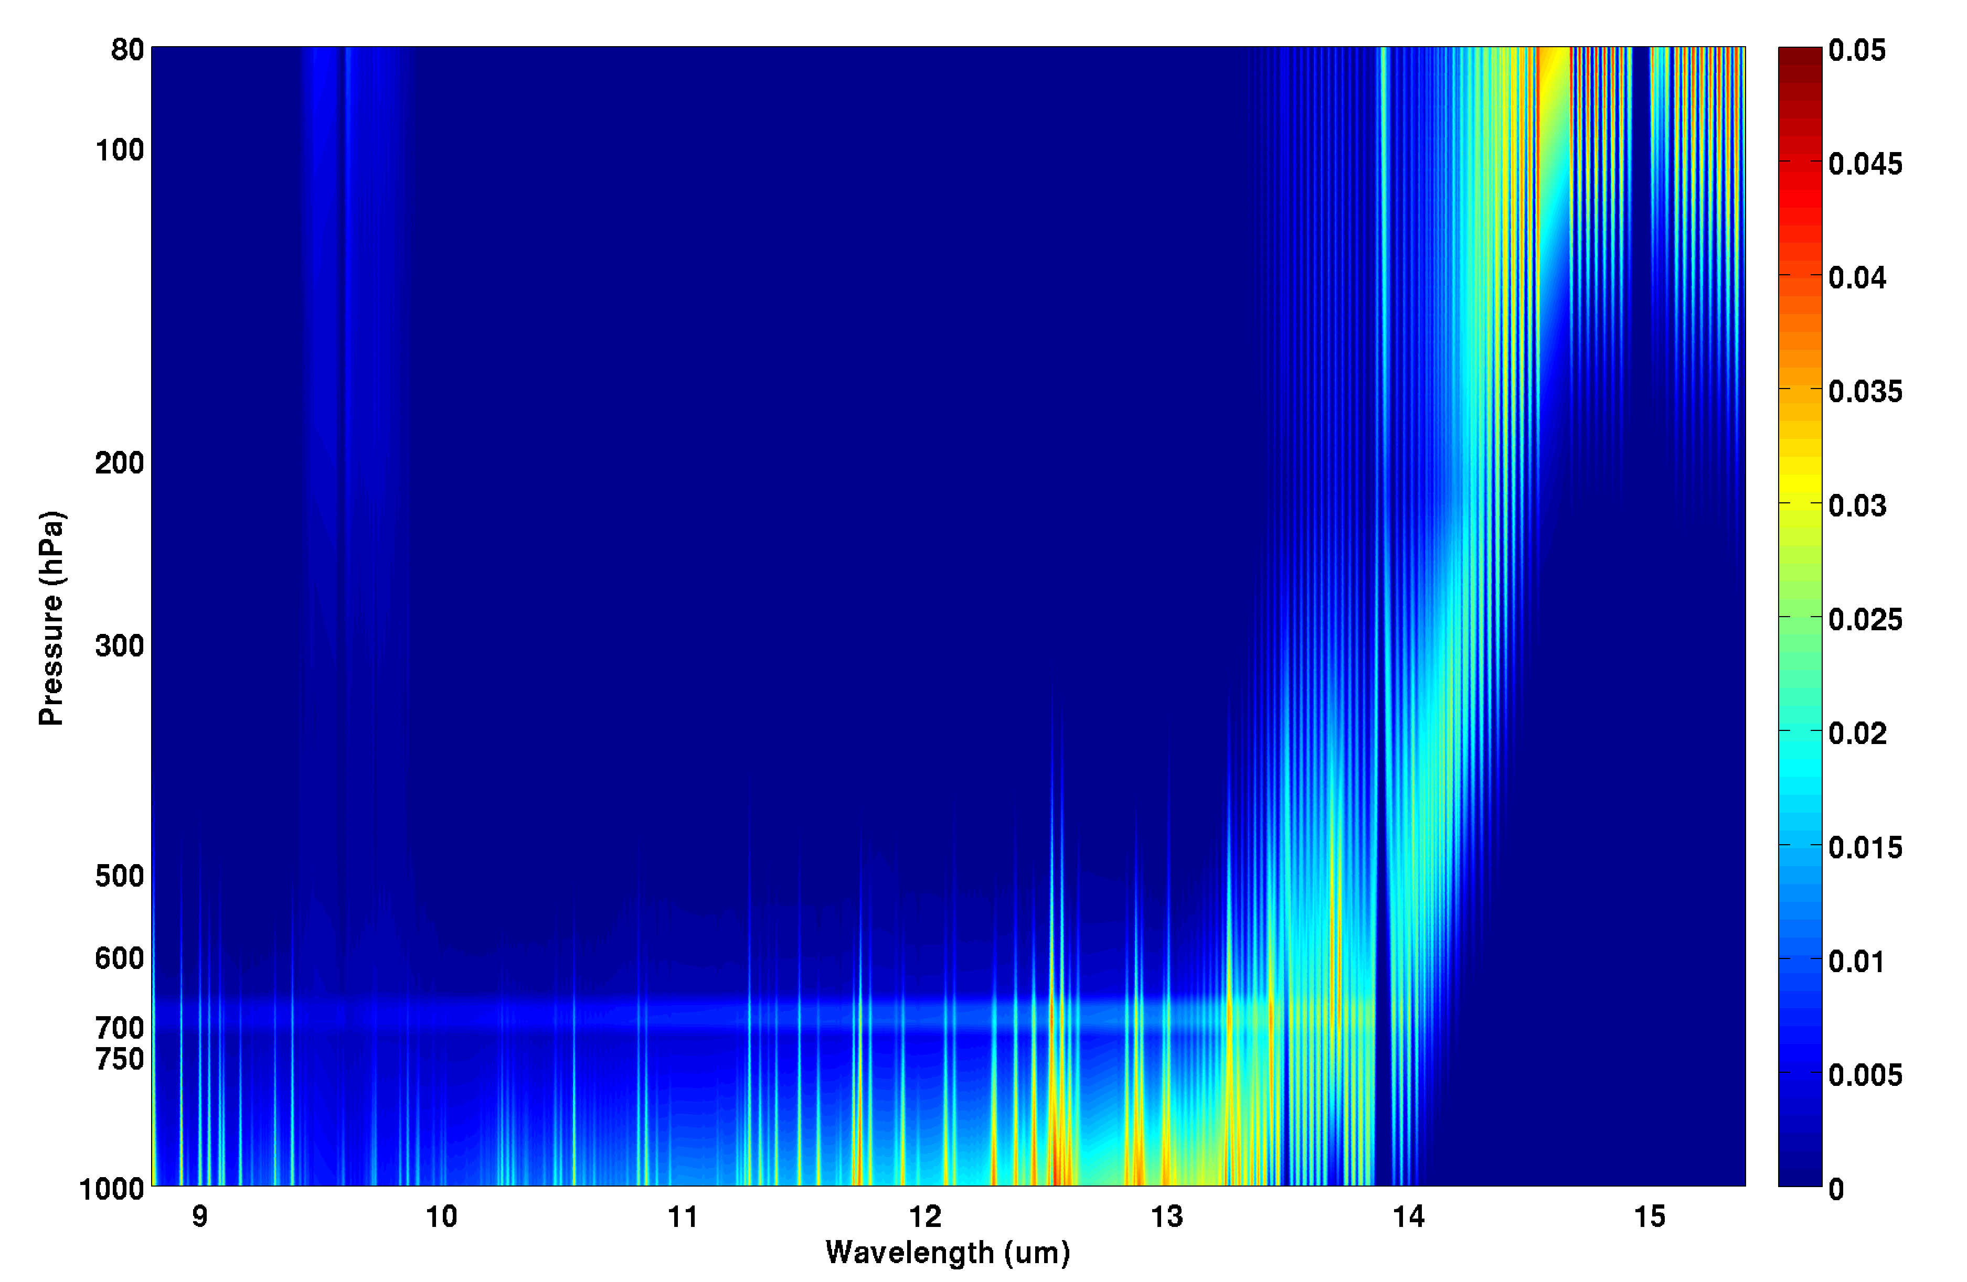
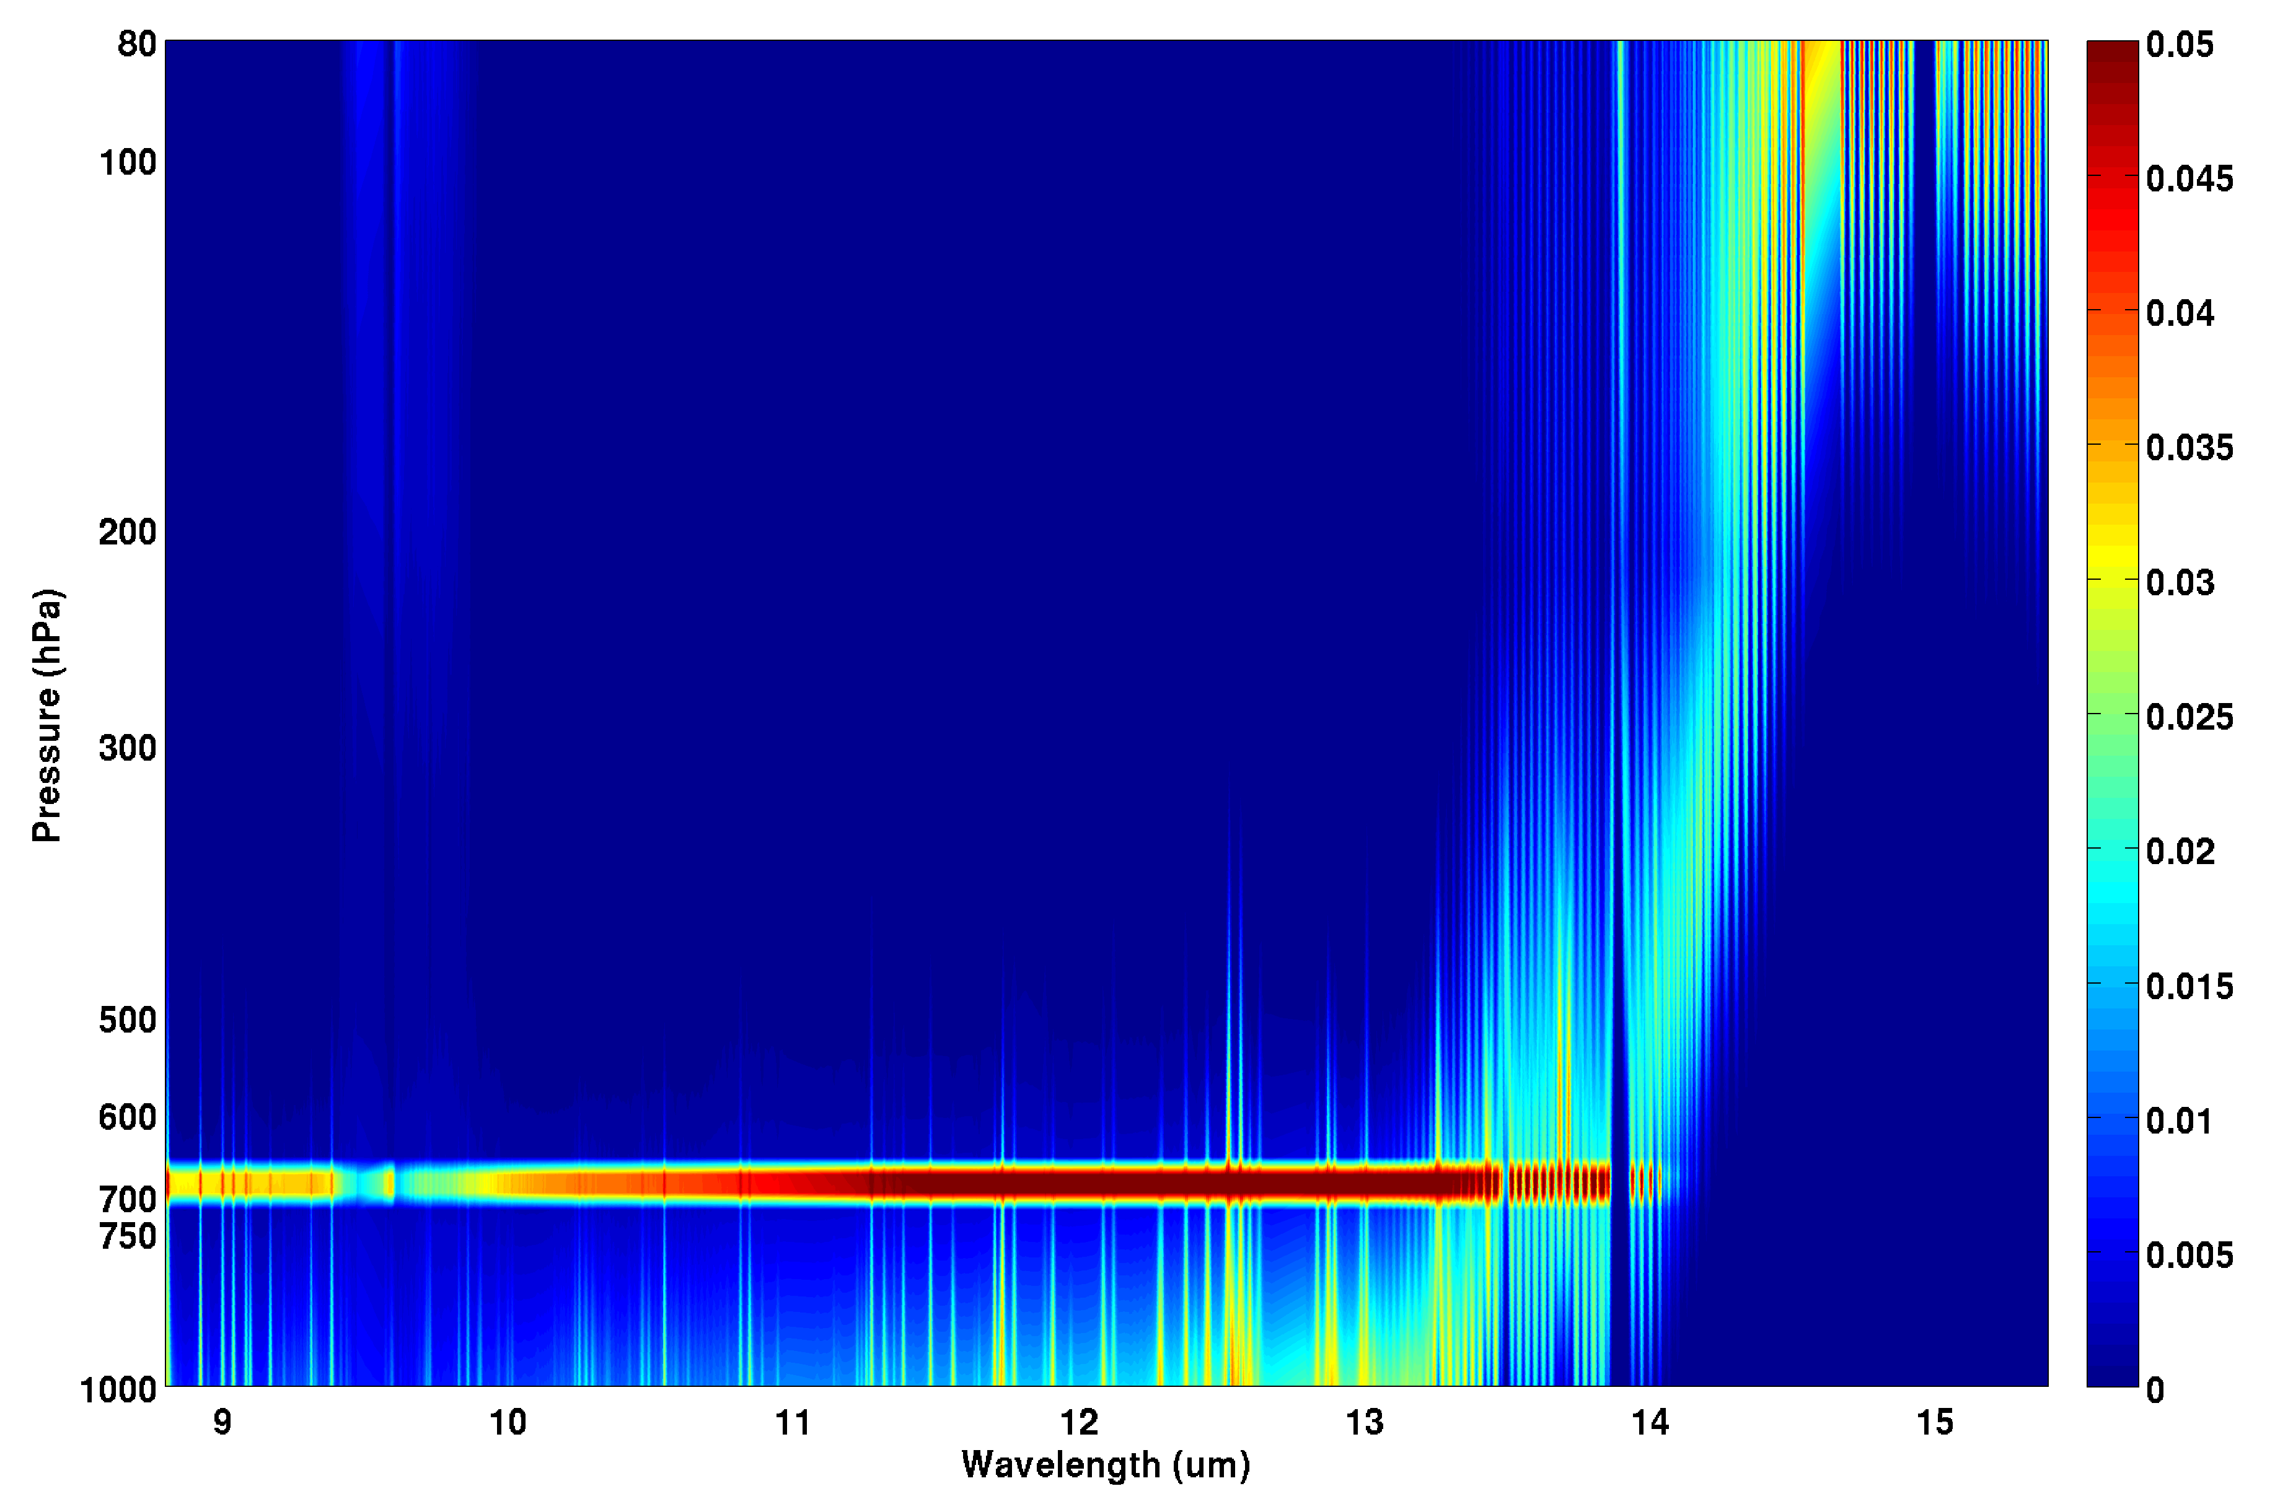
Direct assimilation of cloudy IR radiances in NWP is preferred but remains challenging because:
(1) Both NWP and RTM have larger uncertainty in cloudy skies;
(2) Big change of temperature Jacobian at cloud level;
(3) There might be inconsistency between satellite observations and NWP on clouds (e.g., satellite sees clouds but NWP does not, vice versa);
(4) Higher nonlinearity in radiance assimilation in cloudy regions.
AIRS longwave temperature Jacobian with a cloud level at 700 hPa.
COT = 0.05
COT = 0.5

Slide 13
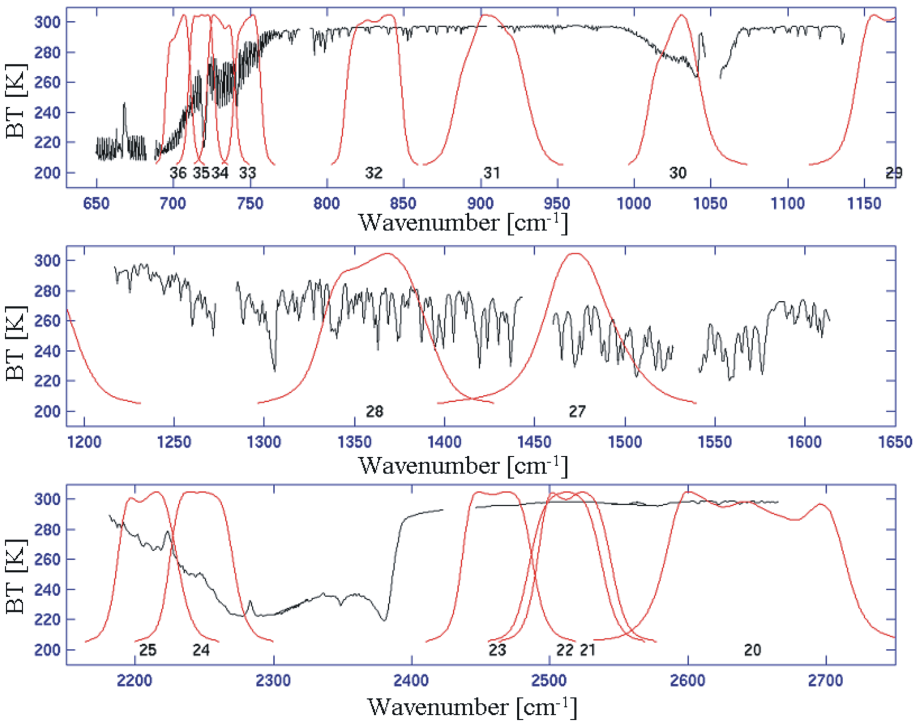
Aqua MODIS IR SRF Overlay on AIRS Spectrum
Direct spectral relationship between IR MODIS and AIRS provides unique application of MODIS in AIRS cloud_clearing !

Slide 14
R¹
R²
AIRS/MODIS cloud-clearing (Li et al.2005)
is NEdR for MODIS band
solve

Slide 15
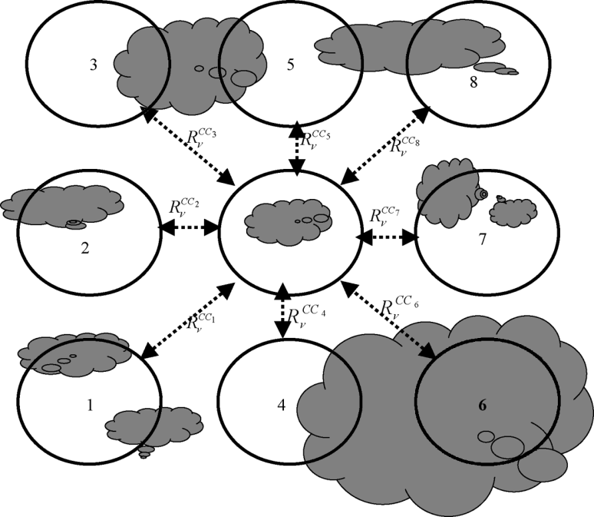
For each cloudy AIRS FOV, 8 pairs are used to derive 8 AIRS CC radiance spectra;
Compare AIRS CC radiances with MODIS clear radiance observations within the AIRS FOV, find the best pair and the corresponding CC radiance spectrum.
AMSU-A
AIRS

Slide 16
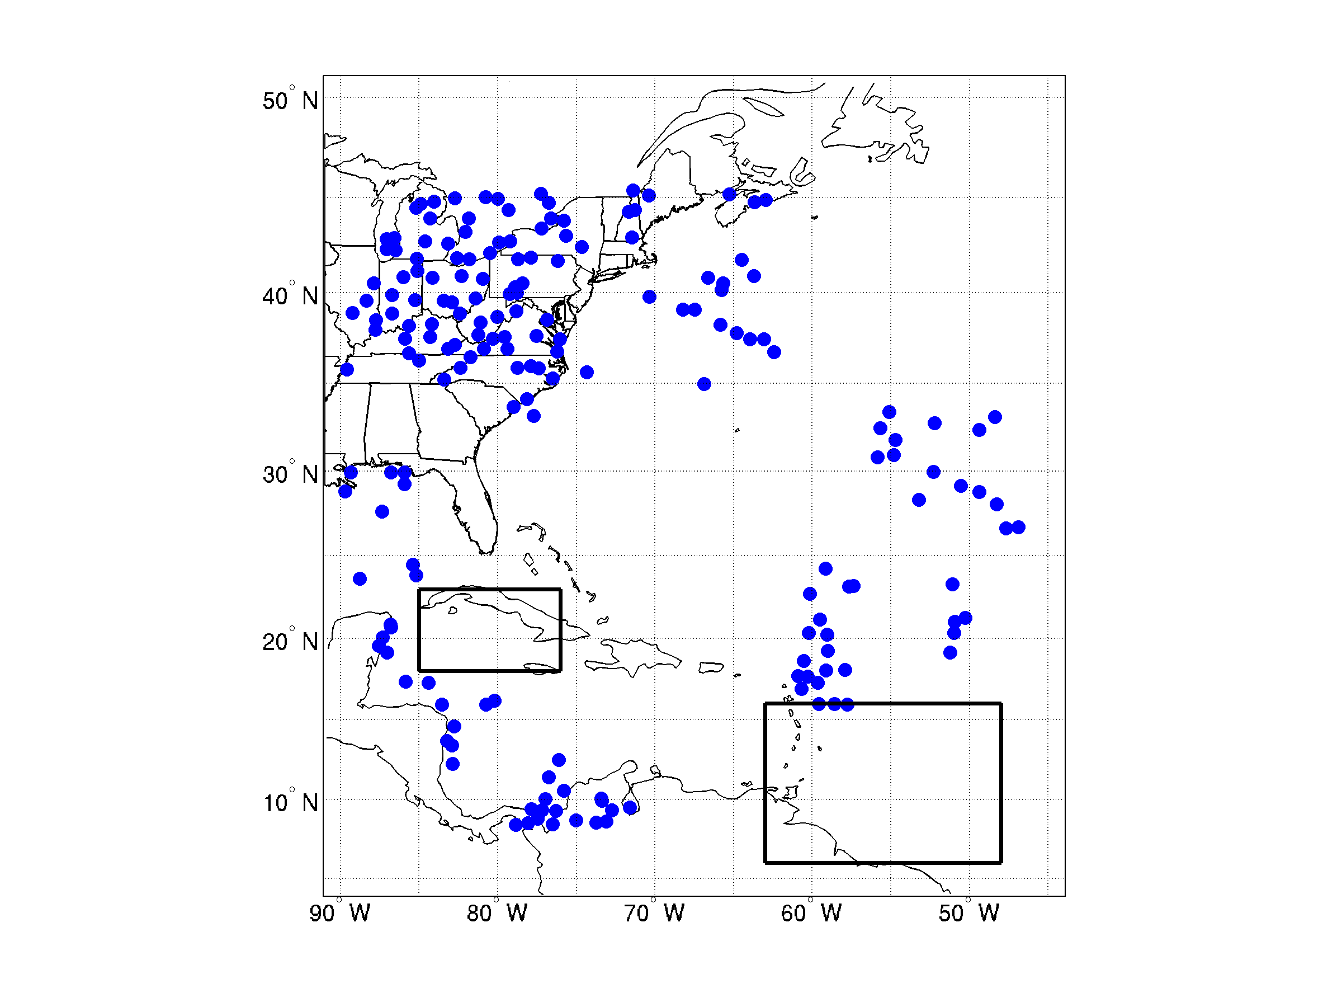
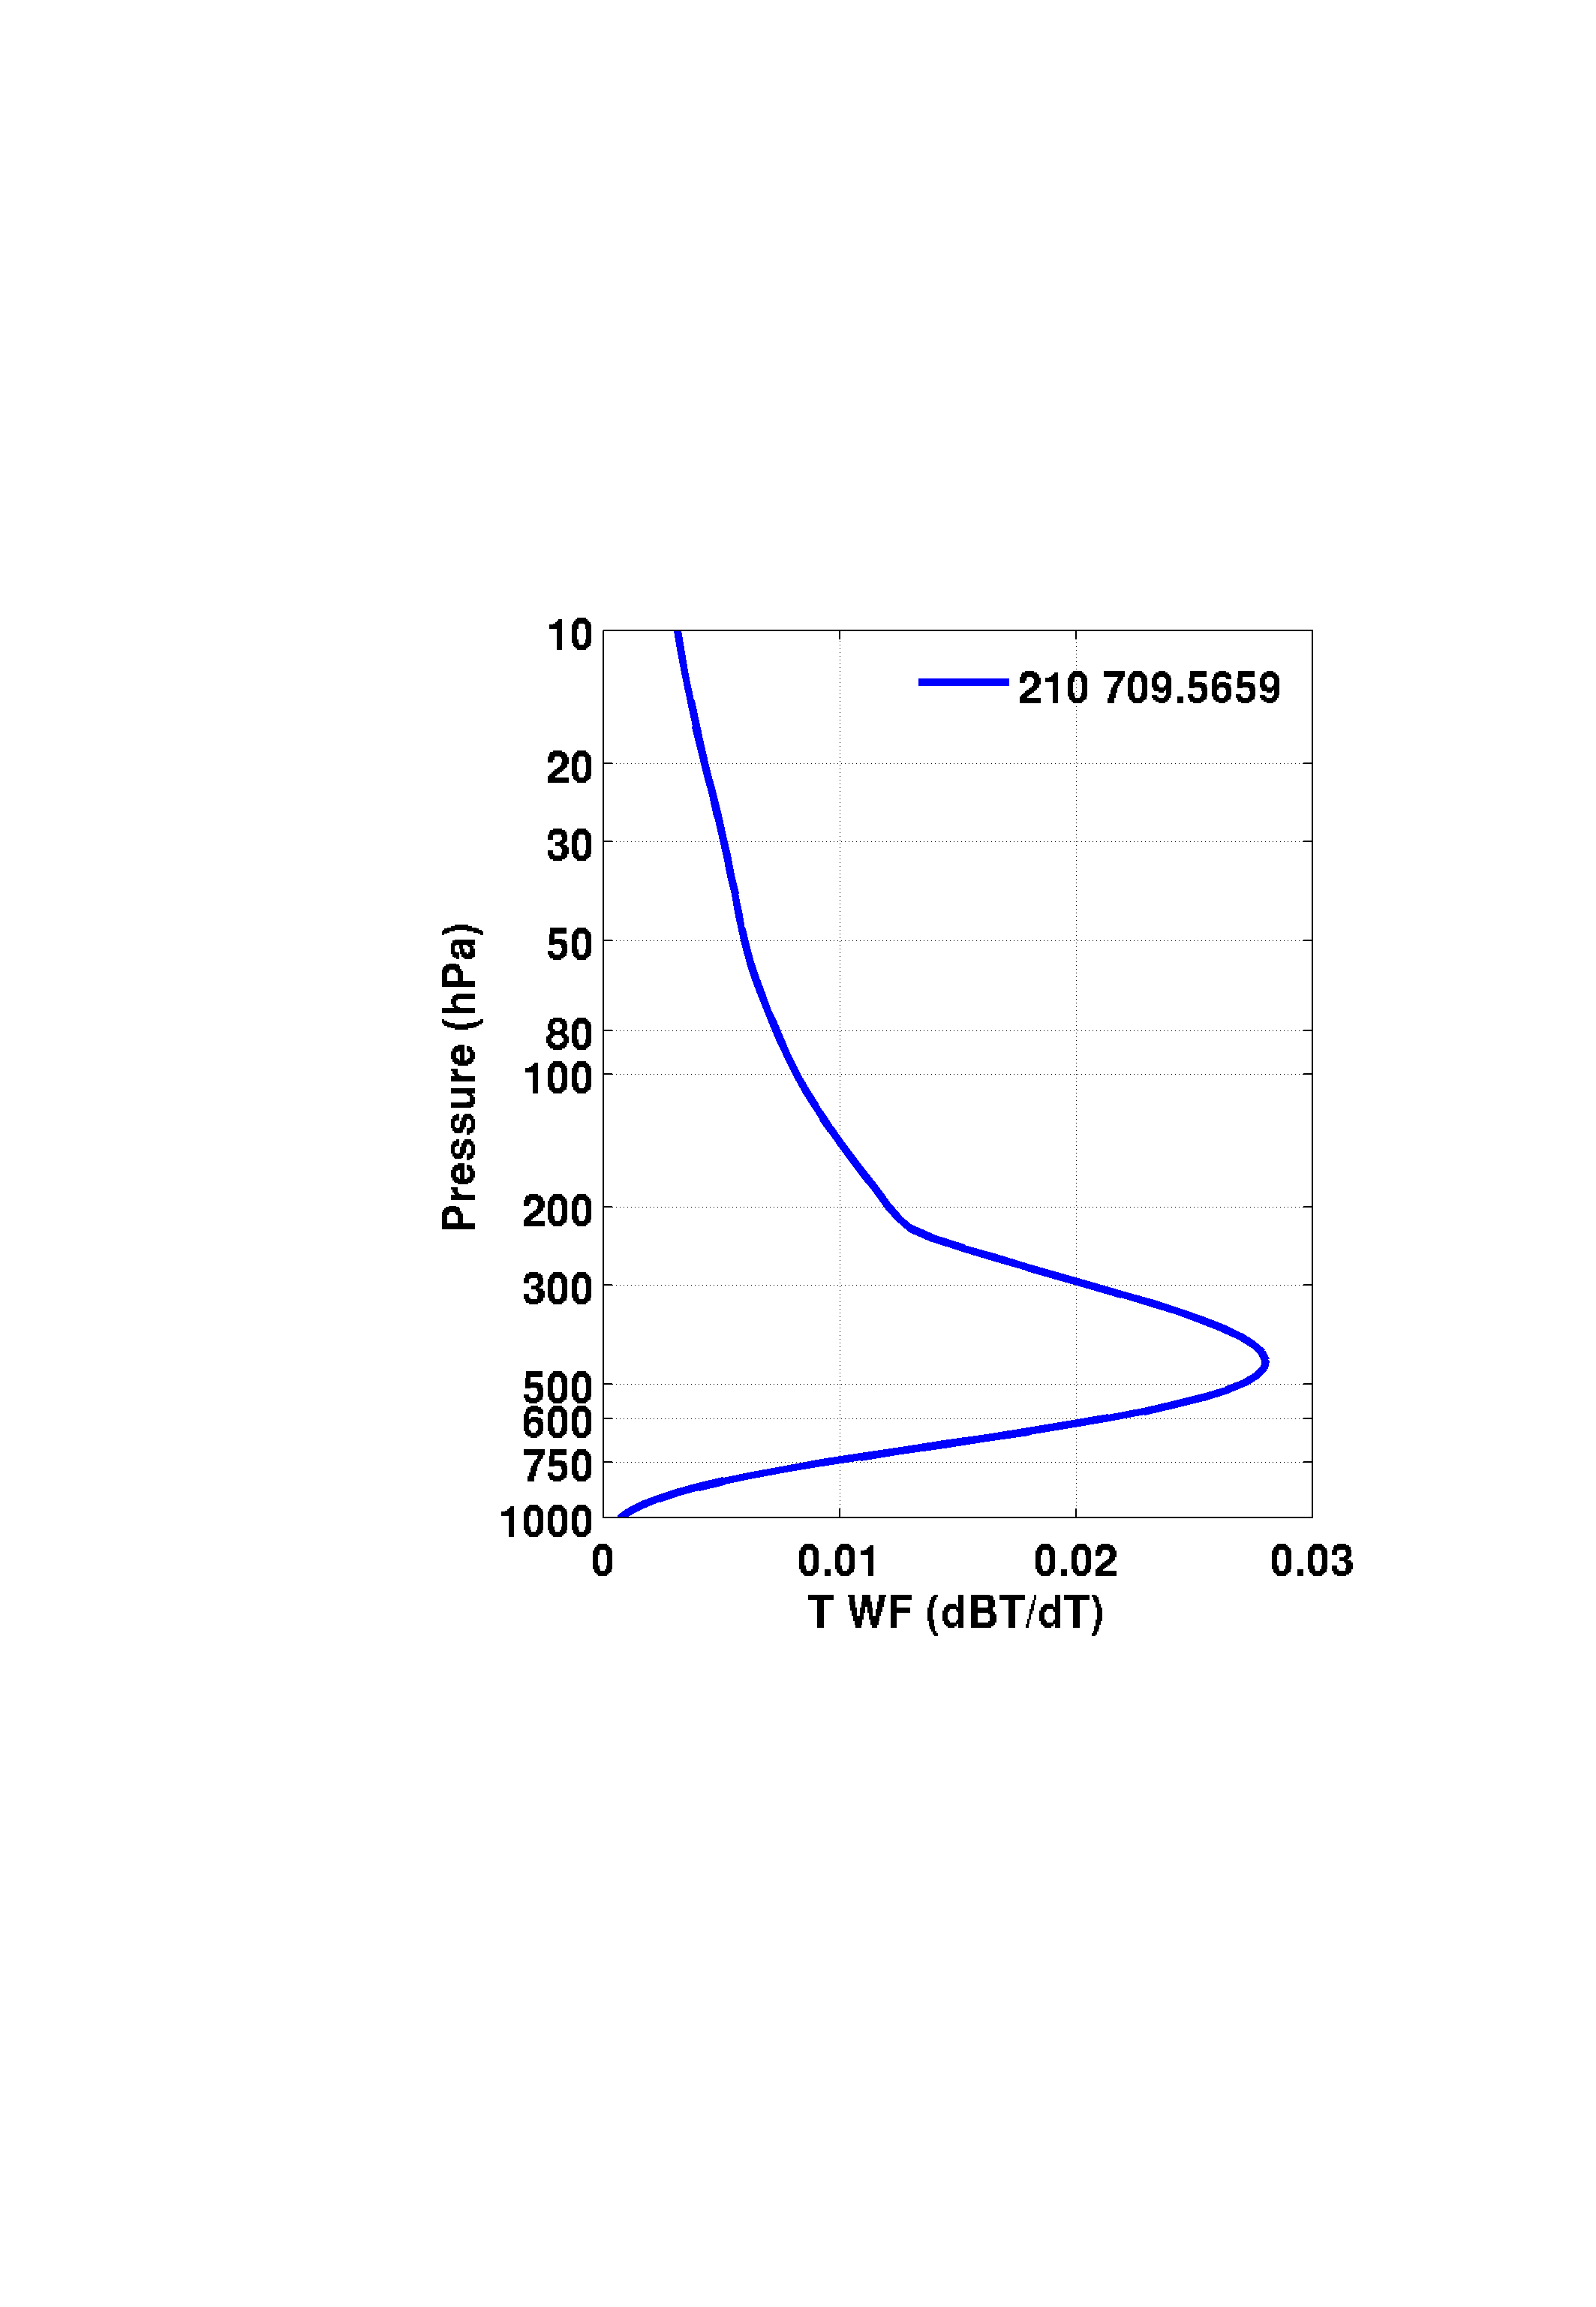
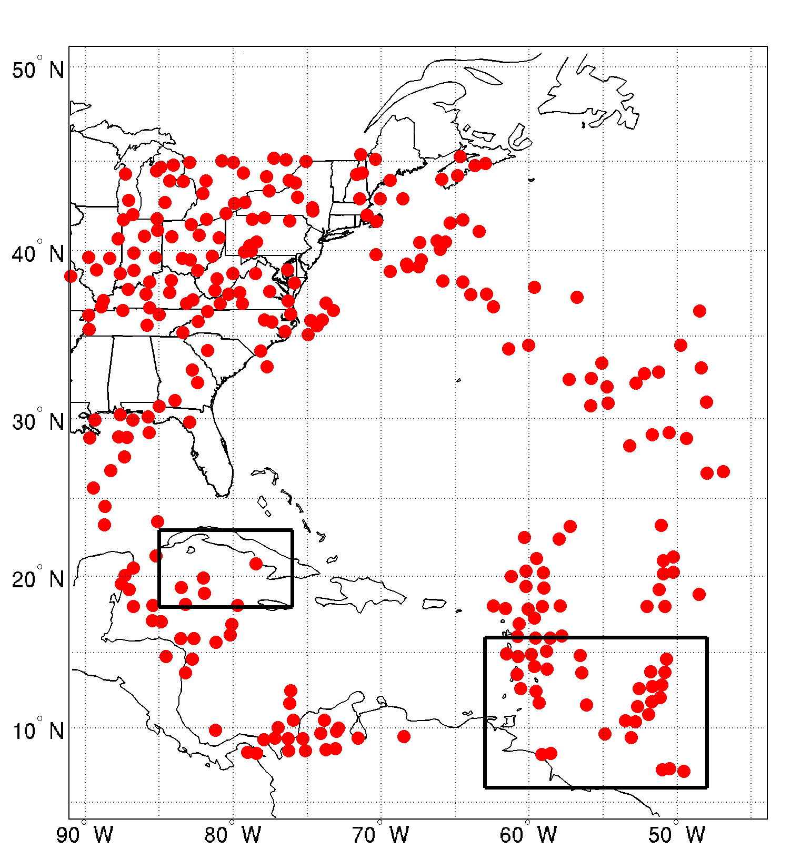
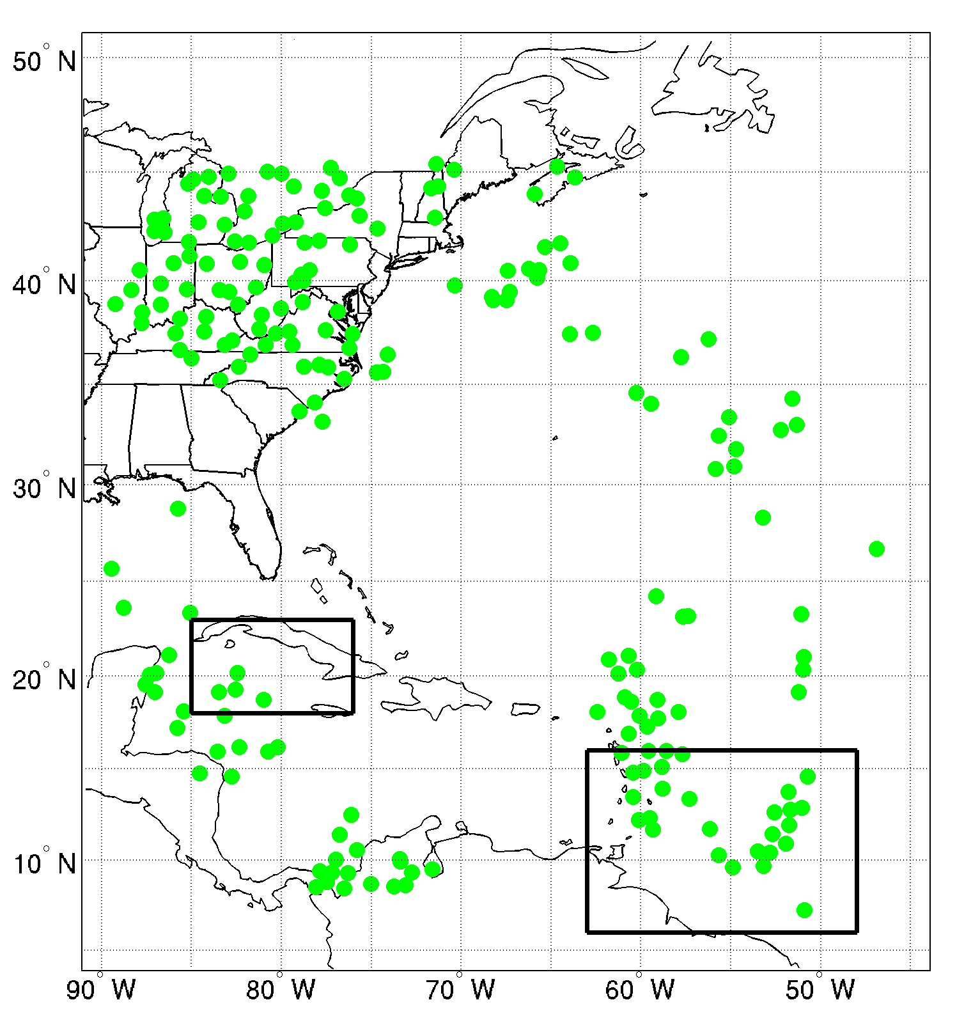
Using cloud-cleared radiances for assimilation
AIRS(MOD clr)
AIRS(GSI clr)
AIRS(MOD cld-clr)
Data in cloudy regions according to MODIS cloud mask are assimilated as clear-sky in GSI, which contains cloud contamination.
Cloud-clearing method generates clear equivalent radiances for assimilation in partially cloudy regions.
Cloud-cleared radiances removes the cloud contamination and provides more clear equivalent radiances.
Wang et al. 2014 - GRL
AIRS data locations at 18z 25, Oct 2012
16

Slide 17
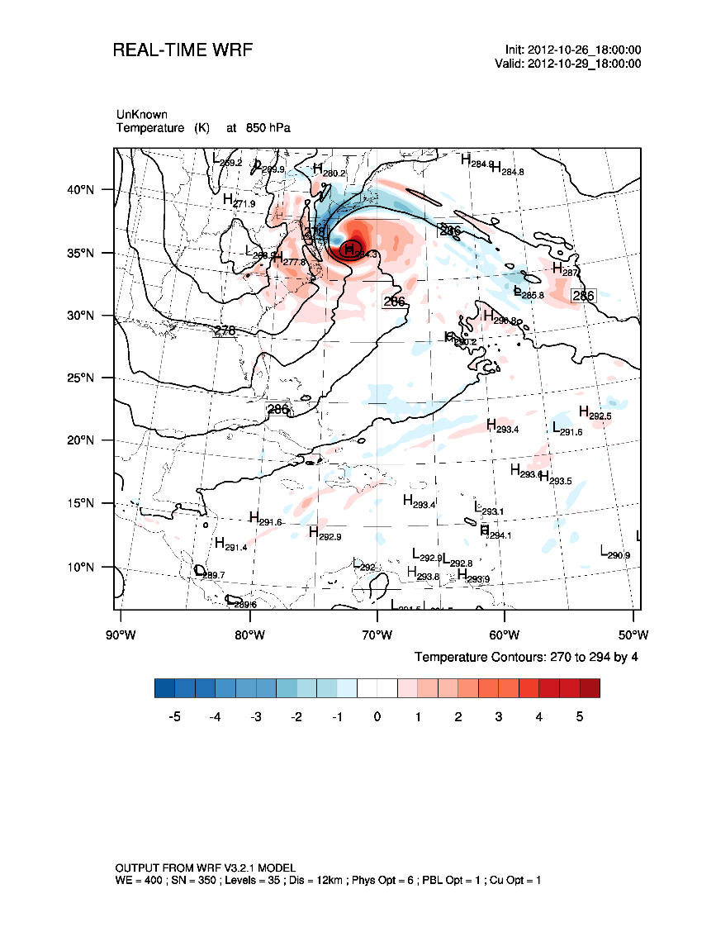
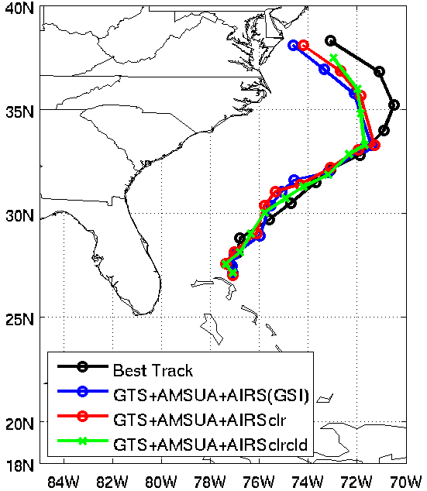
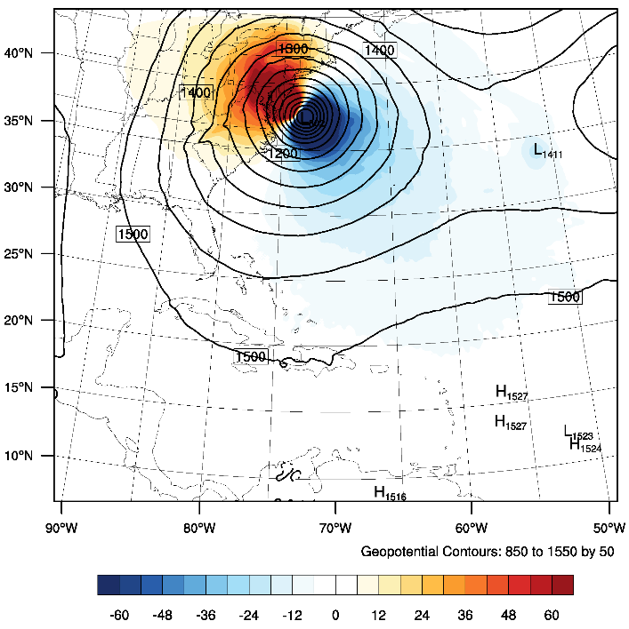
Impact of assimilating cloud-cleared radiances on forecasts
Advanced Infrared Sounder Cloud Detection and Cloud-clearing and its Impact on Radiance Assimilation in NWP
Temperature at 850 hPa
The difference in temperature indicates AIRS (MOD cld-clr) is warmer at southeast, and colder at northwest of hurricane center.
Geopotential height of AIRS (MOD cld-clr) is lower at the southeast, and higher at the northwest of hurricane center.
The warmer temperature and lower geopotential height region of AIRS (MOD cld-clr) is further southeast compared to AIRS (MOD clr).
The difference indicates the hurricane center of AIRS (MOD cld-clr) is southeast of the hurricane center of AIRS (MOD clr).
Geopotential Height at 850 hPa
72–hour forecast hurricane tracks
From 18z 26 to 18z 29 Oct, 2012
72-hour forecast
AIRS (MOD clr-cld) – AIRS (MOD clr)
17

Slide 18
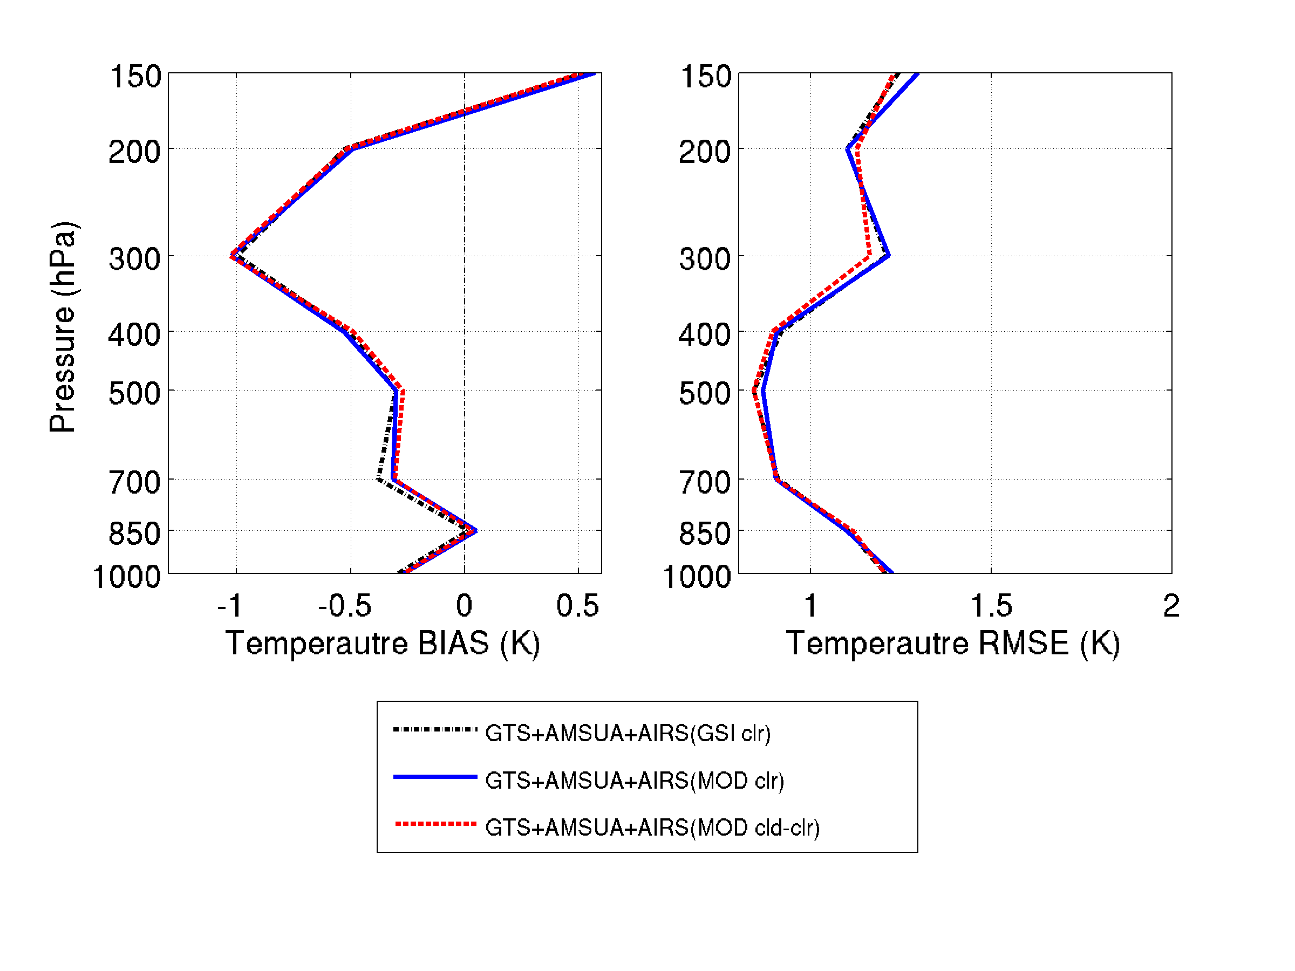
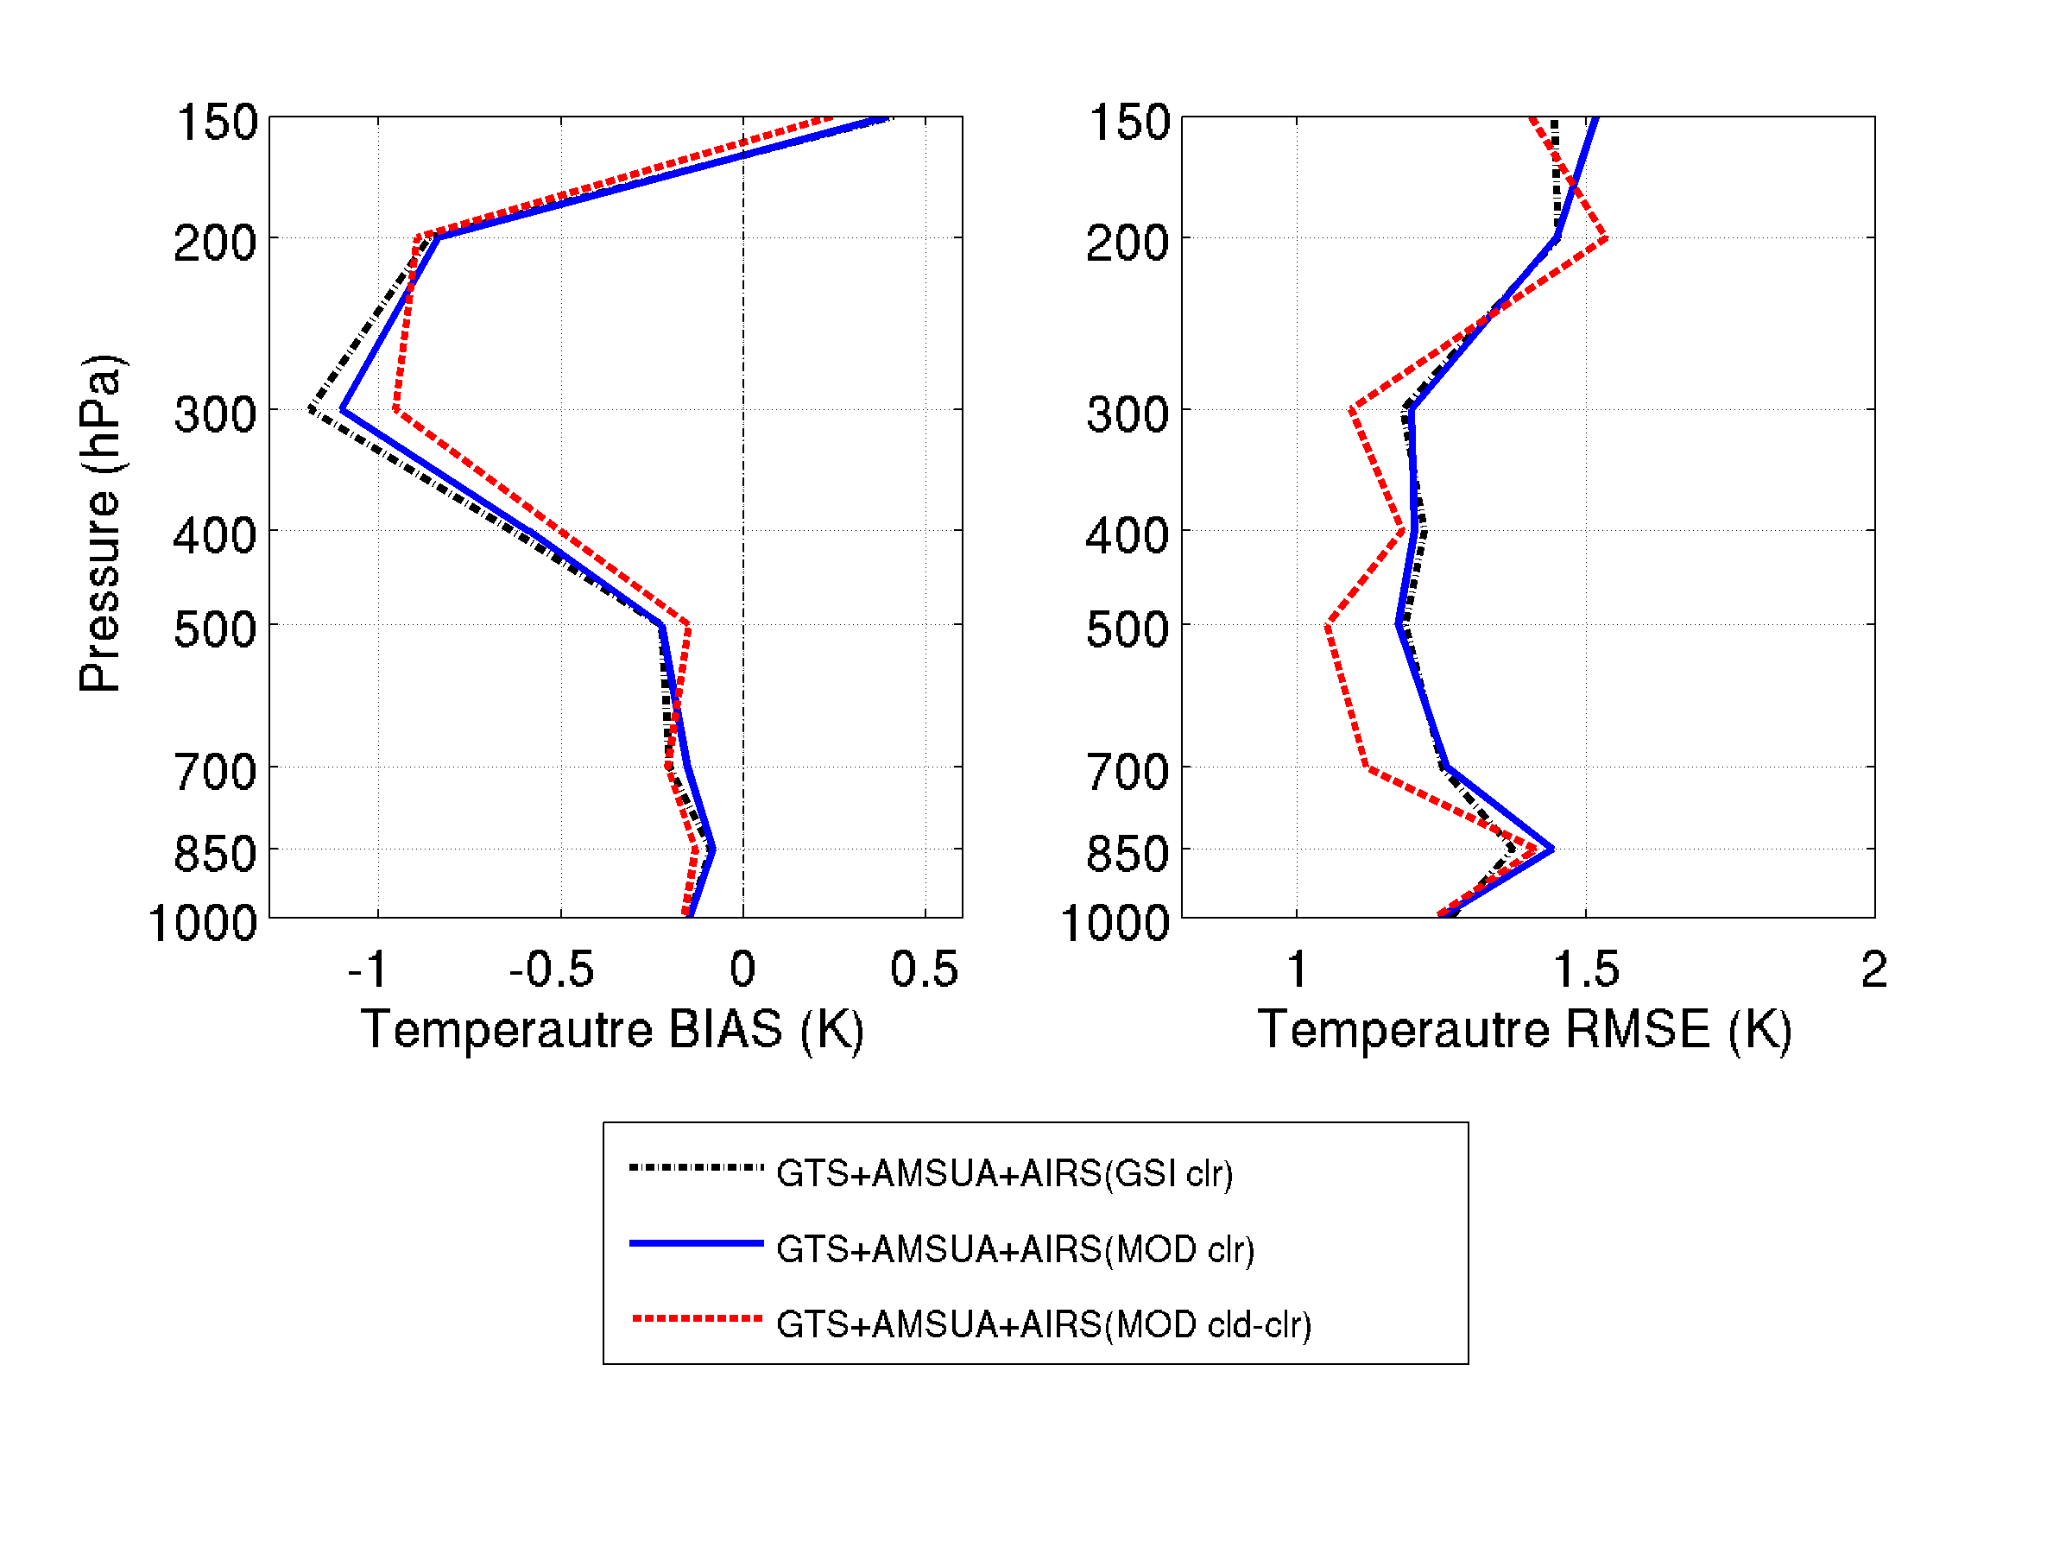
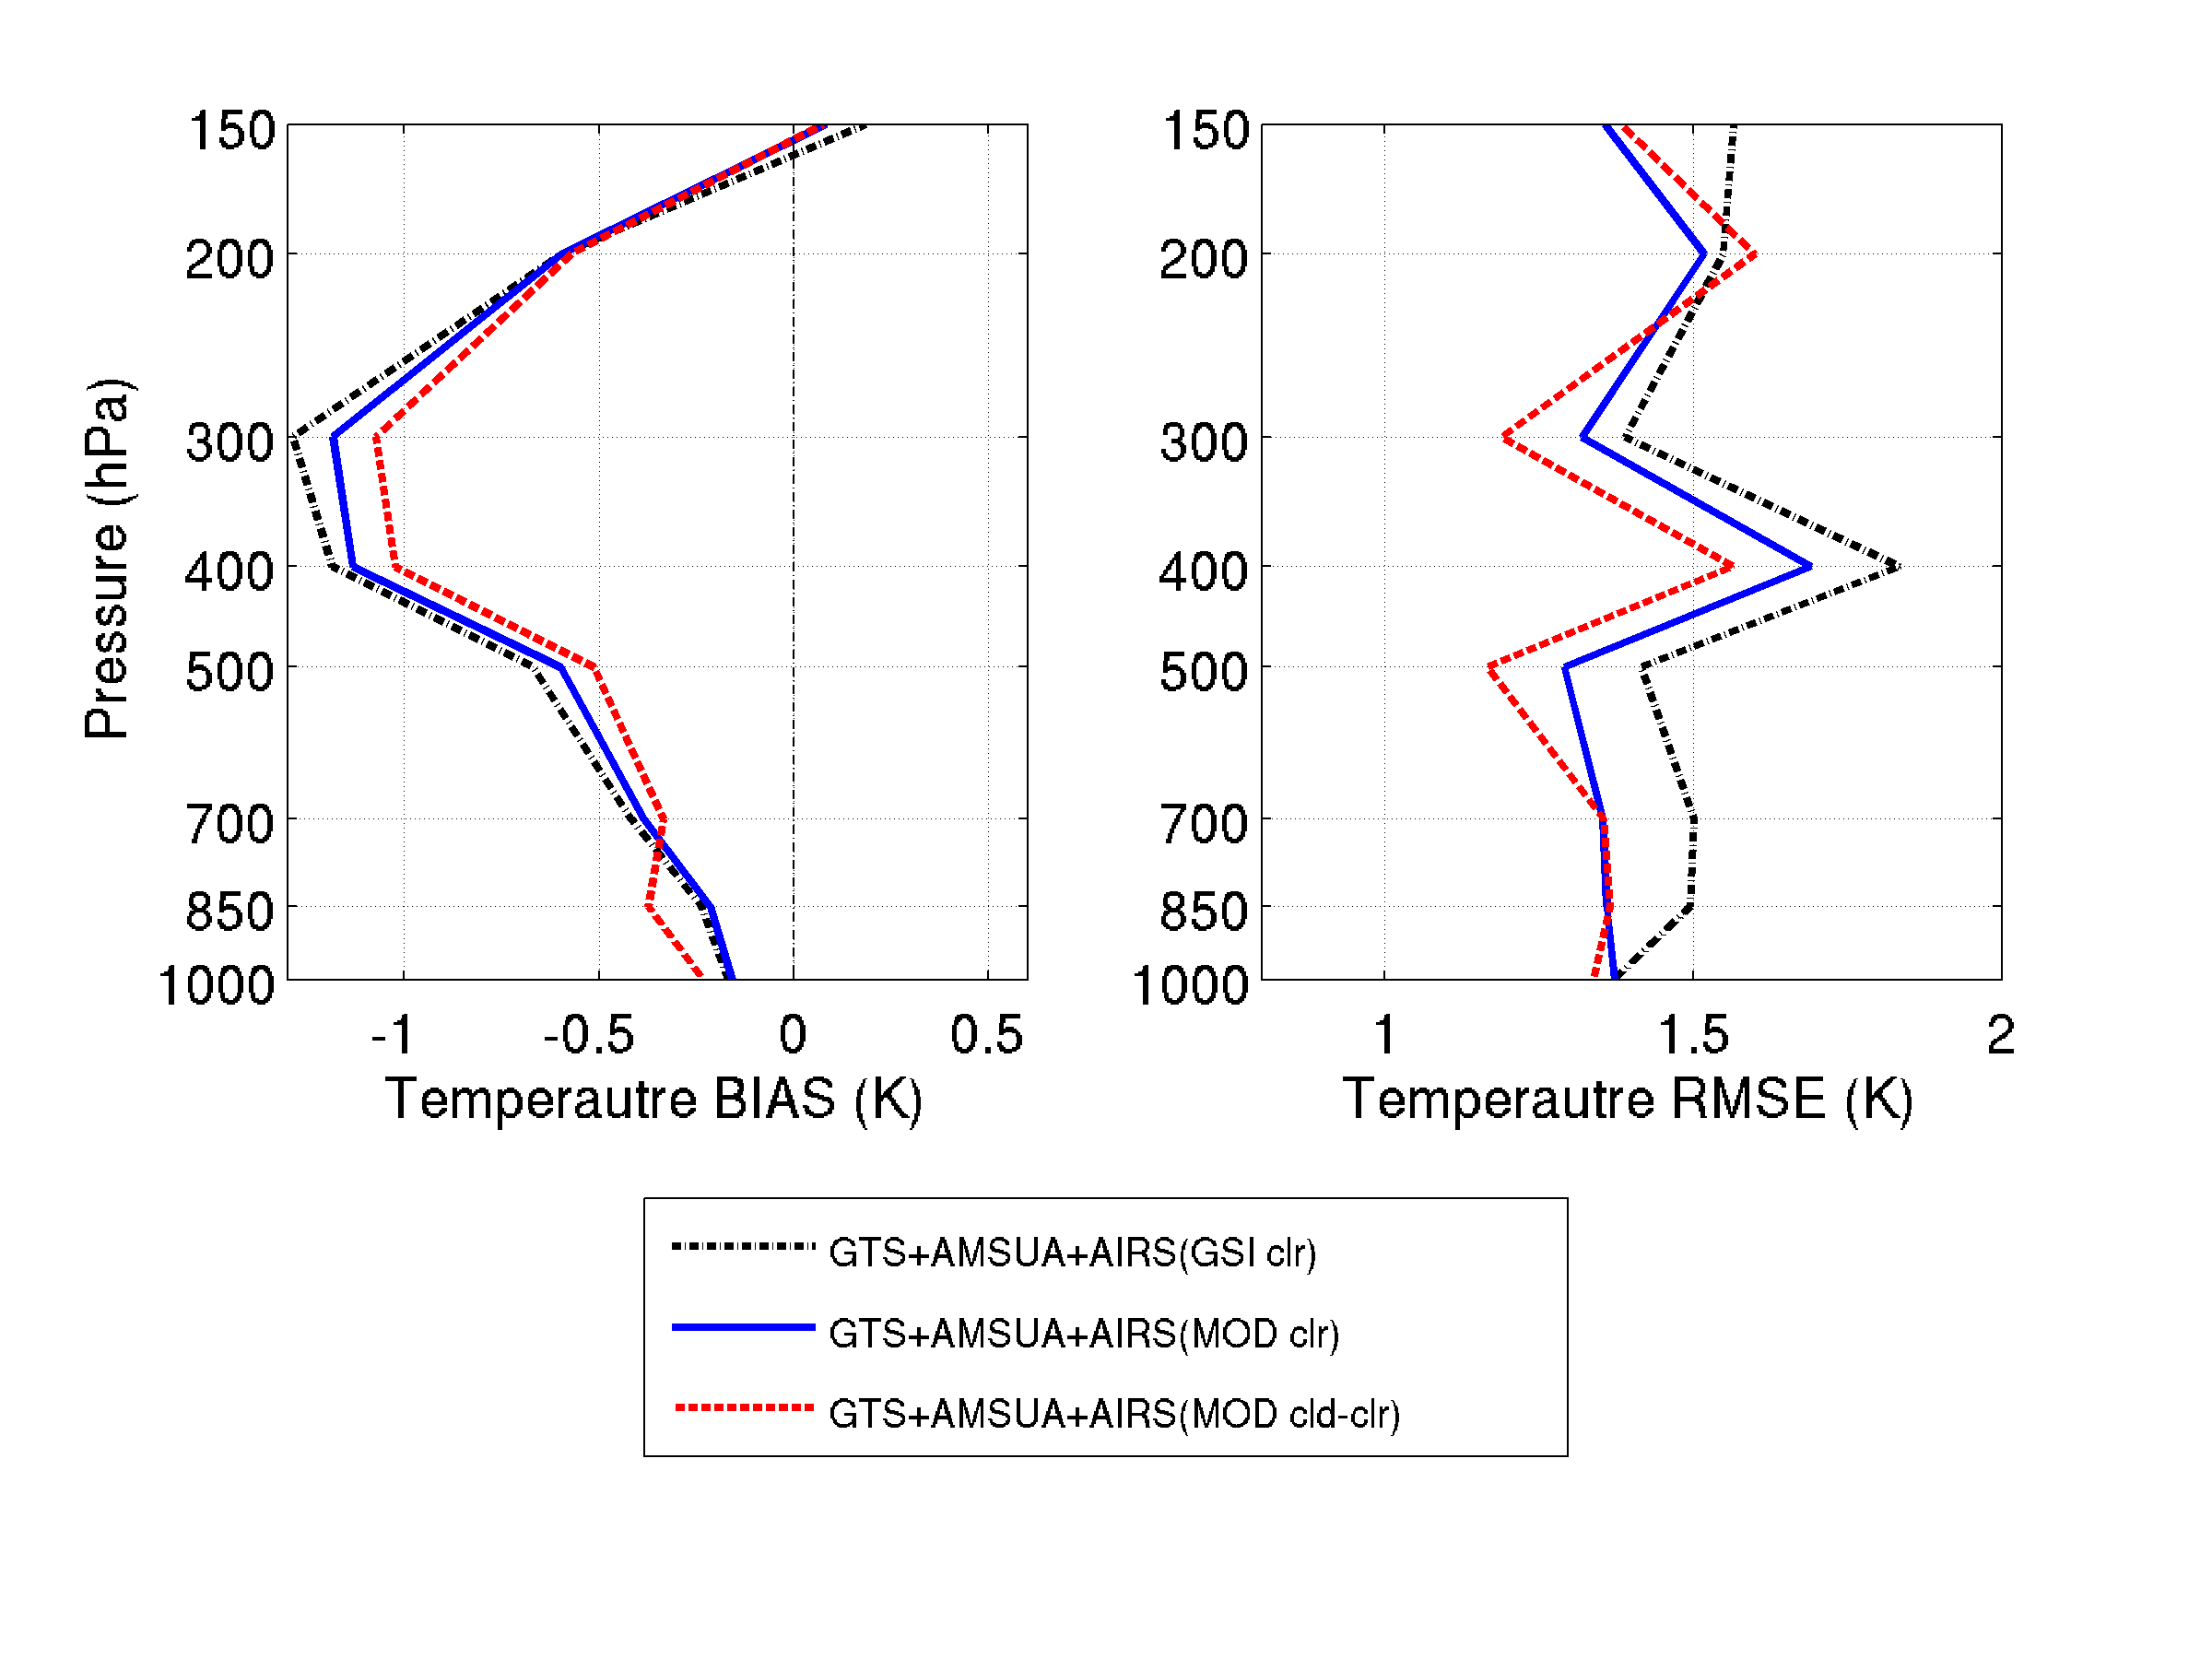
Impact of assimilating cloud-cleared radiances on forecasts
BIAS and RMSE for 24-hour forecasts, 48-hour forecasts and 72-hour forecasts of temperature profiles between the AIRS (GSI clr) and radiosondes, AIRS (MOD clr) and radiosondes, and AIRS (MOD cld-clr) and radiosondes
At 24-hour forecast, the difference of temperature BIAS among the three experiments is less than 0.1K.
At 48-hour forecast, from 500 hPa to 200 hPa, the BIAS of AIRS (MOD cld-clr) is 0.2K smaller than that of AIRS (MOD clr) and AIRS (GSI clr).
At 72-hour forecast, BIAS and RMSE of AIRS (MOD cld-clr) is smallest.
The RMSE also increased with forecast hours, which is consistent with the model errors growing over time.
24-hr
48-hr
72-hr
Wang et al. 2015 - JGR
18

Slide 19
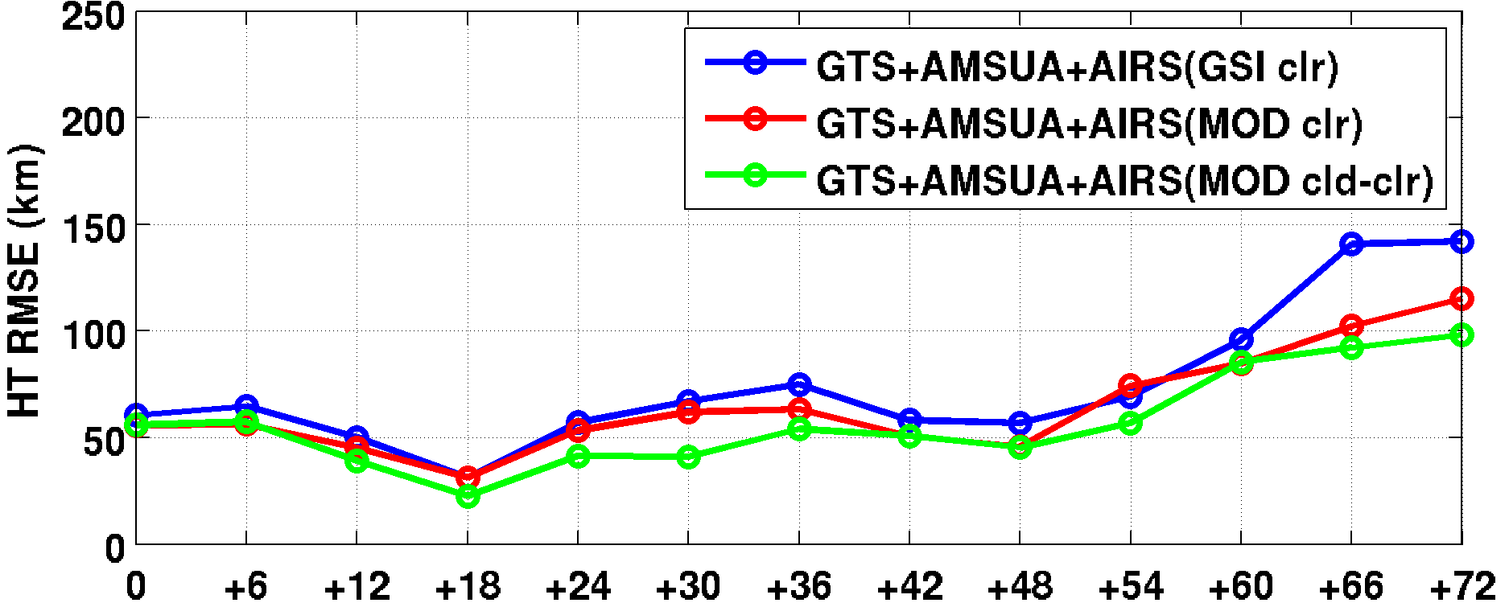
Impact of assimilating imager based cloud-cleared radiances (CCRs) on forecasts
Advanced Infrared Sounder Cloud Detection and Cloud-clearing and its Impact on Radiance Assimilation in NWP
GTS: Conventional data
AMSUA: 4 AMSU-A radiances from NOAA-15,-18, Metop-A and Aqua
AIRS (GSI clr): AIRS clear location radiances detected from GSI
AIRS (MOD clr): AIRS clear location radiances detected by MODIS
AIRS (MOD cld-clr): AIRS clear location radiances detected by MODIS, plus AIRS cloud-cleared radiances (imager based)
Hurricane Sandy (2012) track forecast RMSE from SDAT
Wang et al. 2015 – JGR
Forecast Time (hours)
19
Notes:
Using cc, we are able to assimilation the thermodyamic information in cloudy regions.
All the atmoerphric fields has improvement

Slide 20
AIRS clear coverage
AIRS clear + cloud-clearing coverage
AIRS global clear and cloud clearing brightness temperature (descending) on Jan. 1, 2004.
Zhang et al. (2010)

Slide 21
Rienecker et al. (2008): GMAO’s Atmospheric Data Assimilation
Contributions to the JCSDA and future plans, JCSDA Seminar, 16 April 2008.
• GEOS-5 model resolution: 1°x1.25°x72L
• Time frame: Jan 01 to Feb 15 2004
• Other Radiance data:
– HIRS-2/HIRS3 (clear channels)
– AMSU-A/EOS-AMSU-A
– AMSU-B/MHS
– SSM-I
– GOES Sounders

Slide 22
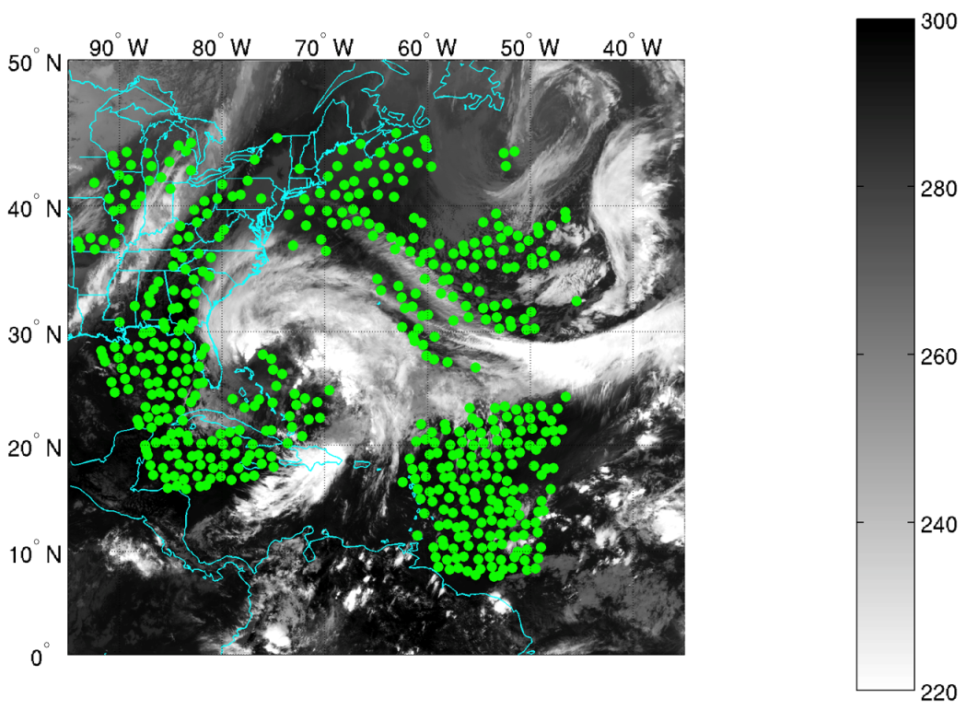
CrIS clear location (GSI)
2012-10-26 18z
How about MW-based CCRs? Using CrIS CCRs from NUCAPS provided by Chris Barnet
CrIS channel 71,
693.75 cm⁻¹
BT(K)
CrIS clear location (VIIRS)
CrIS cloud-cleared location (CCR)

Slide 23
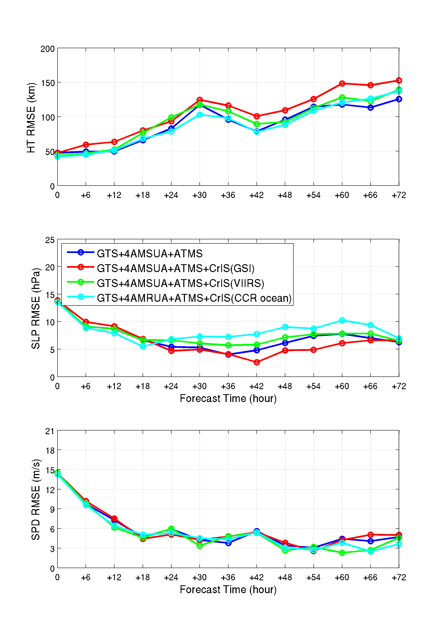
Preliminary result: CrIS(VIIRS) + CCR over ocean only, gives the best result in this case
Forecast Time (hours)
CrIS CCR provide additional information (mainly over cloudy regions) beyond CrIS clear only radiances
CrIS CCR over ocean is more reliable than over land, suggest to use CrIS CCR over ocean only
Work needed for improving CrIS MW-based CCR assimilation in GSI system

Slide 24
Research finding 3: Microwave sounder sub-pixel cloud-screening with collocated imager cloud products helpful for radiance assimilation.

Slide 25
Microwave sounder sub-pixel cloud detection with imager – a little complicate
Unlike IR sounder and imager, MW sounder and IR imager see clouds differently;
Possible imager (e.g., AVHRR, MODIS, VIIRS) cloud products for MW sounder (e.g., AMSU-A, ATMS) sub-pixel cloud-screening
  Cloud-top height
  Cloud mask (30% for AMSU-A, 70% for ATMS) (Han et al. 2015, MWR)
  Cloud optical thickness

Slide 26
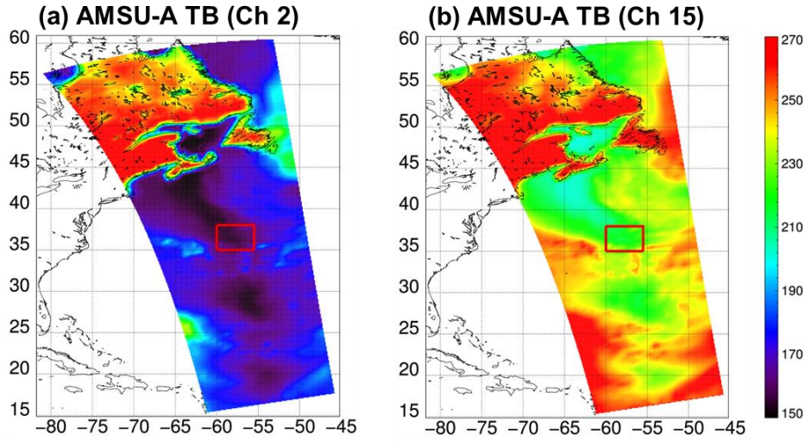
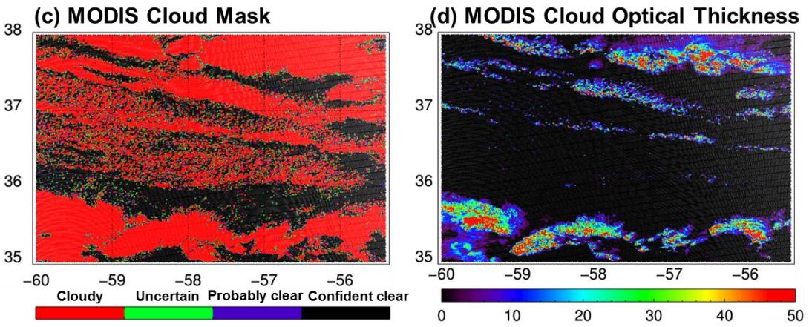
Sub-Pixel Cloud Detection Method
Microwave Sounders: about 48 km spatial resolution at nadir
31.4 GHz
89 GHz
MW
Radiances
Sub-pixel
Cloud Detection
Clear Sky Assimilation
Collocation
The sub-pixel cloud detection method is applied in conjunction with a default QC screening of assimilation system
Imager Cloud Products
(CM, COT, …)

Slide 27
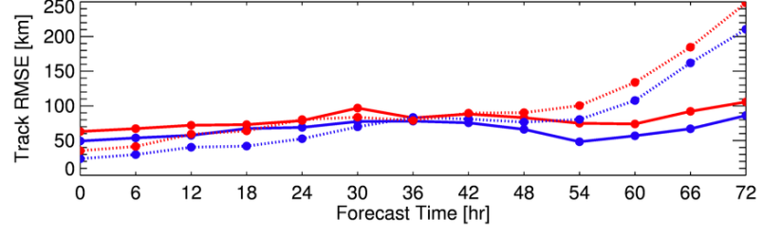

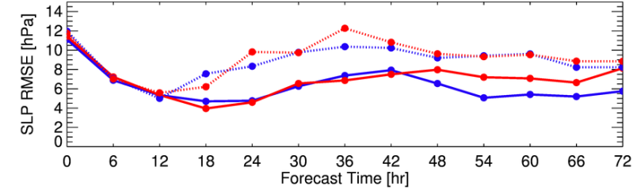
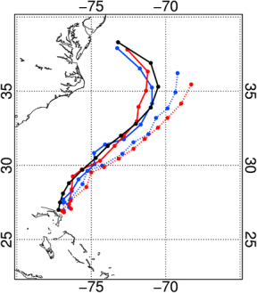
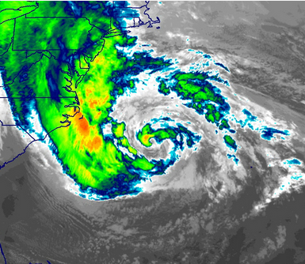

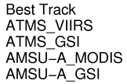
Microwave sounder sub-pixel cloud characterization with imager cloud product
MW sounder sub-pixel cloud characterization with collocated imager cloud products
ATMS/VIIRS onboard NPP
AMSU-A/MODIS onboard Aqua
Track RMSE
WRF-ARW v3.2.1, v3.6: 12km horizontal resolution, 35 vertical layers from SFC to 10 hPa
GSI v3.0, v3.3: 3-Dvar Data Assimilation Method
NAM background error covariance matrix
Cycled bias correction
Conventional Data – from GTS
Satellite radiances: ATMS/NPP, AMSU-A/Aqua
SLP RMSE
Hurricane Sandy
Assimilation : Oct 25 06z to Oct 27 00z, 2012
Forecasts: Oct 25 06 to Oct 30 00z, 2012
Assimilation every 6 hour
Assimilation window: 90 min
Hurricane Sandy (2012) forecast RMSE from 8 groups.
(1) ATMS (solid lines) is better than Aqua/AMSU-A (dashed lines) for Hurricane Sandy (2012 forecasts;
(2) MW sounder sub-footprint cloud characterization with imager cloud products (blue lines) improves GSI precipitating cloud detection (red lines) for radiance assimilation, which has the potential for operational use.
72 hour track forecasts started at 18 UTC, 26 Oct
GOES-13 10.7 μm

Slide 28
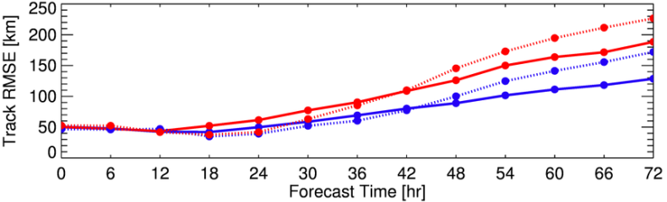
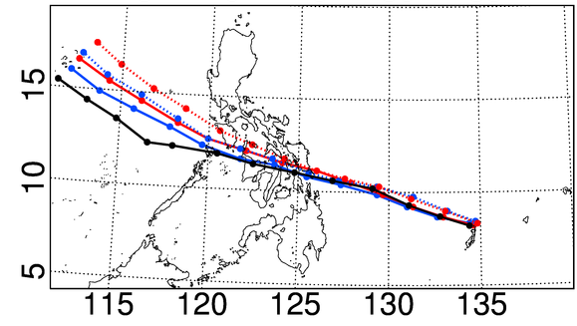
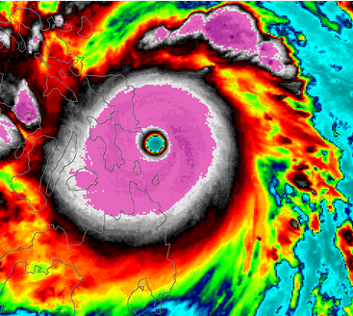
Microwave sounder sub-pixel cloud characterization with imager cloud product
MW sounder sub-pixel cloud characterization with collocated imager cloud products
ATMS/VIIRS onboard NPP
AMSU-A/MODIS onboard Aqua
WRF-ARW v3.2.1, v3.6: 12km horizontal resolution, 35 vertical layers from SFC to 10 hPa
Track RMSE
GSI v3.0, v3.3: 3-Dvar Data Assimilation Method
NAM background error covariance matrix
Cycled bias correction
Conventional Data – from GTS
Satellite radiances: ATMS/NPP, AMSU-A/Aqua
Typhoon Haiyan (2013) track forecast RMSE from 12 groups. (WRF/GSI)
Hurricane Haiyan
Assimilation : Nov 4 06z to Nov 7 00z, 2013
Forecasts: Nov 4 06 to Nov 10 00z, 2013
Assimilation every 6 hour
Assimilation window: 150 min
72 hour track forecasts started at 18 UTC 06 November 2013. (WRF/GSI)
(1) ATMS (solid lines) is better than Aqua/AMSU-A (dashed lines) for Typhoon Haiyan (2013) forecasts;
(2) MW sounder sub-footprint cloud characterization with imager cloud products (blue lines) improves GSI precipitating cloud detection (red lines) for radiance assimilation, which has the potential for operational use.
COMS-1 10.8 μm

Slide 29
Outlines
CIMSS real time SDAT (satellite data assimilation for TC forecasts) system as research testbed for improving the utilization of satellite data in regional NWP
Research progress on IR/MW sounder radiance assimilation with SDAT
  IR sounder sub-pixel cloud characterization for improving radiance assimilation
  Assimilation of IR sounder thermodynamic information in partly cloud cover
  MW sounder cloud-screening for radiance assimilation
SDAT real time demonstration and application
  Performs on 2015 hurricane season
Future plan on using HWRF

Slide 30
Erika: 2015.08.25.00 – 2015.08.29.06
Dynamic models along with official guidance are mostly right to the best track
Statistical models are most left to the best track

Slide 31
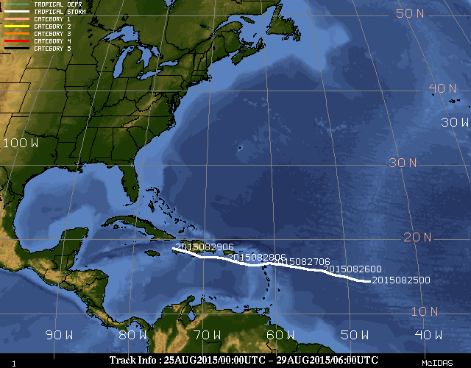

Slide 32
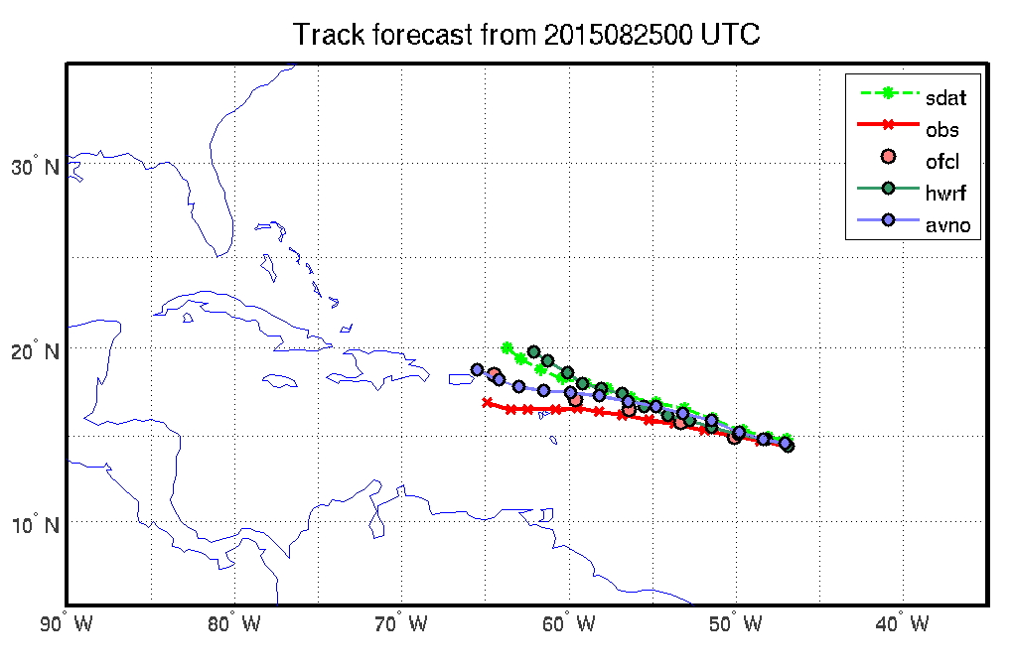
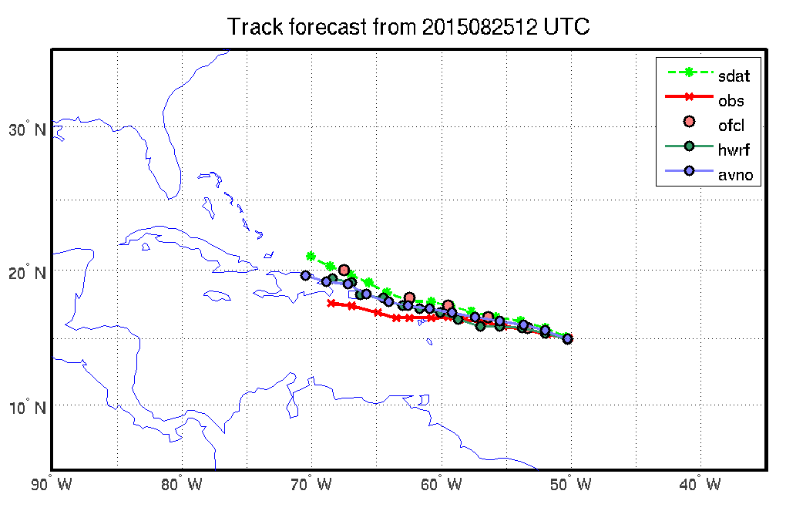
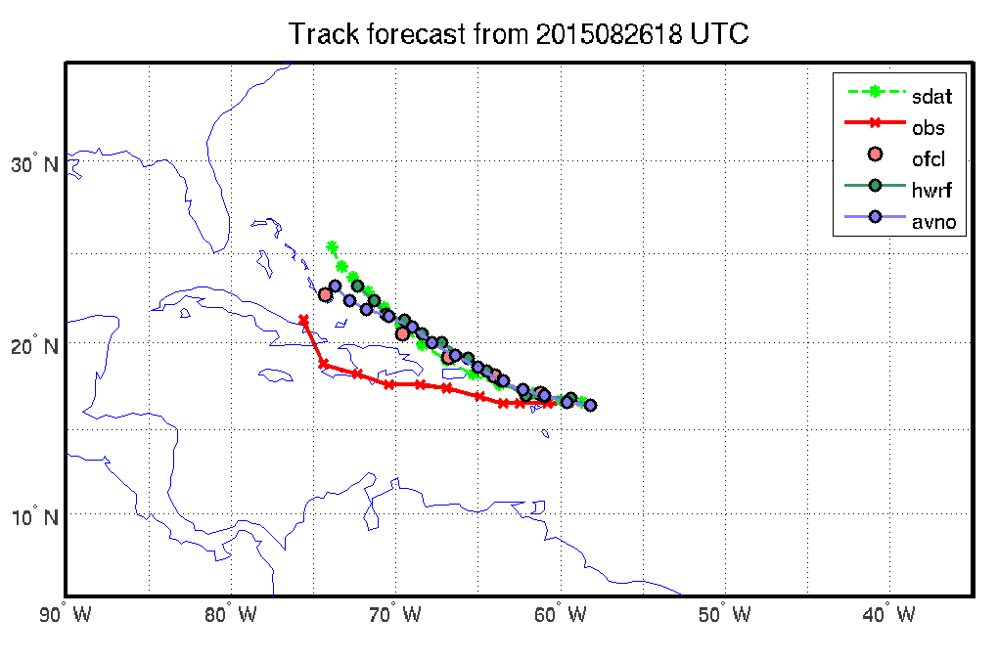
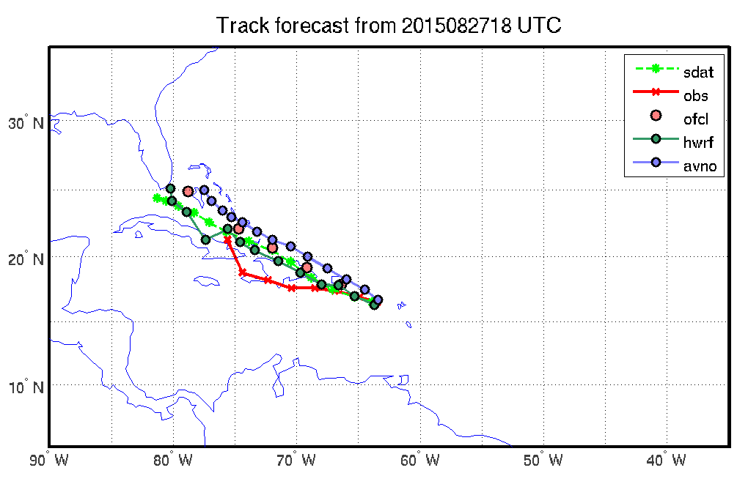
Track forecasts

Slide 33
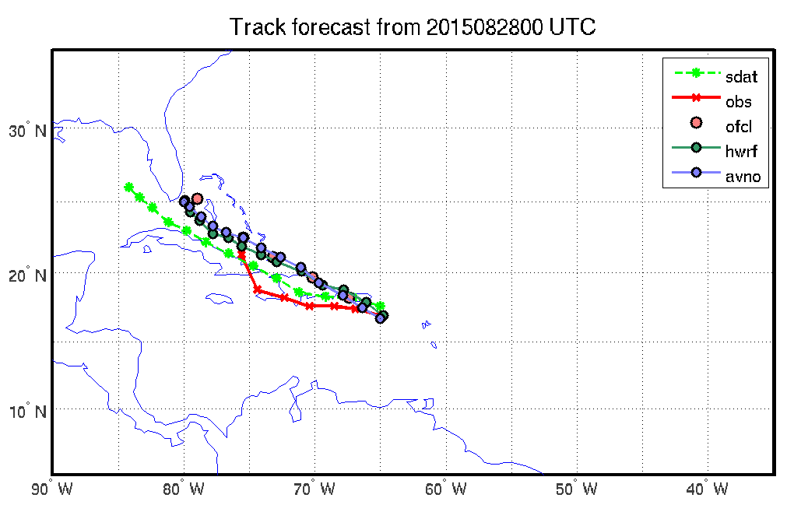
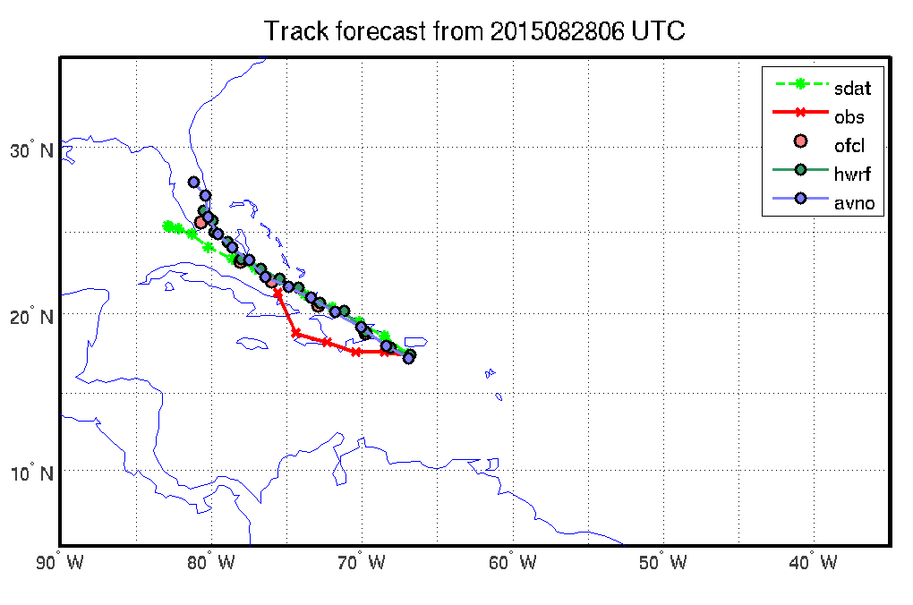
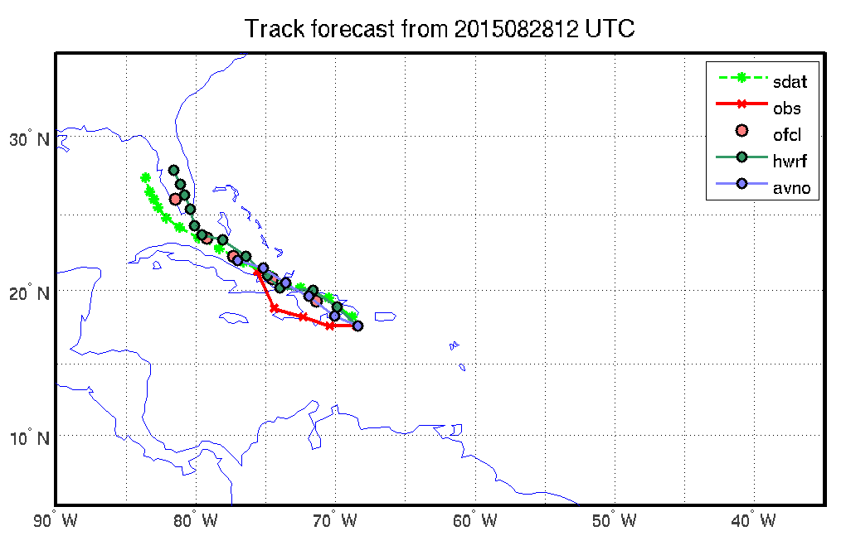
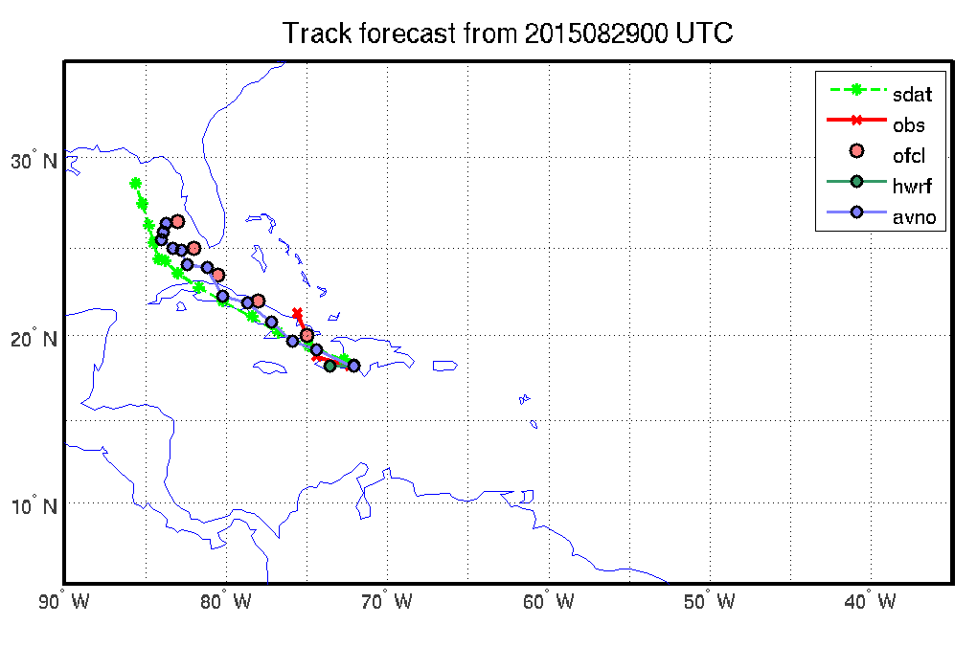

Slide 34
SDAT real time forecasts - 2015 Hurricane-3 Danny
2015.08.19.00 – 2015.08.23.06

Slide 35
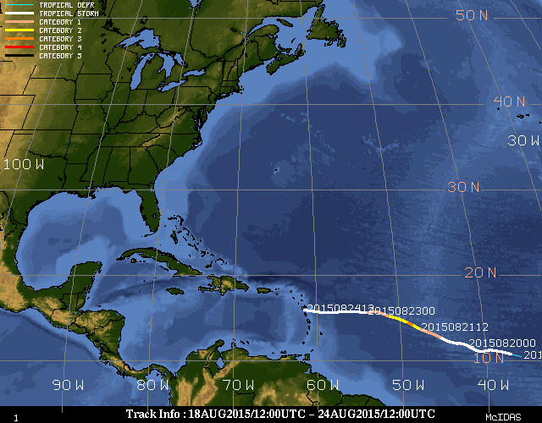

Slide 36
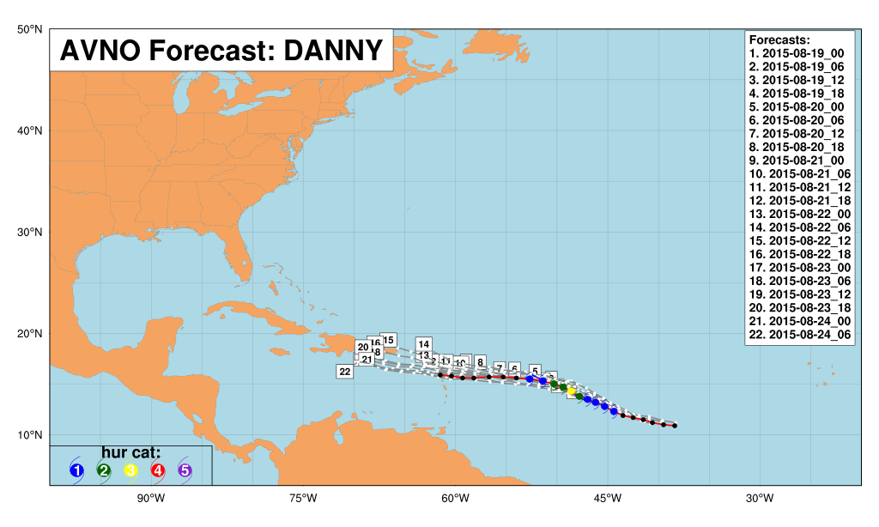
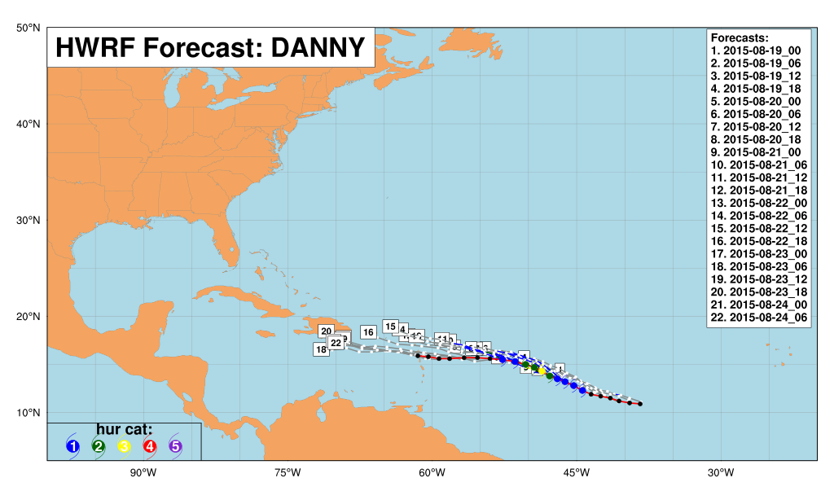


Slide 37
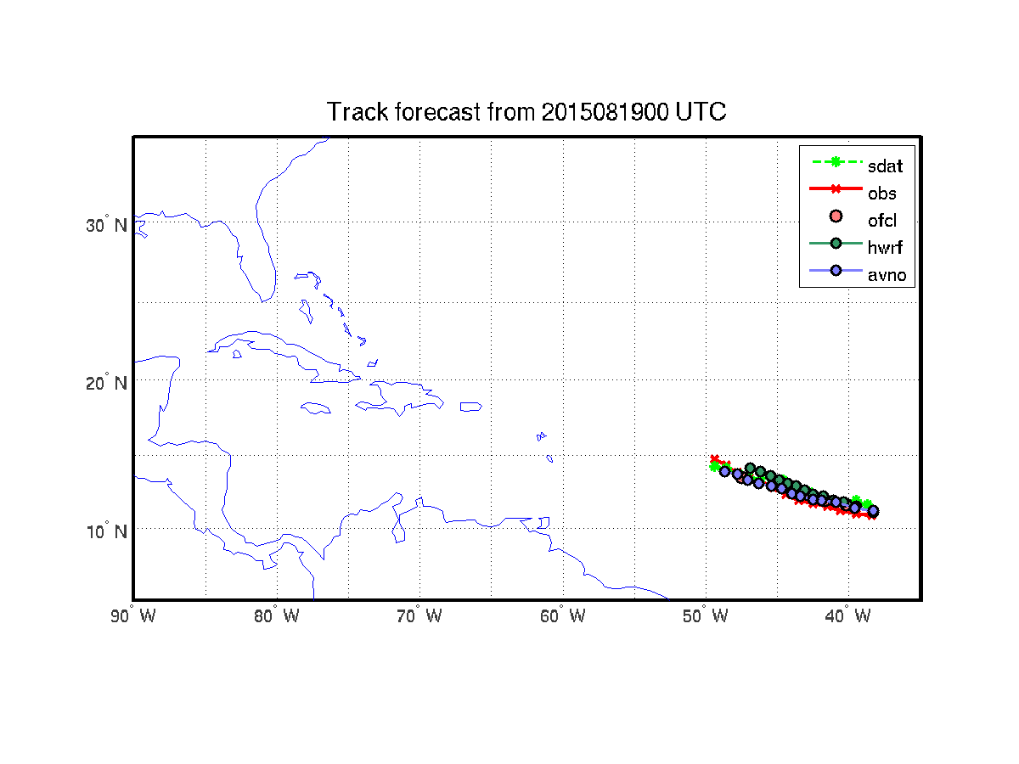

Slide 38
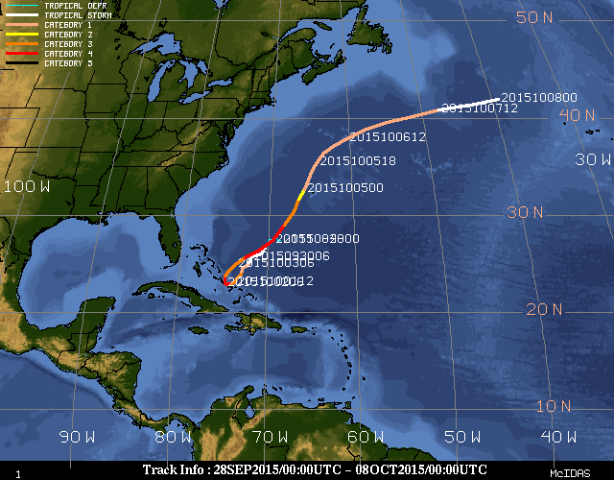
Hurricane Joaquin Best track

Slide 39
30 September 2015

Slide 40
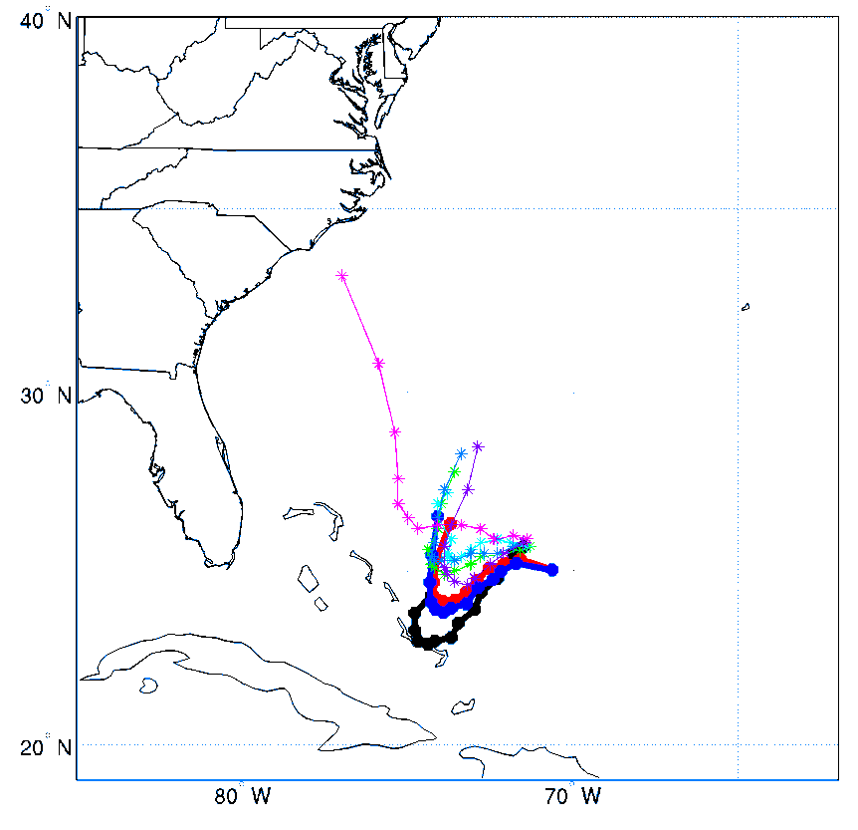
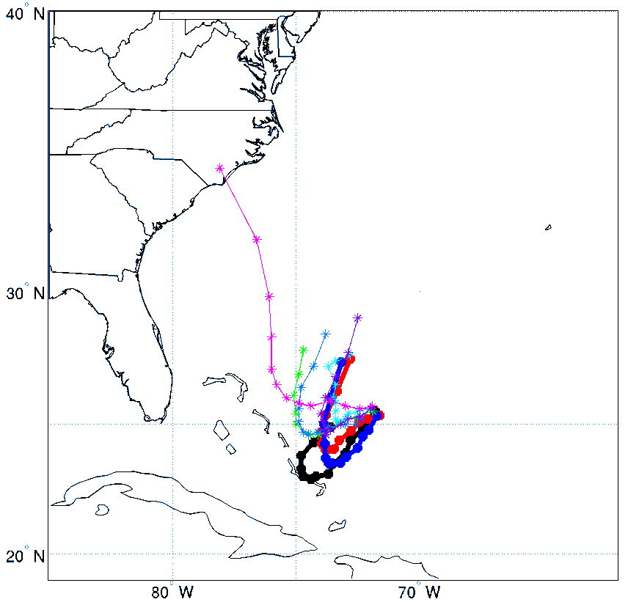



2015-09-30 00z
2015-09-30 06z
2015-09-30 12z
2015-09-30 18z

Slide 41





2015-09-30 00z
2015-09-30 06z
2015-09-30 12z
2015-09-30 18z

Slide 42
01 October 2015

Slide 43




2015-10-01 00z
2015-10-01 06z
2015-10-01 12z
2015-10-01 18z

Slide 44




2015-10-01 00z
2015-10-01 06z
2015-10-01 12z
2015-10-01 18z

Slide 45


Slide 46

06 UTC 29 Sep - 00 UTC 5 Oct 2015
(forecast starting time)

Slide 47
Future plan
Implement re-location technique for SDAT
Radiances from clear locations + radiances from clear channels;
Develop CrIS CCRs with VIIRS (demontrated already for AIRS with MODIS)
Continue impact study on NUCAPS CrIS CCRs
Comparisons among CrIS CCRs (imager-based, background-based and MW-based) and impact, through collaboration with Andrew Collard and Chris Barnet;
Collaborate with HWRF team - Potential transition of research to operation
  Application of CrIS sub-pixel cloud characterization (using CrIS new BUFR data);
  Better clear channel detection;
  CrIS CCRs (both imager-based and MW-based);
  High temporal resolution GOES-R three water vapor channels’ radiance assimilation

