Slide 1
Experiments
H16A: FY16 Baseline (dt=30s, non-hydrostatic fix, ICLOUD3 fix, etc. )
HWRF: FY15 Operational HWRF
PBL1: EDMF with alpha and variable Richardson Number.
PBL2: PBL1+modified horizontal diffusion coefficient for d02/d03, 1/1.2

Slide 2
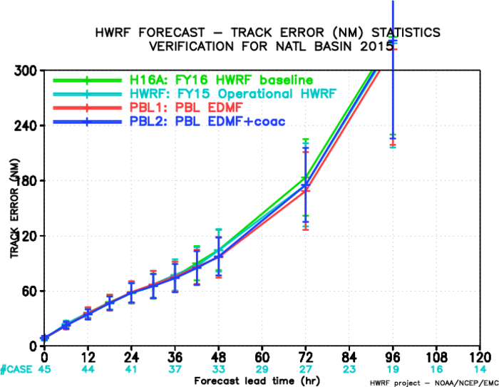
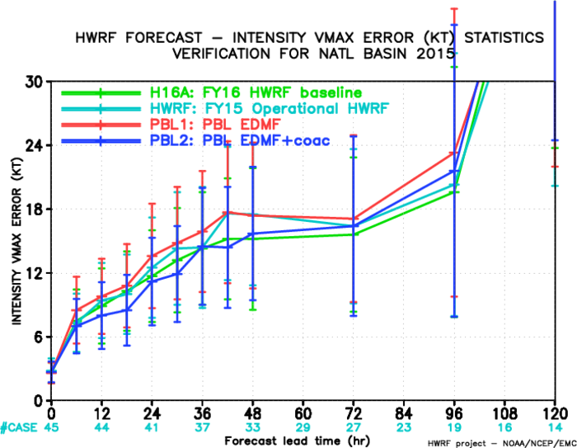
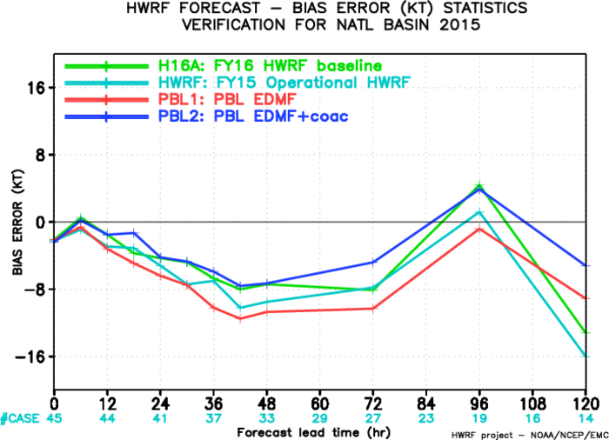
AL track/intensity verification:
PBL2 has a comparable track forecast errors as PBL1;
PBL2 has smaller intensity errors than PBL1, and reduces negative biases.

Slide 3
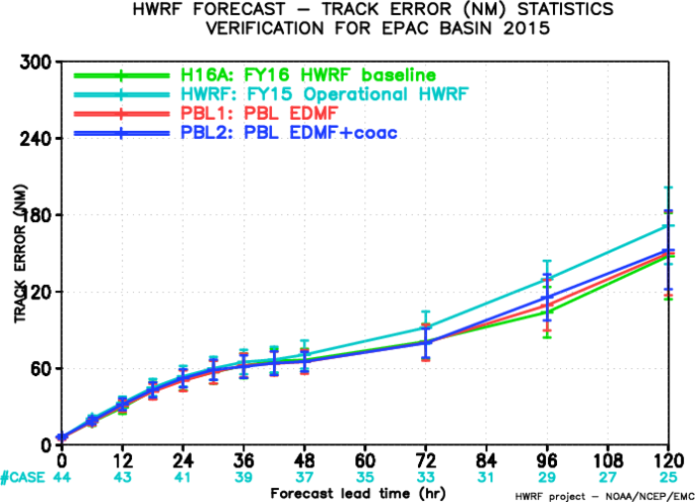
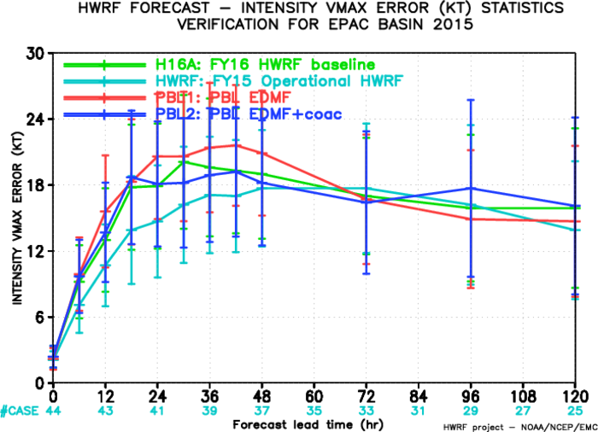
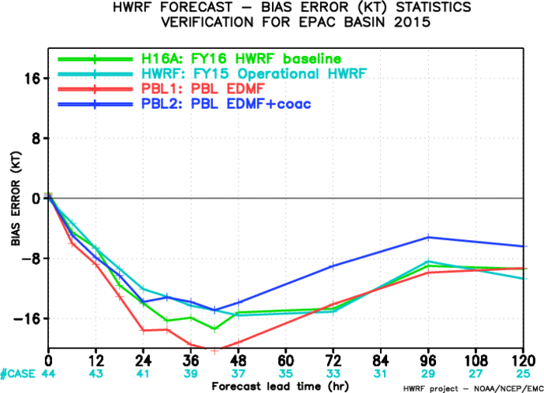
EP track/intensity verification:
All experiments produced smaller track forecast errors than operational HWRF;
Intensity biases are reduced.

Slide 4
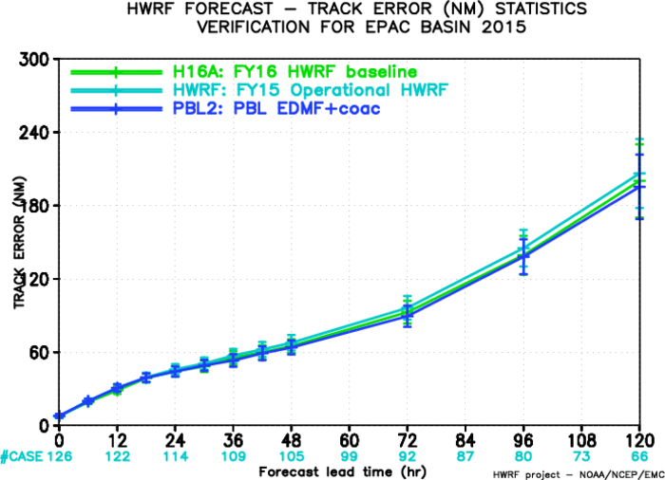
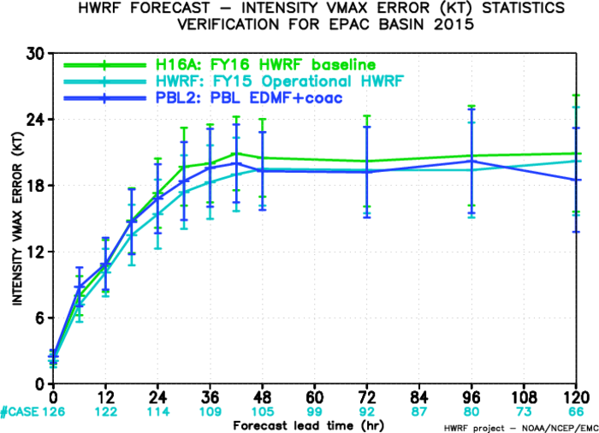
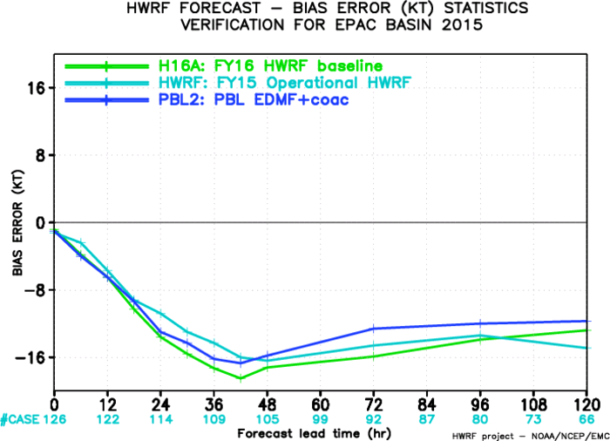
EP track/intensity verification (no PBL1, more samples):
PBL2 has a better track forecasts
PBL2 better than H16A.

