Slide 1
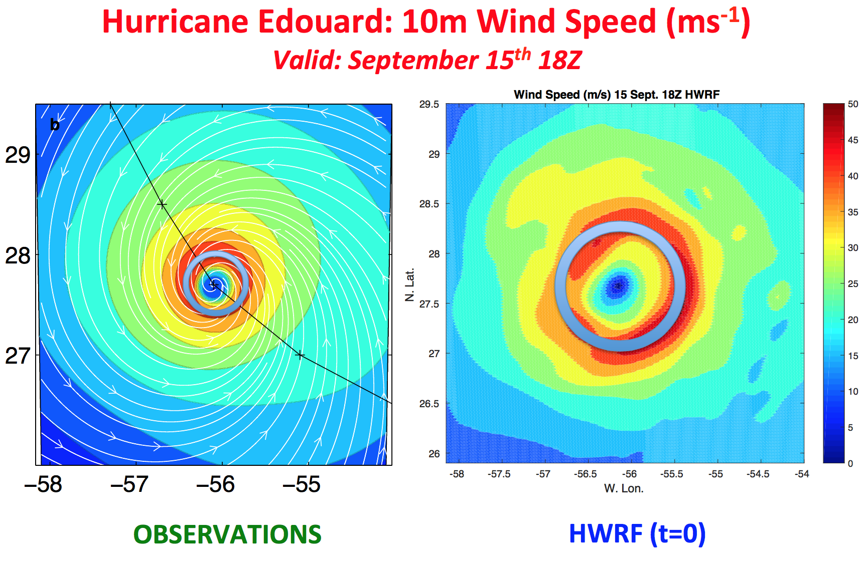
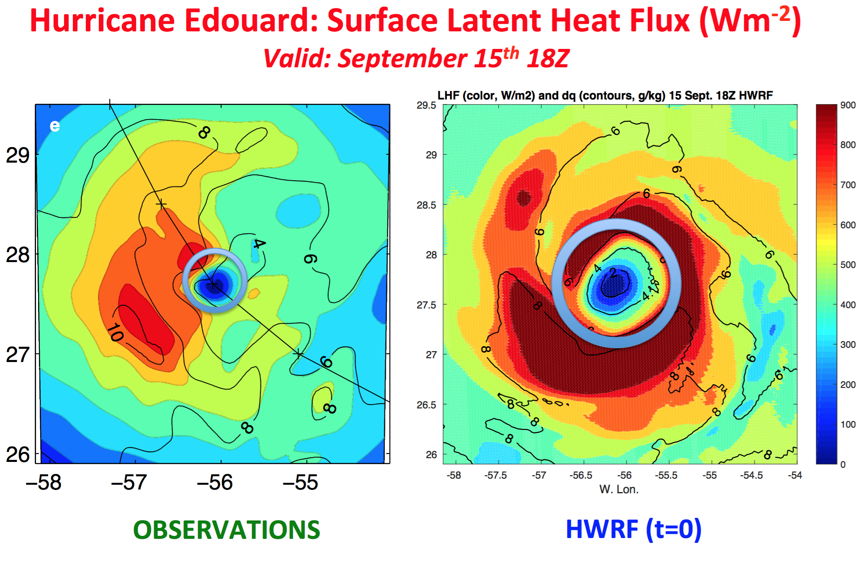
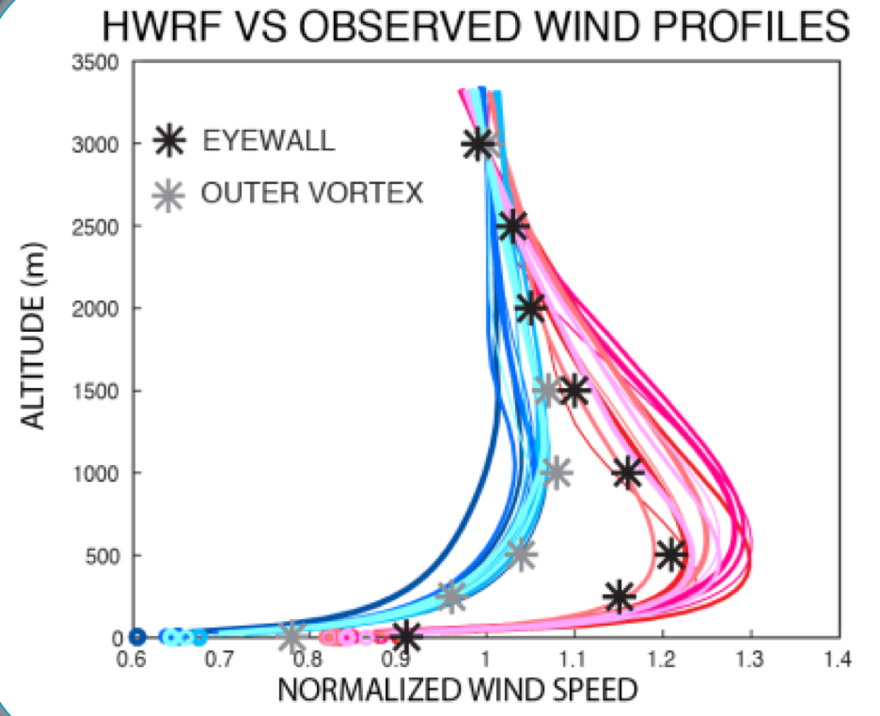
Physics upgrades
Update GFS developments
Scale aware parameterizations
  Used in a variety of applications
Stochastic
  Variability
Identify model biases
Motivate model development
Strengthen communication with the scientific community
Keep a holistic approach (beyond intensity & track errors)
RMW~2x!!
Surface winds ~10-20% too weak
Observed surface winds are used to adjust the entire vortex.
Vortex ends up resulting too strong above.
LHF~50% higher

Slide 2
RMW~2x!!

Slide 3
RMW~2x!!

Slide 4
How systematic this is?
  Abstrat Conference H&TM
  “Numerical Model Bias of the Radius of Maximum Wind”
  by: Marks, Sellwood and Abarca
    Main idea: Compare RMW Doppler radar Vs HWRF, 37 storms Atlantic and Epac 2008-2015
  Look at cycles valid for the observation time

Slide 5
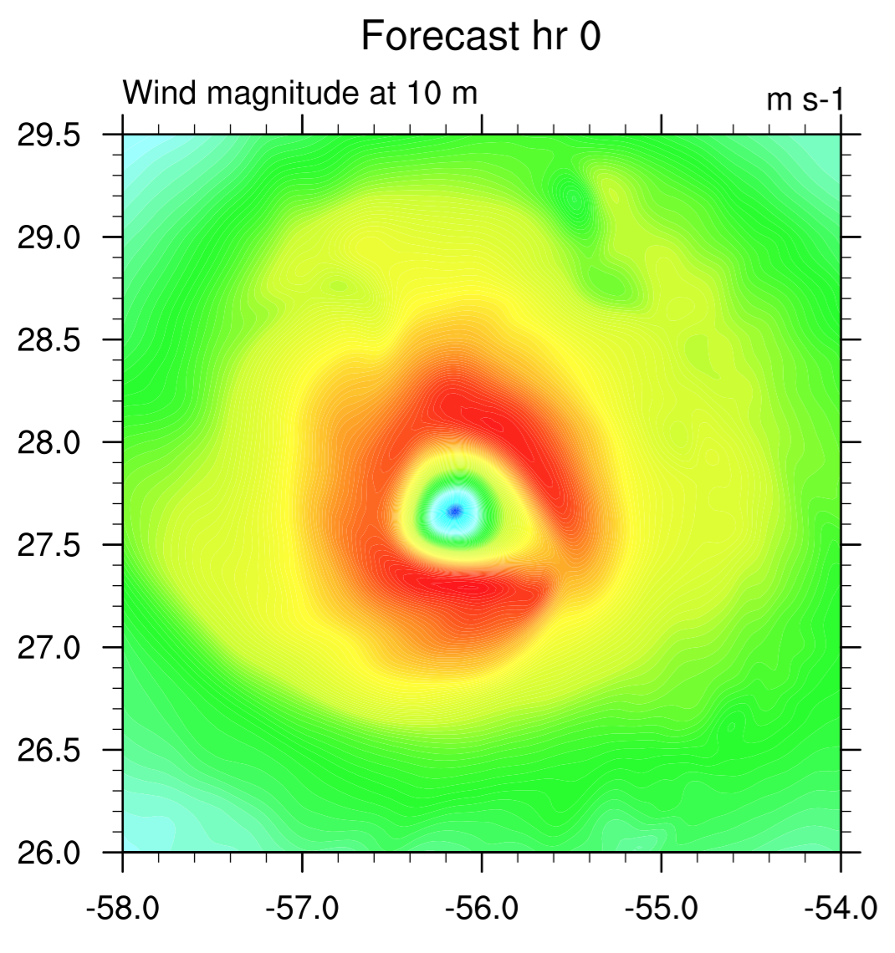
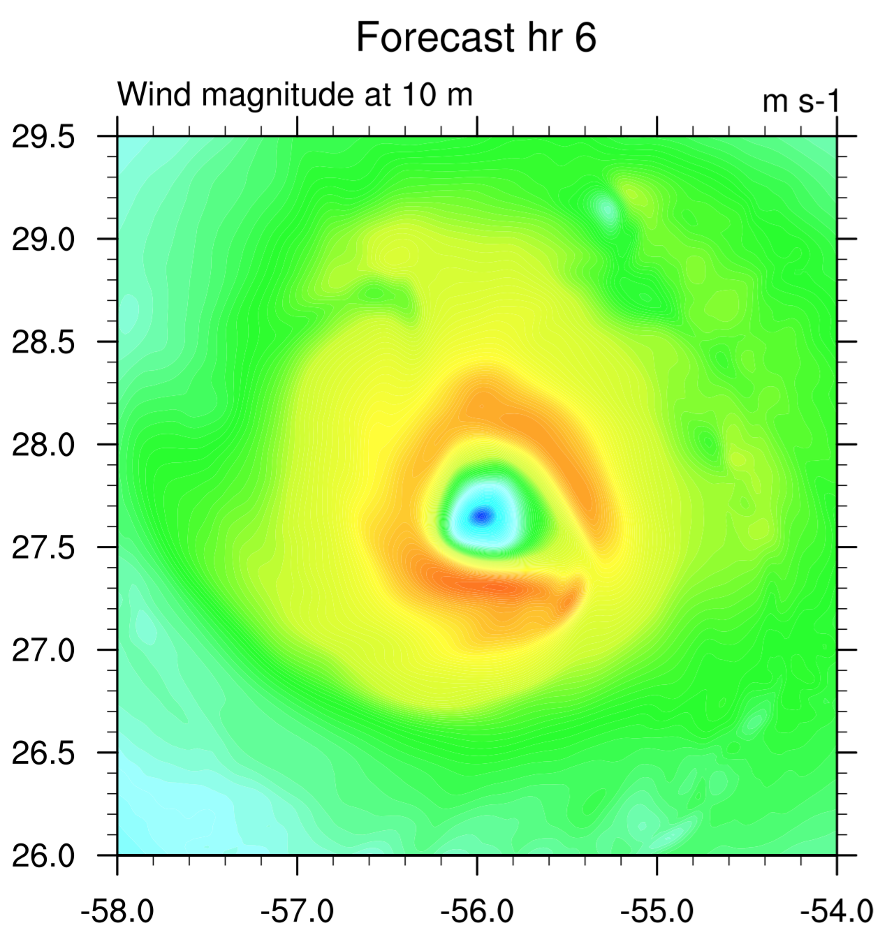
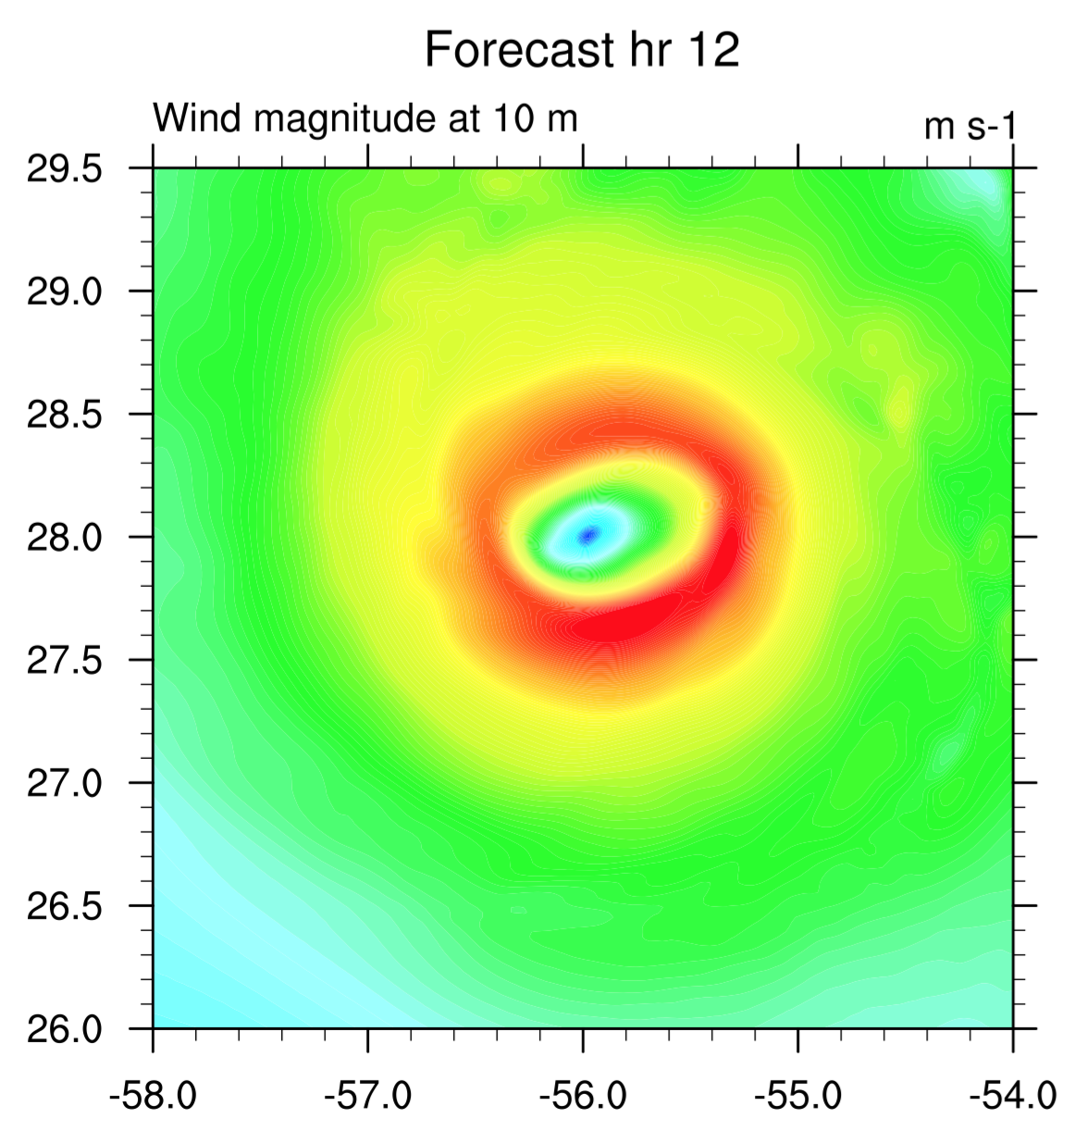
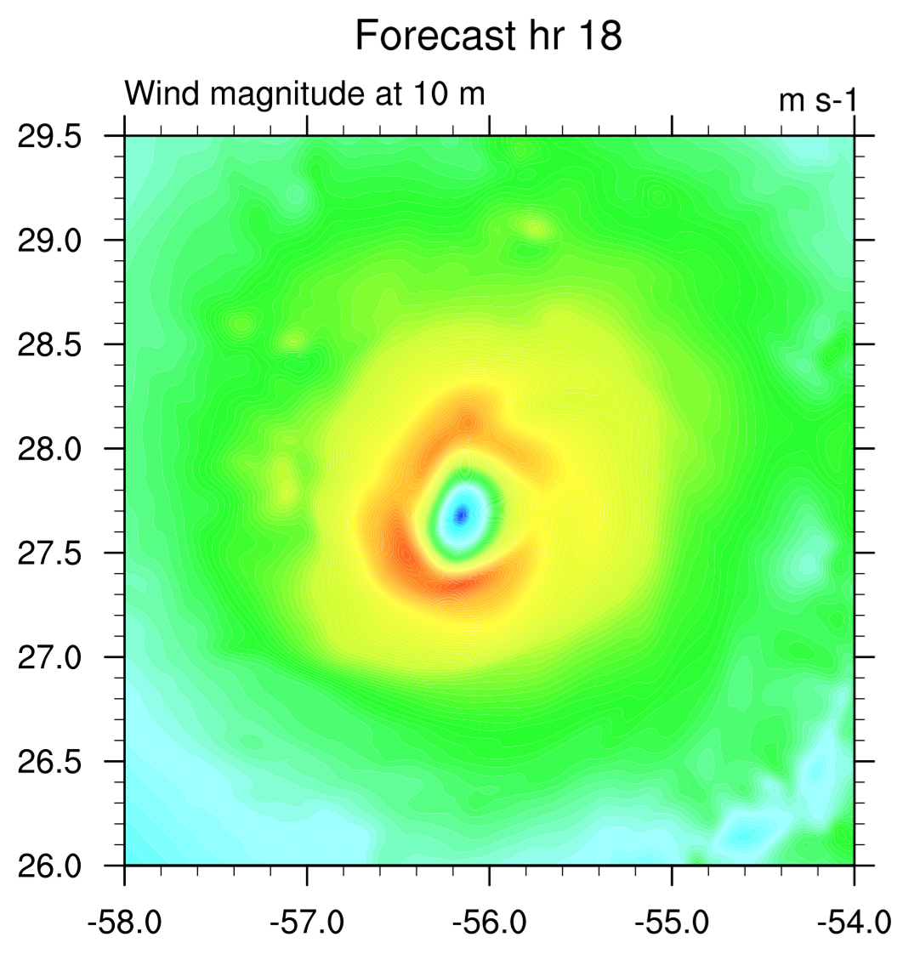
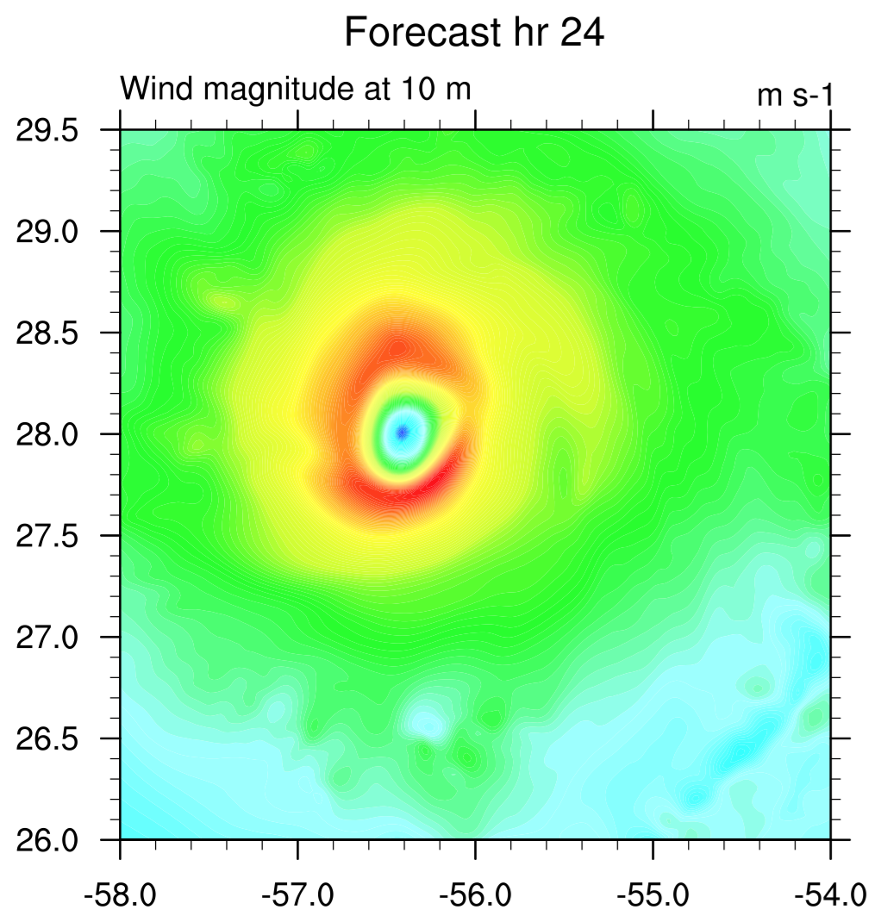
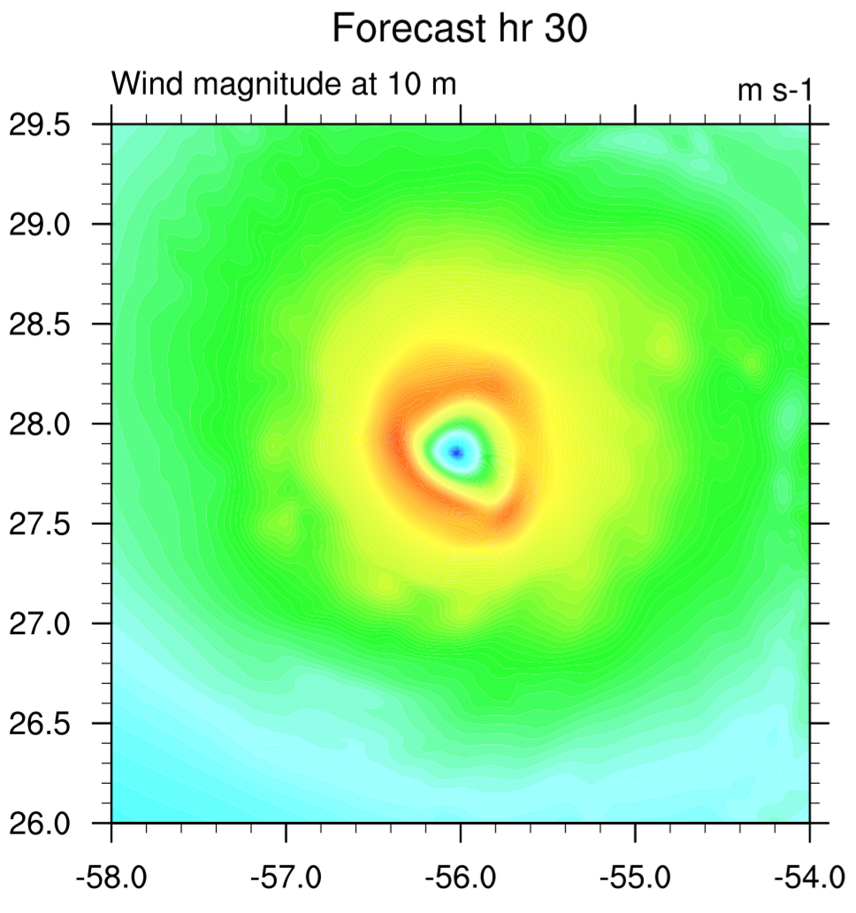
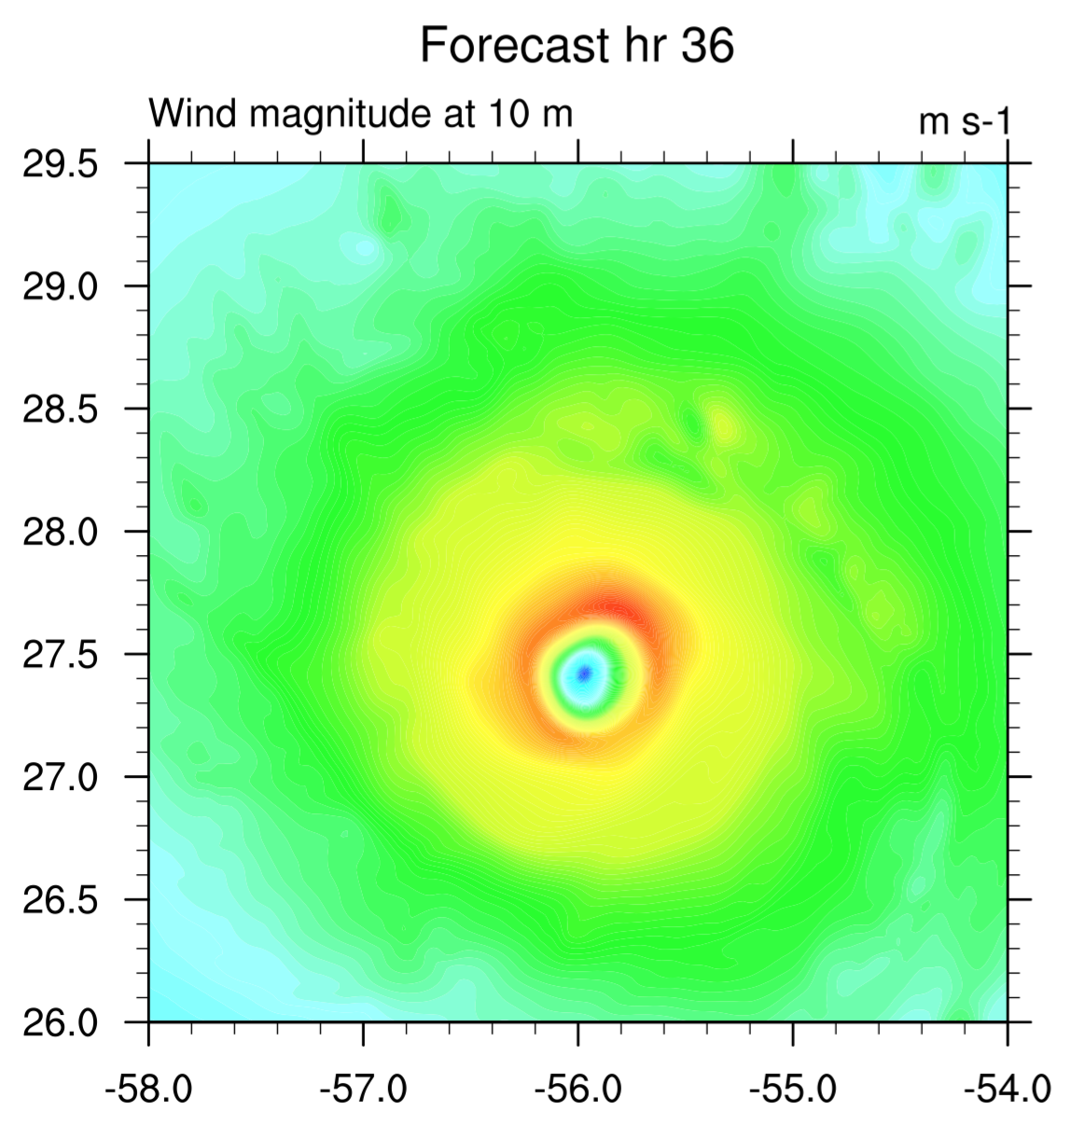
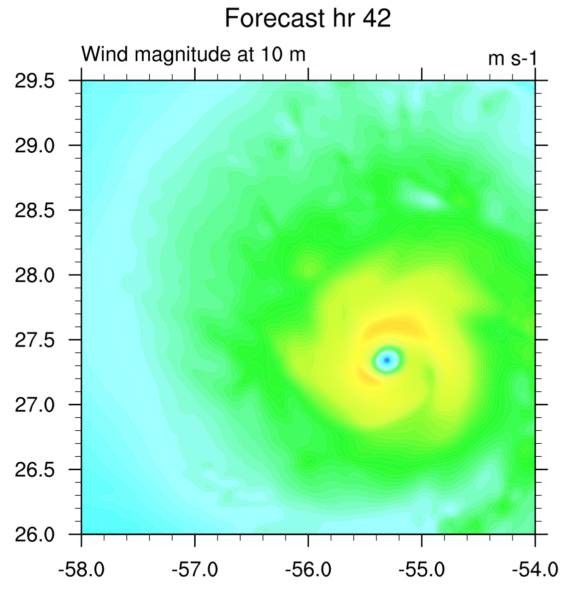
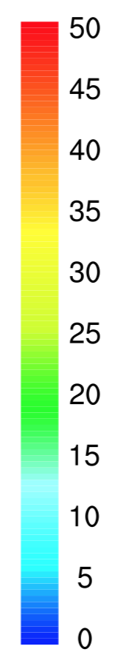
HWRF 2015, Valid 15 Sept, 1800

Slide 6
HWRF 2015, Valid 15 Sept, 1800

Slide 7
Physics or vortex initialization?

Slide 9
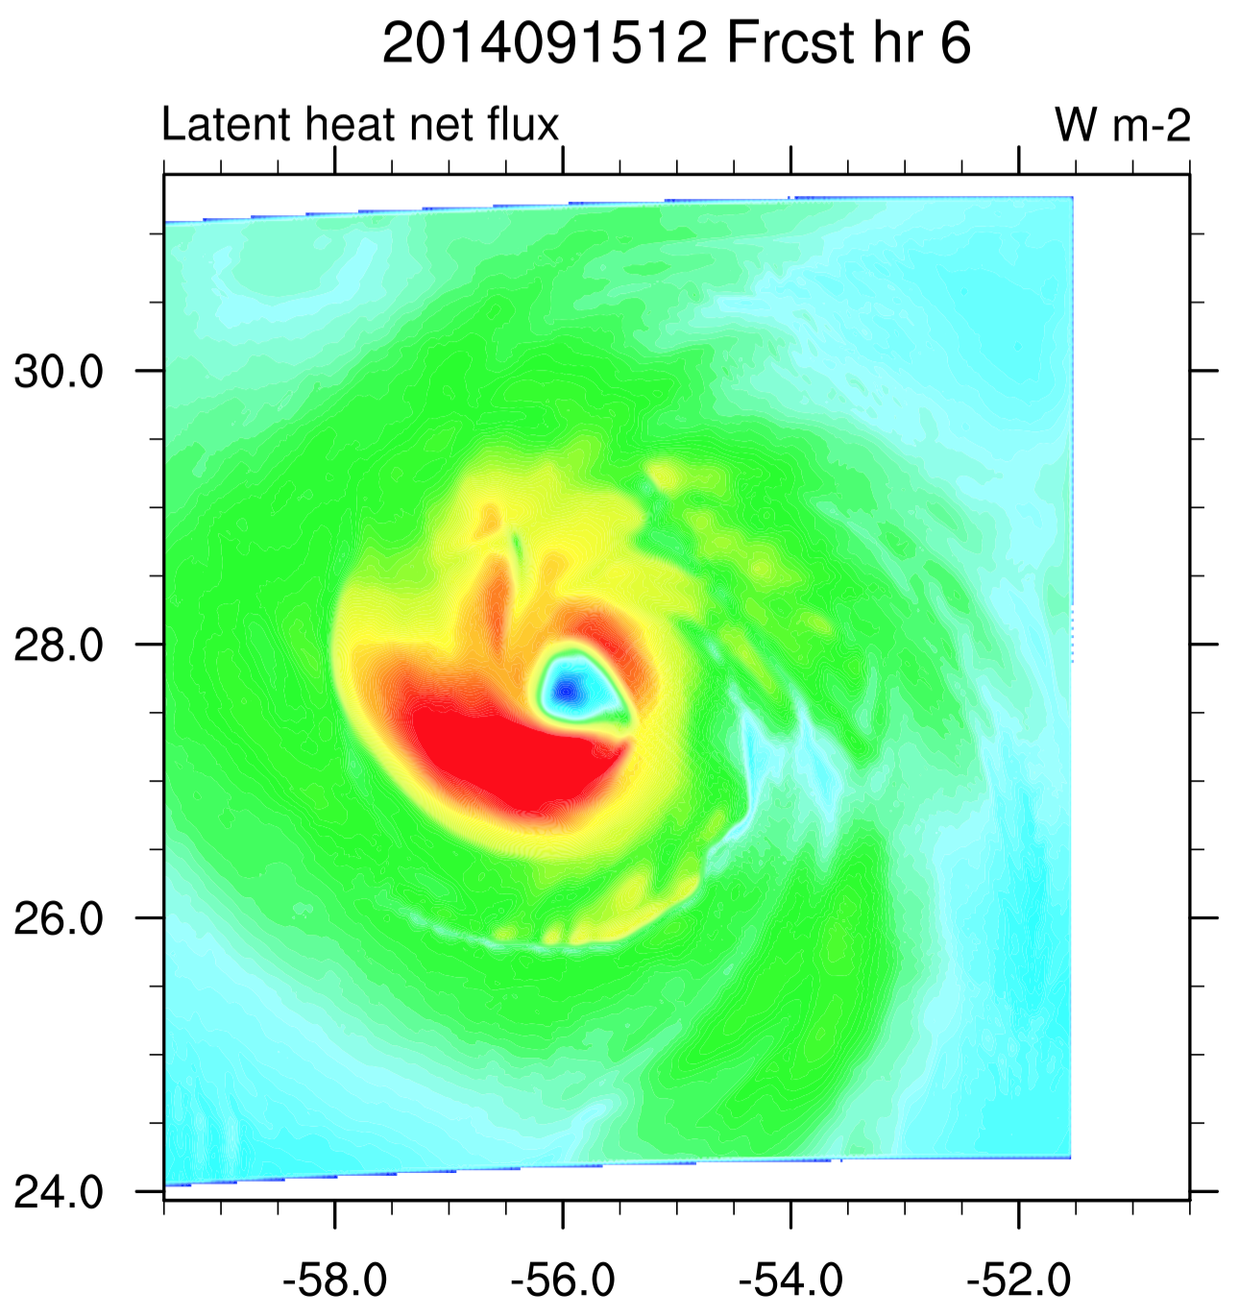
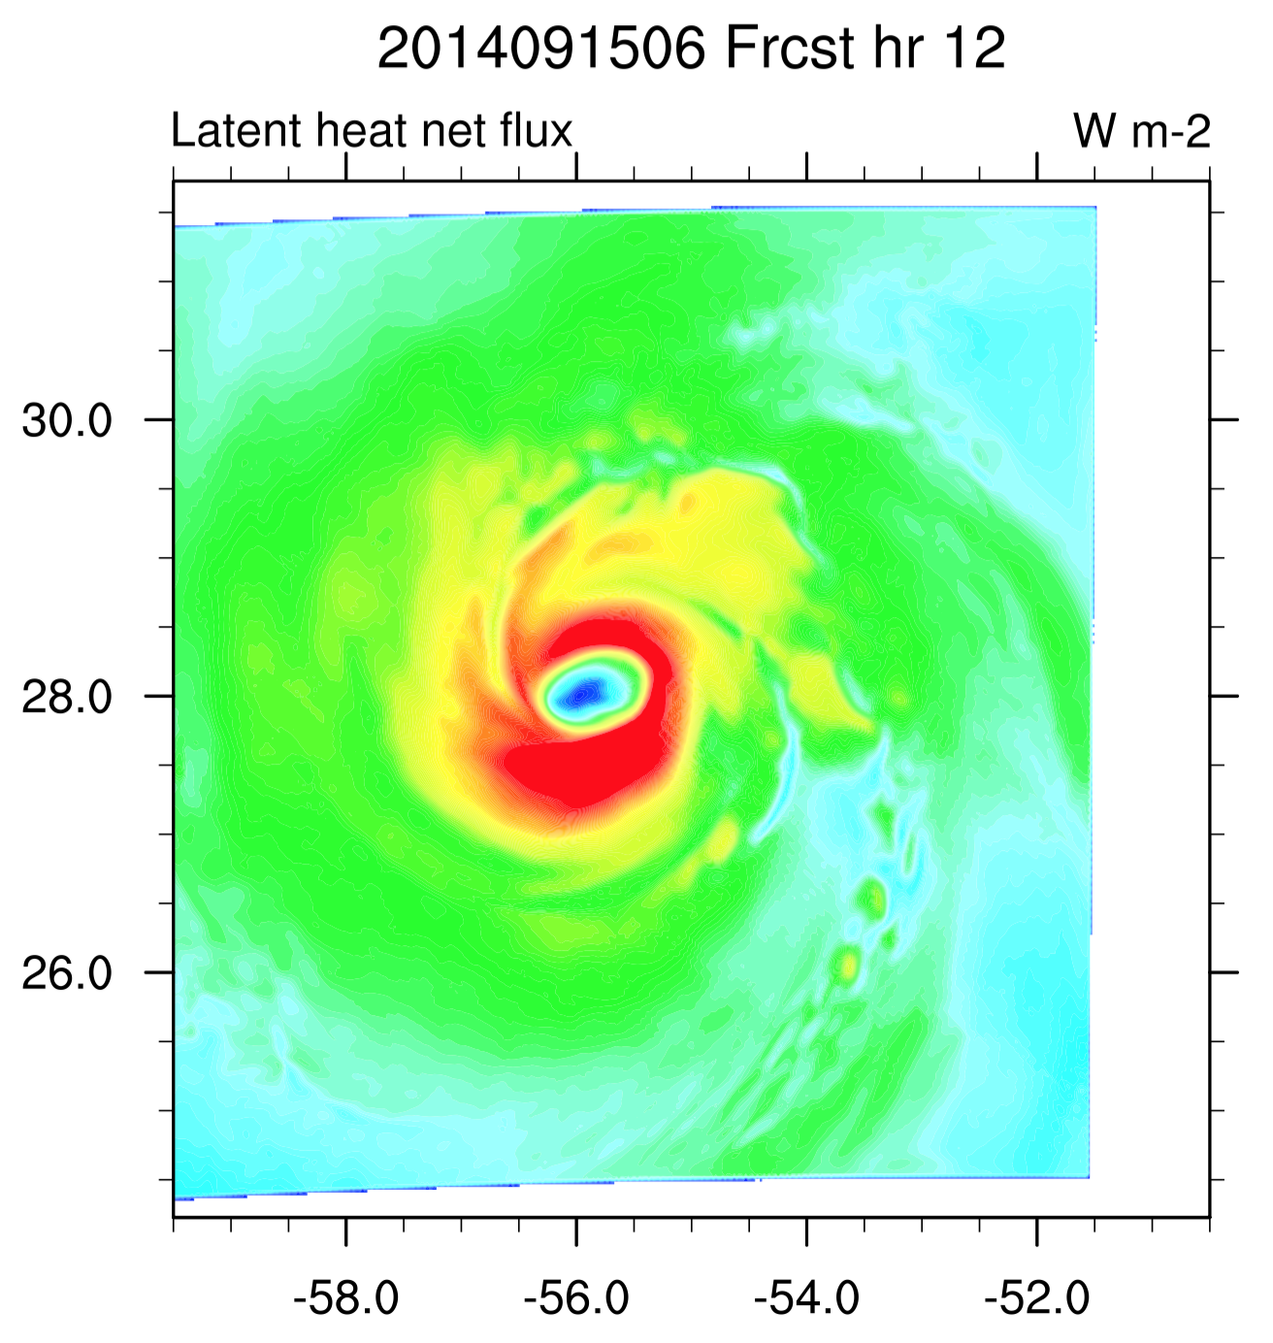
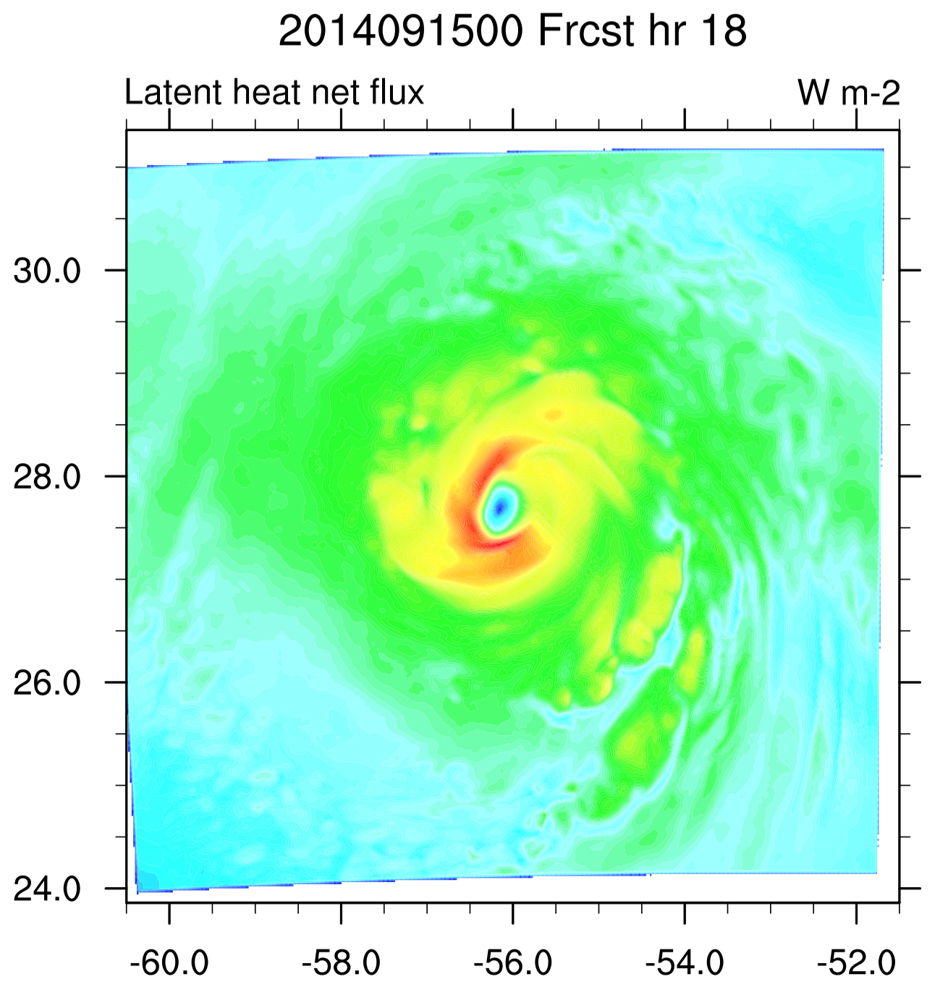
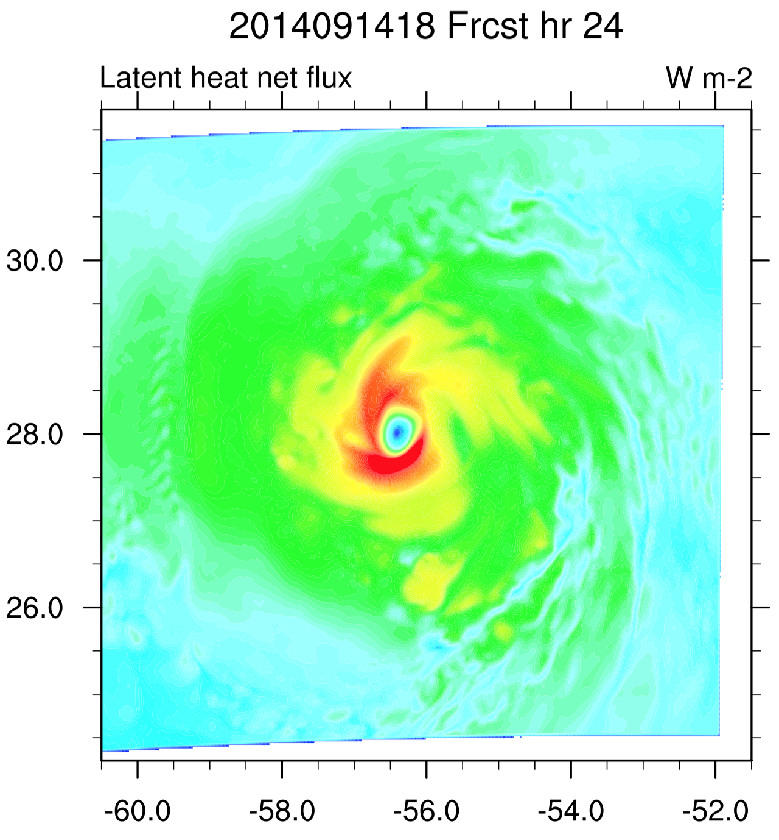
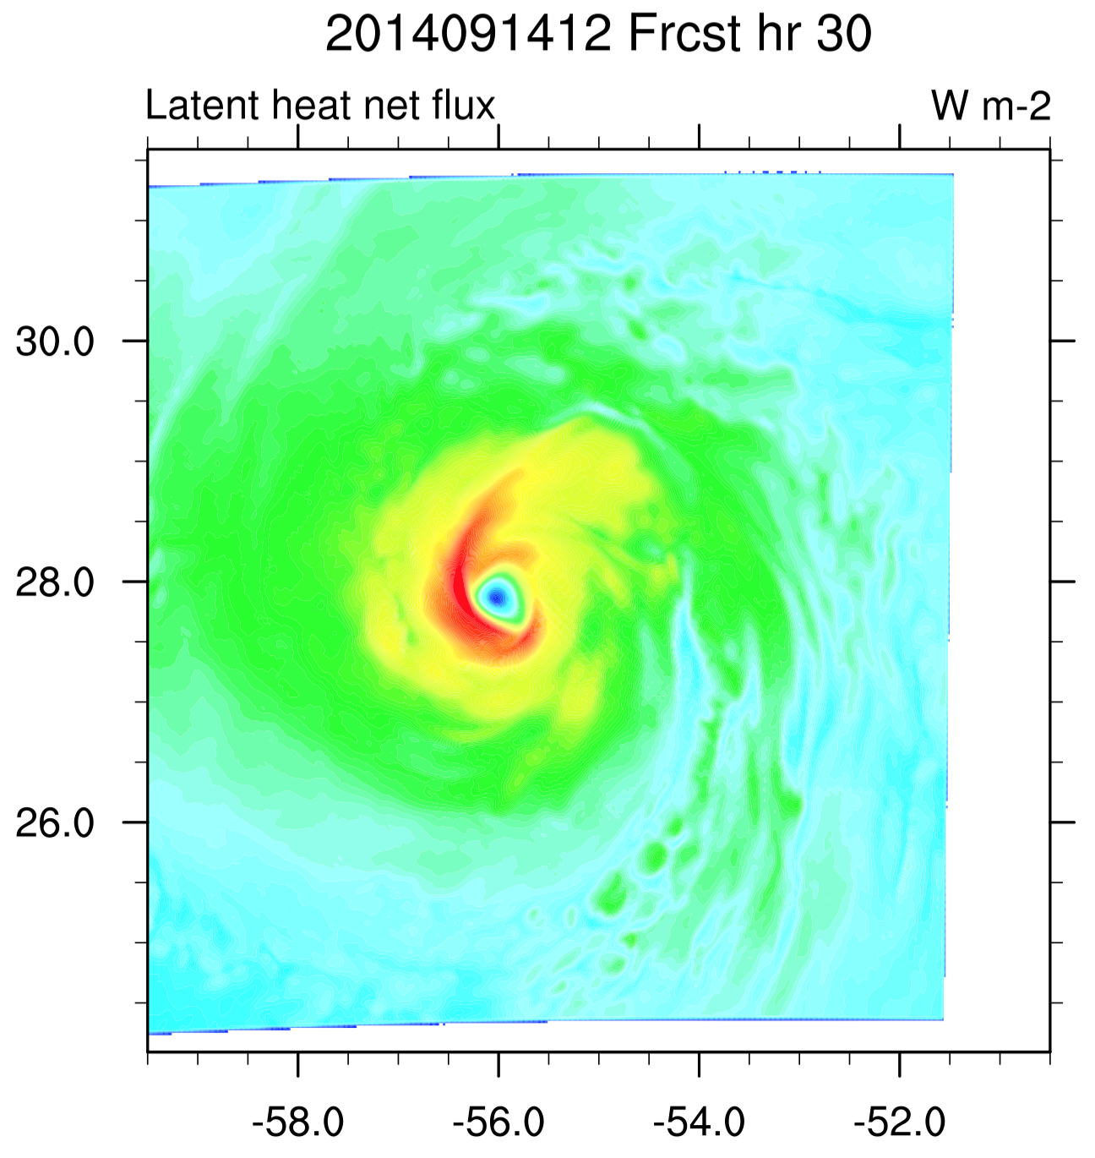
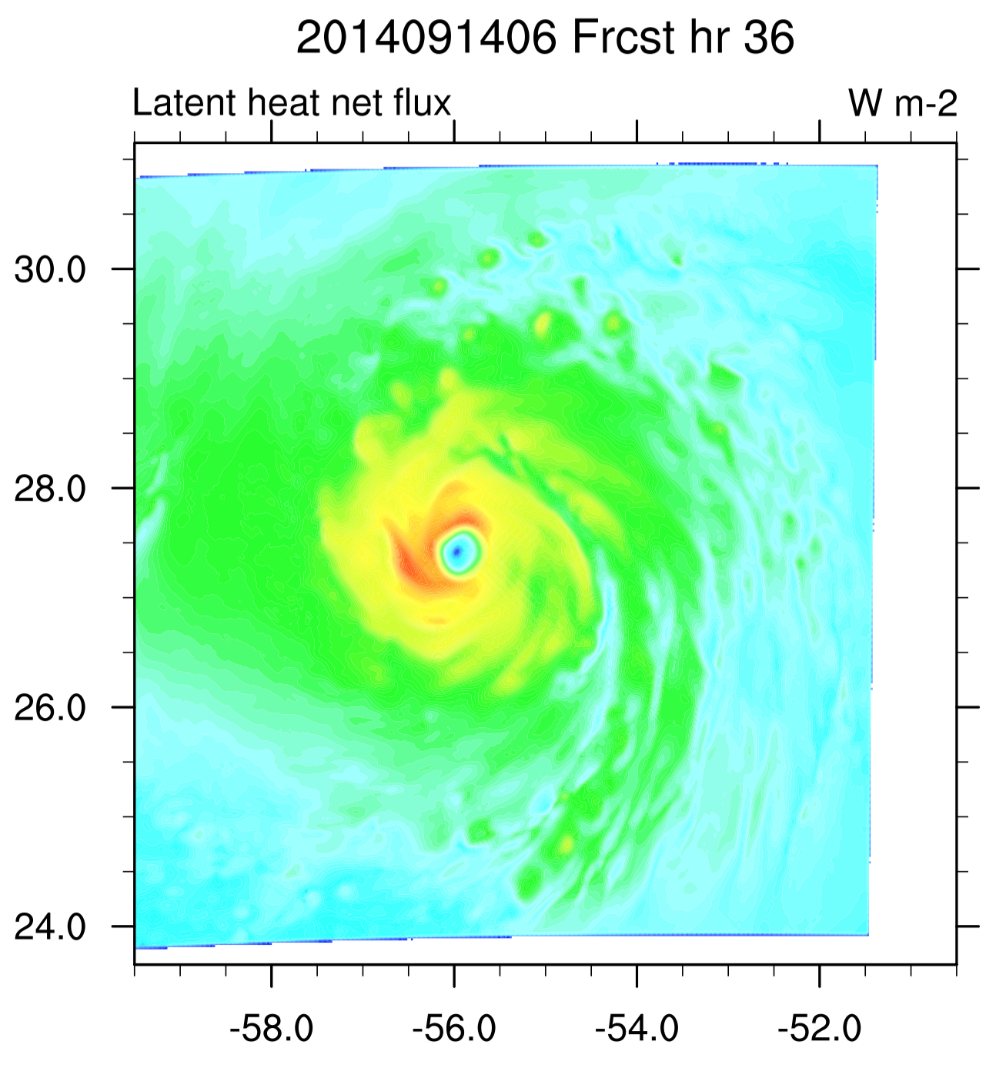
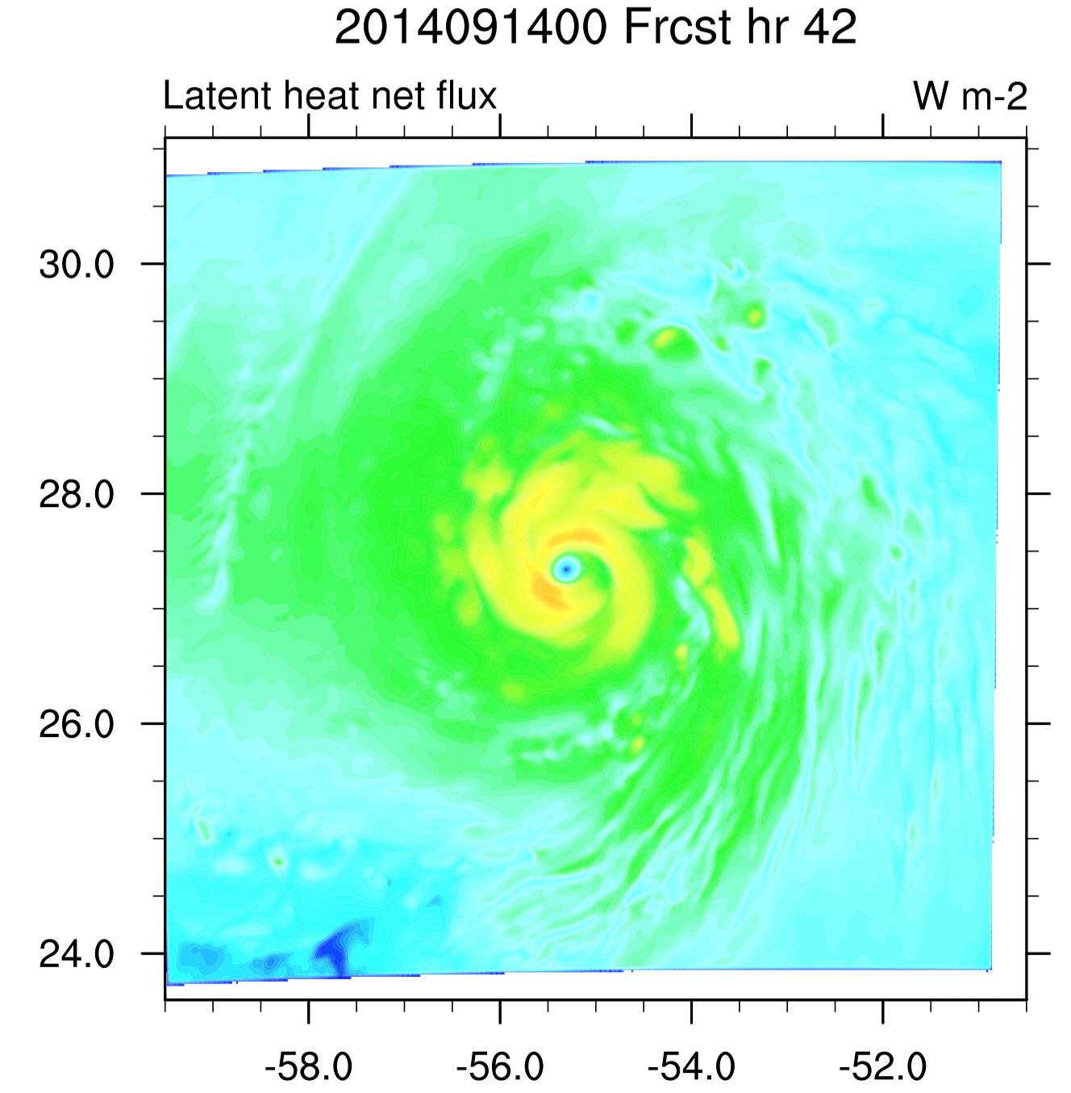
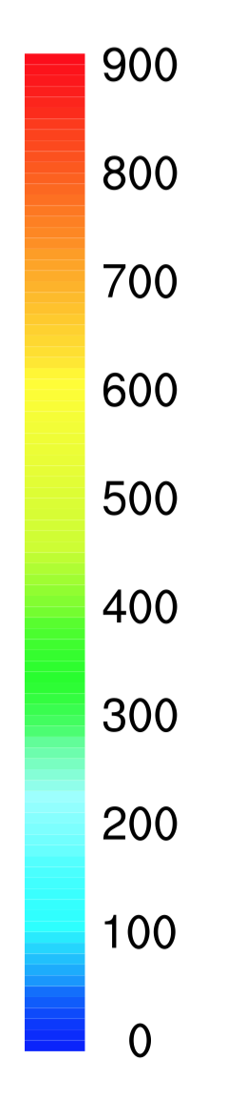
Wm⁻²

Slide 10
Physics or vortex initialization?

Slide 11
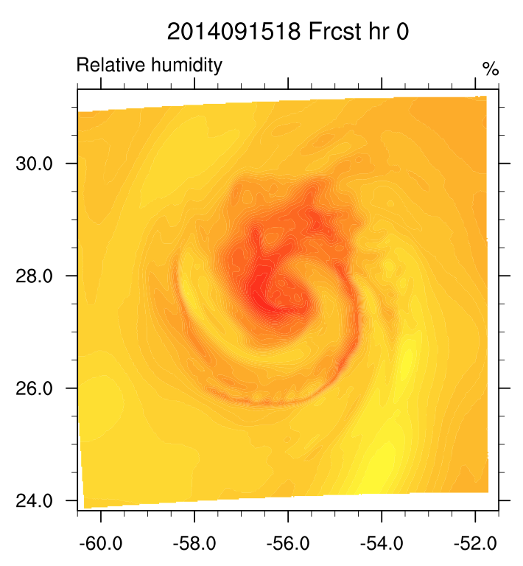
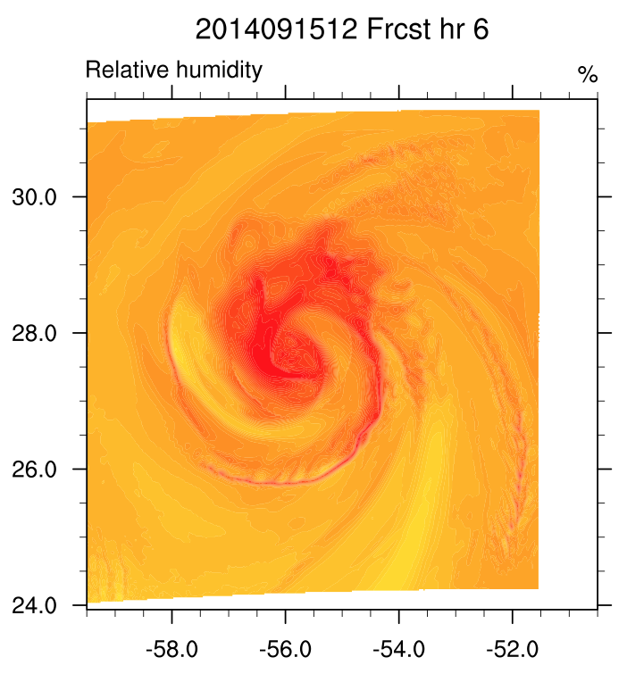
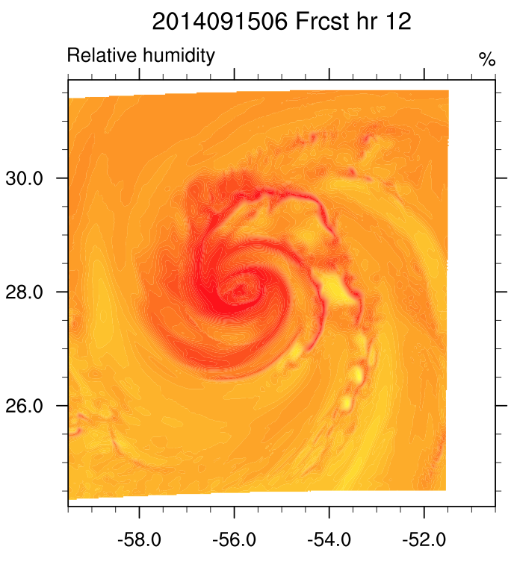
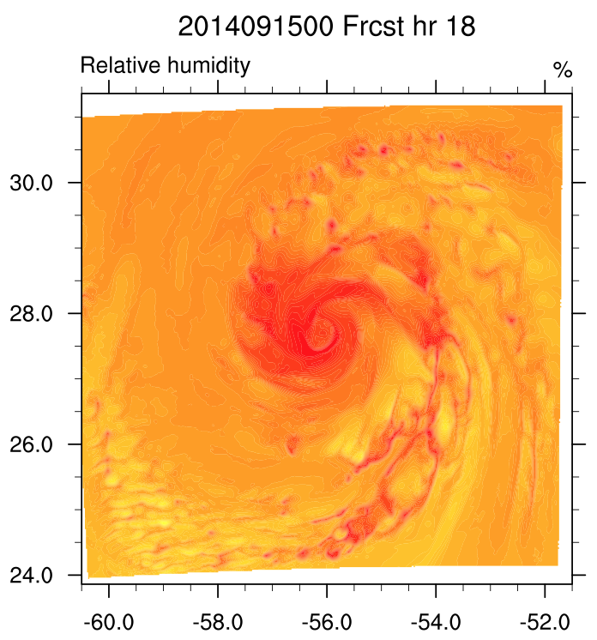
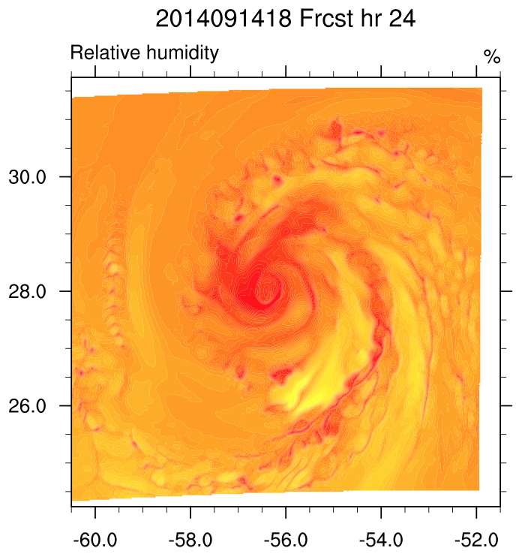
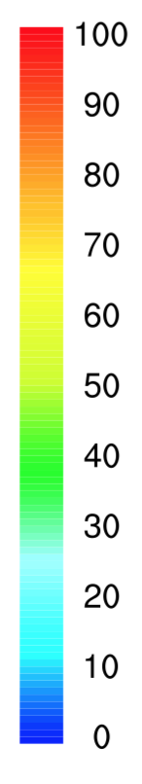
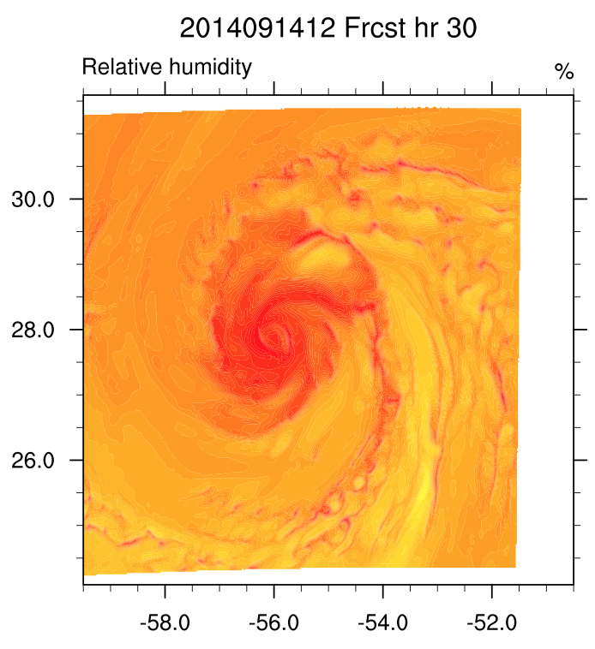
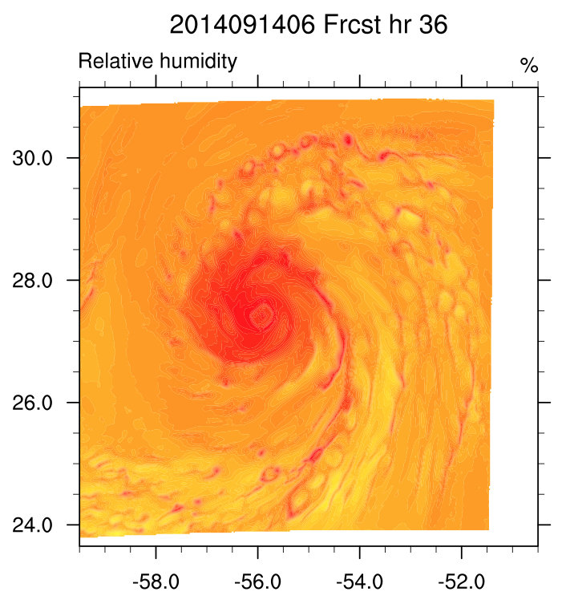
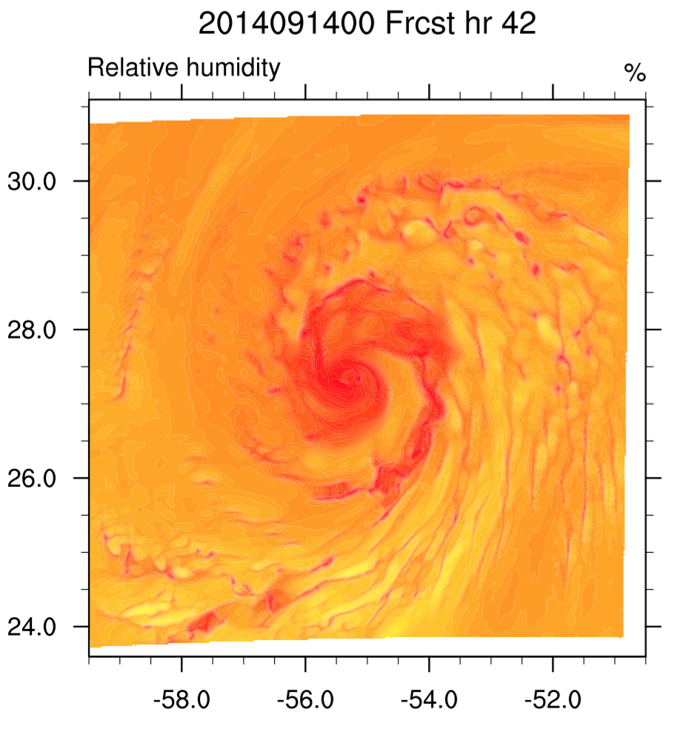
RH Interpolated to 1000 mb

Slide 12
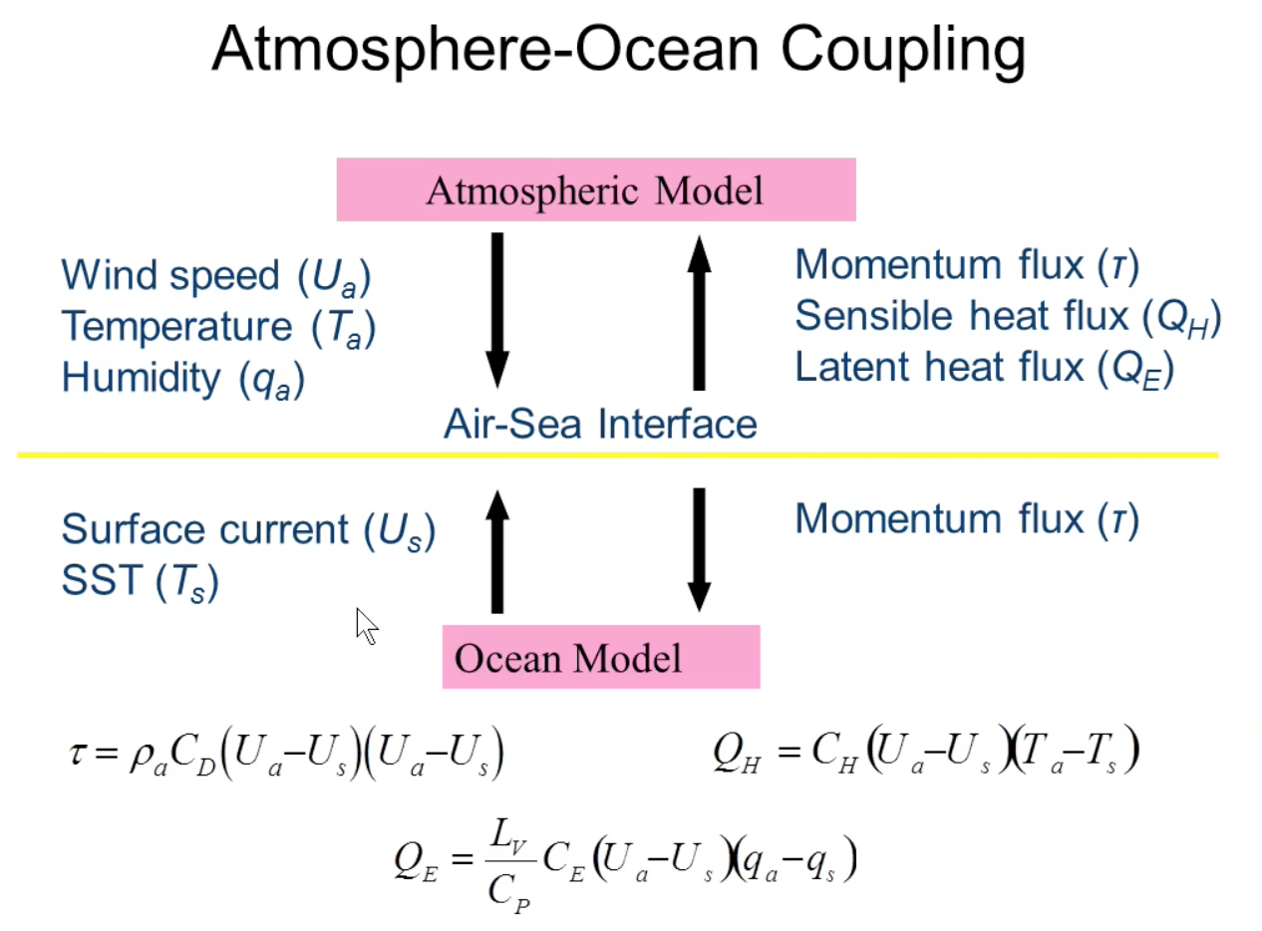
Ginis et al. (2015)

Slide 13
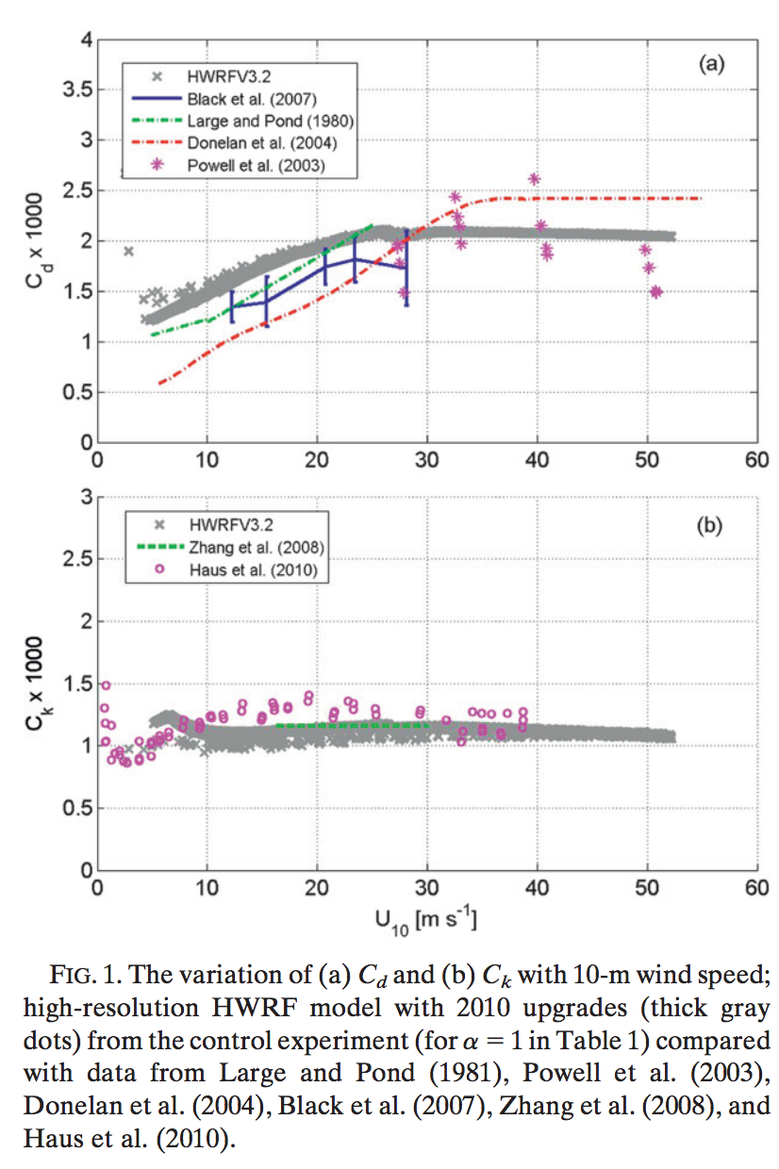
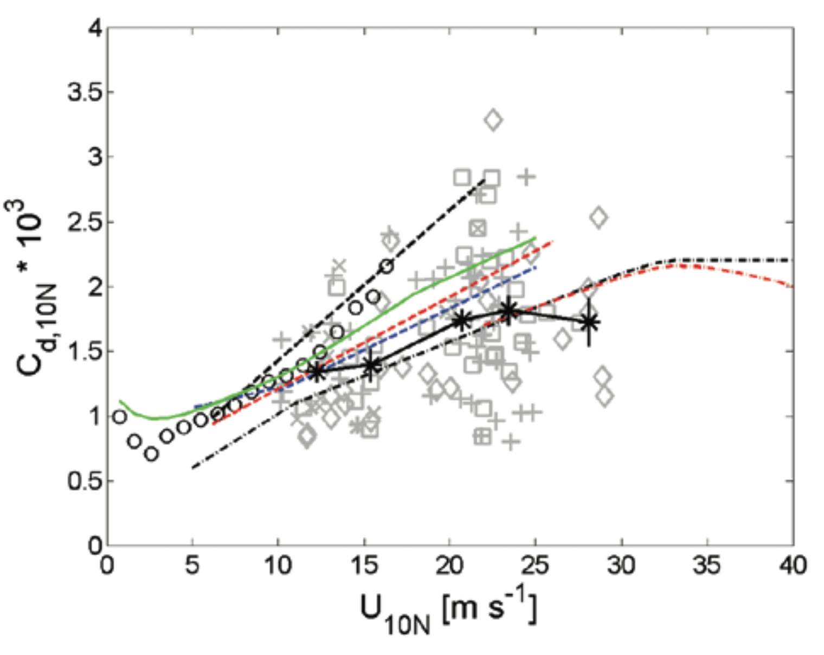
Black et al (2007)
Gopalakrishnan et al. (2013)

Slide 14
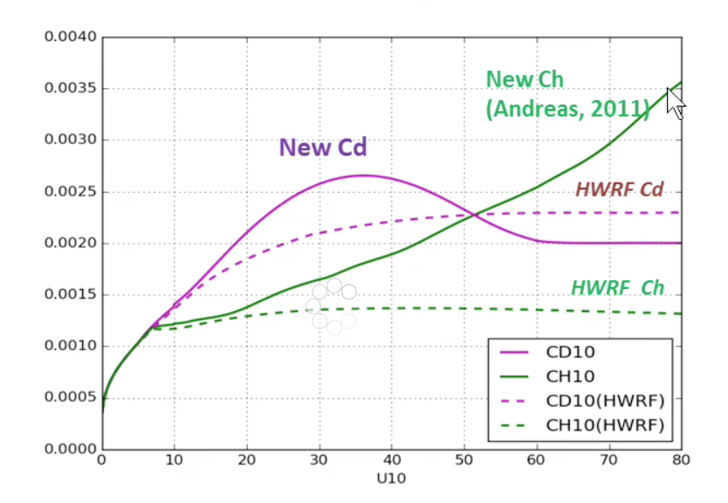
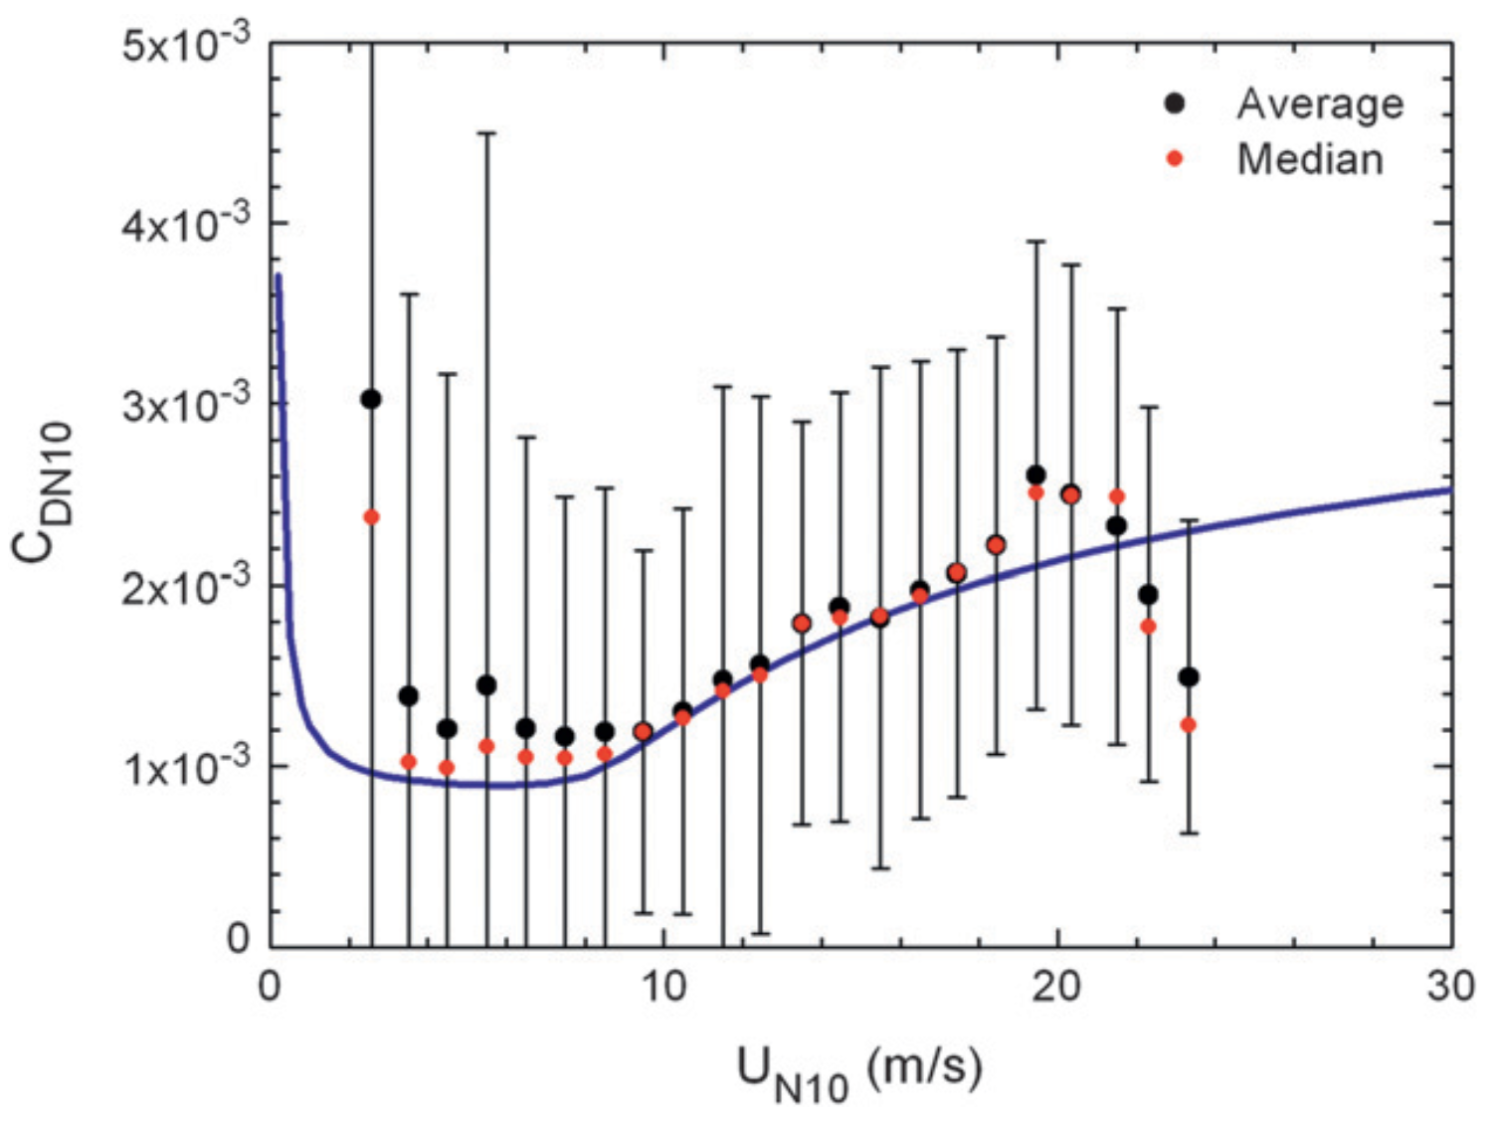
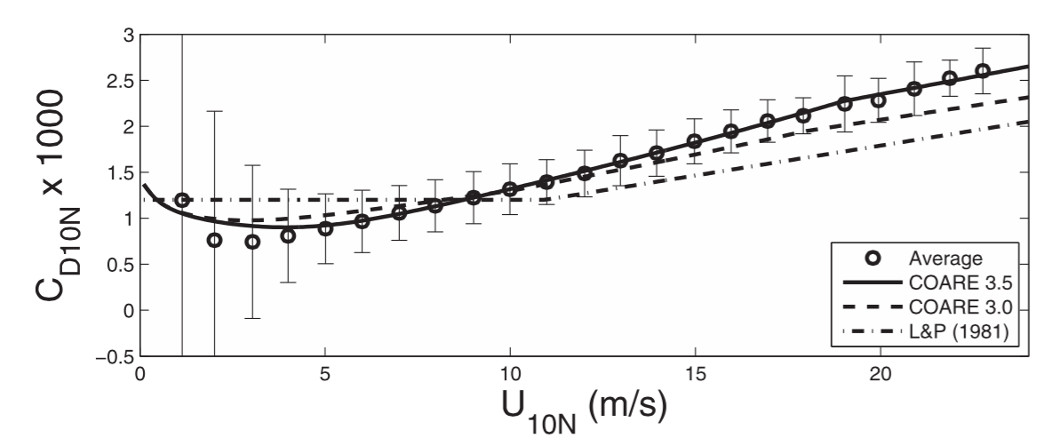
~25%higher than CBLAST at 23m/s
Edson et al. (2013)
Andreas et al. (2012)

Slide 15
Ginis et al. (2015)

Slide 16
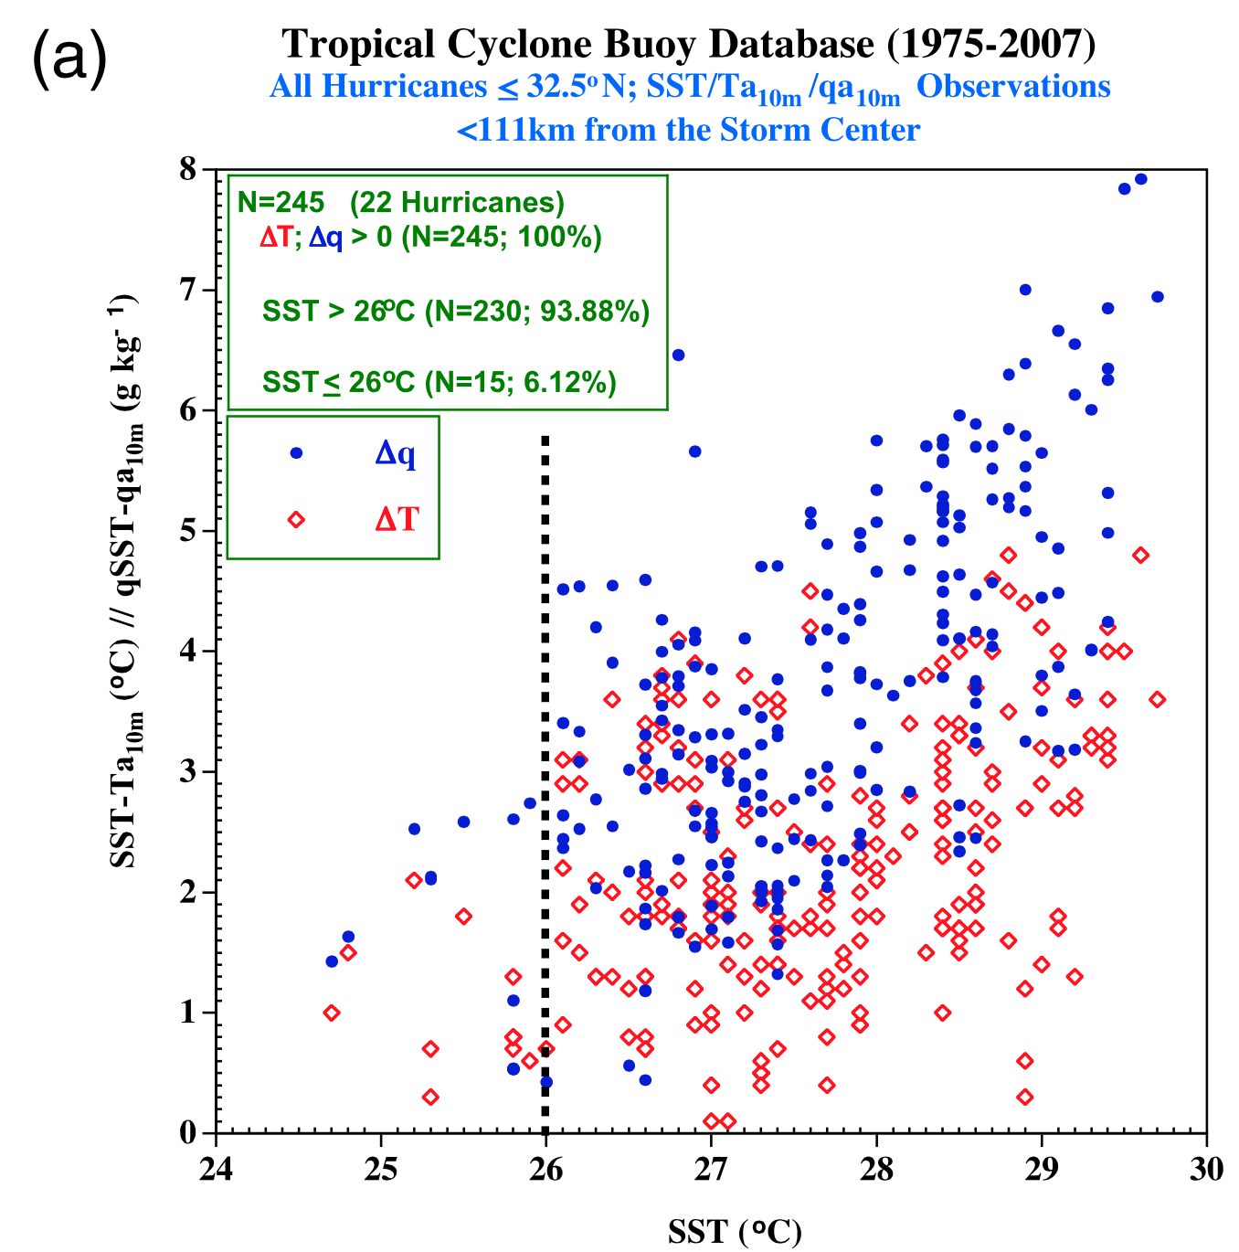
~30 year, air-sea, buoy-based thermodynamical study
Includes the inner core (no, eye and r<~110km)
Take home: It is not SST>26C what (really) matters for the hurricane. What matters is a positive enthalpy flux, roughly captured by Td>SST (and it just happens that Td is observed to be < 26.5C).
Possibly use for HWRF:
Alternative metric for model evaluation
Physically meaningful as it taps into the thermodynamic imbalance that fuels the storm
Not tied to a particular storm, but has a more climatological perspective.
Possibility of identifying biases that can then be a reference for model development.
HWRF?
No 10m data in grib2 files
Cione (2015, MWR)

Slide 17
Parameterization of updraft fraction (σ_{u})
1) Pan et al., 2014:
2) Arakawa & Wu, 2013:
3) Grell & Freitas, 2014:
R ~ 2.86 Km
4) Kwon & Hong, 2015:

Slide 18
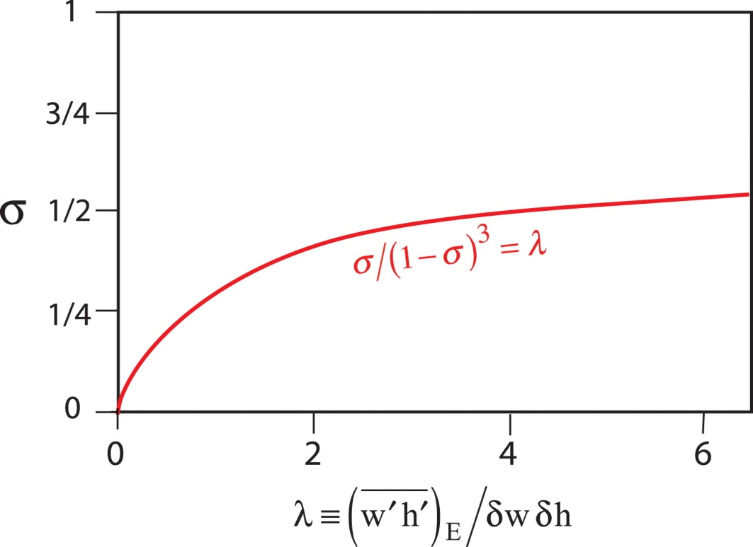
λ in Arakawa & Wu (2013)
(1-σ)² in Grell & Freitas (2014)

Slide 19
Tests in both GFS and HWRF
1)
Arakawa & Wu (AW; 2013)
2)
Grell & Freitas (GF; 2014)
3)
Combination of AW & GF
4)
Modified Grell & Freitas (GFM)

Slide 20
Modified parameterization of updraft fraction (σ_{u}) for scale-aware SAS
1) Arakawa & Wu, 2013:
Use of vertical velocities
at the cloud base
a₁=0.1
2) Grell & Freitas (2014):
3) Modified Grell & Freitas:
Actual entrainment rate at the cloud base is used to compute the cumulus radius rather than the constant value

Slide 21
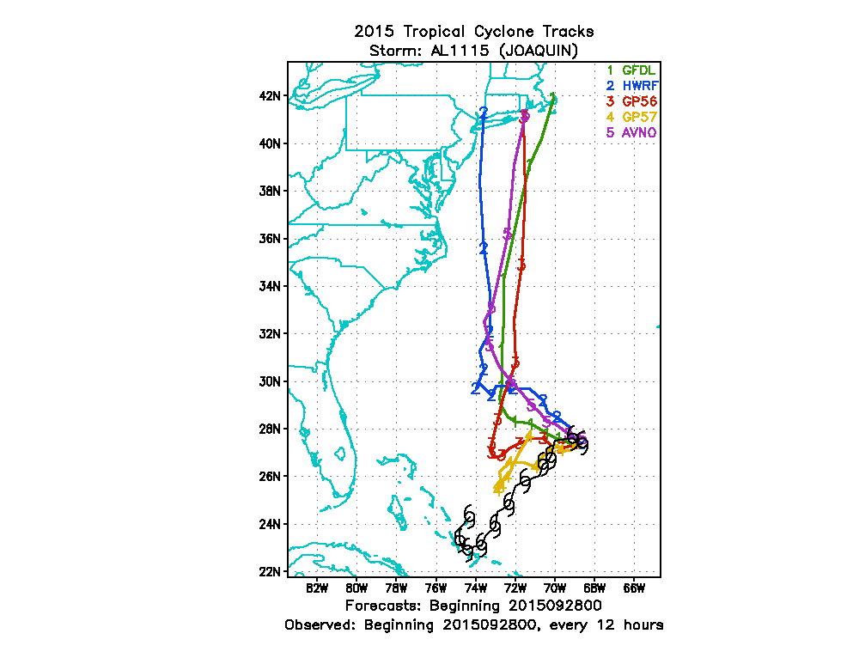
Morris Bender, 2015
Add a “relaxation time” (5 min), more “aggressive” than reducing dtconv
It is not a great idea, from the physics point of view, to call the convection every time step
With the overturning time of convective cells being ~0.5-1 hour, how does 5 min fits here?
2) Tune the entrainment
Reduce c1 (you get best results with it ~80% and have tried 70%)
Best results with the largest reduction of c1 (and even with ncloud=0) but are hesitant about that because
it is less physically justifiable to not pass the info to the microphysics about the activity of convection, essentially, in some way, duplicating some the effects of the convective parameterization?

