Slide 1
URI hurricane-wave coupling research
Isaac Ginis
EMC 12/15/2014
Research group:
Brandon Reichl, Austen Blair, Kun Gao (PhD students)
Biju Thomas, Tetsu Hara

Slide 2
Atmosphere
α
γ
SST
Q_{air}
H_{s}
U_{c}
U_{ref}
R_{air}
c_{p}
Rib
τ_{air}
KE_{D}
Ocean
τ_{diff}
τ_{cor}
λ
La
Waves
U_{c}
U_{λ}
Hurricane model air-sea fluxes depend on sea state, sea spray, and include surface current.
Wave model forced by sea state dependent wind forcing and includes surface current.
Ocean model forced by heat flux, sea state dependent wind stress modified by growing or decaying wave fields and Coriolis-Stokes effect. Turbulent mixing is modified by the Stokes drift (Langmiur turbulence).

Slide 3
τ_{air} – atm. stress
F_{Q} – latent heat flux
F_{S} – sensible heat flux
F_{R} – radiation heat flux
θ – potential temperature
R_{ref}– atm. spec. humidity
Ri_{b} – bulk Richardson num.
U_{ref} – atm. wind
τ_{c} – stress on currents
SST – sea surf. temp.
Atmospheric Model
U_{c} – surface current
U_{λ} – current at depth
λ – mean wavelength
γ –wind/stress misalignment
α – Charnock coeff.
τ_{Cor} - Coriolis-Stokes stress
τ_{dif} – wave mom. budget
Ψ – wave spectrum
La – Langmuir num.
U_{10N} – neutral 10m wind
τ_{air}, F_{Q}, F_{S}
R_{ref}, U_{ref}, θ_{ref}
U_{ref},F_{R}
ASIM
Atm.
fluxes
γ, α,
U_{c}, SST
Ri_{b}, τ_{air}, F_{S}, F_{Q}
U_{c},
U_{λ},
SST
Ocean
Model
Coupler
λ
Wave
Model
La, λ,
F_{R},
F_{Q} ,
F_{S}
U_{λ}
τ_{diff}, τ_{Cor},τ_{air}
τ_{diff}, τ_{Cor},
α, γ, La
U_{ref},
Ri_{b}, U_{c}
Ψ
Ocean
fluxes
Wave
fluxes
τ_{c}
U_{10N}

Slide 4
Coupler
λ
Wave
Model
U_{c} – surface current
U_{λ} – current at depth
λ – mean wavelength
γ –wind/stress misalignment
α – Charnock coeff.
τ_{Cor} - Coriolis-Stokes stress
τ_{dif} – wave mom. budget
Ψ – wave spectrum
La – Langmuir num.
U_{10N} – neutral 10m wind
Ri_{b} – bulk Richardson num.
U_{ref} – atm. wind
U_{λ}
Ψ
U_{ref},
Ri_{b}, U_{c}
τ_{diff}, τ_{Cor},
α, γ, La
Wave
fluxes
U_{10N}
w3asimmd (Air-Sea Interface Module)
w3asim
Interfaces in ww3_shel, computes and processes incoming/outgoing variables.
w3fldX
Calculates wind stress vector from wave spectrum (X represents different theories).
w3mfbg
Calculates wave momentum and energy terms for computing stress budgets.
wmbg
Calculates wave momentum and energy budgets and Coriolis-Stokes stress.
wavemflux
Performs stability adjustments for wind profile when coupled to atmosphere.
bulkfluxes
Calculates bulk fluxes (wind speed dependent) for outside of wave domain.

Slide 5
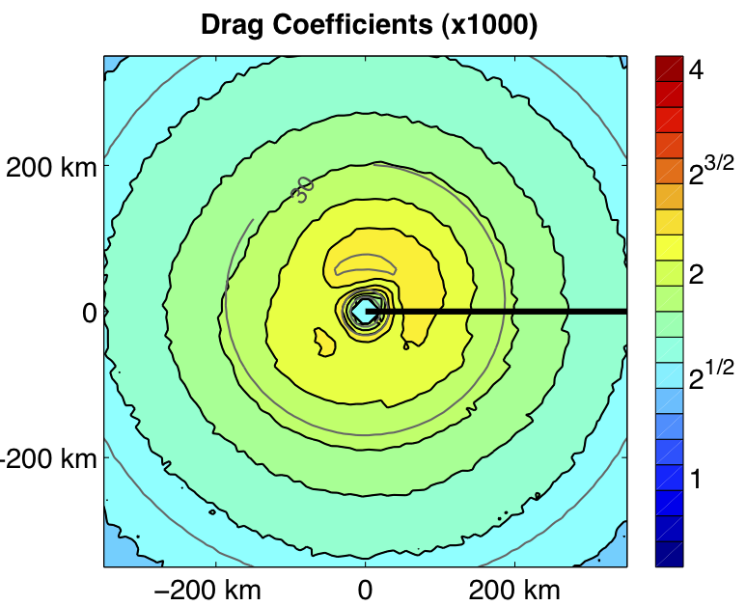
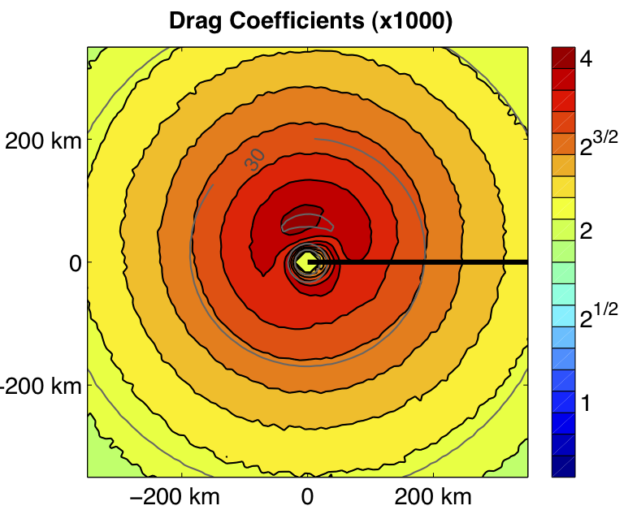
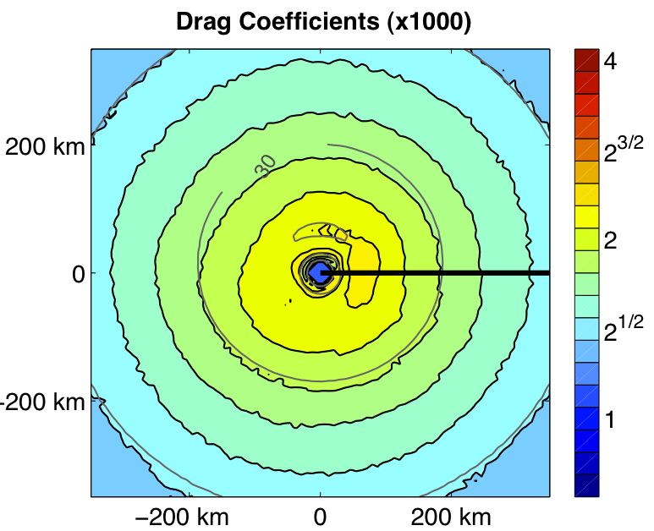
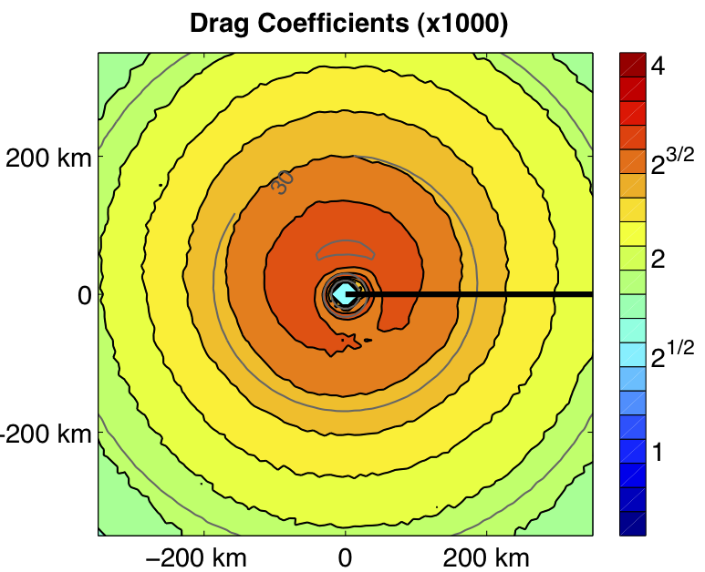
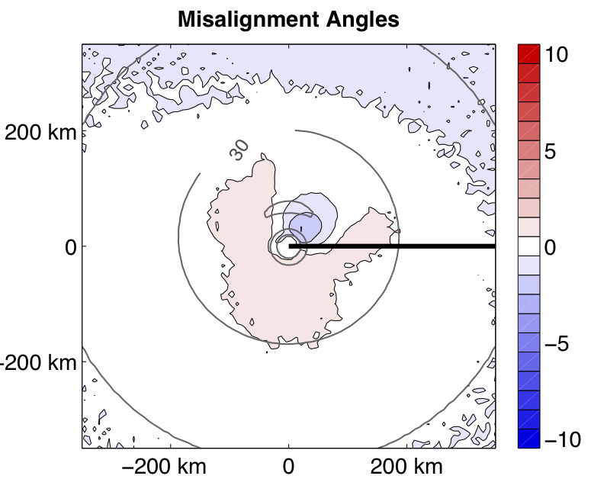
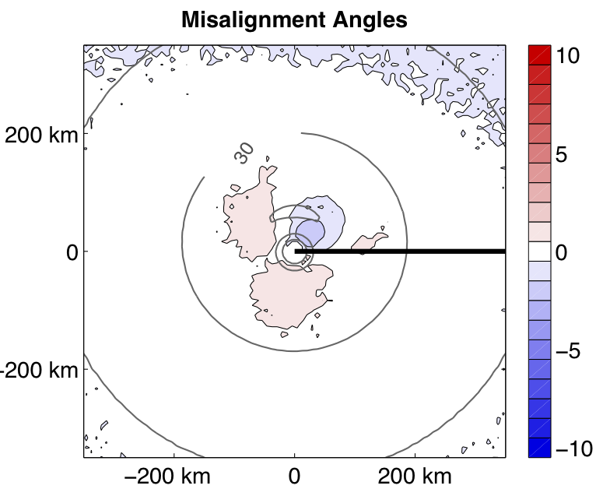
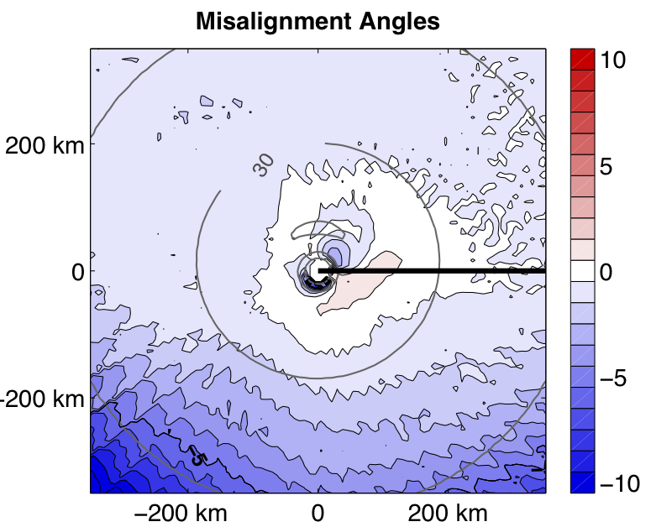
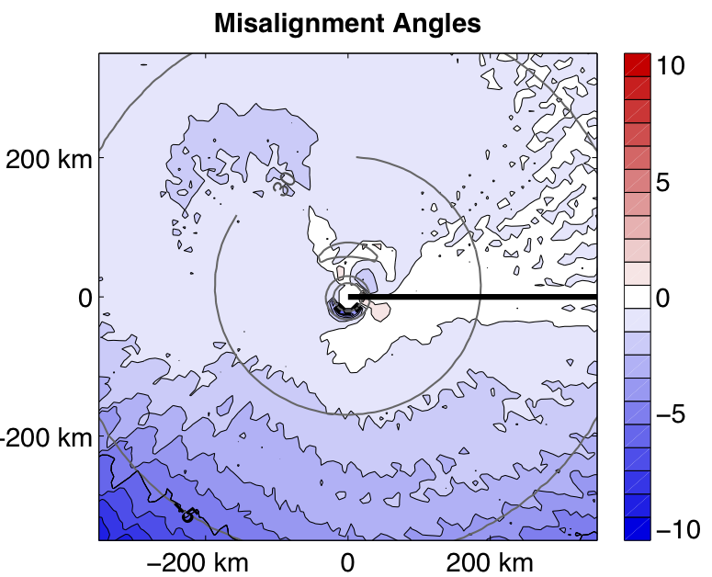
w3fldX – Results (Idealized Tropical Cyclone Experiments)
w3fld1 – Reichl, Hara, and Ginis, 2014 (RHG)
w3fld2 – Donelan, Curcic, Chen, and Magnusson, 2012 (DCCM)
The sea state dependence of the drag coefficient is dependent on the high frequency wave spectral tail.
The angle between the stress and the wind vector is sensitive to the method.
RHG low tail
RHG high tail
DCCM low tail
DCCM high tail
RHG low tail
RHG high tail
DCCM low tail
DCCM high tail

Slide 6
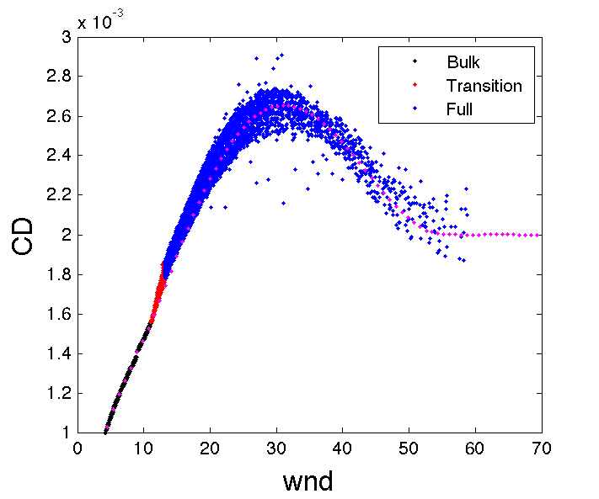
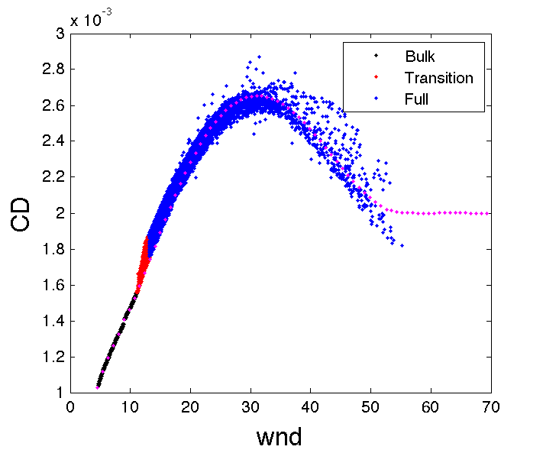
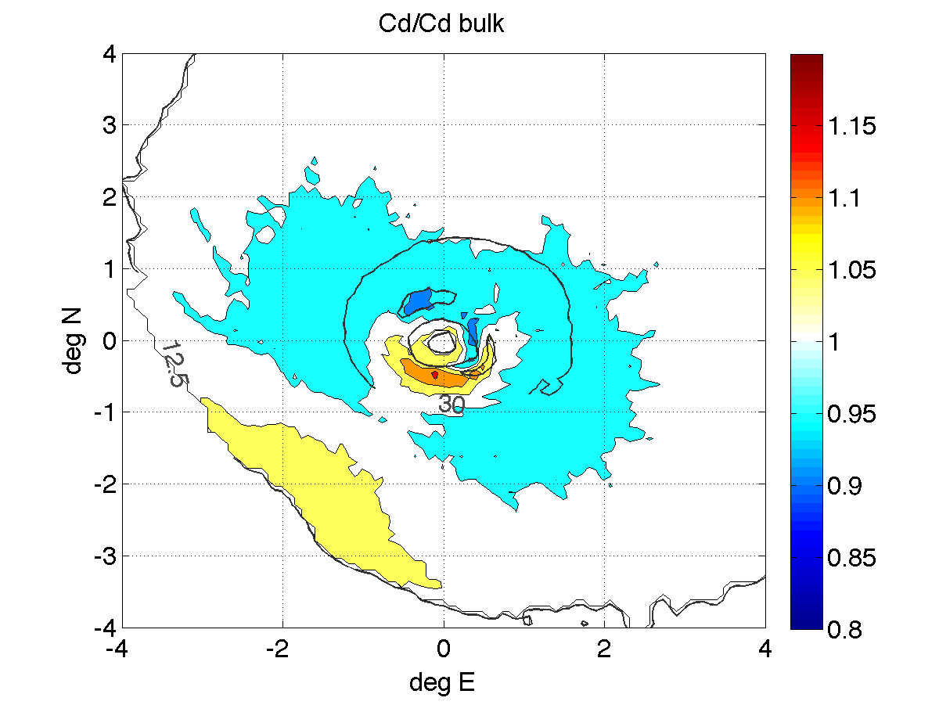
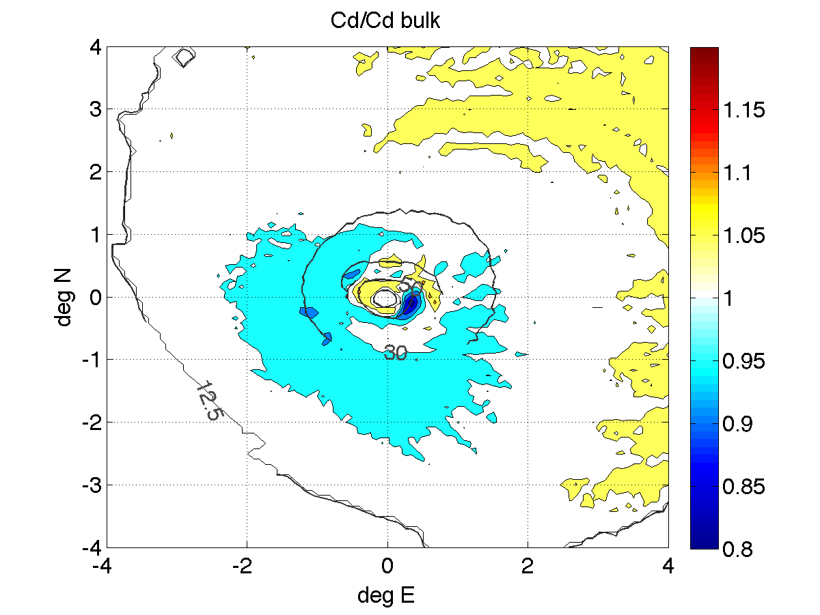
Tail adjustment to match the new bulk Cd formulation
URI method
DCCM method

Slide 7
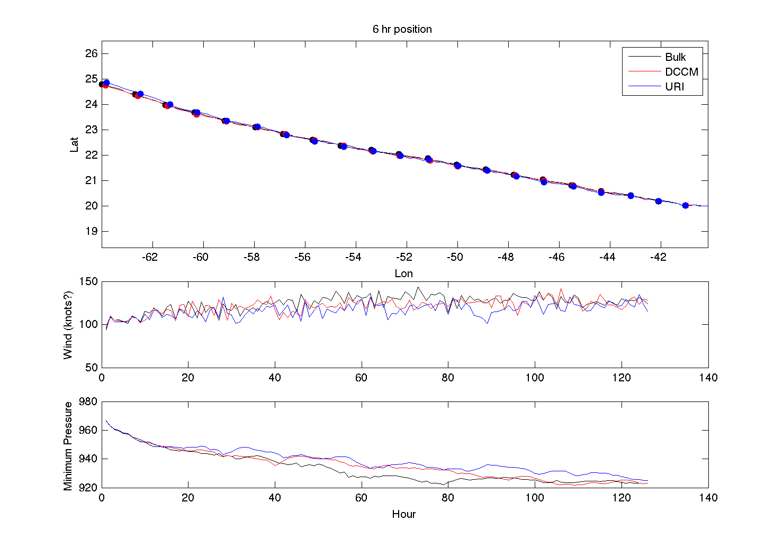
Idealized experiments with GFDL-WW3-MPIPOM

Slide 8
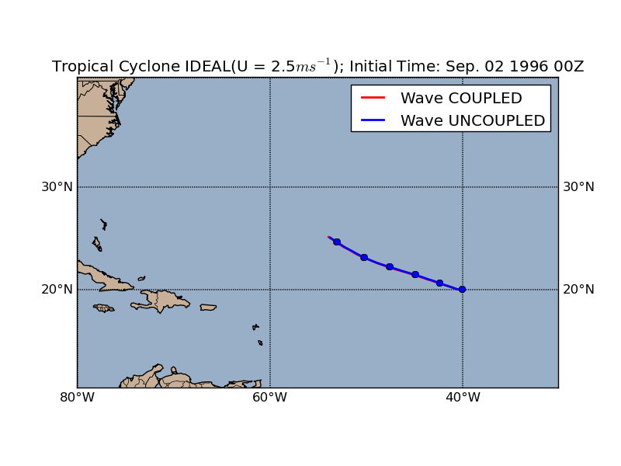
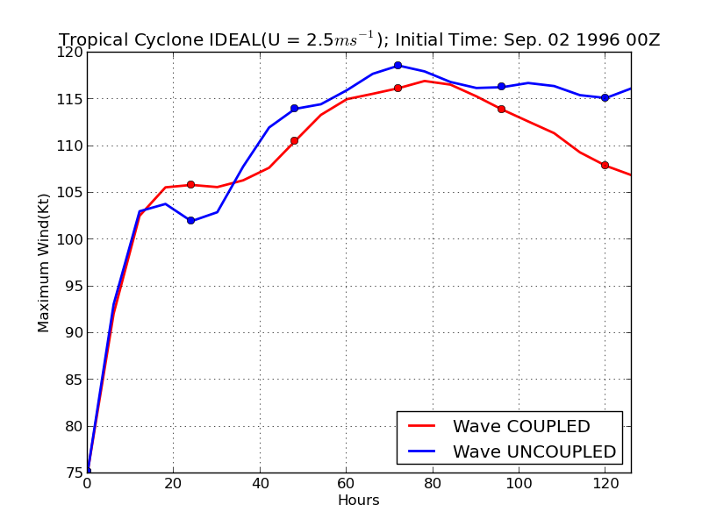
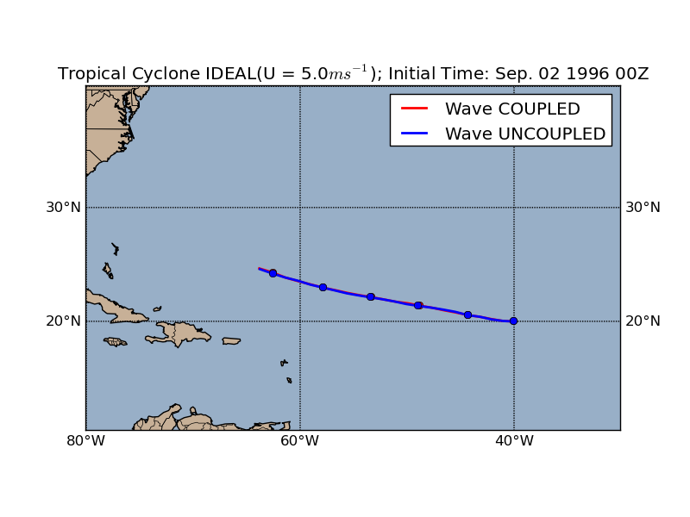
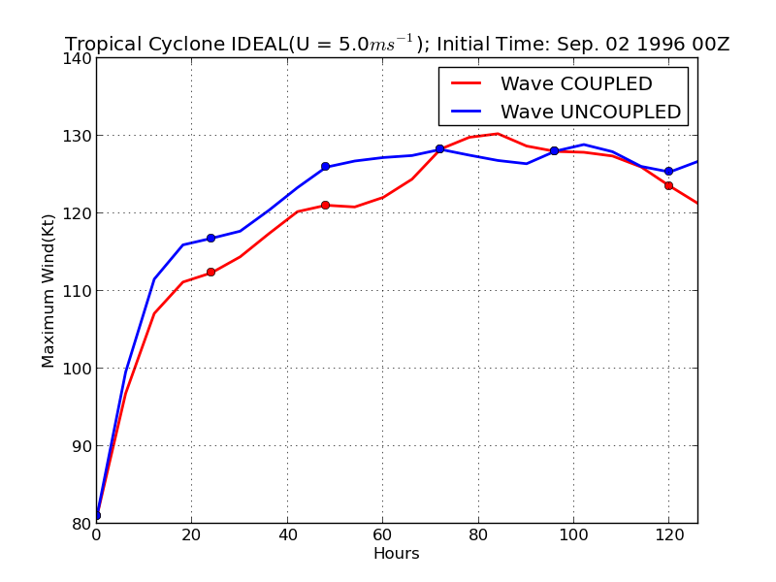
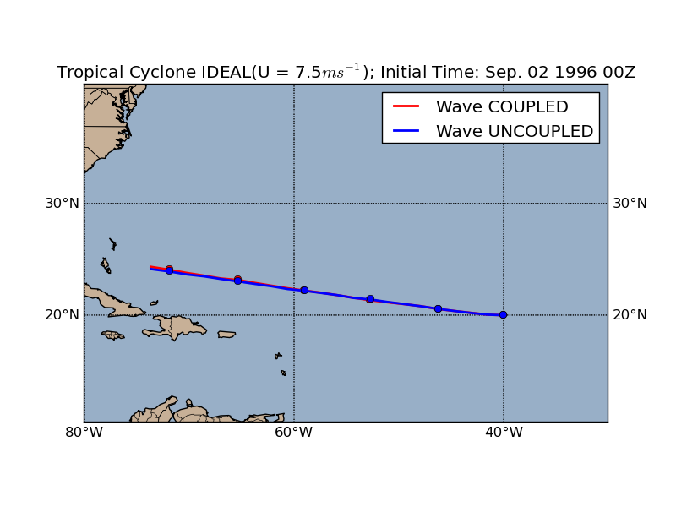
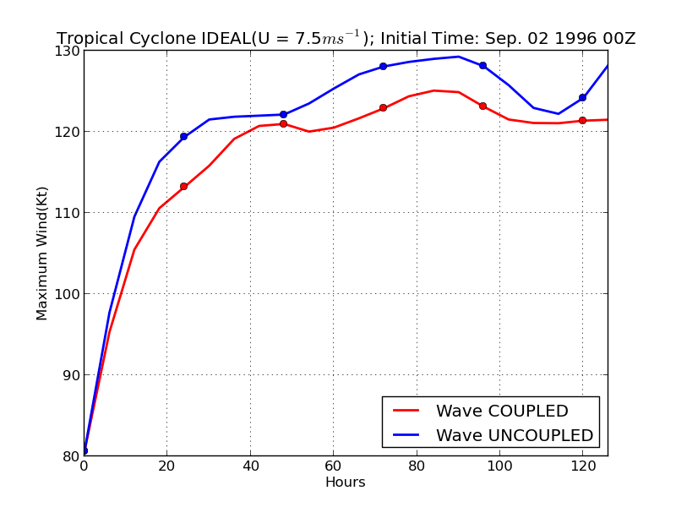
Idealized experiments: impact of different storm translation speeds (URI method)
2.5 m/s
5.0 m/s
7.5 m/s

Slide 9
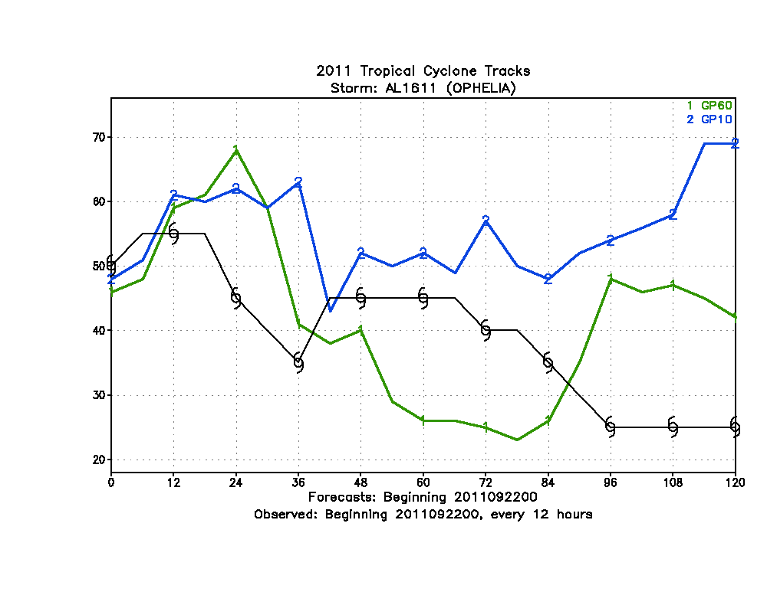
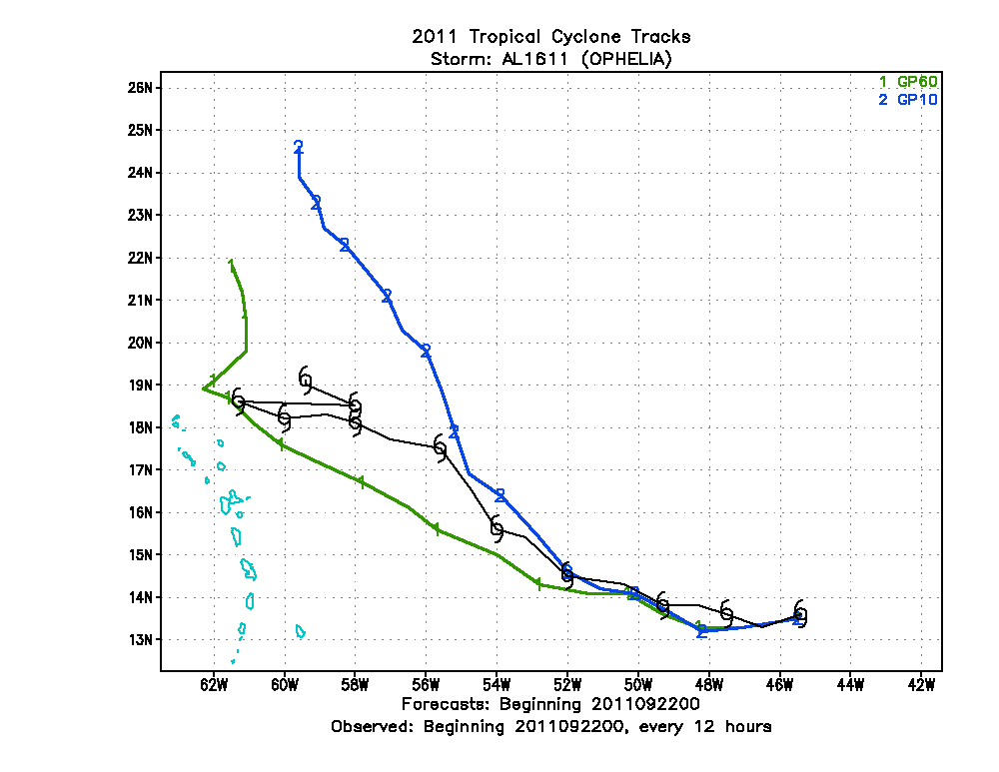
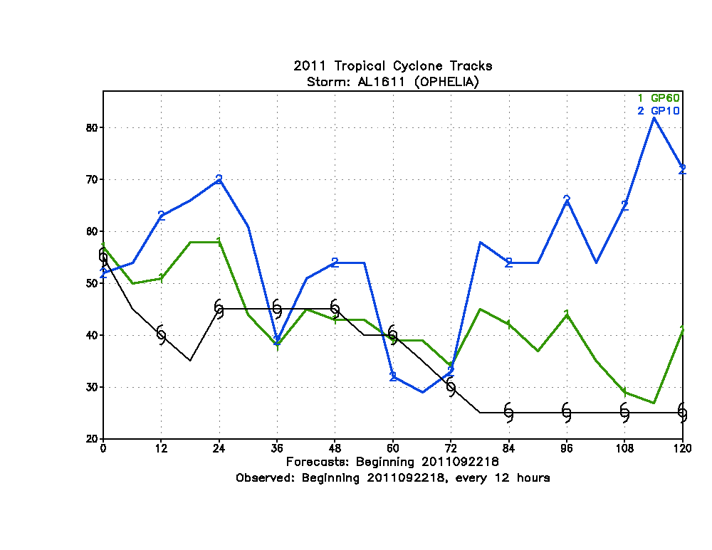
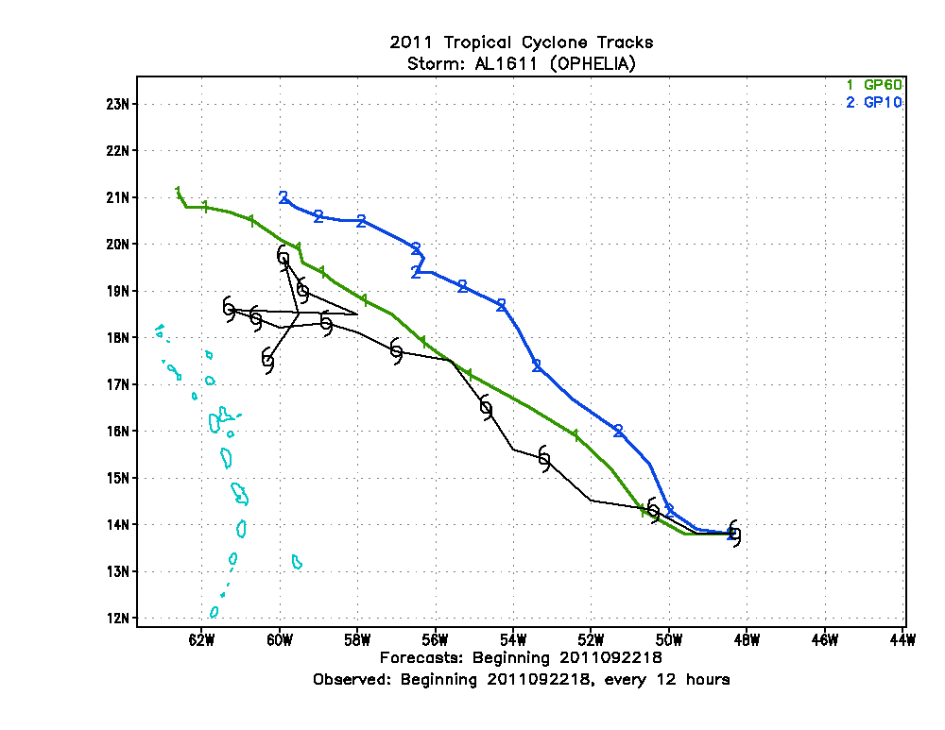
Real-case tests: Ophelia
Blue – no waves
Green – with waves
AVERAGE INTENSITY ERRORS (KT) FOR HOMOGENEOUS SAMPLE
00 12 24 36 48 72 96 120
GP60 5.0 11.8 12.9 11.4 13.9 25.1 20.0 17.3
GP10 4.6 12.1 12.5 11.6 14.8 25.2 30.3 31.9
#CASES 38 36 36 34 32 28 24 22

Slide 10
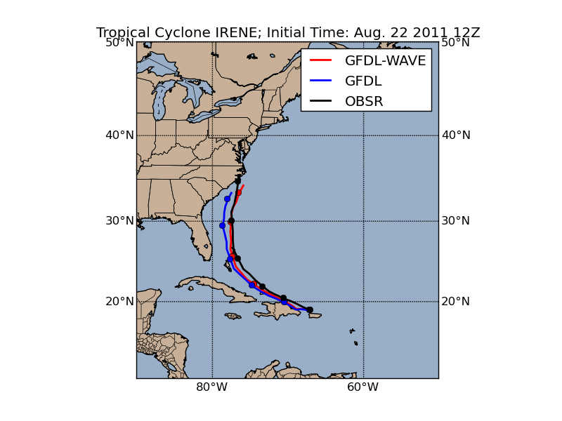
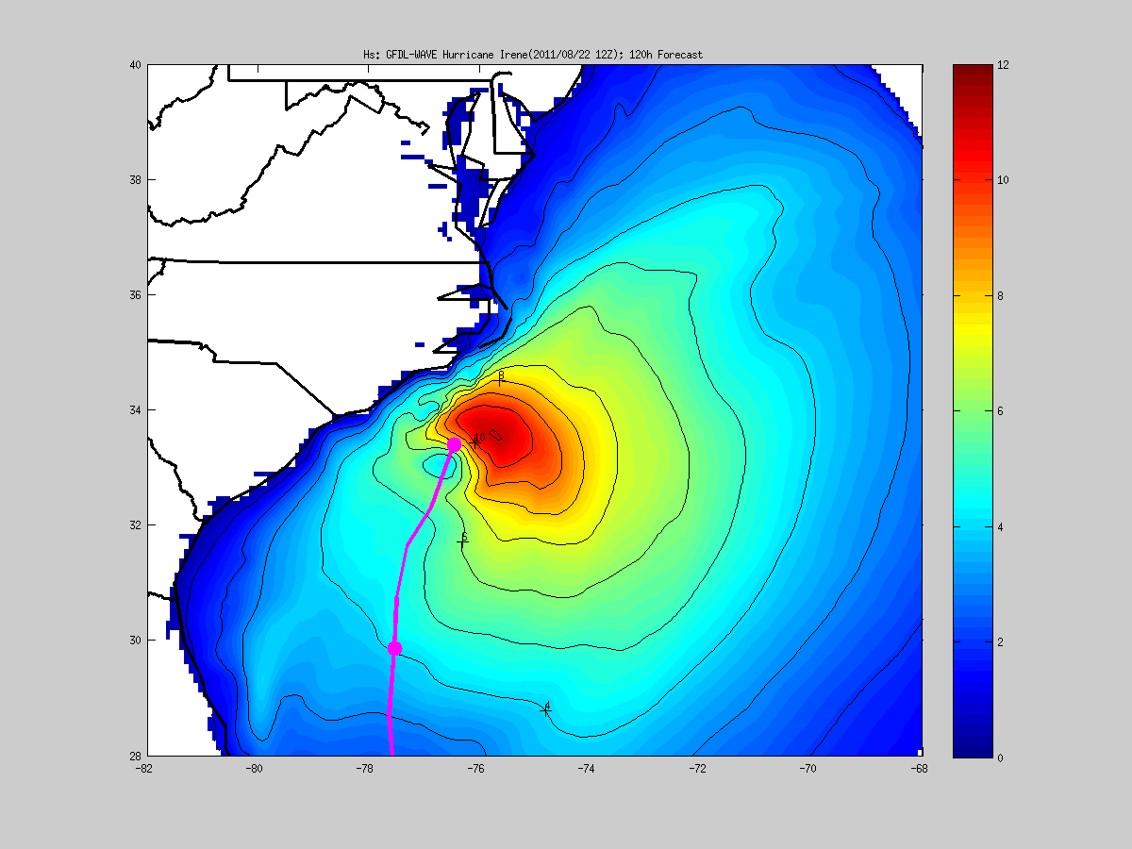
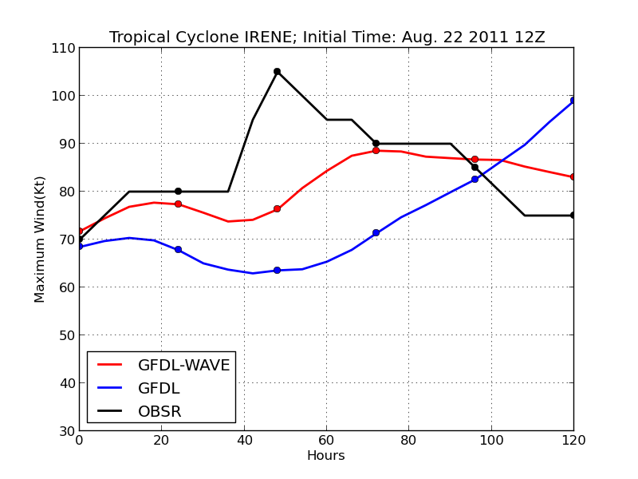
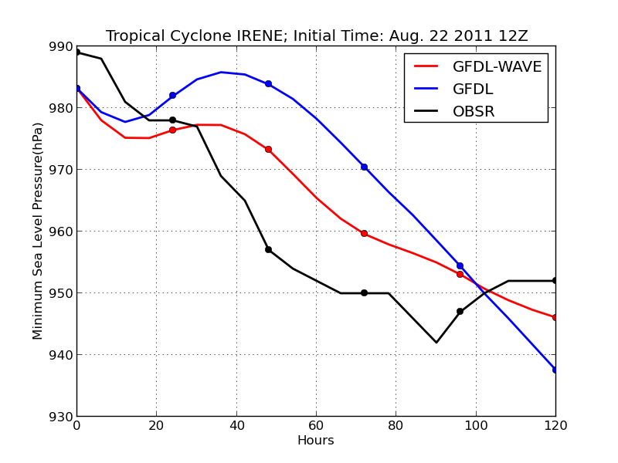
Real-case tests: Irene (Initial time: Aug. 22, 2011 12Z)

Slide 11
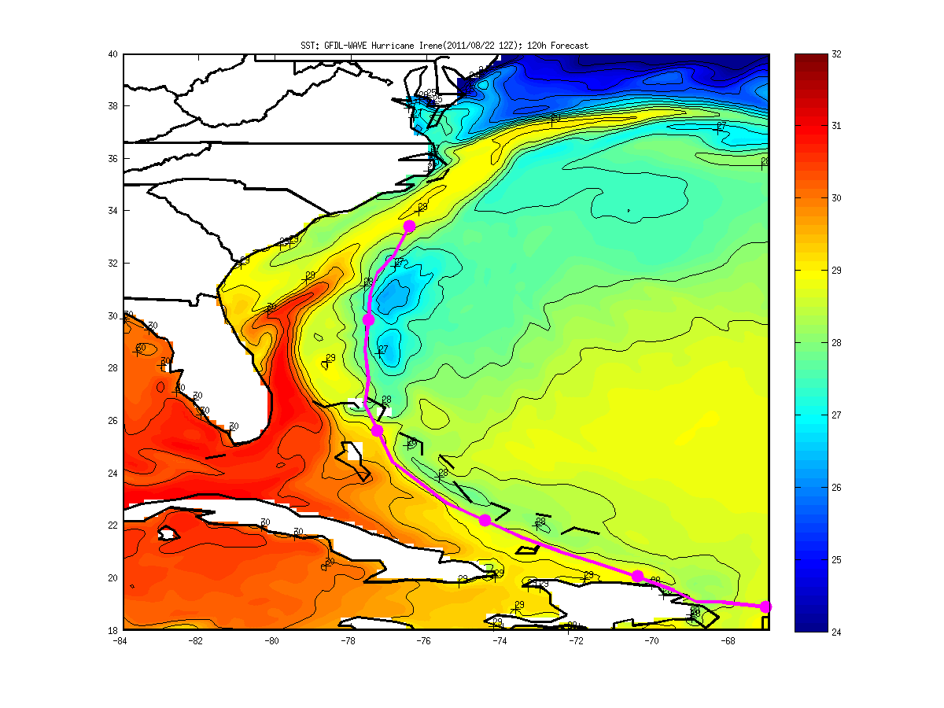
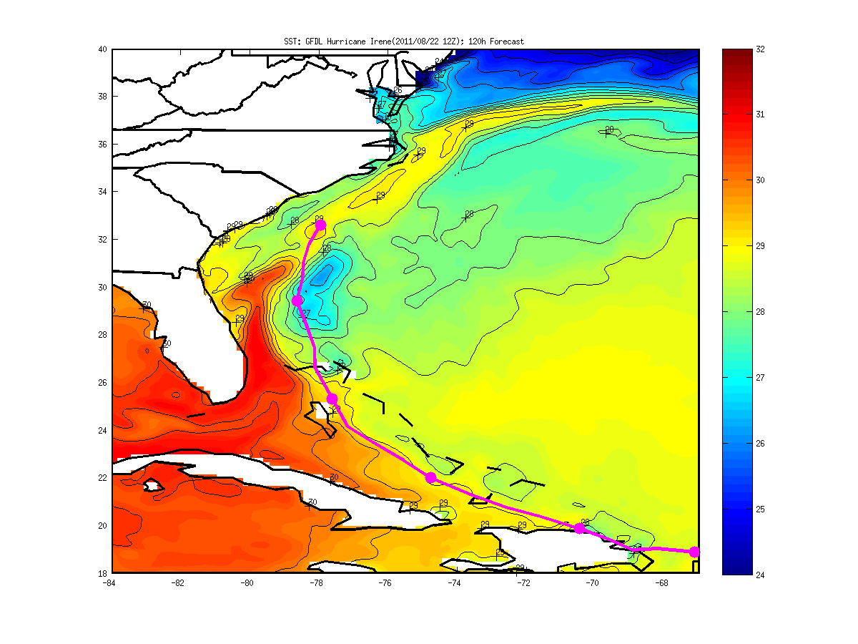
Real-case tests: Irene (Initial time: Aug. 22, 2011 12Z)
With waves
No waves

Slide 12
Average track & intensity errors 489 cases in 2010-2012
average track errors (NM) FOR HOMOGENEOUS SAMPLE
00 12 24 36 48 72 96 120
G10I 11.3 29.2 46.6 62.6 77.4 113.0 166.2 256.6
G60I 11.3 29.3 46.3 62.4 77.7 112.9 167.0 257.1
#CASES 489 464 438 414 388 342 297 251
AVERAGE INTENSITY ERRORS (KT) FOR HOMOGENEOUS SAMPLE
00 12 24 36 48 72 96 120
G10I 2.9 7.1 9.4 11.7 13.4 14.9 15.6 16.4
G60I 2.9 7.2 9.4 11.3 13.2 14.7 15.4 16.2
#CASES 489 464 438 414 388 342 297 251
G10I – no waves G60I- with waves

Slide 13
Next steps
Implement and test wave-dependent Langmuir mixing in the ocean mixing parameterization
Finish the development of HWRF-WW3-MPIPOM

