Slide 1
URI hurricane research
Isaac Ginis
EMC 12/15/2014
Research group:
Brandon Reichl, Austen Blair, Kun Gao (PhD students)
Biju Thomas, Tetsu Hara

Slide 2
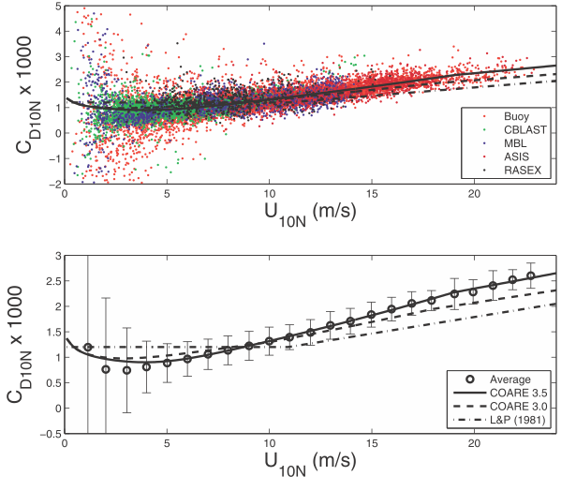
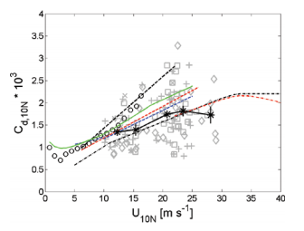
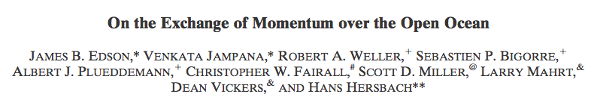
C_{d} direct measurements
COARE 3. 5 (Edson et al. 2013)
CBLAST (Black et al. 2007)
CBLAST C_{d} is significantly lower compared to direct measurements and COARE 3.5 at U₁₀< 25 m/s

Slide 3
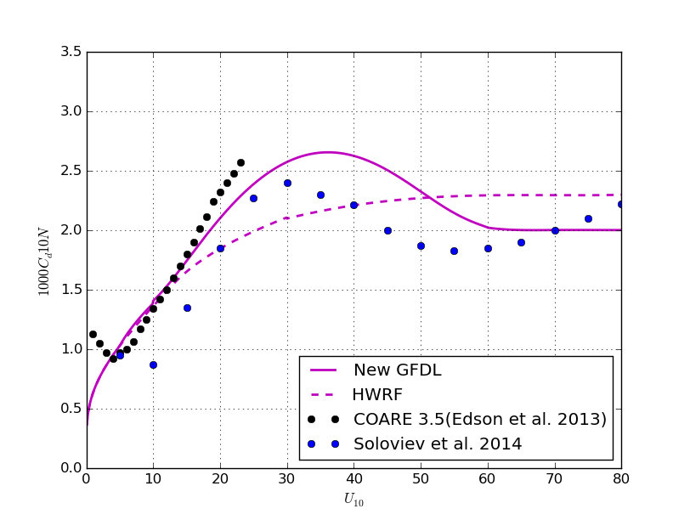
New C_{d} Formulation and
Referenced Studies
COARE 3.5
HWRF
Soloviev et al.

Slide 4
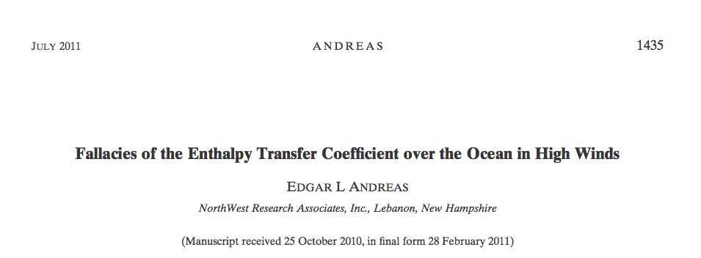
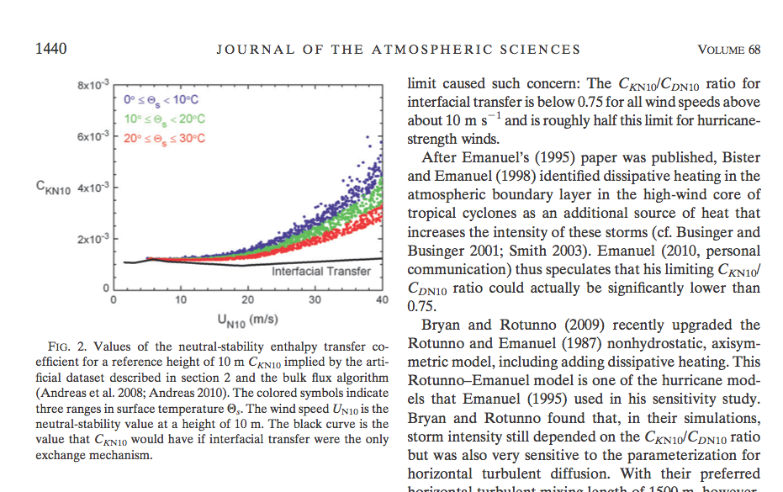
New C_{h} Formulation and
Referenced Studies

Slide 5
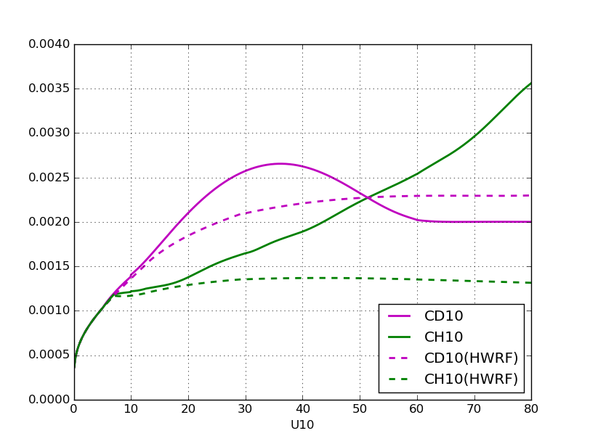
New GFDL C_{d} and C_{h} formulations
New Ch
New Cd
Current HWRF
and GFDL Cd
Current HWRF Ch

Slide 6
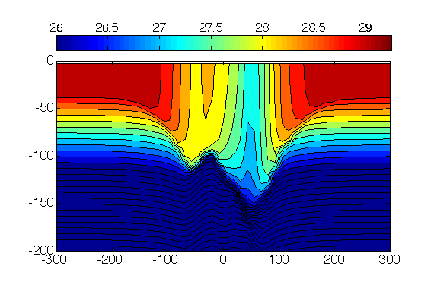
Evaluating ocean mixing parameterization in hurricane conditions and impact of Langmuir turbulence
(NSF-funded project in collaboration T. Kukulka, U. Delaware)
60 m/s
65 m/s
Strong Winds
Heat Flux
Momentum Flux
Storm Translation
depth (m)
Turbulent Mixing
5 m/s
Transect of ocean Temperature under a hurricane from a numerical simulation.
(km)
(°C)

Slide 7
1D ocean column model and LES model
⬥ A 1D column model (General Ocean Turbulence Model) that uses multiple mixing schemes including Mellor-Yamada and KPP
⬥ The resulting currents and temperature from the 1D model are compared to an LES model.
⬥ The identical wind stress (τ) is used to force the LES model.
750 m
LES domain
τ
dx, dy ~3 m
dz ~1 m
750 m
1D column
Stokes drift
240 m
⬥ If the column model can match the horizontal mean of the LES over a range of hurricane wind conditions, then the modified KPP can be used to better include Langmuir turbulence in basin scale models.

Slide 8
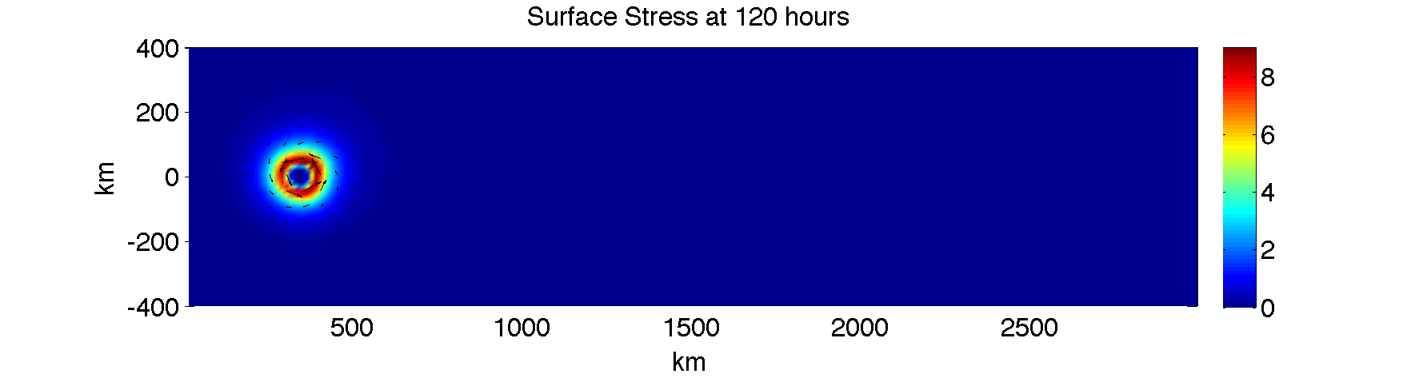
Experimental setup
• Translating idealized hurricane
1D and LES models are run at the same locations to the right and left of the storm track

Slide 9
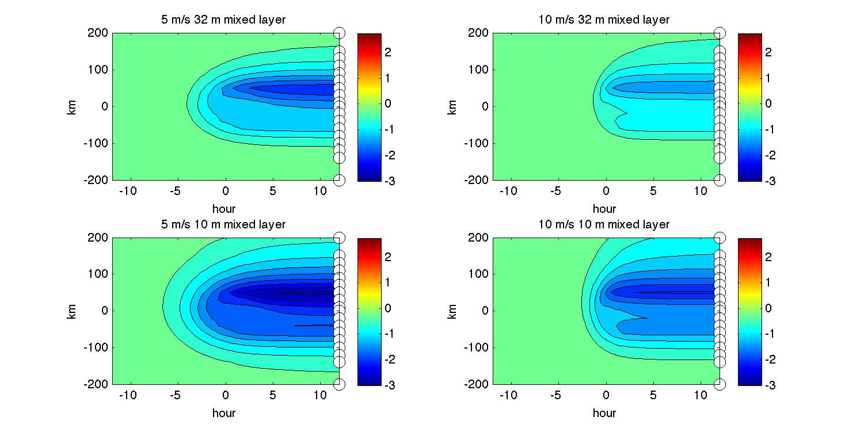
Locations of 1D and LES models

Slide 10
KPP parameterization and Langmuir turbulence
K-Profile Parameterization (Large et al., 94)
⬥ Stokes drift is the net movement of water due to the wave orbitals below surface waves.
⬥ Vertical turbulent fluxes mix momentum and temperature in the upper ocean.
u (or v) equation
θ equation
⬥ Langmuir circulations are generated through interaction between Stokes drift of the surface wave field and vorticity of the currents.
⬥ Boundary layer models parameterize these terms from the shear of the mean.
τ
⬥ K can be determined using the KPP model as:
Stokes drift
h - Mixing layer depth
W - Turbulent velocity scale
G (z) - Non-dimensional shape-function

Slide 13
Including explicit Langmuir turbulence in KPP
⬥ We tested two ways in which previous studies have included Langmuir turbulence in KPP.
Enhancing the turbulent velocity scale (McWilliams and Sullivan, 2001)
⬥ The enhancement is a function of the turbulent Langmuir number (La) which is the ratio of the wind friction (stress) to Stokes drift current.
⬥ We choose a definition of La that accounts for misalignment from the shear for the wind and the Stokes drift (Van Roekel et al., 2012).
Using Lagrangian currents and K (McWilliams et al., 2012)
⬥ The K-parameter is determined by the Lagrangian currents (Eulerian currents + Stokes drift), rather than the Eulerian currents.

Slide 14
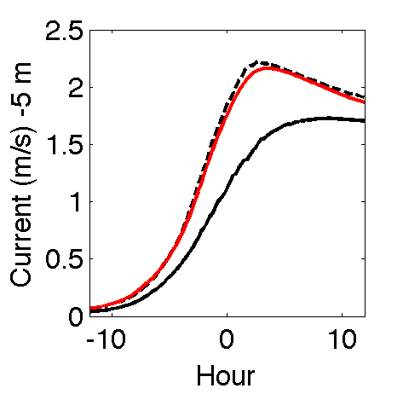
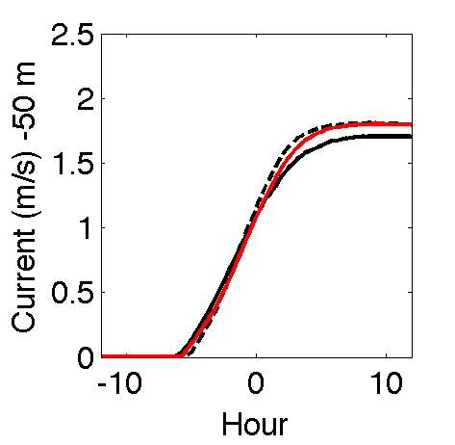
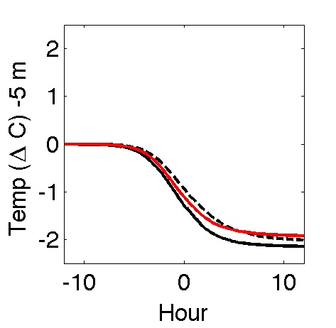
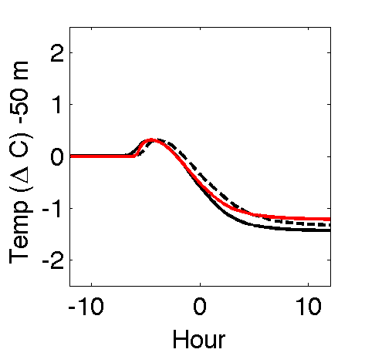
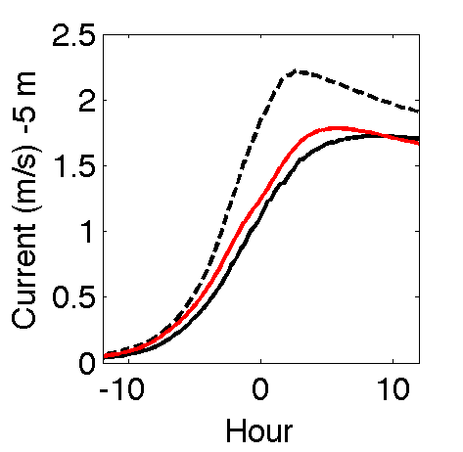
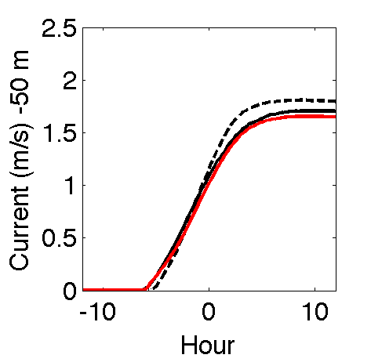

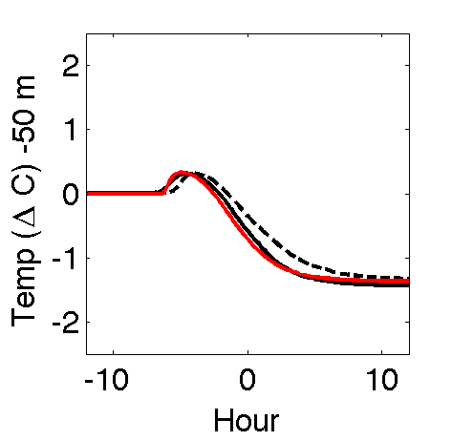
The modified KPP scheme works well to reproduce both the LES with and without Stokes drift at shallow and deep depths.
LES w/ Stokes
LES w/o Stokes
1D results
Results from modified GOTM 1D model (located at right side RMW) under an idealized hurricane compared to LES results.
Currents
KPP w/ Ri_{c}=0.125
Temperature
SHALLOW
DEEP
SHALLOW
DEEP
KPP w/ Ri_{c}=0.125 & both enhancement and Lagrangian currents
SHALLOW
DEEP
SHALLOW
DEEP

Slide 15
Single grid roll-resolving model
(ONR-funded project in collaboration with J. Doyle, NRL)
Hurricane model
idealized stationary, axisymmetric hurricane BL
COAMPS-TC
Singe Grid Roll-resolving model
local Cartesian coordinates
resolves roll equations at a single grid
of the hurricane model
provides roll-induced fluxes to the hurricane model

Slide 16
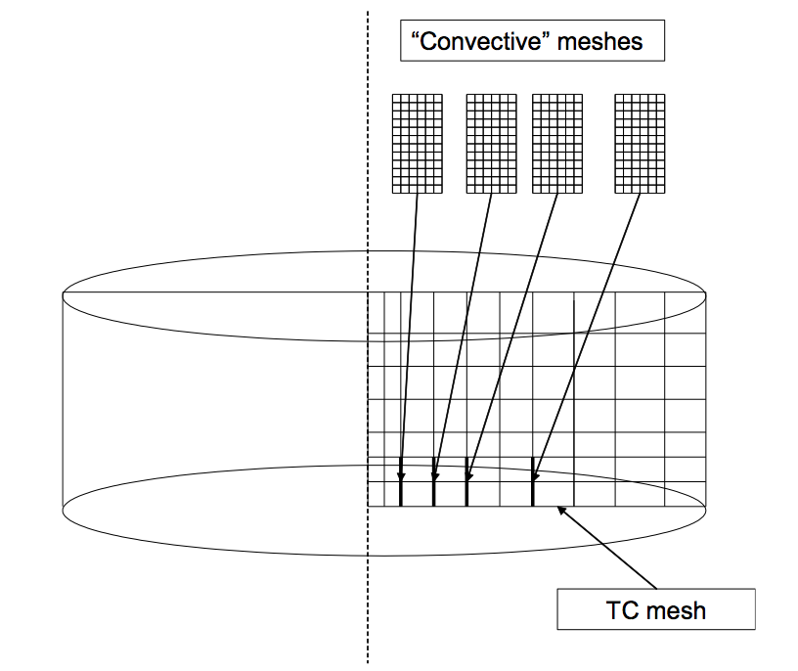
Conceptual diagram of embedding SRM into the hurricane model
z
Mesh of
hurricane model
z
Mesh of SRM

Slide 17
Conceptual diagram of embedding SRM
into the hurricane model
z
Mesh of
hurricane model
SRM is embedded
at this location

Slide 18
Conceptual diagram of embedding SRM
into the hurricane model
z
Mesh of
hurricane model
SRM is embedded at multiple locations

Slide 19
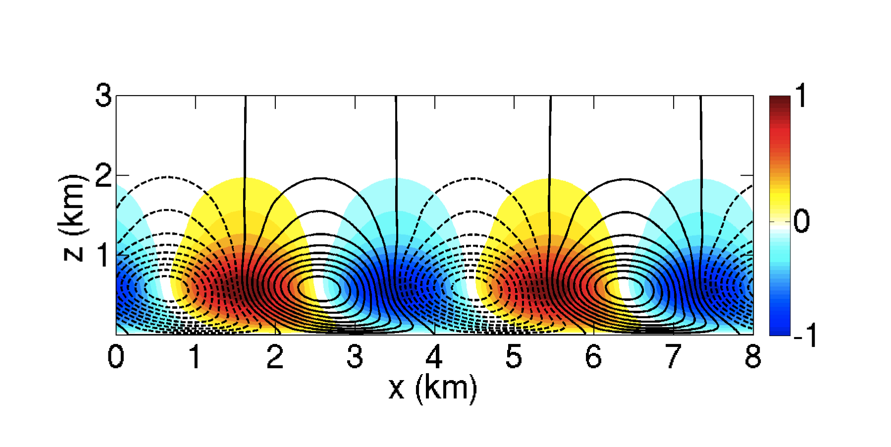
Generation mechanism of rolls in HBL:
Inflection point instability of radial wind profiles
(Gao and Ginis, 2014, J. Atmos. Sci.)
inflection points
Rolls generated by inflection point instability
(no stratification effect considered)
Colors: normalized vertical velocity
Contours: streamlines
Mean HBL wind distribution
(resolved by URI-HBL model)

Slide 20
Typical stratification profile in the hurricane
Stable layer
Mixed layer
θv (K)
dθv/dz (K/km)
virtual potential temperature
Research question:
How does stratification, particularly the mixed layer height, affect rolls?

Slide 21
Five Experiments
initial radial wind profile
(same in all experiments)
initial stratification profiles
(mixed layer height is varied)
mixed layer height
inflection point
Mean radial wind (m/s)
Mean θv (K)

Slide 22
Domain-averaged kinetic energy of rolls
Under a higher mixed layer, rolls can reach a stronger magnitude.

Slide 23
Roll structures under lower and higher mixed layer
Mixed layer height = 300 m
Mixed layer height = 600 m
Cross-roll direction
Cross-roll direction
Contours : streamlines
Color : vertical velocity
Rolls can trigger internal waves in the stable layer.
Under a higher mixed layer, phase lines of internal waves are more inclined from the vertical.

Slide 24
Embedding SRM into COAMPS-TC
total wind speed at z=3km
roll-induced tendencies
resolved by SRM

Slide 25
Approach
Original formulation:
New (COAMPS-TC with SRM):

Slide 26
Experimental Strategy
Stationary TC
Two-step calculations:
Step 1: Run COAMPS-TC (original version) to spin up a TC vortex, as the initial condition for the TC-roll coupled experiments.
Step 2: Run COAMPS-TC with SRM embedded at selected locations (with λ modification).

Slide 27
Step 1: Spinning up the TC vortex
Model setup:
f-plane : 20N
SST : 303.1K
Domain size : 1000km X 1000km
Horizontal resolution : 5km
PBL option: 2 (original MY)
Start from weak a barotropic vortex and run for 70hr

Slide 28
Step 2: Group 1 experiments
Two experiments:
ROLL: with rolls (with λ modification)
CTRL: without rolls (with λ modification)

Slide 29
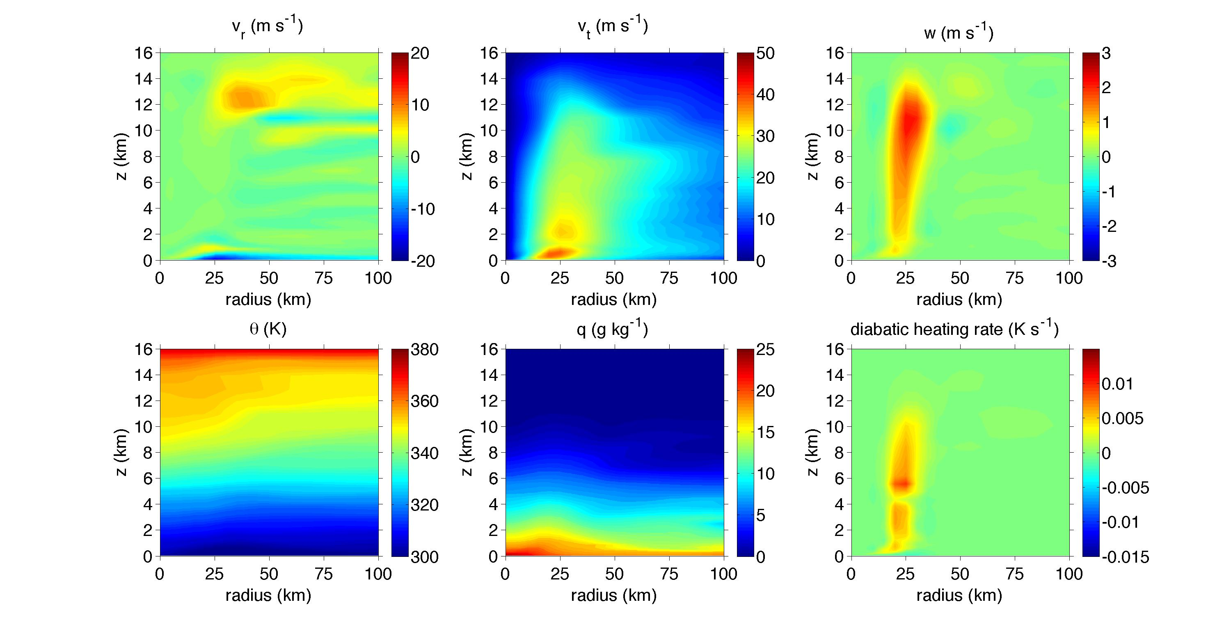
Initial TC structure for the coupled TC-roll run
Azimuthal-averaged
70hr after the spin-up run

Slide 30
SRM are embedded at the grid points within
radius = [15-50] km
total wind speed at z=3km
70hr after the spin-up run

Slide 31
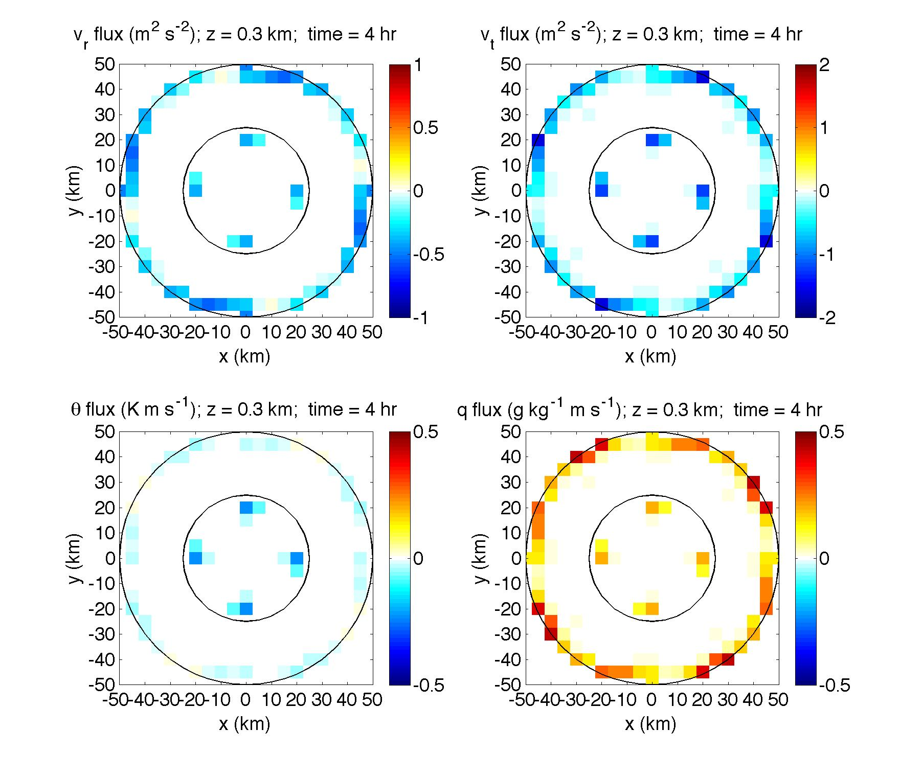
Formation of rolls
Roll-induced fluxes at 300m (mid BL), t=4hr

Slide 32
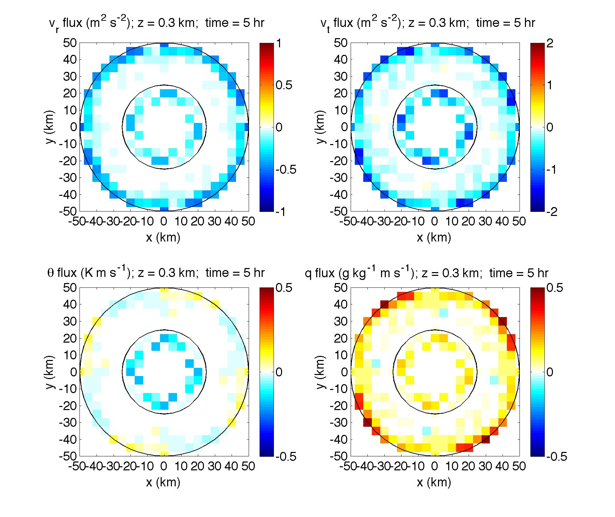
Formation of rolls
Roll-induced fluxes at 300m (mid BL), t=5hr

Slide 33
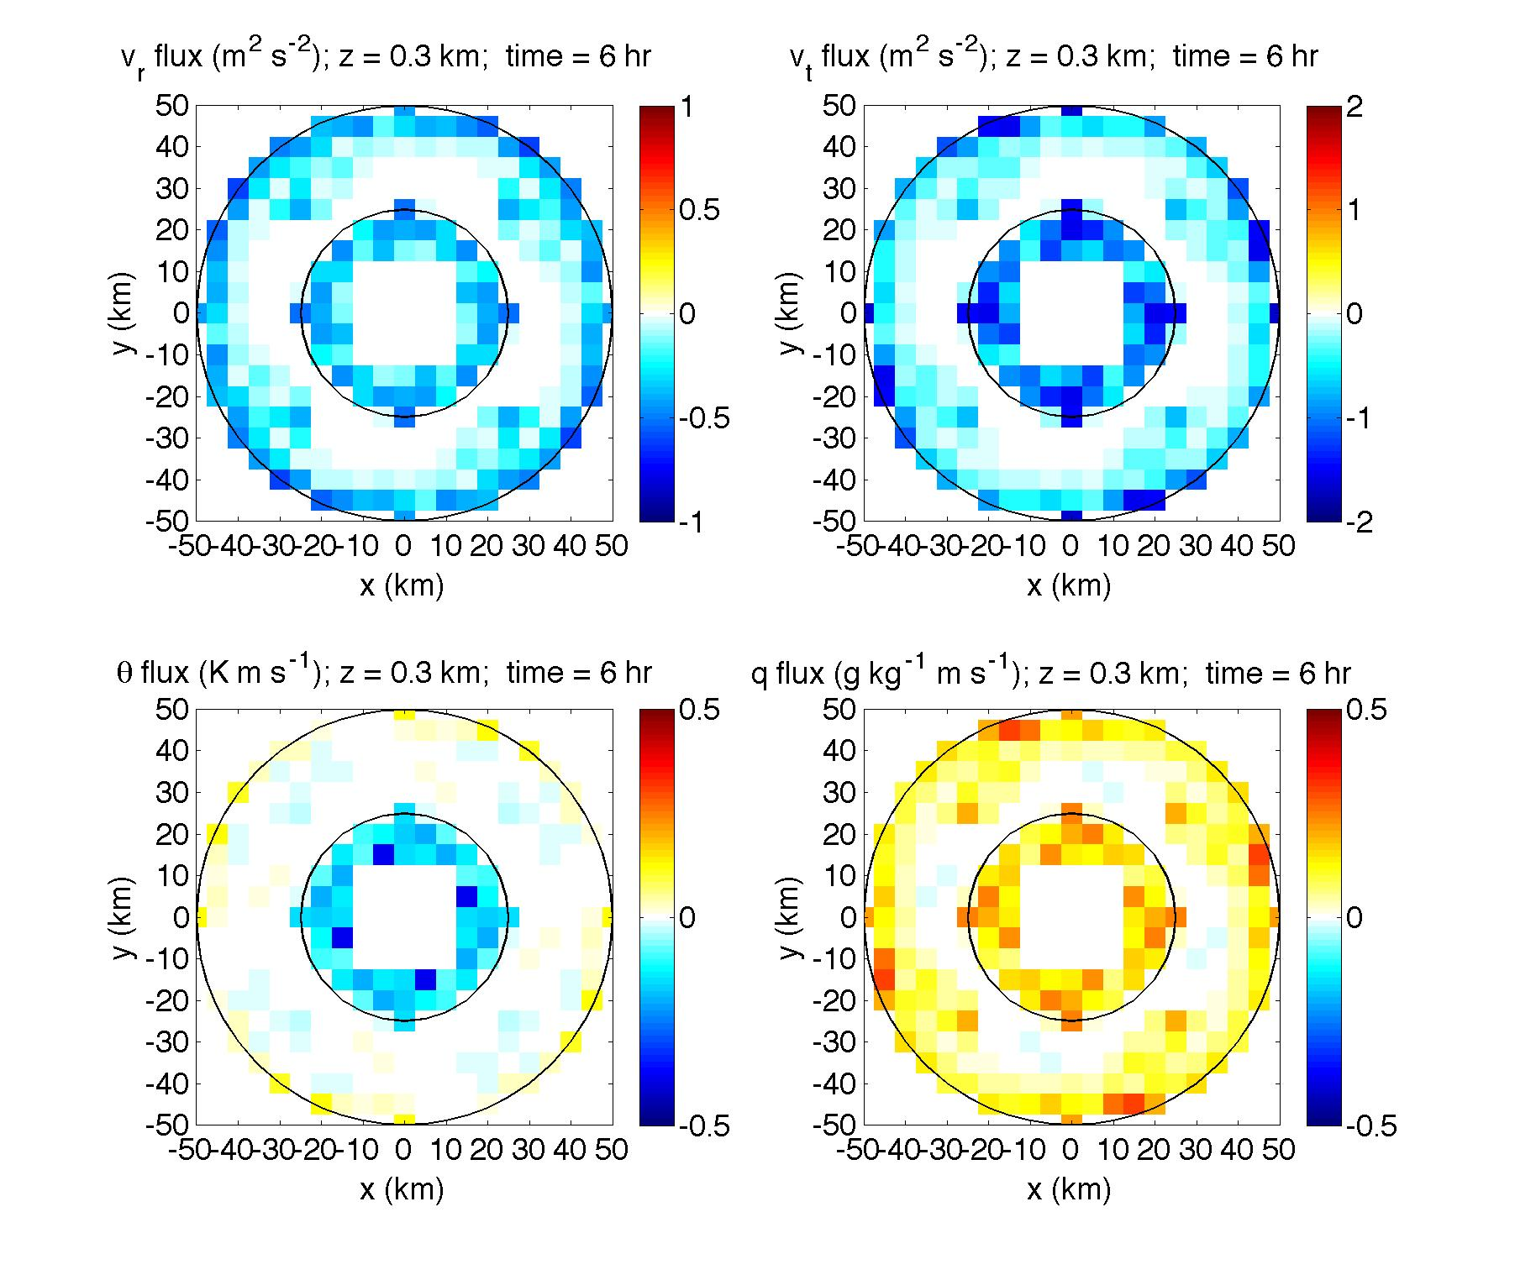
Formation of rolls
Roll-induced fluxes at 300m (mid BL), t=6hr

Slide 34
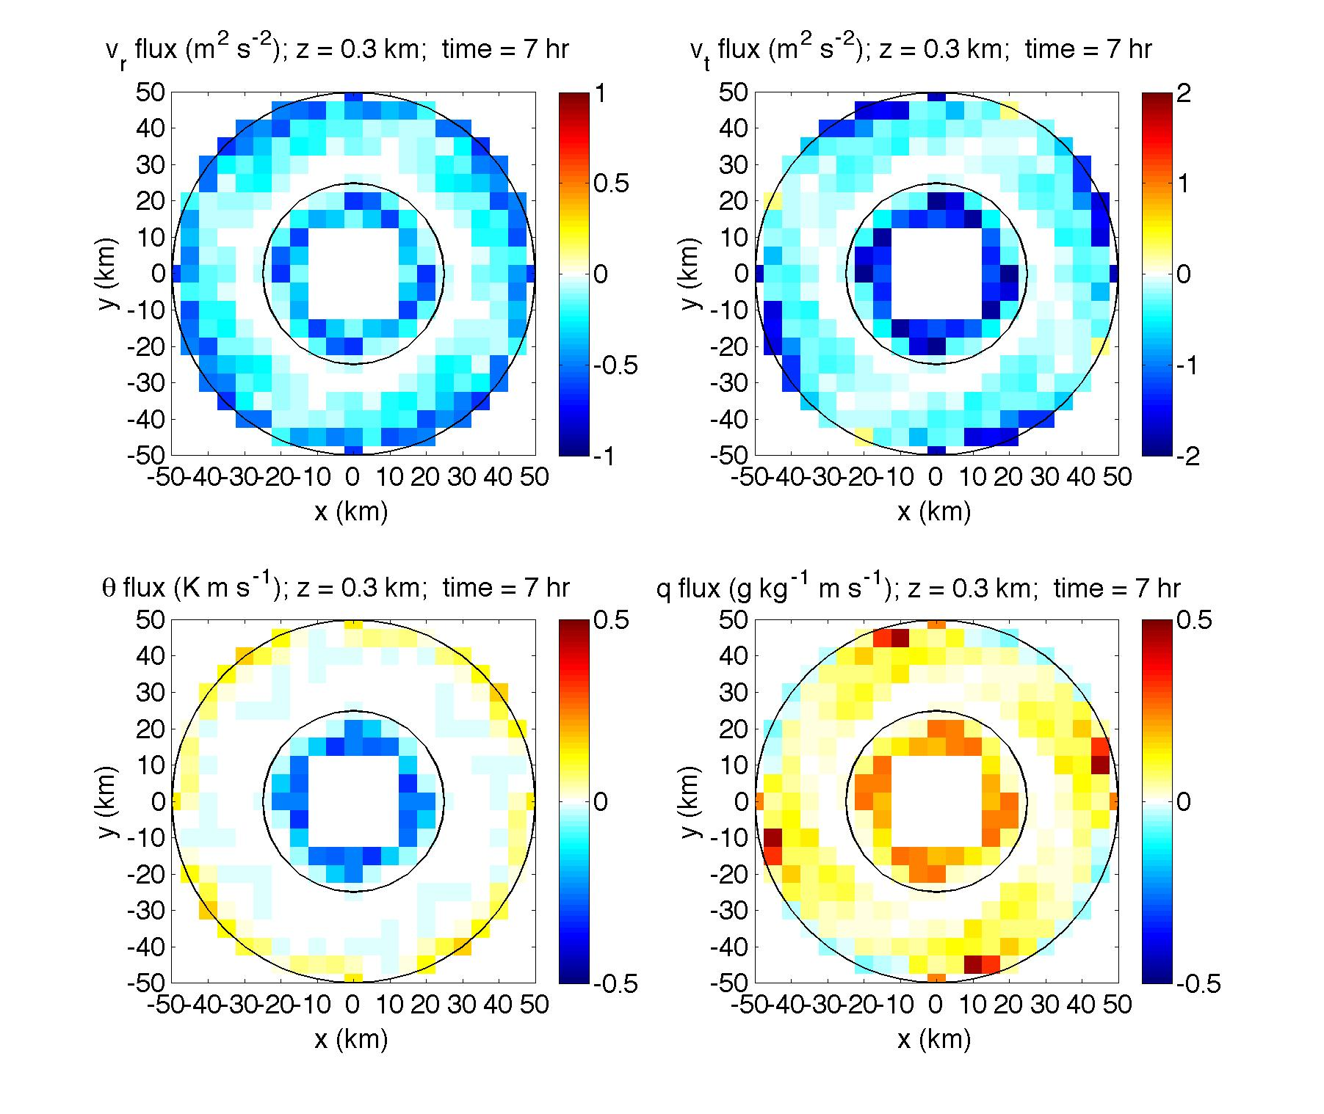
Formation of rolls
Roll-induced fluxes at 300m (mid BL), t=7hr

Slide 35
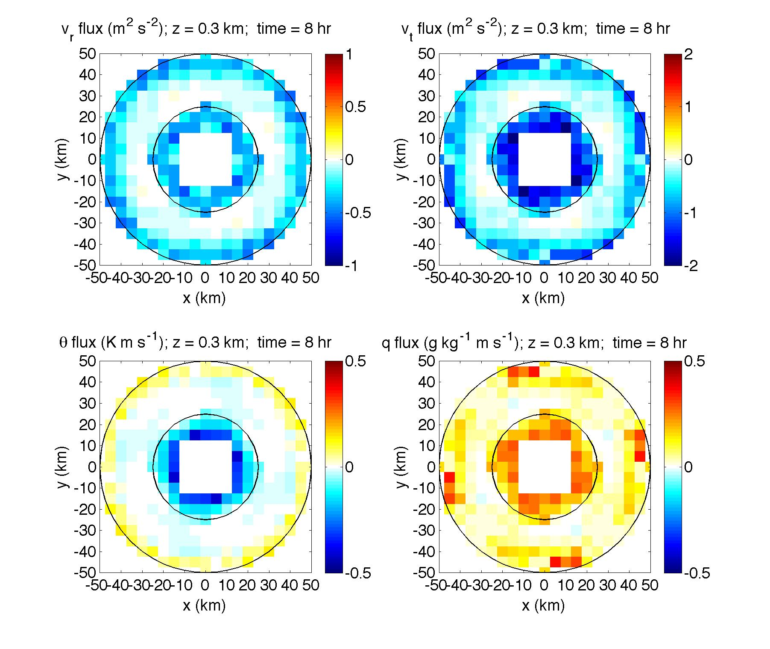
Formation of rolls
Roll-induced fluxes at 300m (mid BL), t=8hr

Slide 36
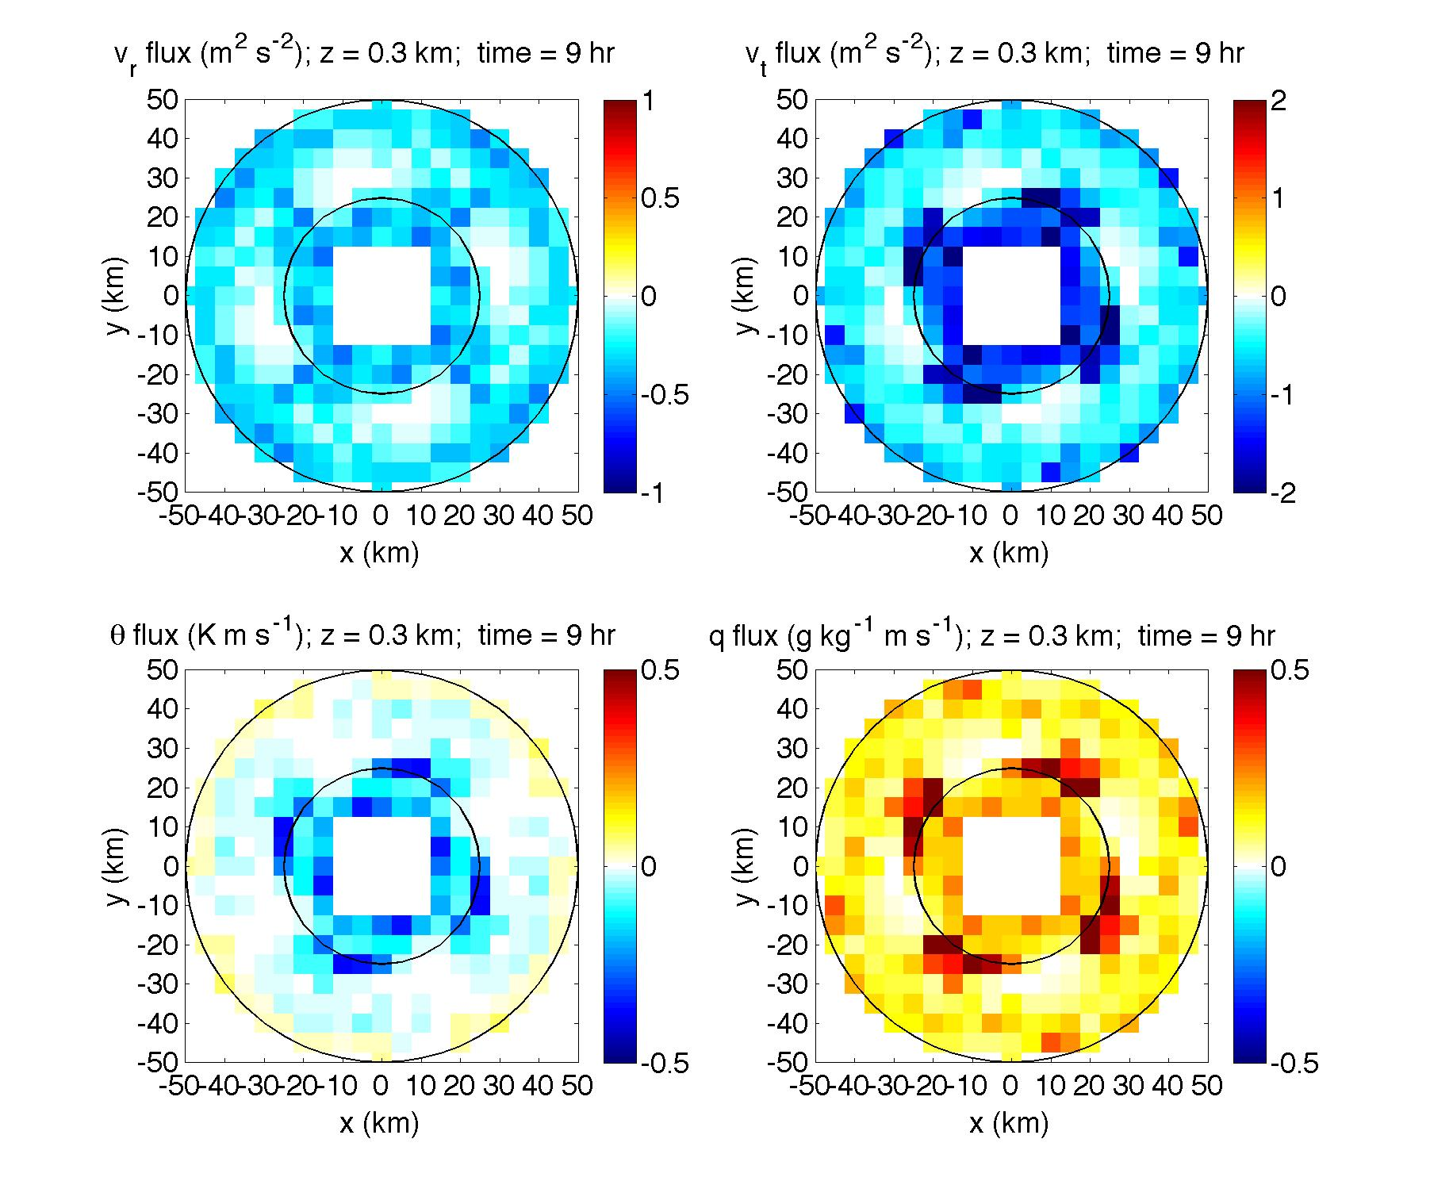
Formation of rolls
Roll-induced fluxes at 300m (mid BL), t=9hr

Slide 37
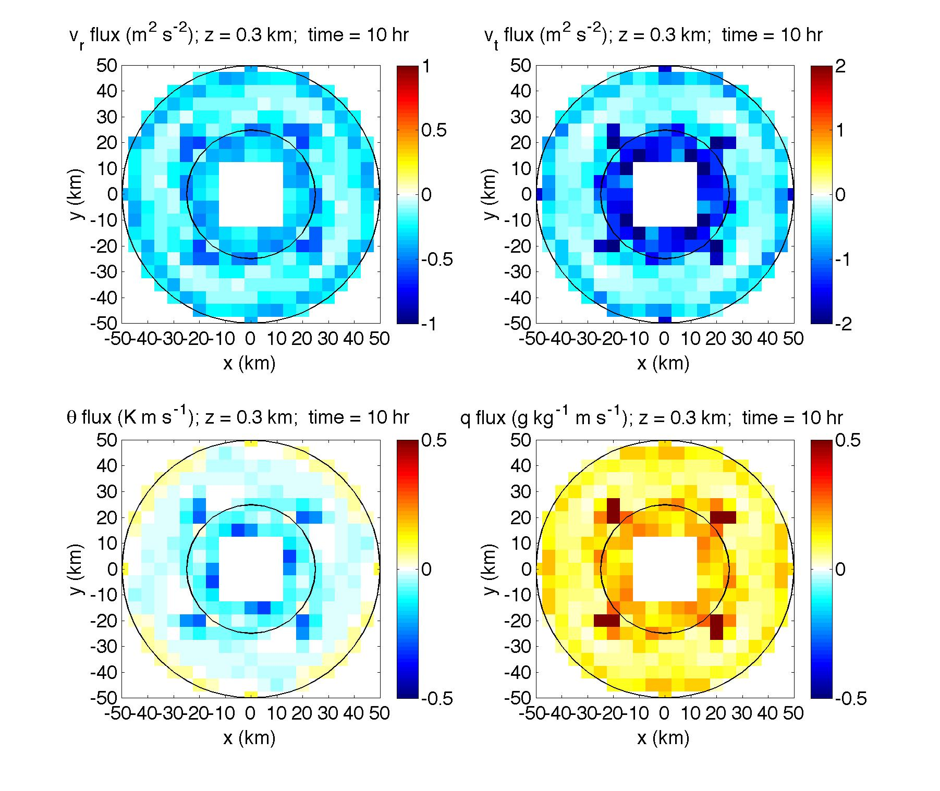
Formation of rolls
Roll-induced fluxes at 300m (mid BL), t=10hr

Slide 38
Roll-induced fluxes vs Turbulent fluxes
Azimuthal averaged
Radius = 25 km
1hr-averaged
Roll-induced fluxes cannot be captured by K-theory

Slide 39
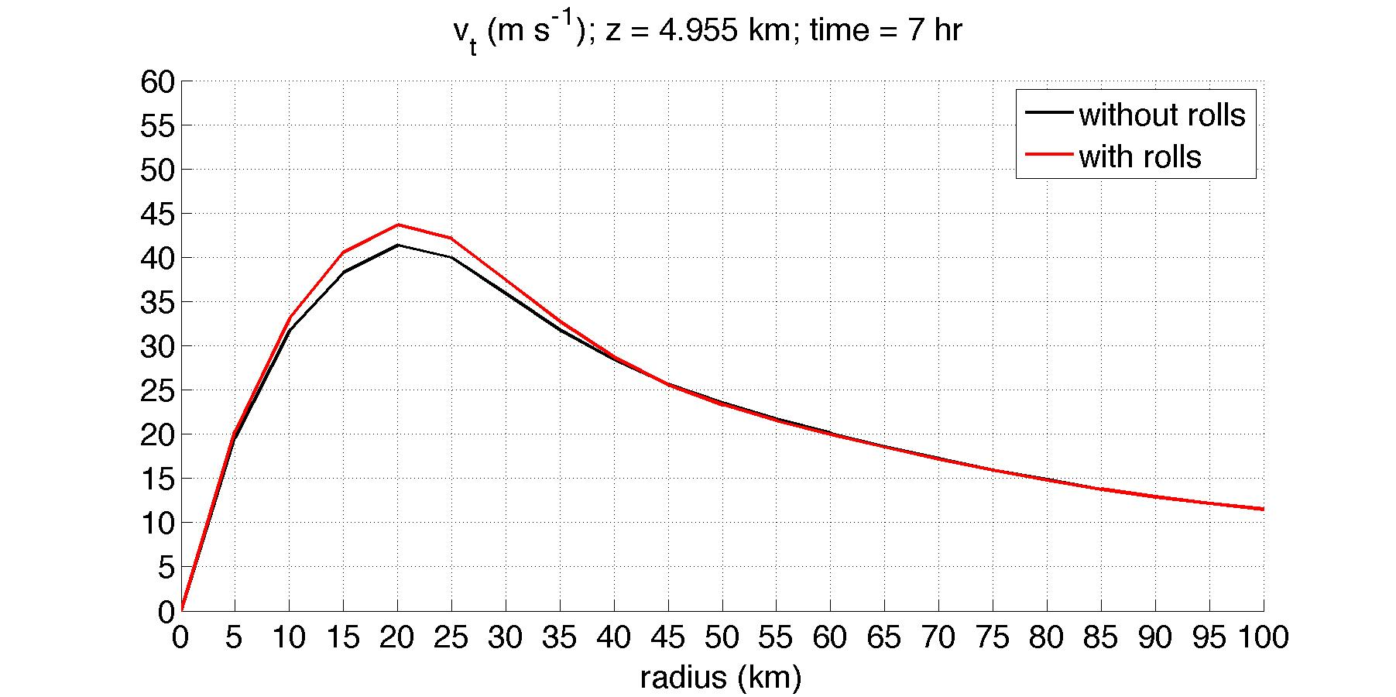
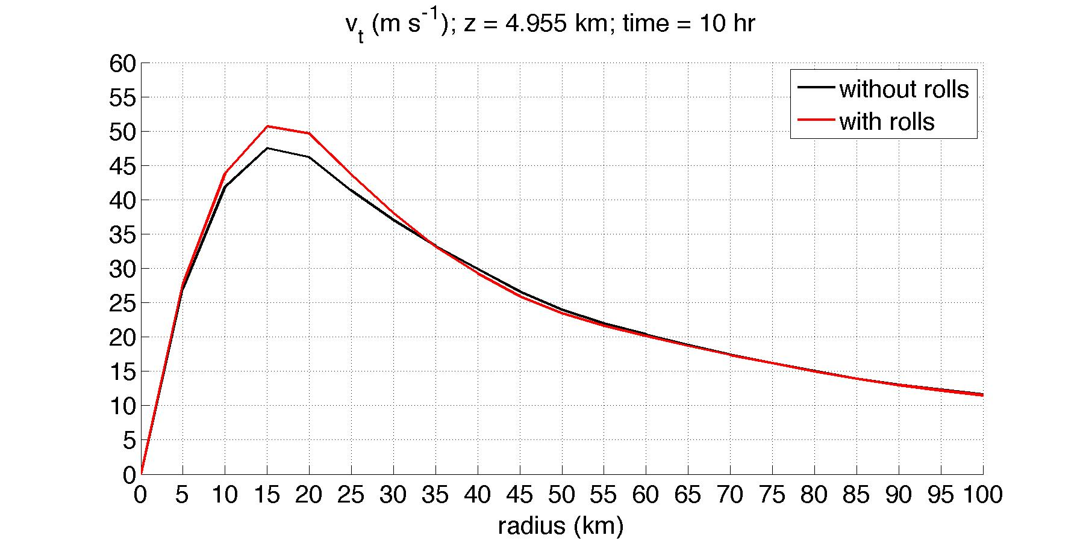
Effect of rolls on TC intensity
Azimuthal-averaged
tangential wind at 5km,
time = 7hr
time = 10hr

Slide 40
Effect of rolls on TC intensity
Max Vt
at z= 5km
Min surface
pressure

Slide 41
Effect of rolls on TC intensity
Stage A
Stage B
Physical processes:
A.1 Rolls are formed at favorable locations
A.2 Rolls modify TCBL structure
Physical processes:
A.1 and A.2 keep operating
TCBL <-> upper atmos

Slide 42
Sensitivity experiments to roll-induced fluxes
4 experiments
CTRL (without rolls)
ROLL (with rolls)
ROLL - UV (Exp 1)
ROLL – TQ (Exp 2)
Radial wind
Azimuthal wind

Slide 43
Time evolution of max Vt at z = 5km

Slide 44
Experiments 3 and 4
5 experiments
CTRL (without rolls)
ROLL (with rolls)
ROLL – UV
ROLL – U (Exp 3)
ROLL – V (Exp 4)
Radial wind
Azimuthal wind

Slide 45
Time evolution of max Vt at z = 5km
The roll-induced azimuthal momentum flux is the most critical component
affecting the TC intensity!

Slide 46
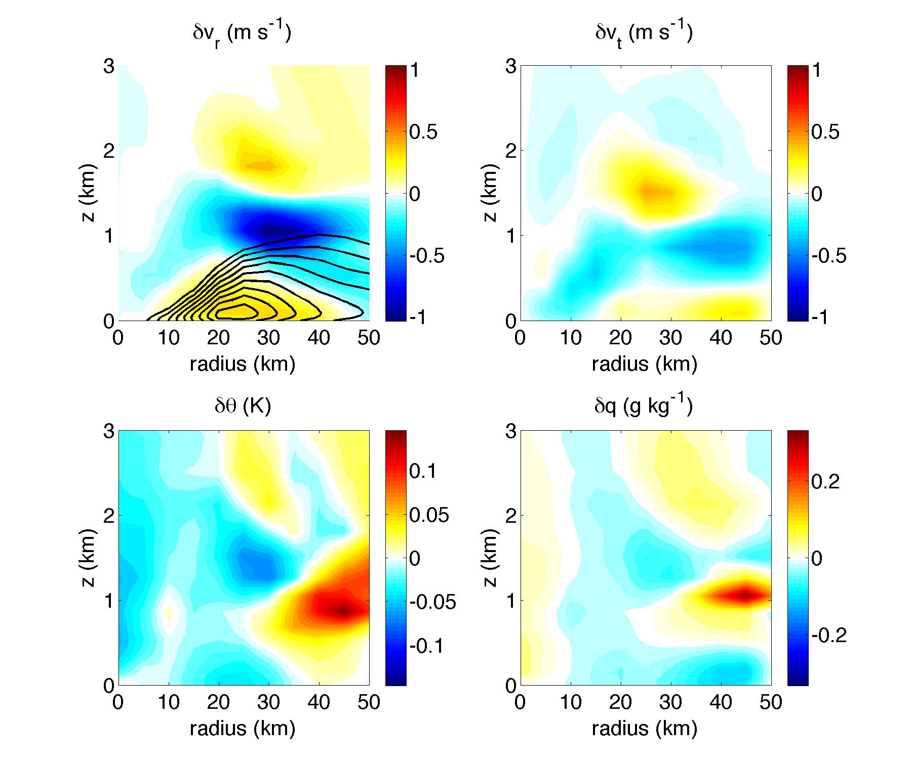
TCBL changes (ROLL – CTRL) azimuthal averaged; 3-4hr averaged
Inflow in
CTRL (without rolls)

Slide 47
Linearized equations describing the TCBL dynamical balances
(following Kepert 2001)
The balanced state without rolls
The balanced state
with rolls

Slide 48
Difference between two states

Slide 49
Radial wind (Vr)
radius = 30km
CTRL
ROLL
ROLL-CTRL

Slide 50
Inward q flux (-Vr*q)
radius = 30km
CTRL
ROLL
ROLL-CTRL

Slide 51
Eyewall convection increased
CTRL
ROLL
ROLL-CTRL
All variables are averaged over z = [1-4]km

