Slide 1
Grell-Freitas Convective Scheme:
Implementation in HWRF
August 2015
Georg Grell and Jian-Wen Bao,
Evelyn Grell
Some info on the GF scheme as it is used in our current version of WRF and HWRF
What is new with recent HIWPP implementations
Status and some initial results
Where we would love to get help
Appendix: Code changes

Slide 2
Part I: Grell-Freitas Convective Parameterization
Scale-aware/Aerosol-aware (Grell and Freitas, 2014, ACP)
  Stochastic approach adapted from the Grell-Devenyi schem
    Originally many parameters could be perturbed
    In 2014 version only 2 were kept (different closures and capping inversion thresholds) - efficiency
  Scale awareness through Arakawa approach (2011) or spreading of subsidence
  Aerosol awareness is implemented with empirical assumptions based on a paper by Jiang and Feingold
  Separate shallow scheme also exists with modifications by Joe Olson – similar to SAS shallow

Slide 3
The scale awareness: Our adaptation of Arakawa’s approach
Define fractional coverage (σ) = area covered by active updraft and downdraft plume
Define very simple relationship between σ and entrainment rate (which is related to radius of plume) – but any other approach may easily be used
Initial entrainment rate determines when σ is becoming important (when scale awareness kicks in),
  Maximum allowable fractional coverage determines when scheme transforms itself to a shallow convection parameterization
  This effect can be turned off

Slide 4
Aerosol awareness
Change 1: Change constant autoconversion rate to aerosol (CCN) dependent Berry conversion
Change 2: Modified evaporation of raindrops (Jiang and Feingold) based on empirical relationship
Change 2 introduces a proportionality between precipitation efficiency (PE) and total normalized condensate (I₁), requiring determination of the proportionality constant C_{pr}

Slide 5
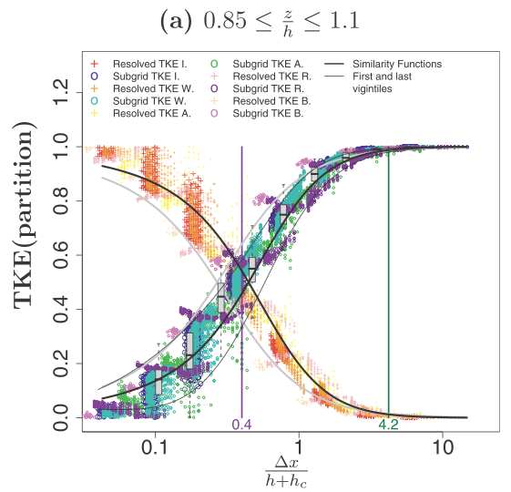
Tapering of Shallow-Cu Scheme
Based off of Honnert et al. (2011, JAS):
  TKE partition in the entrainment layer
Other methods are/will be tested (i.e., Shin and Hong 2013, JAS).
Figure 5
RAP/HRRR Grey Zone Testing

Slide 6
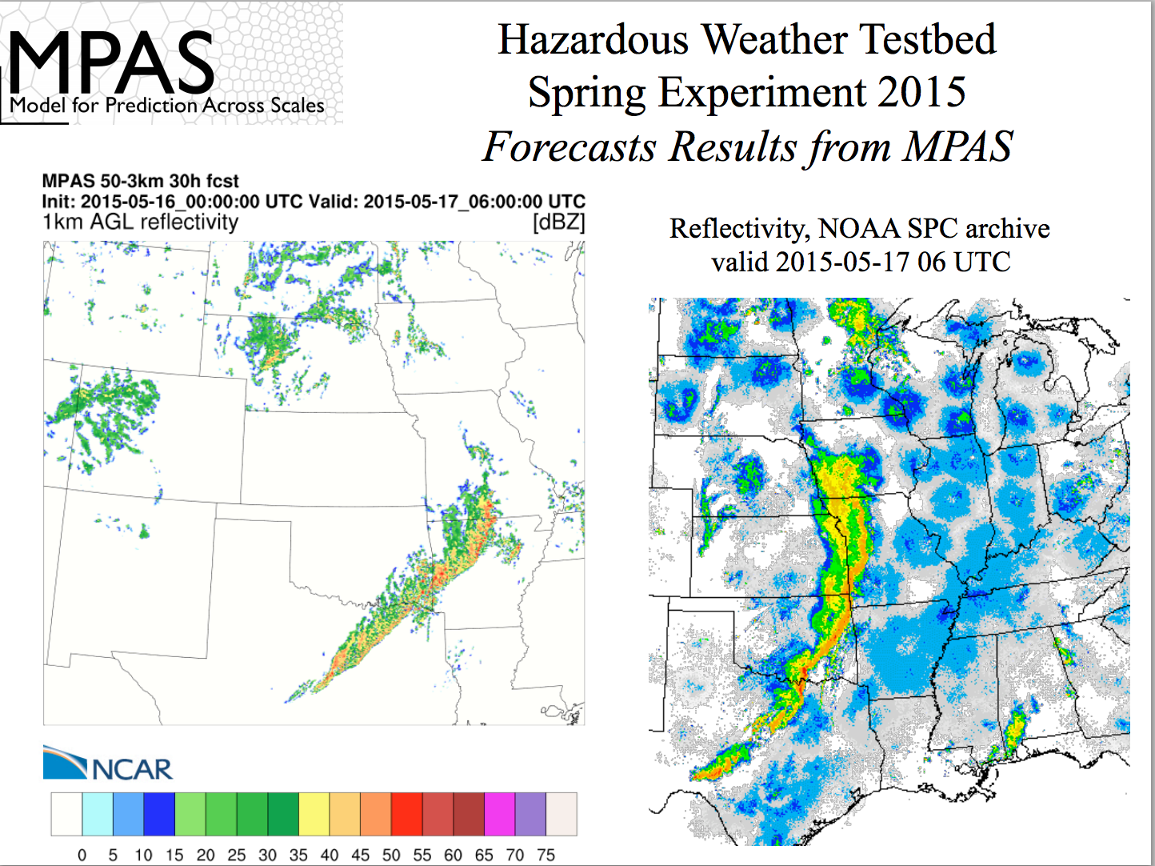
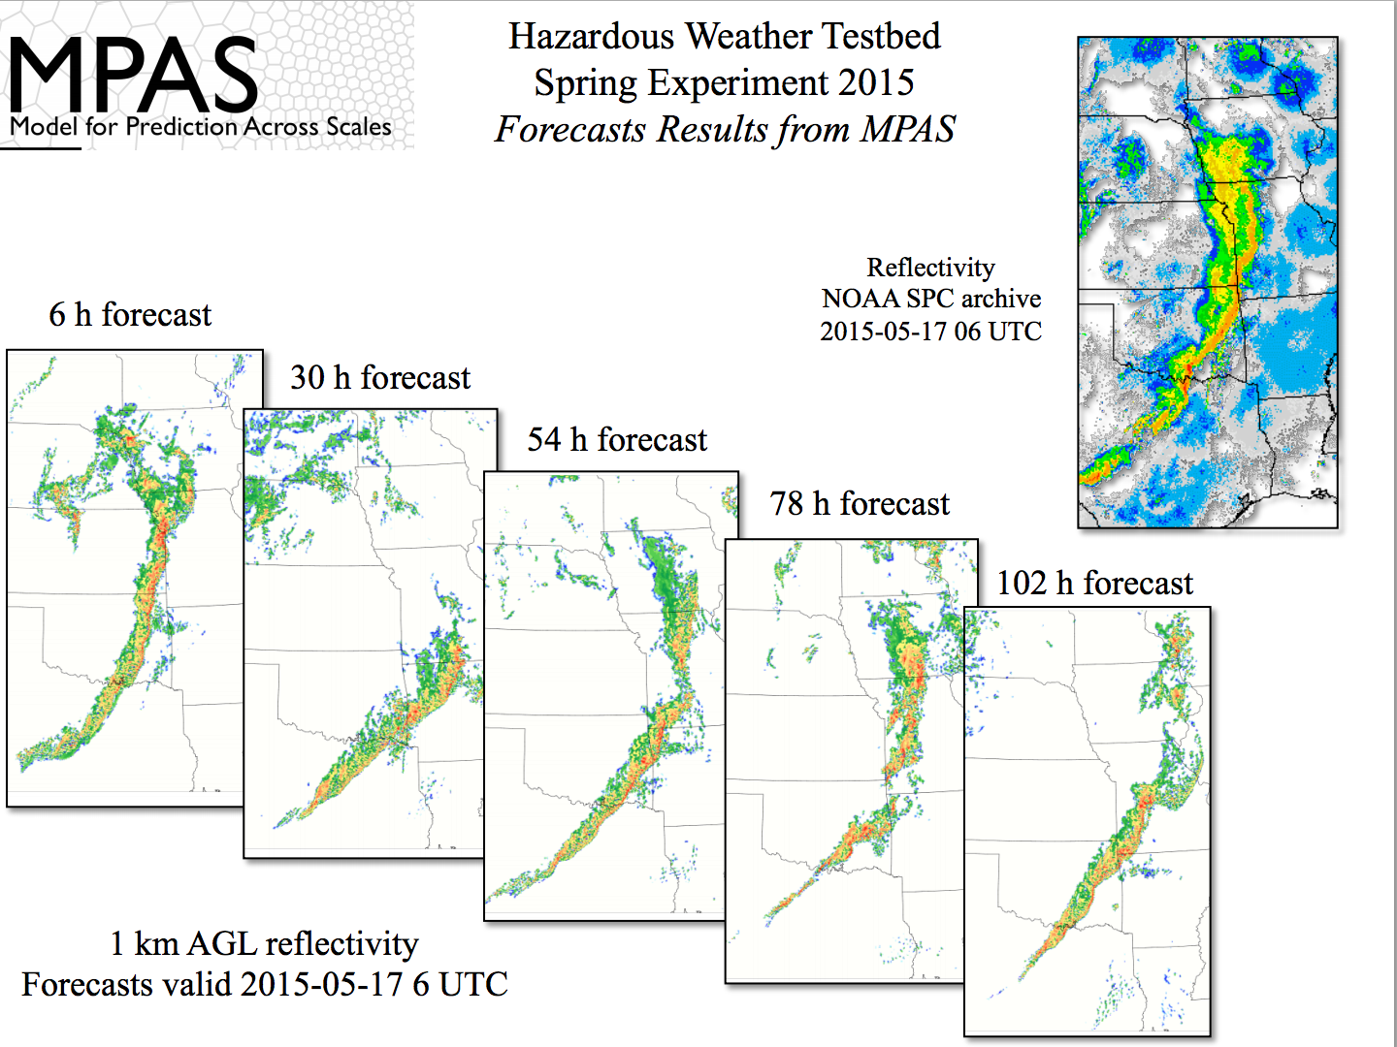

Slide 8
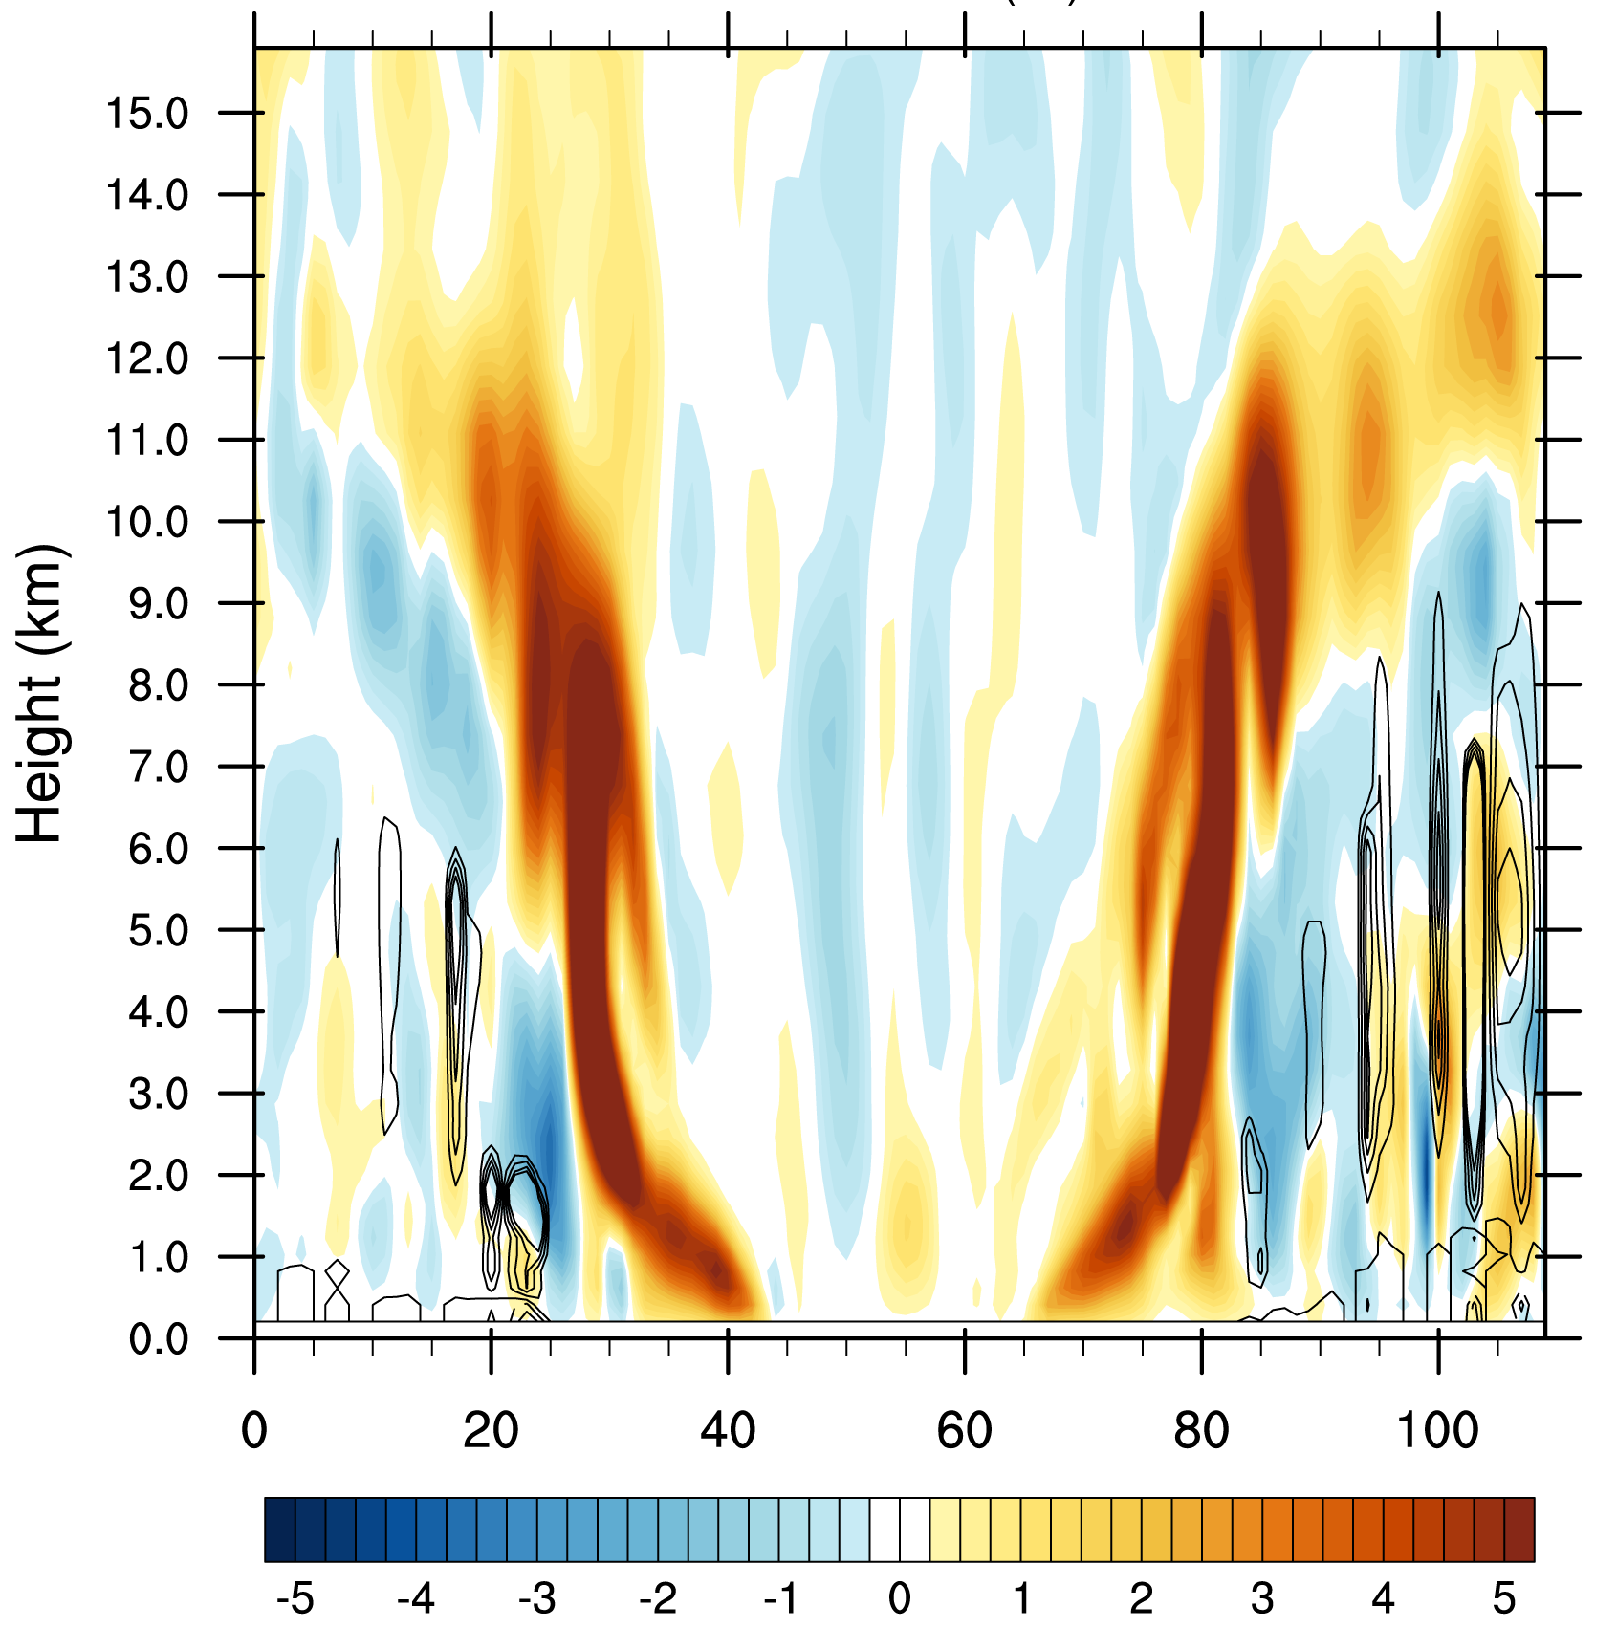
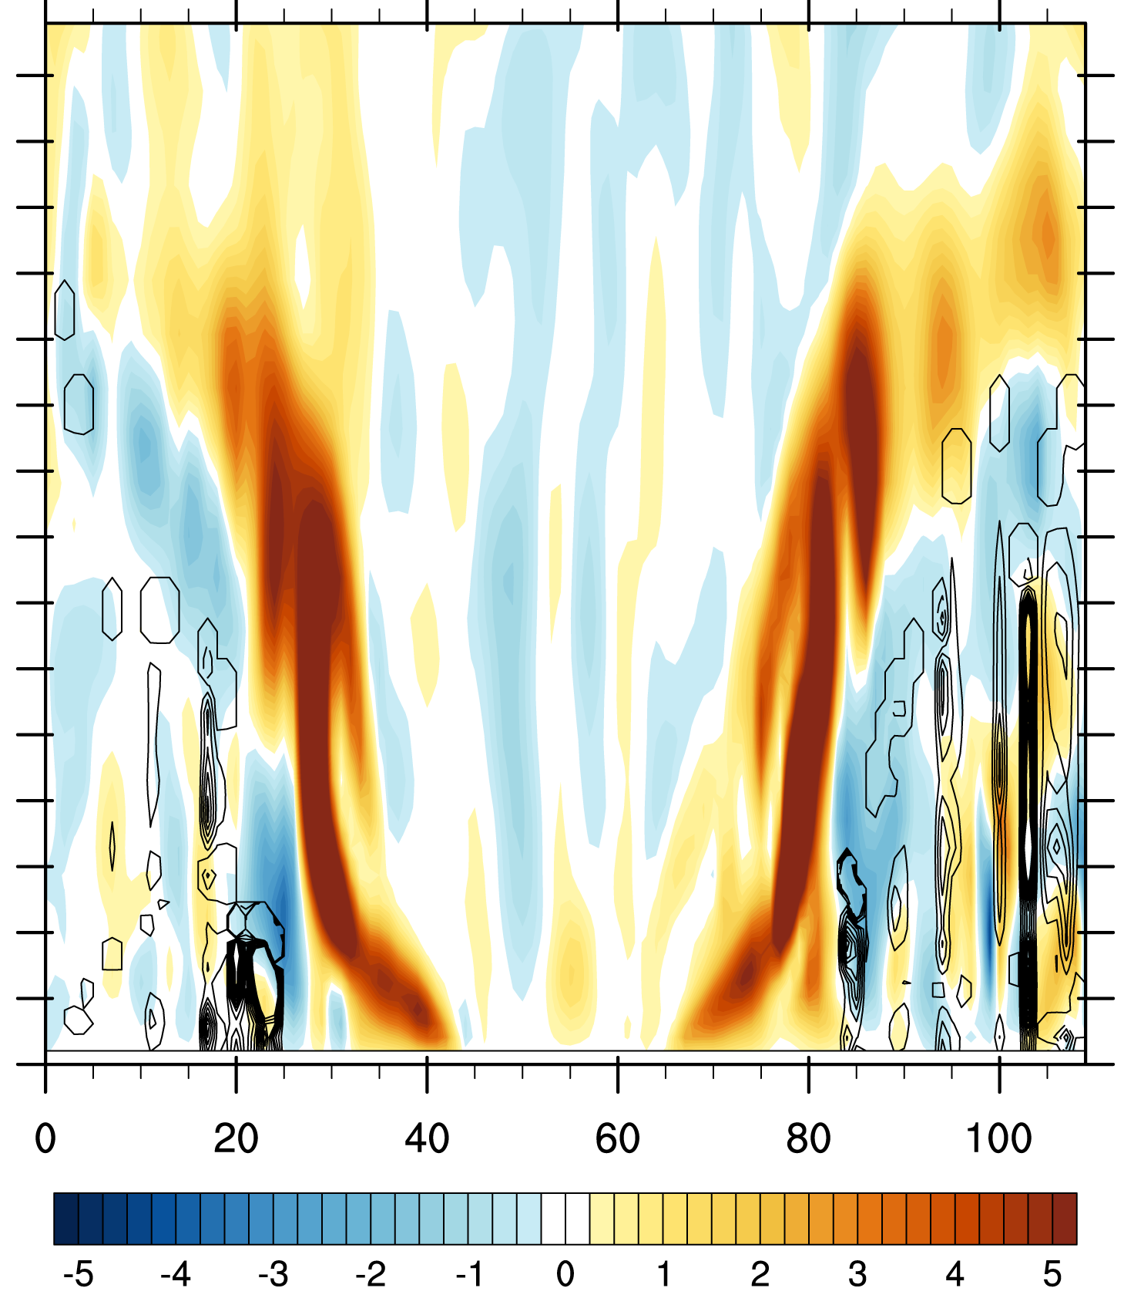
Example from previous idealized WRF runs: adding a 1km resolution domain
Cross-section through center of storm, dx=1km, vertical velocity in color (m/s)
Heating tendencies (contours)
W (m/s) in color
Drying tendencies (contours)
W (m/s) in color

Slide 9
Scale-awareness (so far tested in WRF, BRAMS, MPAS) seems to work fine with an extremely simple version of the Arakawa (2011) approach
Unfortunately, that is not enough. Heating and drying profiles look similar to cloud resolving simulations, but interaction with other physics is key

Slide 10
  Part II: recent new “HIWPP” implementations – not yet in HWRF version, but will be soon
    Momentum transport (as in SAS or ECMWF)
    Additional closure for deep convection: Diurnal cycle effect (Bechtold )
    Mass conserving transport completed for shallow scheme
    Mass conserving transport for deep currently being tested
    Additional closures for shallow convection (including the SAS shallow convection closure, and one from Renno and Ingersoll, JAS 1996)
    PDF approach for normalized mass flux profiles was implemented (fitting LES modeling for shallow convection and allows easy application of stochastic perturbation of vertical heating and moistening profiles)
    GF scheme was fully immersed into GFS 2012 and 2015 physics (replacing the call to SAS deep and/or shallow schemes)
    Rain evaporation (by parameter choice) after tendency calculations, and additional cloud water/ice detrainment formulation

Slide 11
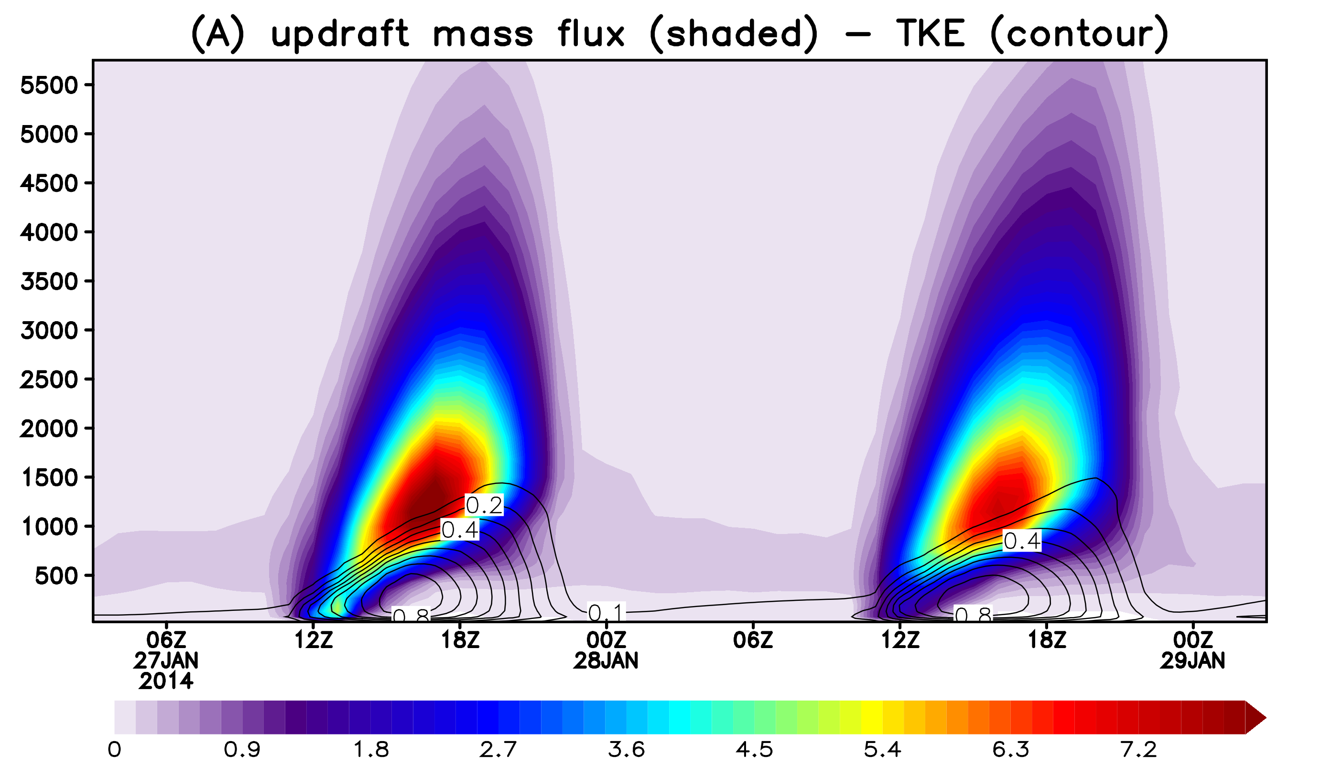
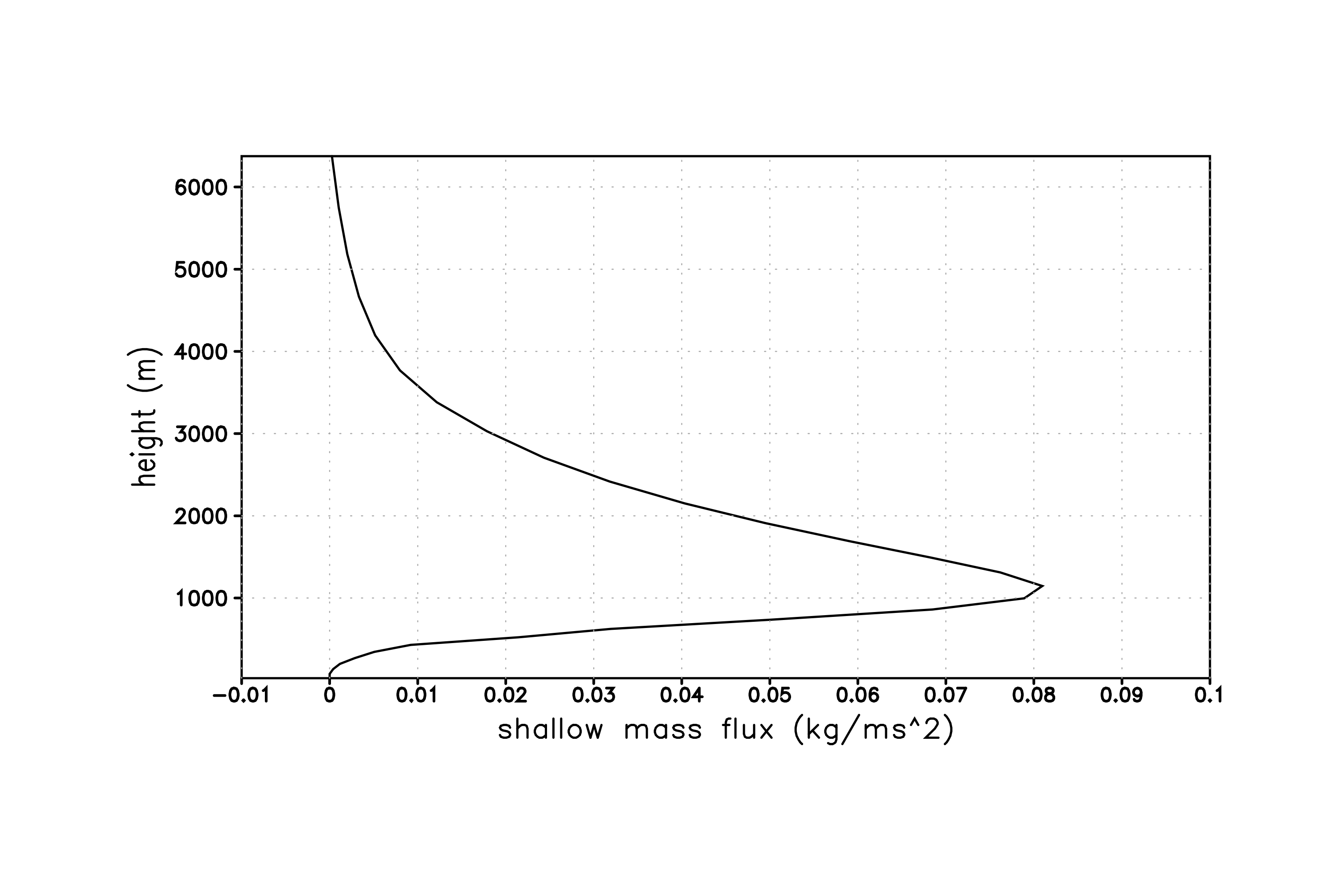
Shallow Convection Scheme
Non-precipitating
Transport of moisture, heat and tracers
Mass flux profile given by a Beta PDF
Three closures – BLQE (Raymond, 1995), W*(Grant, 2001) and convection as natural heat engine (Rennó and Ingersoll, 1996).
Diurnal cycle of shallow convection and diffusion in PBL
Mass flux Profile
Height (m)
Siebesma et al 2003
Similar with LES
Sharp increase, peaking just above boundary layer
Smooth decrease above
updraft mass flux: shaded
TKE: contour

Slide 12
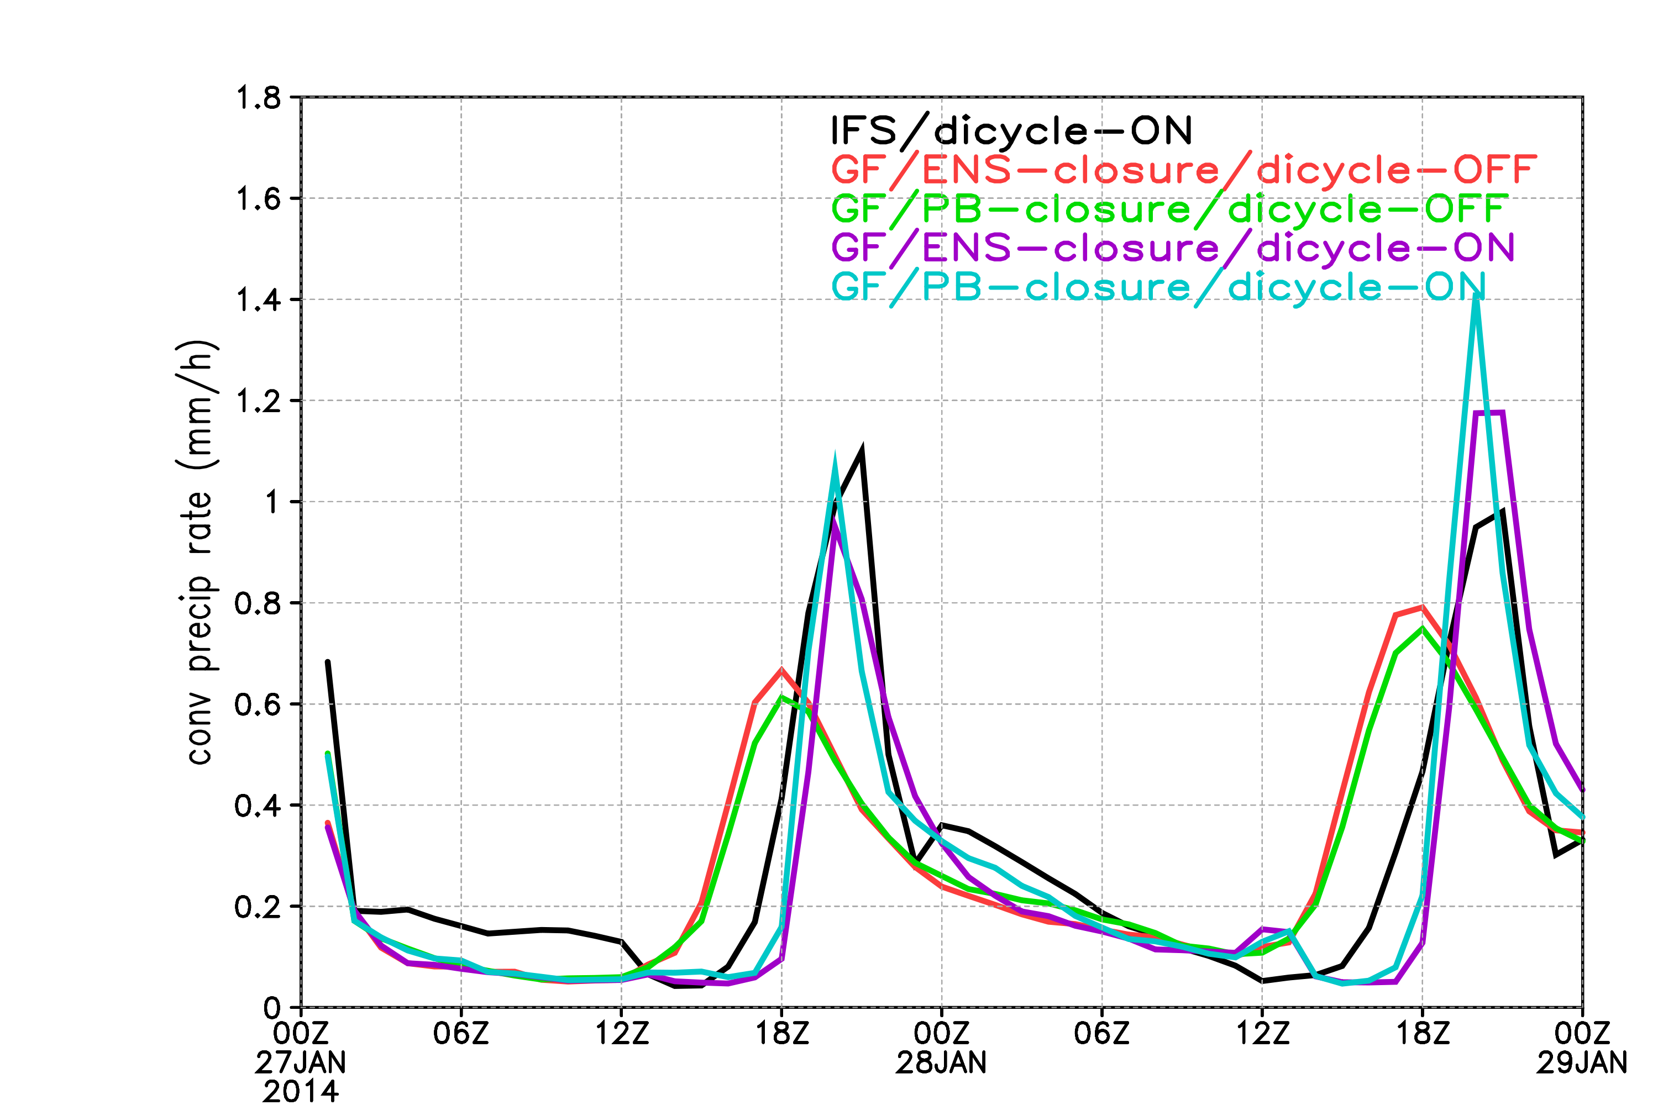
Conv prec rate (mm/h) from cumulus parameterization
(area average over Amazonia domain)
Impact of diurnal cycle inclusion: probably not important for HWRF
21Z

Slide 13
Stochastic Parameter Perturbation in GF Scheme
  For stochasticism
    Starting to work with Judith Berner’s approach (Stochastic Kinetic Energy Backscatter scheme (SKEBS) but currently restricted to WRF) – Isidora Jankov
      Apply directly to closure assumptions – for location and strength of convection)
      Apply to skewness of vertical mass flux PDF’s (an easy way to significantly alter vertical heating and drying profiles
    Plan is to try for forecast improvements or ensemble data assimilation

Slide 14
Interesting comparison of performance between mixed physic and stochastically perturbed parameters ensembles
Experiment design
Regional RAP model simulations
Can be transferred to FIM, GFS, MPAS, HWRF, or other NGGPS core for testing on global domains
14 day period 15-31 May, 2013, 24 hr simulations
Focus on convective Grell-Freitas parameterization
The control run, expensive mixed physics ensemble includes two versions of Arakawa-Schubert (AS) scheme, Betts-Miller-Janjic (BMJ) and Grell Freitas (GF) convective parameterizations - ctrl
Stochastically perturbed parameter ensemble experiments (using only one run!):
  Stochastically perturbed closures-V3
  SKEBS scheme was added to closure perturbations – V3_skeb

Slide 15
Combination of stochastic physics and SKEB impact on standard variables

Slide 16
Part III: Current Status
First goal has been achieved: implementation of basic GF into HWRF
  HWRF 2014 package, as downloaded from DTC website
  GF scheme as in WRFv3.6 release
  Radiation feedback not applied
  Shallow scheme not applied, but available
Run on 2 cases (atmospheric model only)
  Sandy
  Daniel
Evaluation is in progress, working on finding good diagnostic measures for tuning the scheme

Slide 17
Interaction with DTC:
Ligia has met with us several times, provided the initial conditions and other files that were needed to get started with HWRF. She has also answered many questions.
Christina has also been very helpful in answering questions and providing guidance.
All work so far has been based on DTC code and documentation.

Slide 18
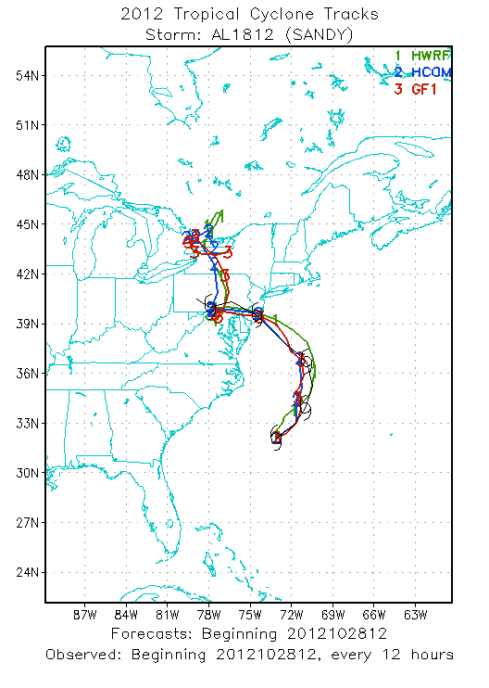
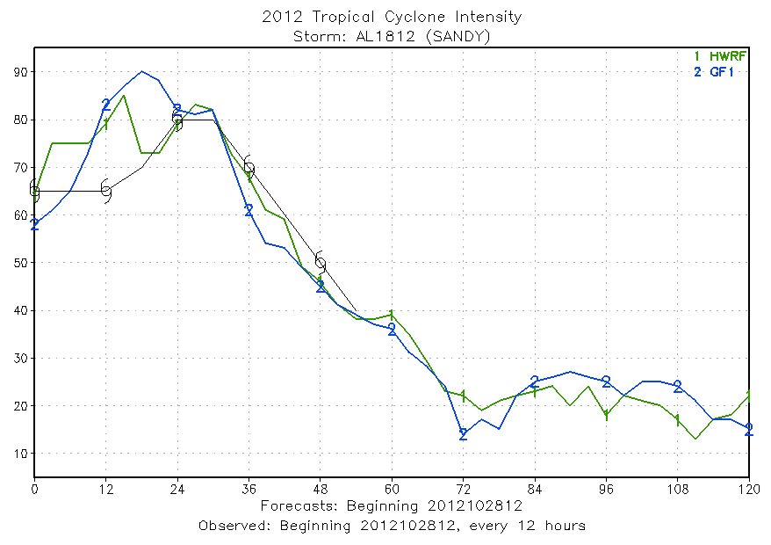
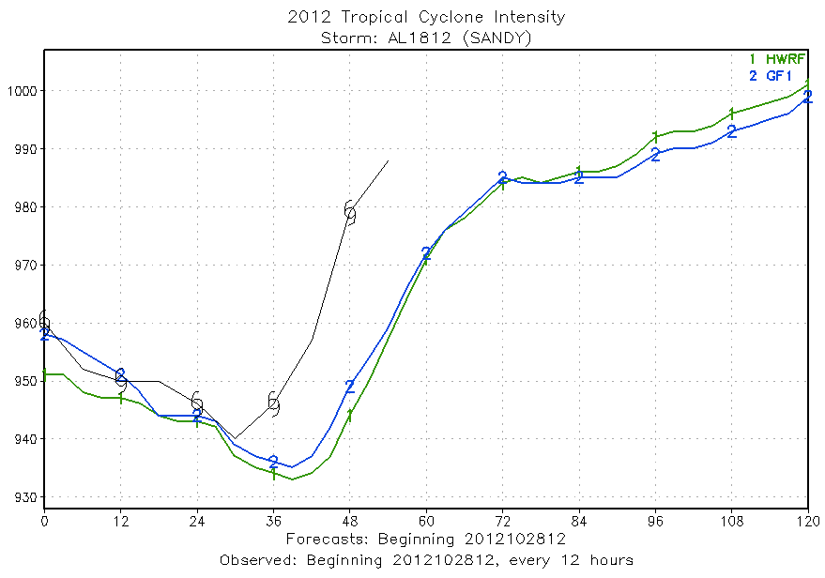
Examples of initial results for Sandy: Track and intensity

Slide 19
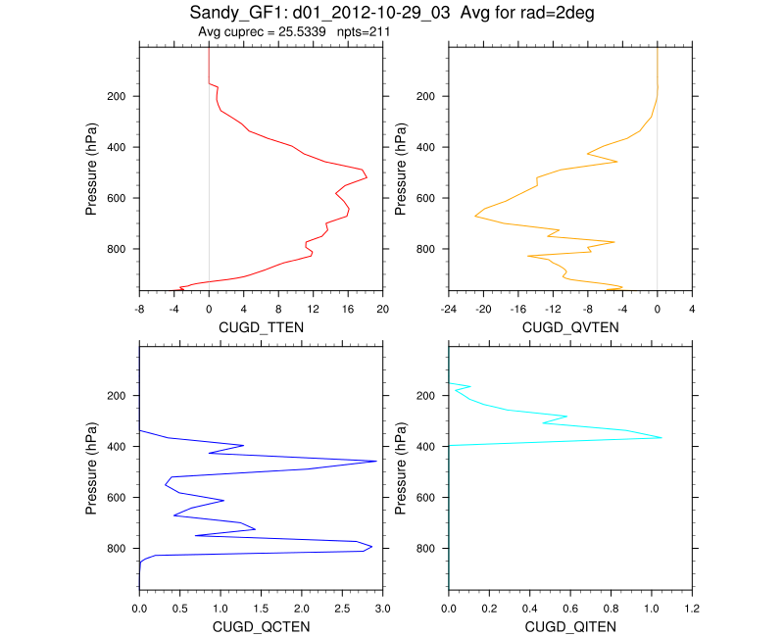
Examples of results for Sandy: Output tendencies from on domain 1

Slide 20
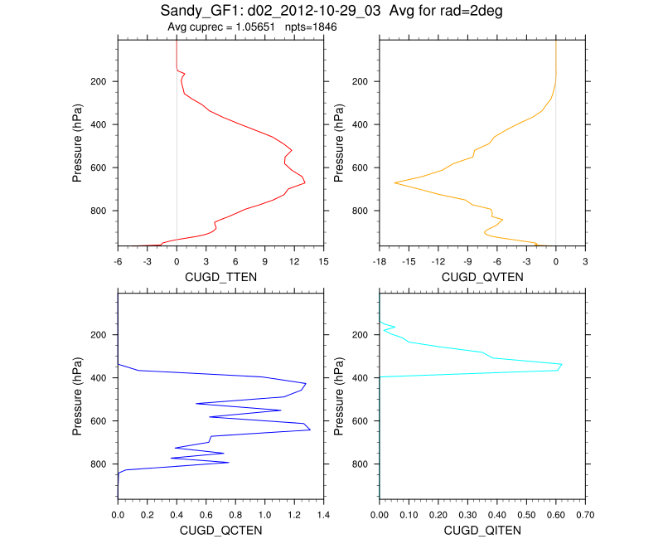
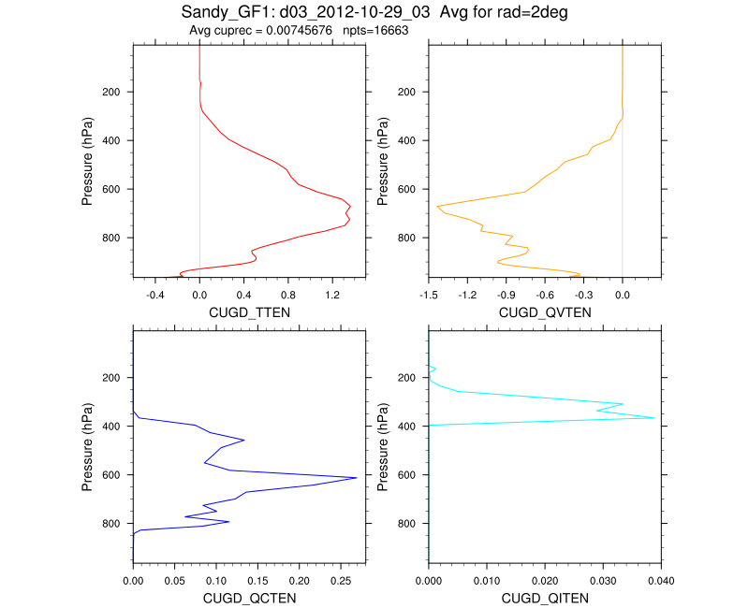
Results for Sandy using GF: Temperature tendencies on different resolutions, radius of 2 deg around center of storm, 2012-10-29-03
Number of points: 211
Number of points: 1846
Number of points: 16663
Domain 1: dx=27km, maximum heating rate of 18 deg/day, average conv precipitation = 40.8 mm/day
Domain 2: dx=9km, maximum heating rate of 13 deg/day, average conv precipitation = 1.7 mm/d
Domain 3: dx=3km, maximum heating rate of 1.4 deg/day, average conv precipitation = 0.01/d

Slide 21
Next steps:
Continued evaluation, verification
Update to 2015 (2016 ?) HWRF package when available
Test HIWPP improvements to GF scheme,
  Momentum transport (both SAS and ECMWF versions)
  PDF’s for normalized vertical mass flux
  Impact of non precipitating shallow convection and radiation interaction
  Even higher resolution?
Test in full HWRF cycling mode
When available: test with SKEBS?
Would be nice to be able to tune momentum transport, if biases are known and can be compared!

Slide 22
Part IV: Where we could use help…
Evaluation -- What is most important? What is available (code and data)?
What physics package(s) should be tested with GF?
We would like to try to improve upon the best performing package that you can provide.

Slide 23
Part 5: Code Changes
Registry: New variables, all added to package gfscheme (cu_physics=3) – xmb_shallow, k22_shallow, kbcon_shallow, ktop_shallow, cugd_tten, cugd_qvten, cugd_ttens, cugd_qctes, cugd_qiten, edt_out, clos_choice, ishallow
Phys/module_cu_gf.F
Phys/module_cumulus driver.F: add GFSCHEME to halo call, some mods to argument list when calling GFDRV
Phys/module_physics_init.F: call gfinit
Dyn_nmm/start_domain_nmm.F: add optional arguments to phy_init call
Dyn_nmm/solve_em .F: mods to output tendencies if GFSCHEME
Dyn_nmm/module_PHYSICS_CALLS.F: add GFSCHEME to test on
MOD(NTSD,NCNVC)/=0 and moist_trans, add variables to arg list for cumulus_driver, save instantaneous tendencies for diagnostic output (subr cucnv).

