Slide 1
2015 Upgrades to the GFDL Hurricane Model
Morris A. Bender, Matthew Morin, and Timothy Marchok (GFDL/NOAA)
Isaac Ginis and Biju Thomas (University of Rhode Island)
Robert E. Tuleya (Old Dominion University)
EMC/NCP CCB Review
Wednesday, April 15th, 2015

Slide 2
Summary of Proposed Upgrades
Upgraded version of GFS
Increase of vertical sigma levels from 42 to 60
Similar Configuration to HWRF levels
Improved Initialization of Moisture Field (r)
Using improved moisture specification: reintroduction of Vortex Specification for all storms (e.g. TD, and weak TS) except Nameless systems
New Specification of Storm size (Rb)
Modified filter depth in vortex specification (Tested, but rejected due to unfavorable impact)
Correct Specification of Ocean Currents in Surface flux computation
Bug Fix in GFDL coupler

Slide 3
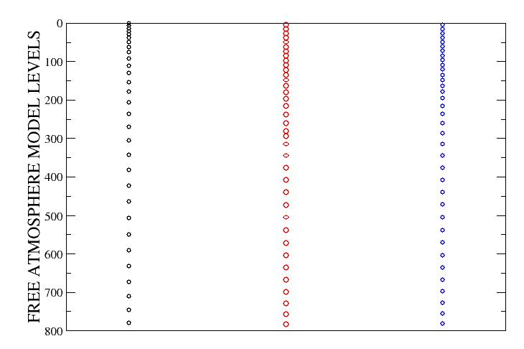
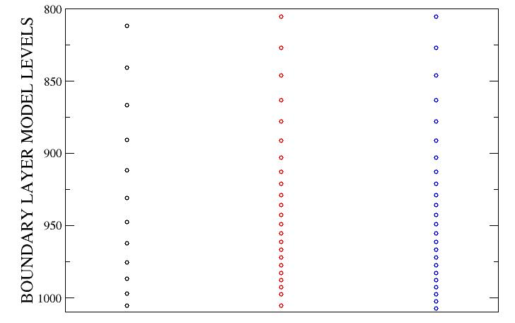
VERTICAL LEVEL CONFIGURATION
42 Level GFDL 60 Level GFDL 60 Level HWRF

Slide 4
Improved Moisture Initialization
Current Scheme :
(U, V, T, r, p*) = (U, V, T, r, p*)_{Envr} + (U, V, T, r, p*)_{axi-sym vortex}
r_{axi-sym vortex} defined with respect to the Environmental moisture field
(Environment is determined by moisture field outside the filter radius)
Lead to Unrealistic drying in middle troposphere
(Limited RI for weak, developing systems)
Revised Scheme :
(U, V, T, p*) = (U, V, T, p*)_{Envr} + (U, V, T, p*) _{axi-sym vortex}
r = r _{gfs} + r_{vortex}
More realistic Initial Moisture lead to significantly Improved Intensification in RI situations

Slide 5
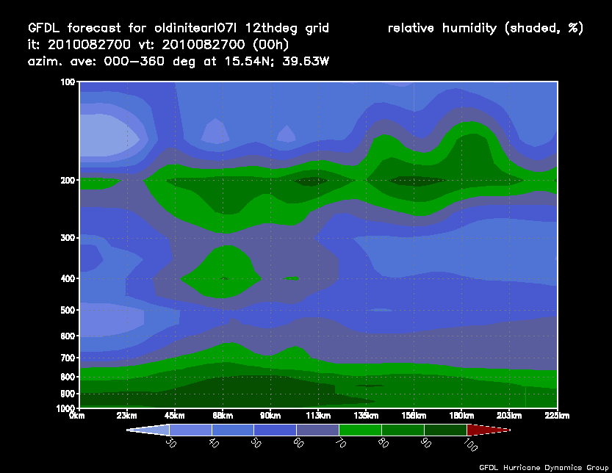
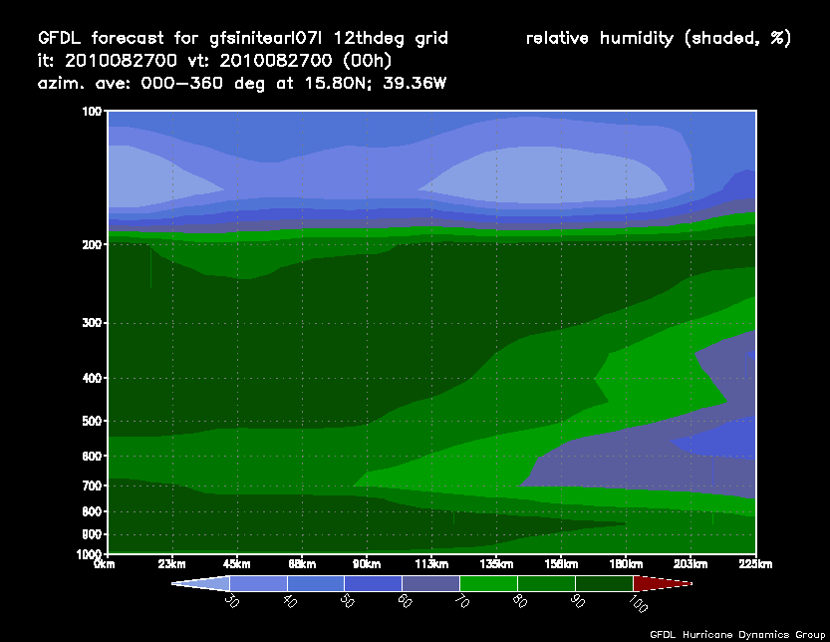
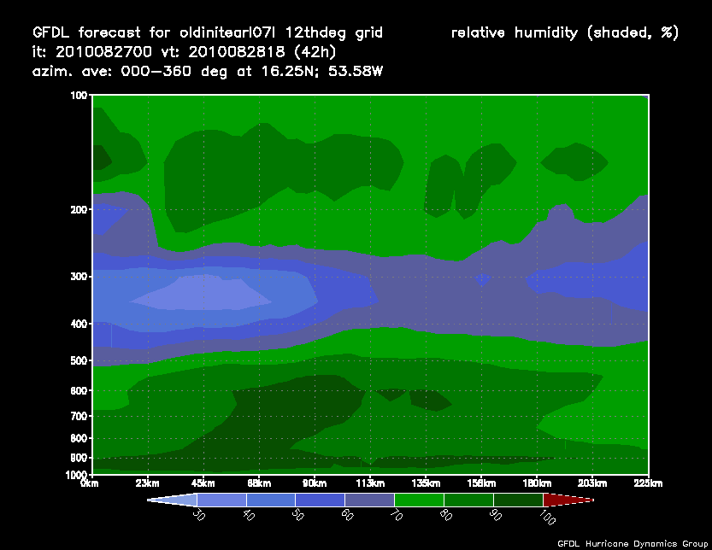
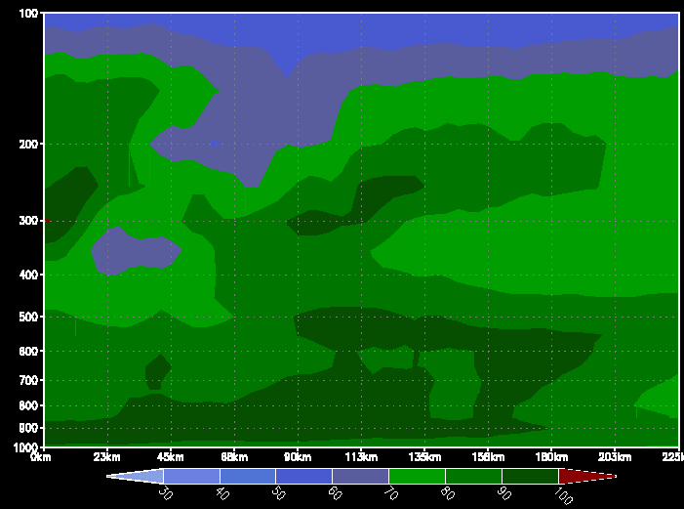
Impact of Improved Moisture Initialization Hurricane Earl (Initial time: 0000 UTC 27 August, 2010)
OLD MOISTURE INITIALIZATION
NEW MOISTURE INITIALIZATION
CIRCULAR-AVERAGED HUMIDITY
CIRCULAR-AVERAGED HUMIDITY
HOUR 0
FORECAST
HOUR 42

Slide 6
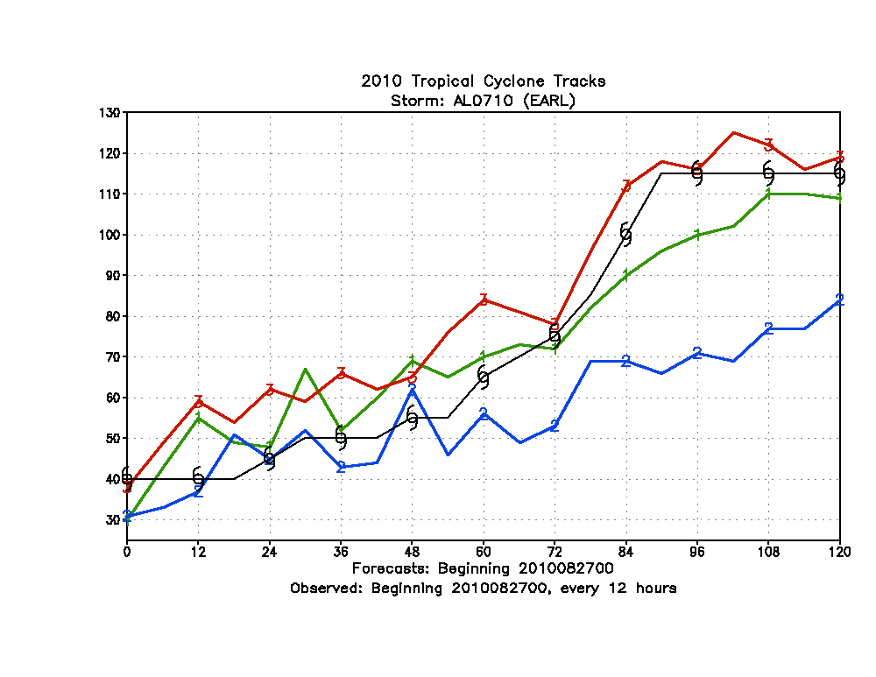
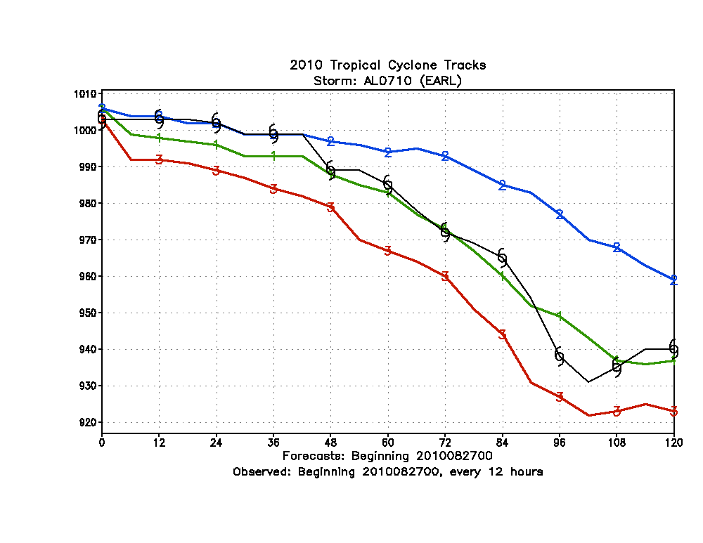
Impact of Improved Moisture Initialization
MAXIMUM SURFACE WINDS (KTS)
CENTRAL PRESSURE (hPa)
OPERATIONAL GFDL (Unbogused)
NEW MOISTURE INIT
OLD MOISTURE INIT
NEW INIT
OLD INIT
OPERATIONAL GFDL
NEW INIT
OPERATIONAL GFDL
NEW MOISTURE INIT
OLD MOISTURE INIT
OLD INIT
HURRICANE EARL (INITIAL TIME: 000 UTC 27 AUGUST, 2010)

Slide 7
Formulation of New Storm Size (R_{b}) (radius where the tangential wind of specified vortex goes to 0)
In current vortex initialization we assume R_{b} is a simple function of the Radius of the Last closed Isobar (RLCI) from the tcvitals file (R_{b} = 1.5 * RLCI)
Assume the Absolute Angular Momentum M(r)
$M(r) =rv+$ ½ f r² $is roughly conserved for$
A parcel of air moving radially inwardly toward the storm center
$V\left(r\right)tan=\frac{M\left(p\right)}{rx} −\frac{1}{2} f r Carr and Elsberry, MWR (1997)$
Where: (x = .4)
$M(p) =$ $M\left(r\right)/$r ^{(1-x)}
$M\left(p\right)=\frac{1}{2}f \left(Rb\right)\left(1+x\right)$ Assuming R_{b} = Radius where tangential wind vanishes
The Absolute Angular Momentum (M_{gale}) at the radius of Gale winds can be determined from the tcvitals :
M(r)_{gale} = r_{gale}v_{gale} + $\frac{1 }{2}$ f r_{gale}²
r_{gale} averaged sum of radIi of
gale winds v_{gale} at each of the
4 storm quadrants
MLG = $log$(2(M(r))_{gale}/f r_{gale}^{(1-x)}
New Estimate for R_{b} :
$\left(Rb\right)$ = e^{(MLG/(1 + x))}

Slide 8
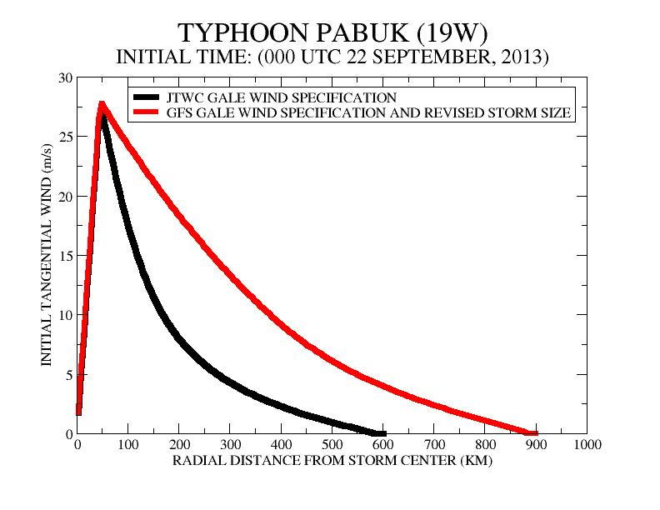
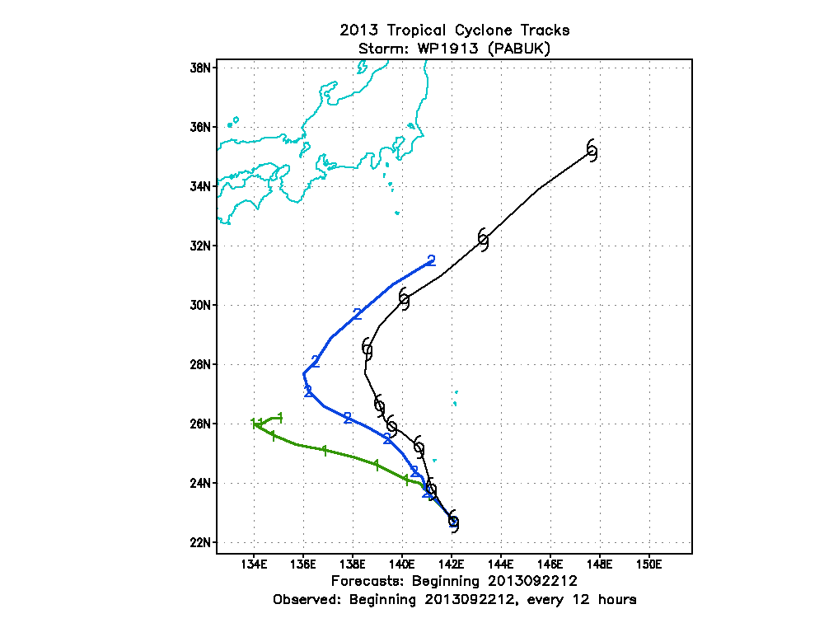
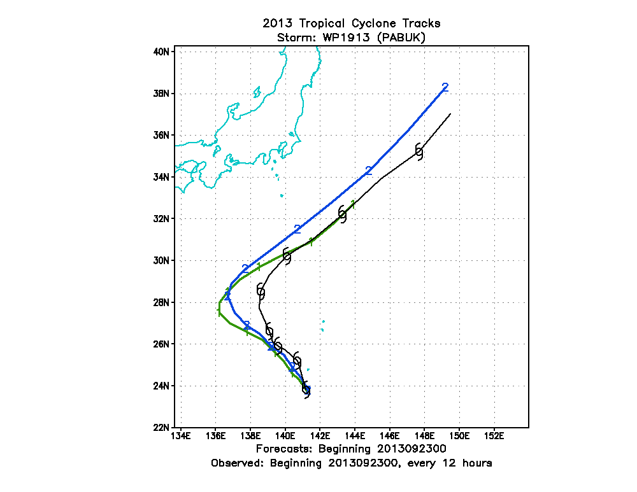
Typhoon Pabuk
New Storm Size
New Storm Size
Old Storm Size
OLD Storm Size
Based on JTWC
1200 UTC 22 September
New Storm Size
New Storm Size
Old Storm Size
Old Storm Size
0000 UTC 23 September
1200 UTC 23 September

Slide 9
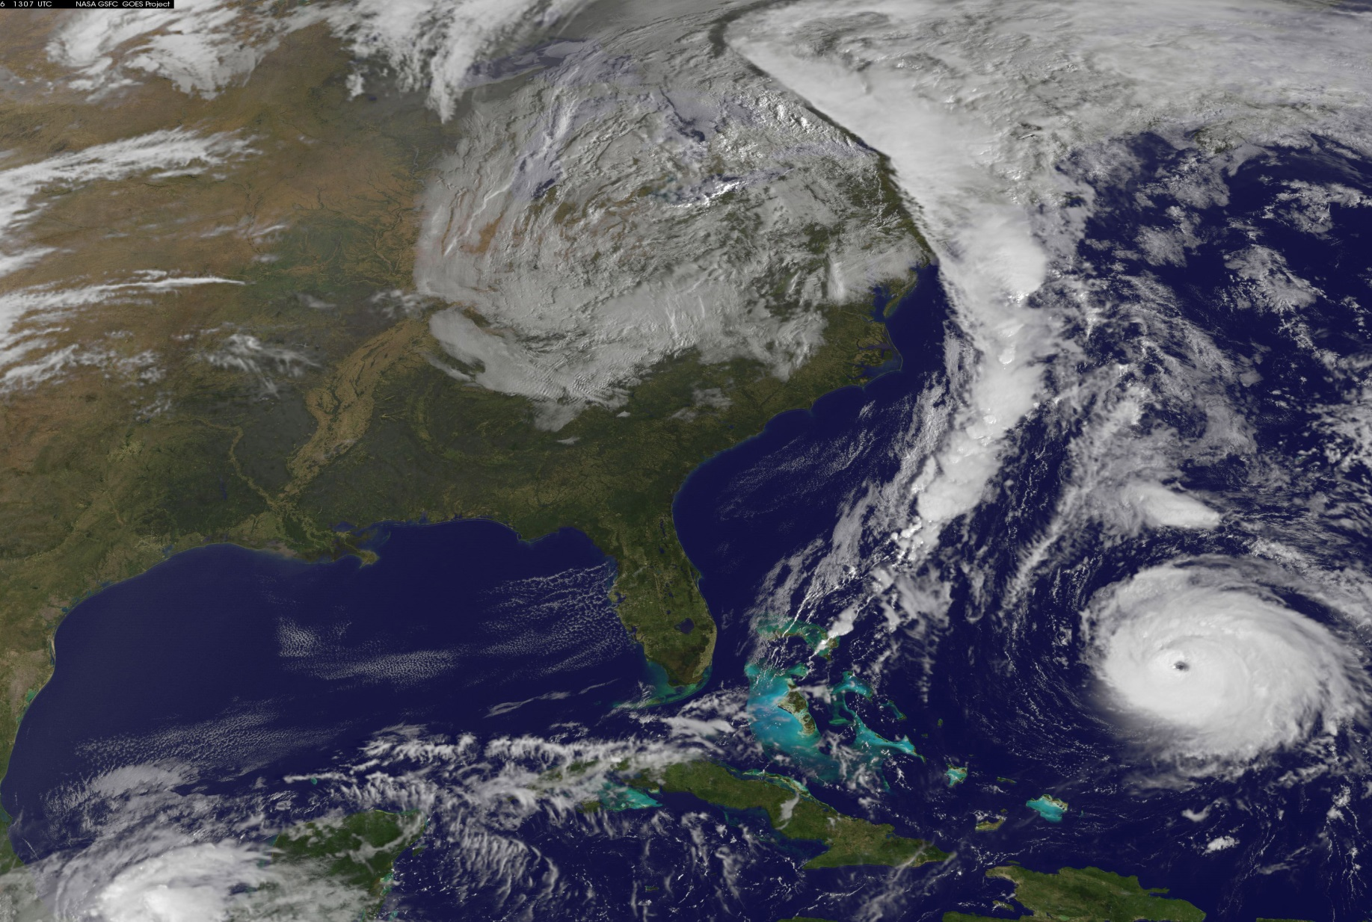
Performance Evaluation of Upgraded Model with Previous GFS

Slide 10
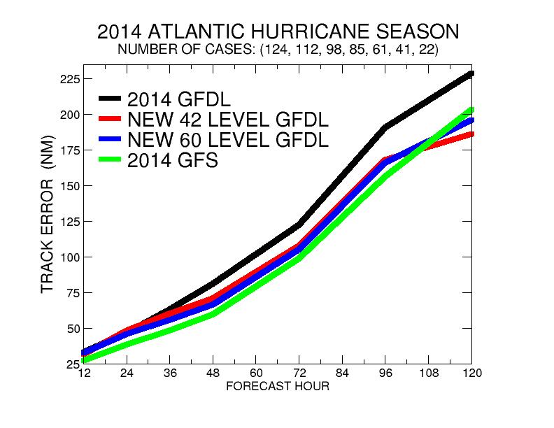
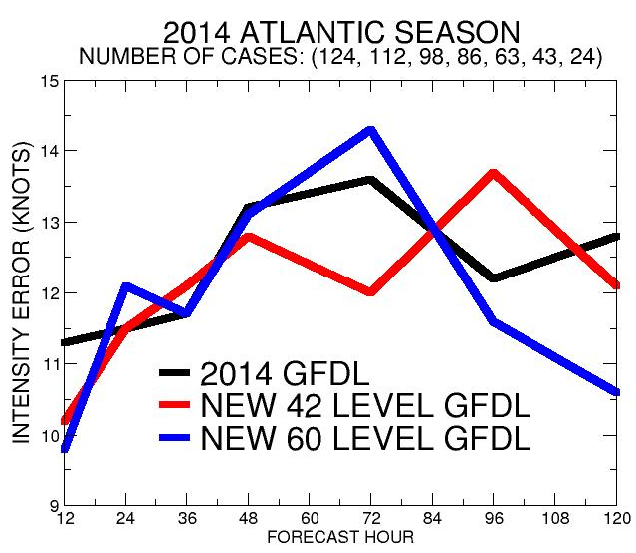
2014 Atlantic Season with 2014 GFS
TRACK ERROR (NM)
INTENSITY ERROR (KNOTS)
16-18% Reduced Track Error for
2-5 Days for Both Upgraded Models
New Models Comparable to GFS
INTENSITY PERFORMANCE MIXED
42 LEVEL IMPROVED EARLY TIME
60 LEVEL IMPROVED LATER TIME

Slide 11
Performance Evaluation With New GFS

Slide 12
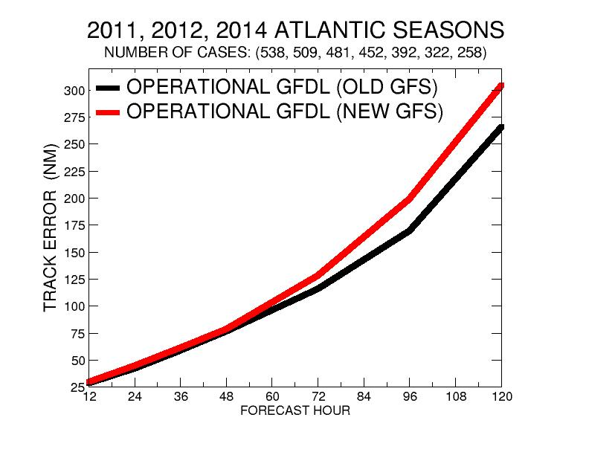
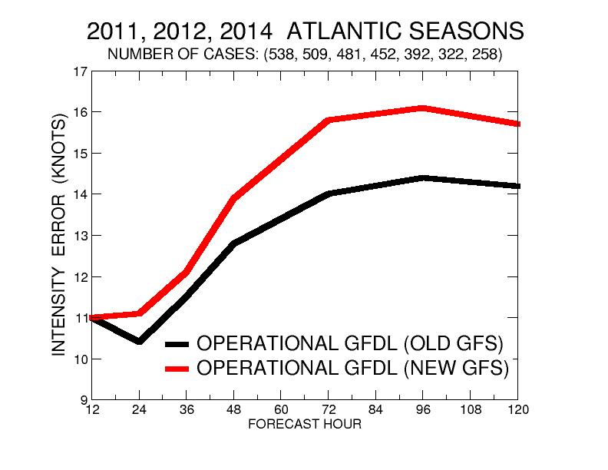
Impact Only of GFS Upgrade in Atlantic
TRACK ERROR (NM)
INTENSITY ERROR (KNOTS)
New GFS Degrades GFDL degraded both track and intensity skill by 6% at days 1-2
Track (12%) and Intensity (10%) Skill Significantly degraded days 3-5

Slide 13
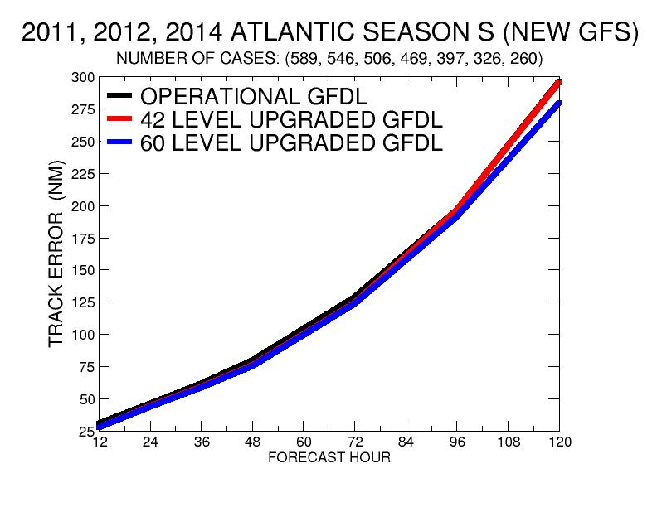
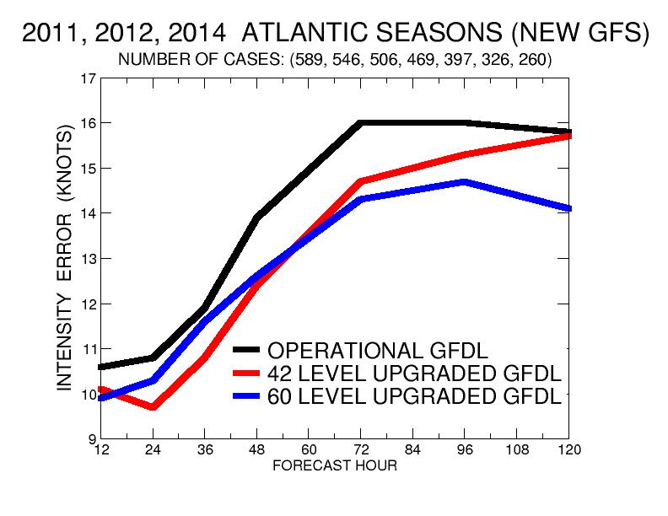
2011, 2012, 2014 Atlantic Seasons with New GFS
TRACK ERROR (NM)
INTENSITY ERROR (KNOTS)
42 Level Model performed better then 60 Level Model through 48 hours.
(10% reduced intensity error compared to current model)
60 Level Model performed best for 4-5 Days
(11% reduced intensity error)
60 Level Model performed slightly better at days 4-5
42 and 60 level models had 5 % and 6% reduced track error through day 3, compared to Current GFDL model

Slide 14
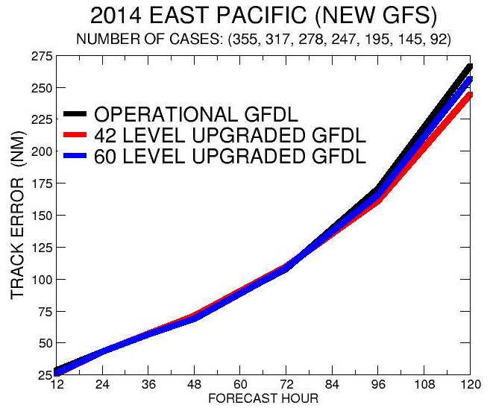
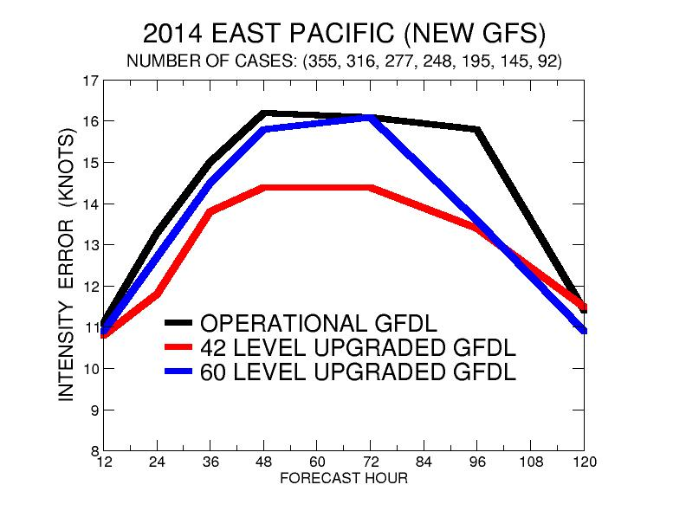
2014 EAST PACIFIC SEASON
TRACK ERROR (NM)
INTENSITY ERROR (KNOTS)

Slide 15
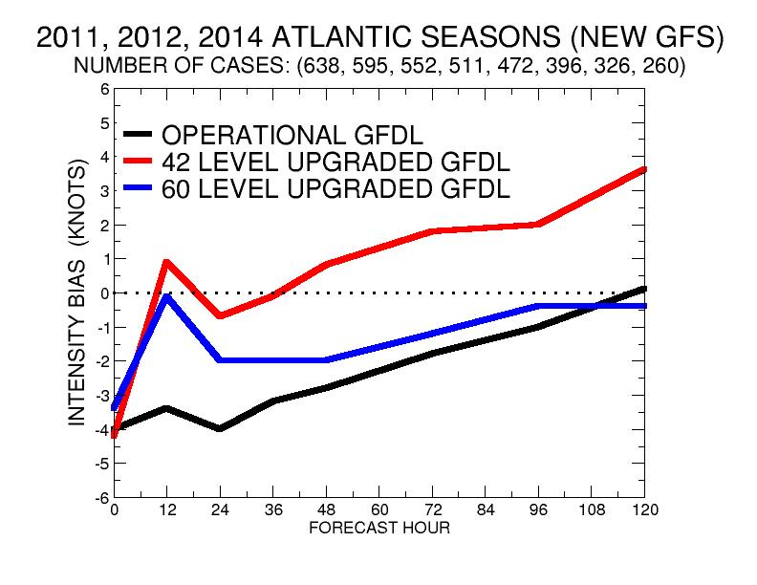
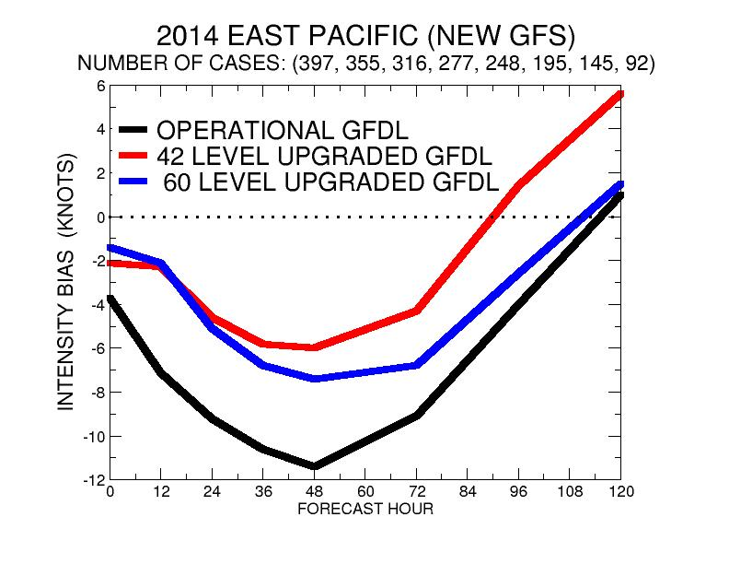
Comparison of Intensity Bias with New GFS
Atlantic Bias (Knots)
Eastern Pacific Bias (Knots)

Slide 16
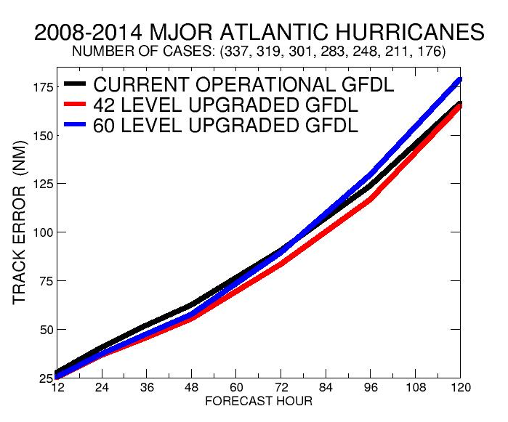
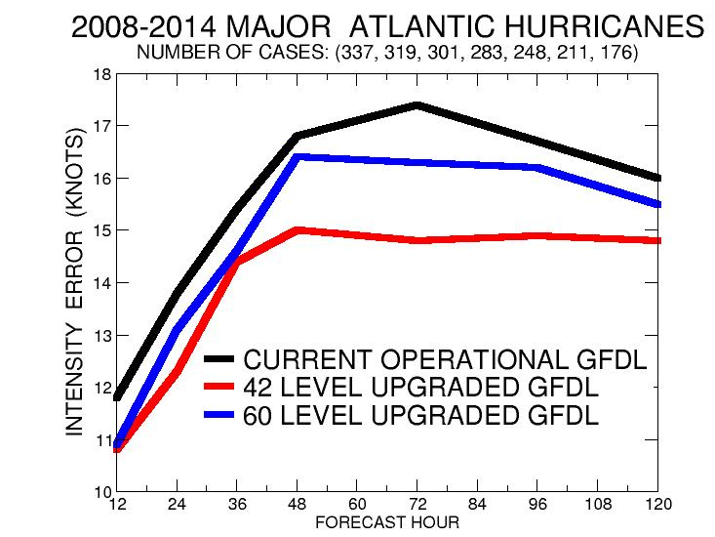
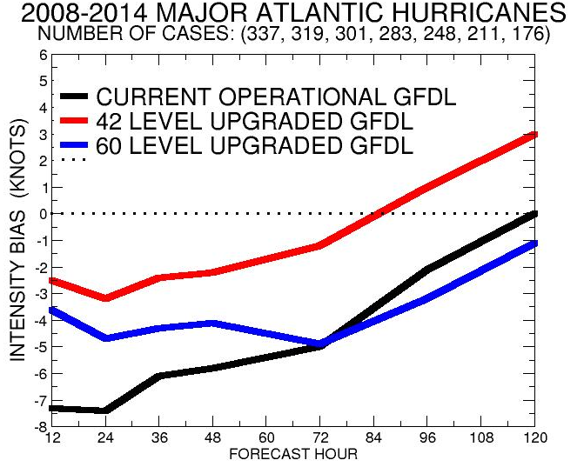
2008 and 2010 Storms Run With Old GFS
(Ike, Danielle, Earl, Igor, Julia)
2011 and 2014 used new GFS (Irene, Katia, Edouard, Gonzalo)
Results Suggest 60 Level Model has Excessive Negative Bias for Intense Hurricanes

Slide 17
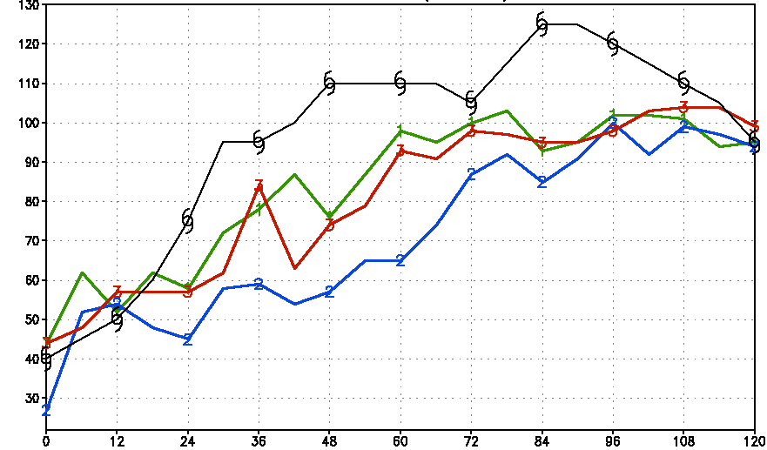
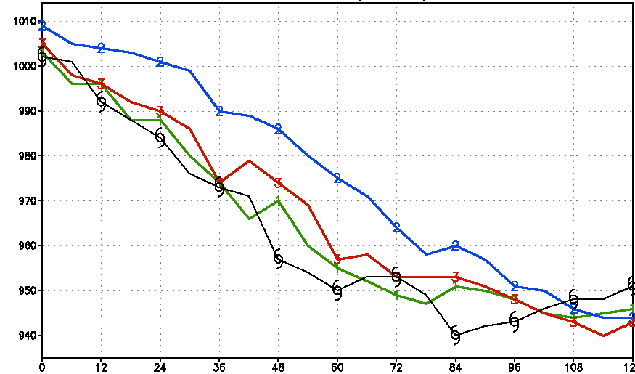
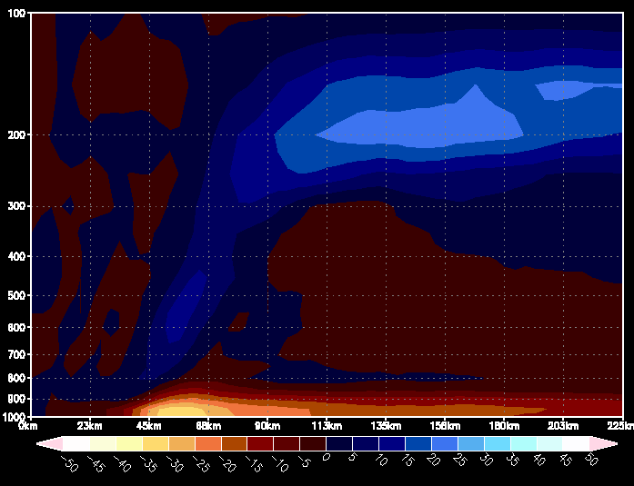
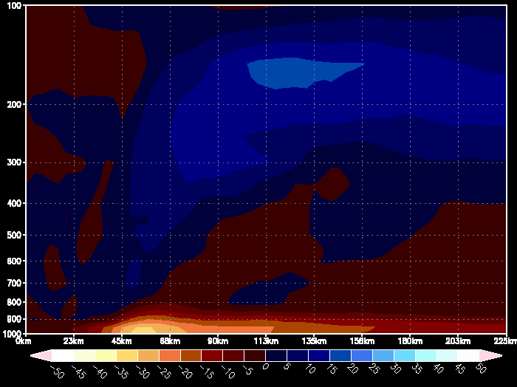
Hurricane Gonzalo (0000 UTC 13 October)
Max Winds
42 Level Model
Wind (knots)
60 Level Model
Wind (knots)
Current GFDL
42 Level GFDL
60 Level GFDL
Current GFDL
42 Level
60 Level
Northeast eyewall
96 hours
Northeast eyewall
96 hours
MSLP
Circular Averaged
Radial Wind
(96 hours)
42 level model
enhanced secondary circulation
42 Level Model
60 Level Model

Slide 18
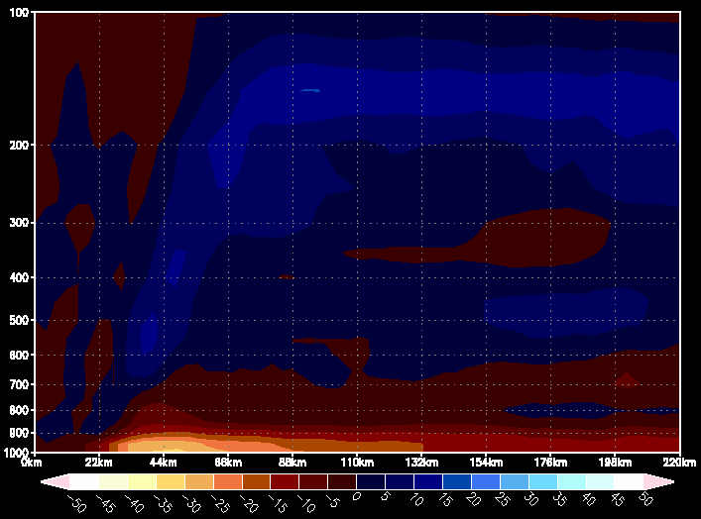
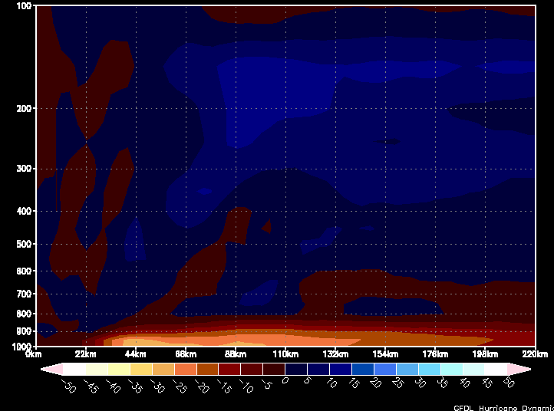
Hurricane Earl (0000 UTC 29 August, 2010)
42 Level Model
Wind (knots)
60 Level Model
Wind (knots)
Northeast eyewall
72 hours
Northeast eyewall
72 hours
42 Level Model
60 Level Model

Slide 19
Hurricane Earl (0000 29 August, 2010)
78 Hours
Larger ice concentration
in 60 level model at upper levels
300 hPa Ice Mixing Ratio
300 hPa Ice Mixing Ratio
42 Level Model
60 Level Model
78 Hours
Reduced
Solar radiation
Lead to more ocean cooling
SST
SST

Slide 20
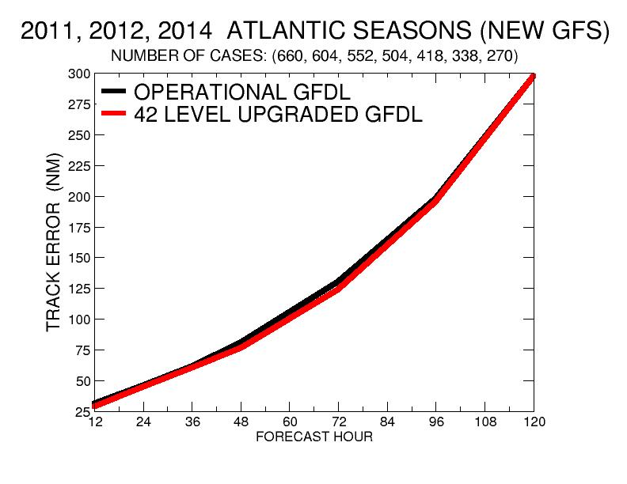
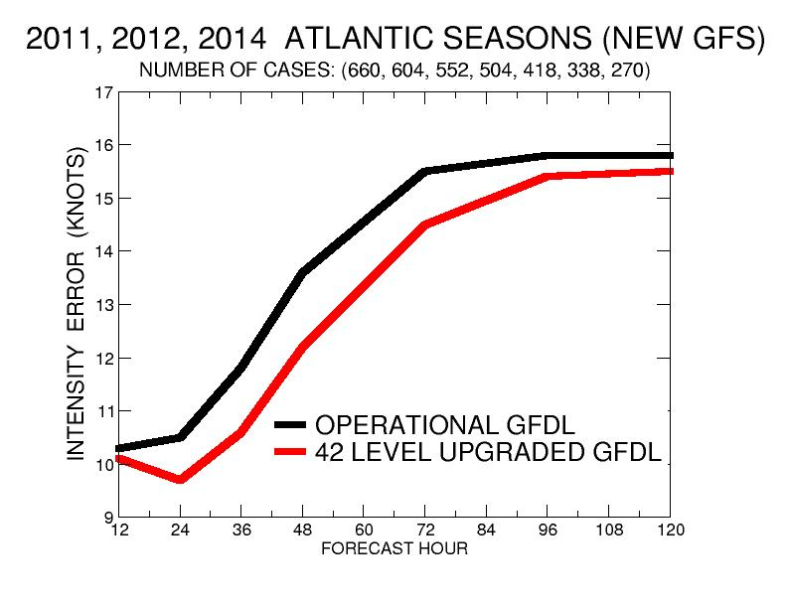
Complete 2011, 2012 and 2014 Atlantic Seasons with New GFS for Late Guidance
TRACK ERROR (NM)
INTENSITY ERROR (KNOTS)
5% Reduced Track Error for 42 level model Days 1-3
10% Reduced Intensity Error for 42 level model at Days 1-3

Slide 21
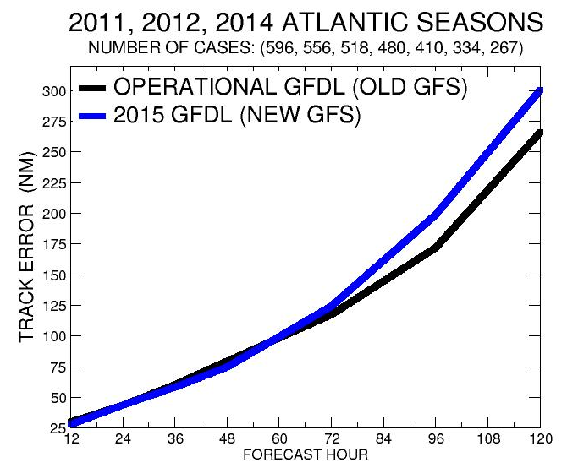
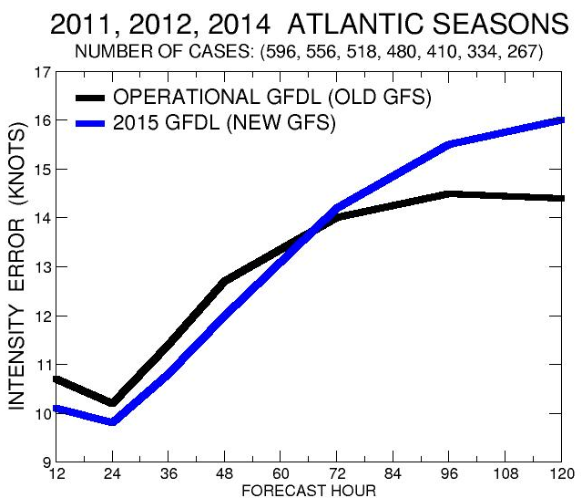
Comparison of Previous Operational System with new GFDL and GFS upgraded System
TRACK ERROR (NM)
INTENSITY ERROR (KNOTS)
Improved Guidance through 48h (4%)
Neutral day 3
Degraded Guidance (11%) Days 4-5
Improved Guidance through 48h (5%)
Neutral day 3
Degraded Guidance (9%) Days 4-5

Slide 22
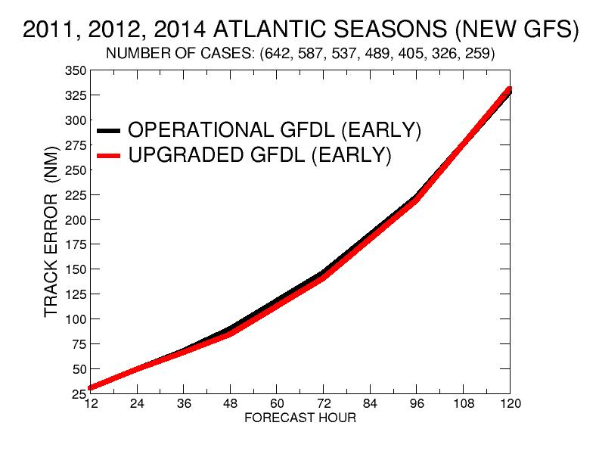
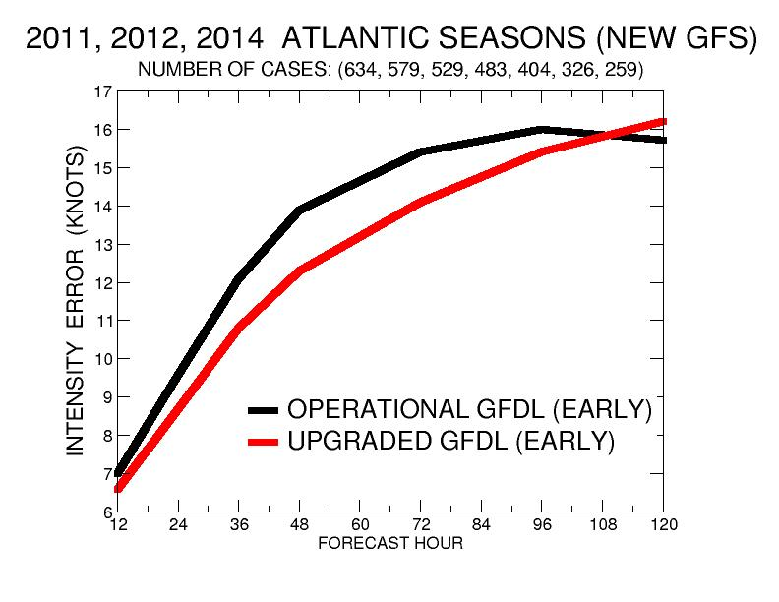
Complete 2011, 2012 and 2014 Atlantic Seasons (Early Guidance)
TRACK ERROR (NM)
INTENSITY ERROR (KNOTS)
Early Guidance Improvements are similar to Late Guidance
Comparing Upgraded GFDL with Current Model using New GFS

Slide 23
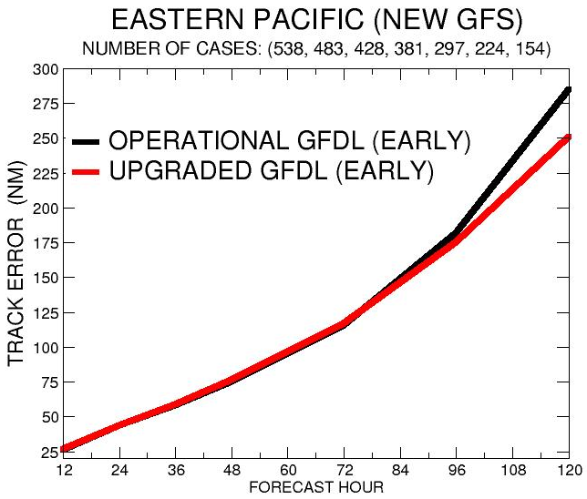
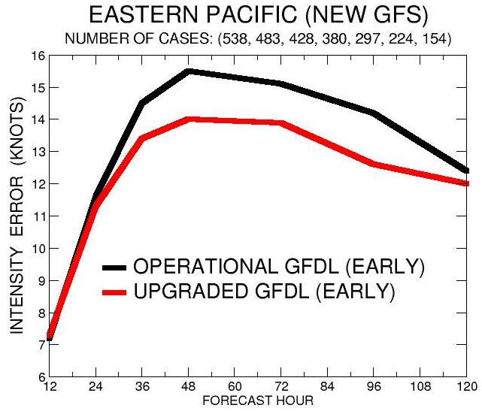
Eastern Pacific with Early Guidance
TRACK ERROR (NM)
INTENSITY ERROR (KNOTS)
10% Reduced Track Error Days 4-5
60% forecasts improved for days 3-5
5-10% Reduced Intensity Error Days 1-4

Slide 24
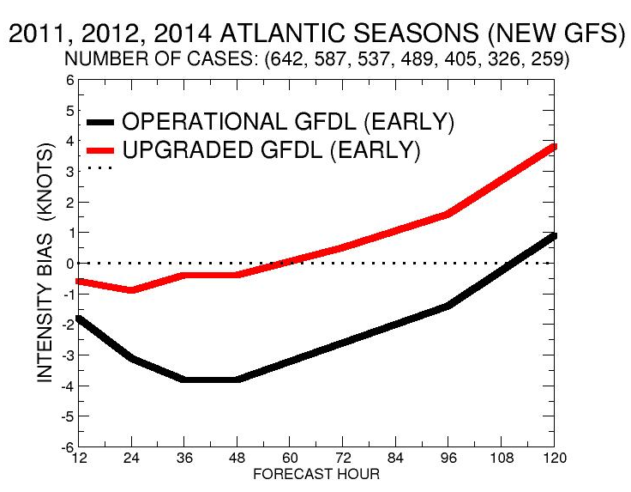
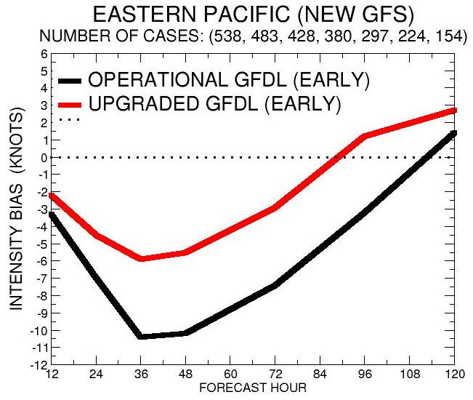
Summary of Intensity Bias with New GFS
Atlantic Bias (Knots)
Eastern Pacific Bias (Knots)
Reduced negative bias in both ocean basins at 1-3 Days Lead Times
Some Positive Bias Later Forecast Times

Slide 25
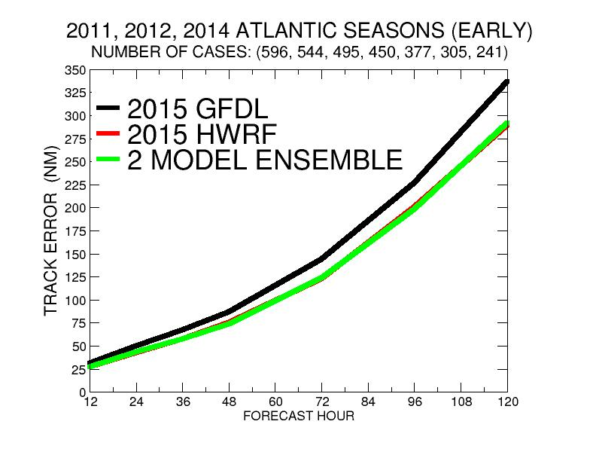
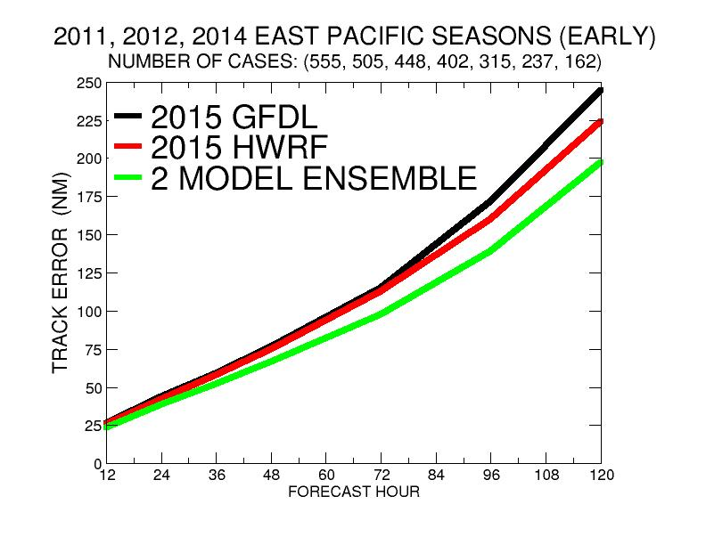
GFDL/HWRF Track Comparison
Atlantic
East Pacific
2-Model Ensemble errors very comparable to HWRF all forecast times
2-Model Ensemble errors average 11% less then HWRF days 1-5

Slide 26
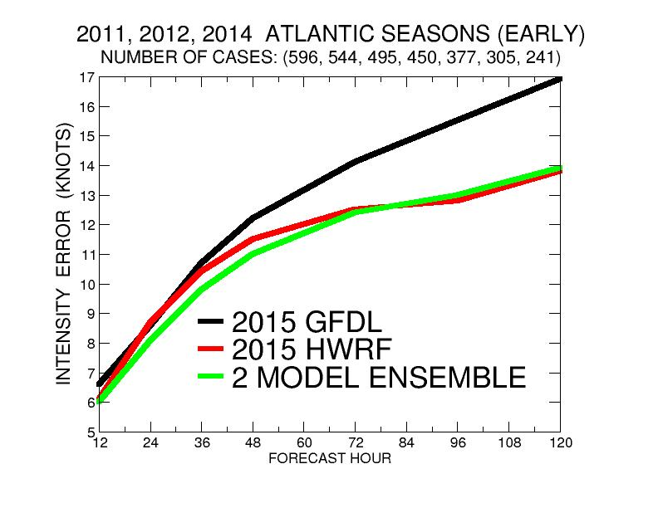
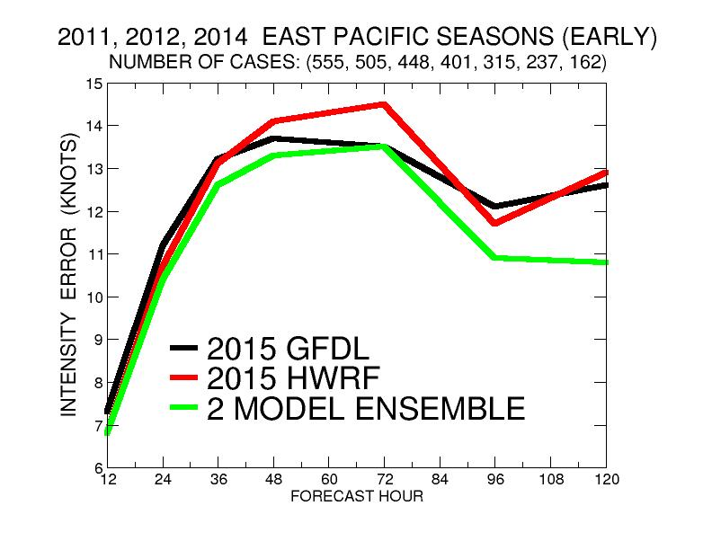
GFDL/HWRF Intensity Comparison
Atlantic
East Pacific
2-Model Ensemble errors 5% less then HWRF days 1-2.
Comparable to HWRF days 3-5
2-Model Ensemble errors average 7% less then either HWRF or GFDL model

Slide 27
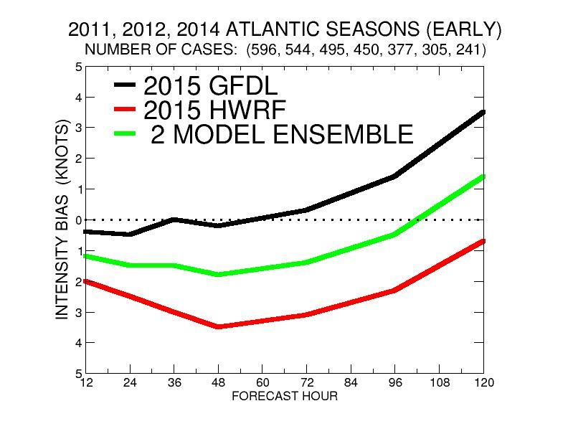
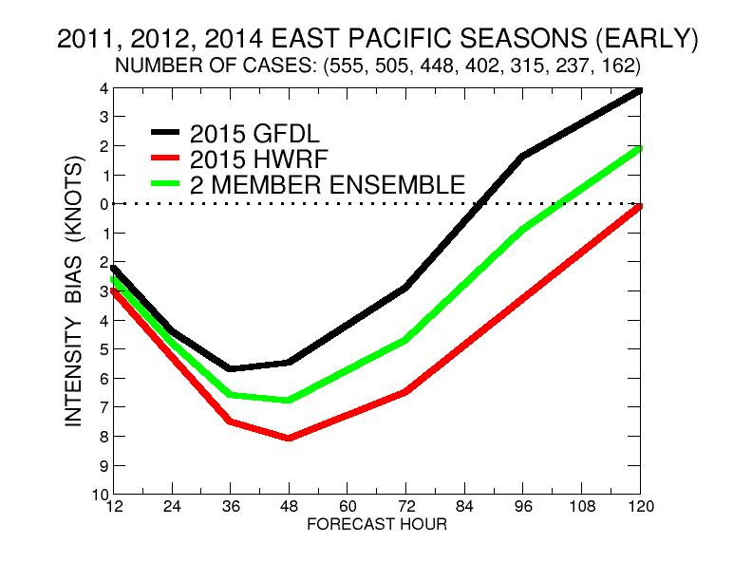
GFDL/HWRF Intensity Bias Comparison
Atlantic
East Pacific
2-Model Ensemble much less overall bias then either GFDL or HWRF

Slide 28
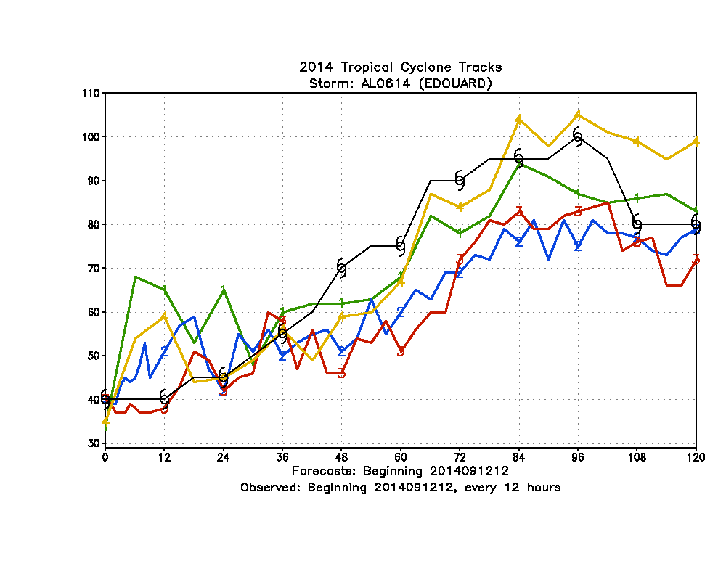
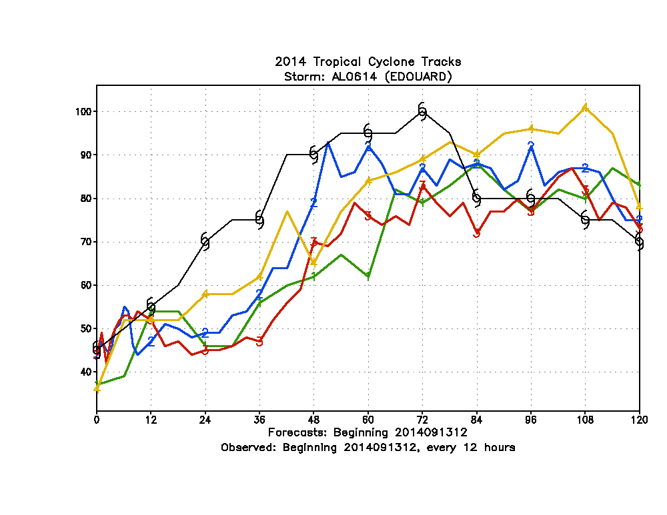
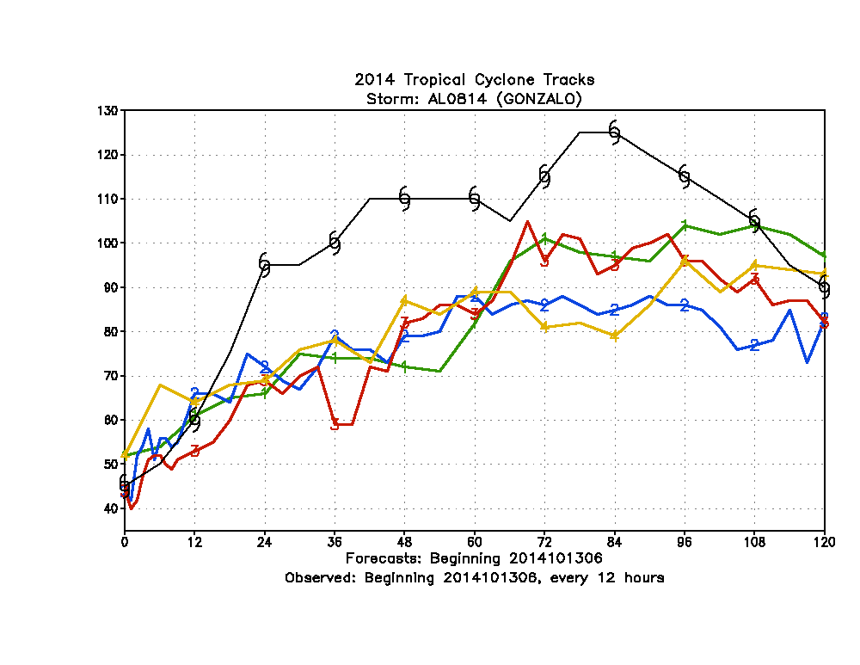
2014 vs 2015 Operational Guidance of Atlantic RI
Hurricane
Edouard
2015 GFDL
Hurricane
Edouard
2015 GFDL
2015 HWRF
2014 HWRF
2014 HWRF
2015 HWRF
2014 GFDL
2014 GFDL
1200 UTC 12 September
1200 UTC 13 September
Hurricane
Gonzalo
Hurricane
Gonzalo
2015 GFDL
2015 HWRF
2014 GFDL
2015 GFDL
2015 HWRF
2014 GFDL
2014 HWRF
2014 HWRF
2015 HWRF
0600 UTC 13 October
1200 UTC 13 October

Slide 29
2014 vs 2015 Operational Guidance of EPAC RI
2015 GFDL
Hurricane
Odile
Hurricane
Vance
2015 GFDL
2014 HWRF
2014 GFDL
2015 HWRF
2014 GFDL
2014 HWRF
2015 HWRF
0600 UTC 12 September
Hurricane
Genevieve
Hurricane
Marie
2015 GFDL
2015 HWRF
2015 HWRF
2014 HWRF
2014 HWRF
2015 GFDL
2014 GFDL
2014 GFDL
0000 UTC 22 August
1200 UTC 3 August

Slide 30
Future Plans
Address Negative Bias in 60 level GFDL model for intense hurricanes, by:
1. Evaluating impact of GFS enhanced PBL turbulence mixing in stratocumulus regions
2. Evaluating different distributions of vertical levels (e.g., reduced number in outflow and more in mid-levels)
Study could have benefit of reducing negative bias in 60 level HWRF in RI and intense hurricanes

Slide 31
Summary of GFDL upgrades
GFDL model upgrade demonstrates improved track and intensity guidance with both old and upgraded version of GFS for Atlantic and Eastern Pacific Hurricane Seasons for both the 42 and 60 level models.
Upgraded version with increased vertical resolution (60 vertical levels) performed well in multi-year Atlantic sample dominated with weaker storms.
For Major hurricanes 60 level version had large negative bias and degraded tracks at later times.
42 Level Upgraded Model is being recommended for 2015 implementation while a more optimal distribution of increased vertical levels is being evaluated for future upgrades and potentially as part of 2015 GFDL ensemble system.

Slide 32
The National Hurricane Center (NHC) endorses the proposed implementation of the GFDL Hurricane Model for 2015. Retrospective runs of this model for a large number of cases from the 2011, 2012, and 2014 hurricane seasons showed a significant reduction, in comparison to the current operational version of the model, in the intensity forecast error of 10-11 % in the Atlantic basin. Also, there was a considerable reduction of a negative bias of intensity forecasts in both the Atlantic and eastern North Pacific. In this regard the intensity bias was reduced to nearly zero in the critical 1-3 day time range in the Atlantic. The impact on track forecasts was largely neutral to slightly positive, except at days 4-5 for the east Pacific where the improvements were more substantial - and on the order of 12%. The NHC looks forward to having these improvements to our numerical guidance for TC prediction for the upcoming hurricane season. Sincerely, Dr. Richard J. Pasch Senior Hurricane Specialist National Hurricane Center/NOAA
ENDOSEMENT FROM THE NATIONAL HURRICANE CENTER

