Slide 1
Hurricane Ensemble Prediction base on Stochastic Convective Trigger Function
Zhan Zhang, Vijay Tallapragada, Weiguo Wang
and HWRF Team

Slide 2
Background and Motivation
Convective Trigger function in Current HWRF Cumulus Parameterization Scheme (SAS: Simplified Arakawa-Schubert)
PCSL-PLFC <= DP(w) Convection is triggered,
PCSL-PLFC > DP(w) No sub-grid convection
PCSL: Parcel pressure at Convection Starting Level,
PLFC: Parcel pressure at Level of Free Convection
DP(w): Convective Trigger function, which is function of large scale
vertical velocity w.
DP(w) ranges from 120hPa -180hPa
Storm intensity is found very sensitive to the convective trigger function;
Develop an effective ensemble method to represent vortex scale uncertainty in the operational HWRF model system.

Slide 3
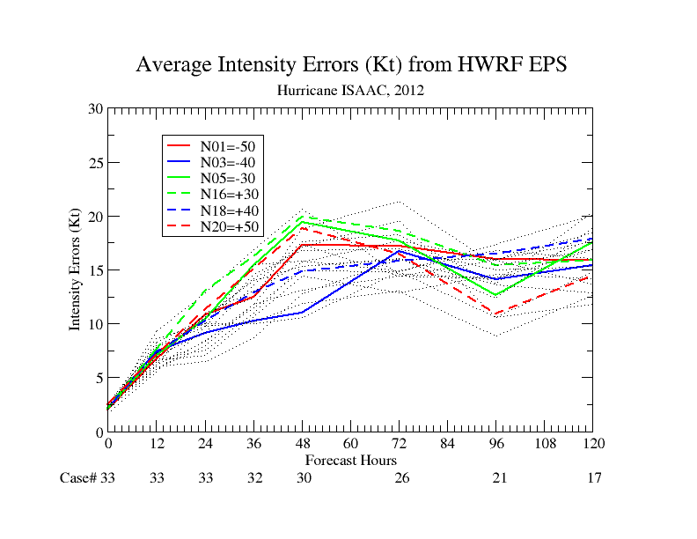
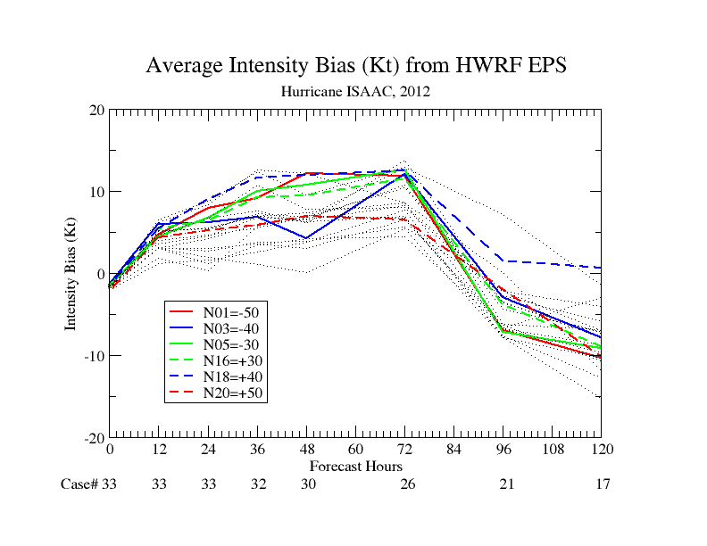
Sensitivity Test
Linear Convective Trigger experiment:
PCSL-PLFc <= DP(w) + Rl(n)
Rl is linear function of ensemble ID.
Rl=-50+(n-1)*dp, dp=5; n=1,2, .. 20
-50, -45, -40, ….. …. 40,45,50
Ensemble Membership
1 2 3 4… … 19 20
more Convection
less Convection
Storm intensity forecasts do not respond linearly to the convective trigger function;
No optimal convective trigger function;
Stochastic trigger function may be a better solution.

Slide 4
Methodology
Model Uncertainties:
Stochastic Convective Trigger
PCSL-PLFC <= DP(w) + Rr (n)
Rr is white noise, ranging from -50hPa to +50hPa, n is nth ensemble member, used as random seed. No spatial and temporal correlations
IC/BC Uncertainties:
20 member GEFS.

Slide 5
Experiment Acronym
HW01 – HW20:
Individual Ensemble Members Generated from Stochastic Convective Trigger + GEFS IC/BC;
HENS/HWMN:
Consensus of HW01-HW20 ensembles;
FY13:
2013 Operational HWRF, Deterministic version of HWRF; Control run for HW01-HW20, no SCT and GEFS perturbations;
H212:
2012 Operational HWRF;
AVNO:
GFS Forecasts;
2012: all storms during Aug. 1 to Oct. 31; 463 cycles
2011: 09L, 12L, 14L and 16L; 144 cycle
Total: 607 cycles.

Slide 6
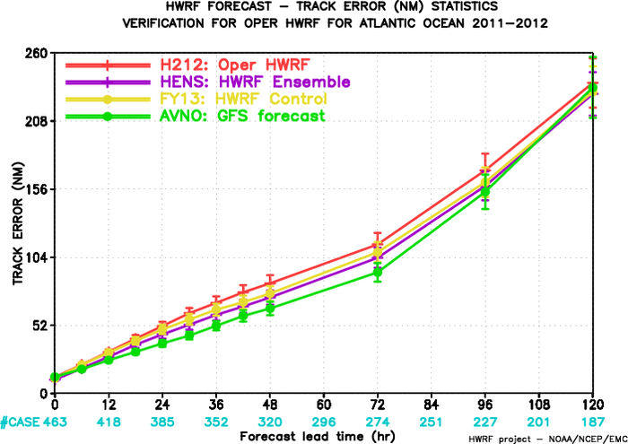
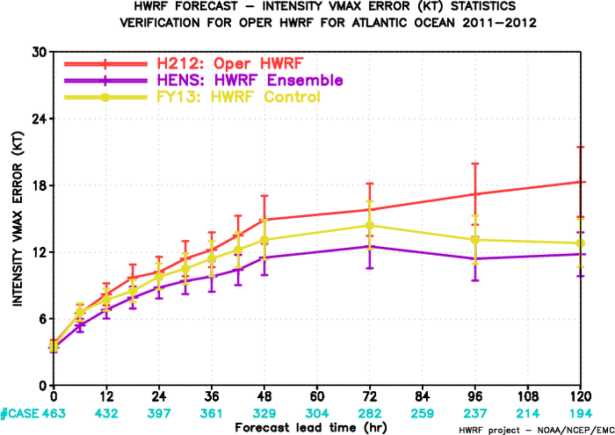
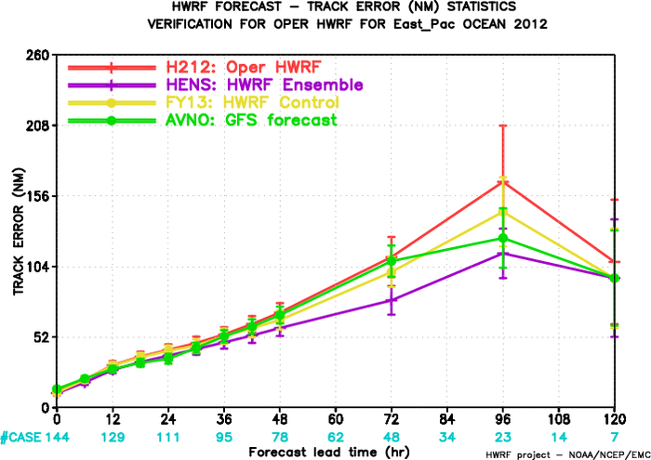
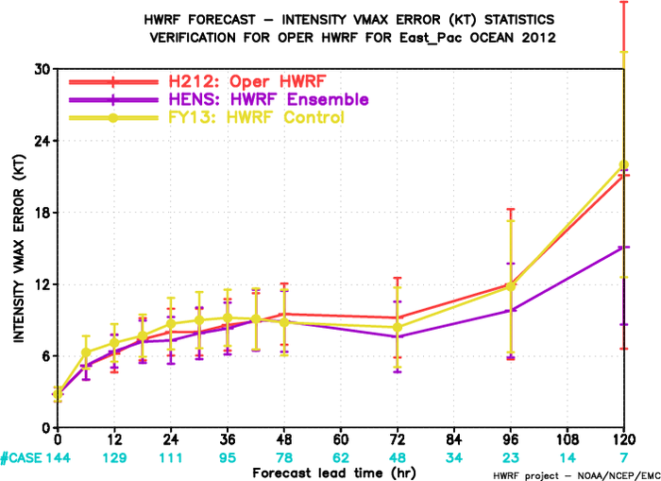
Track/Intensity Verifications
ATL-Track
ATL-Intensity
10 7 7 4 4 2 1
12 10 14 12 13 13 8
comparable
~14% improvement
EP-Track
EP-Intensity
11 11 11 11 20 23 12
9 15 11 1 10 12 22
~23% improvement at day 4
~22% improvement at day 5

Slide 7
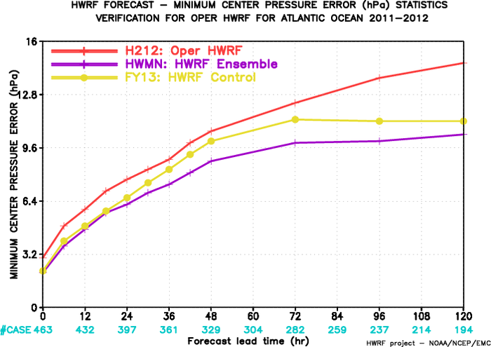
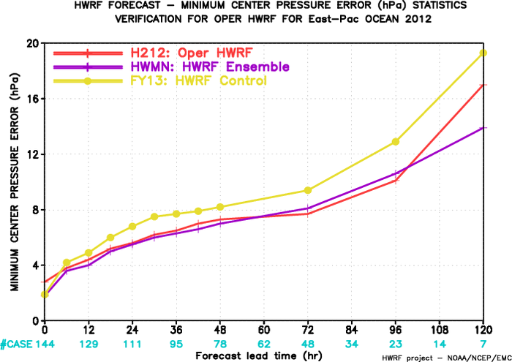
Central Pressure Verifications
Atlantic
E-Pac

Slide 8
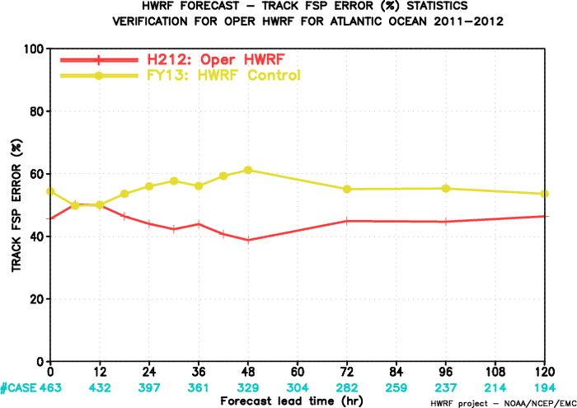
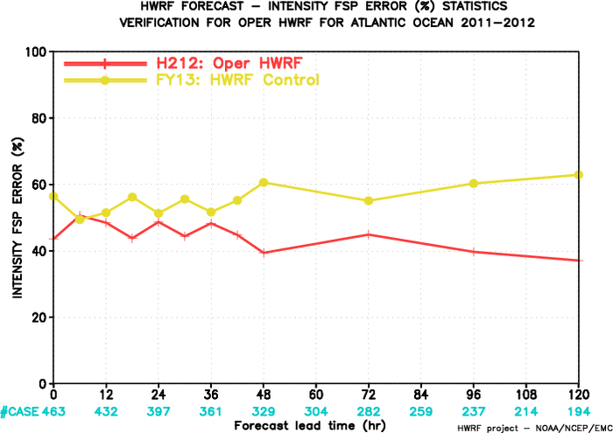
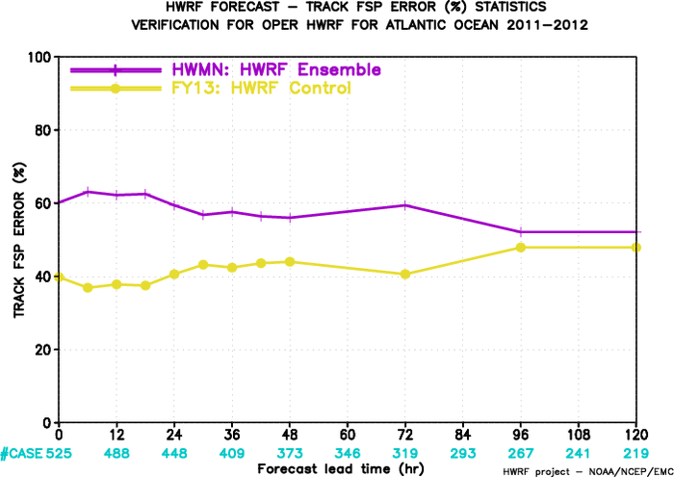
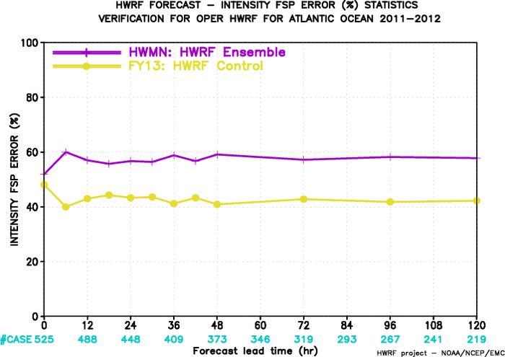
Frequency Superior Performance Verifications
(Atlantic Basin)
Track: FY13 vs. H212
Intensity: FY13 vs. H212
Track: HWMN vs. FY13
Intensity: HWMN vs. FY13

Slide 9
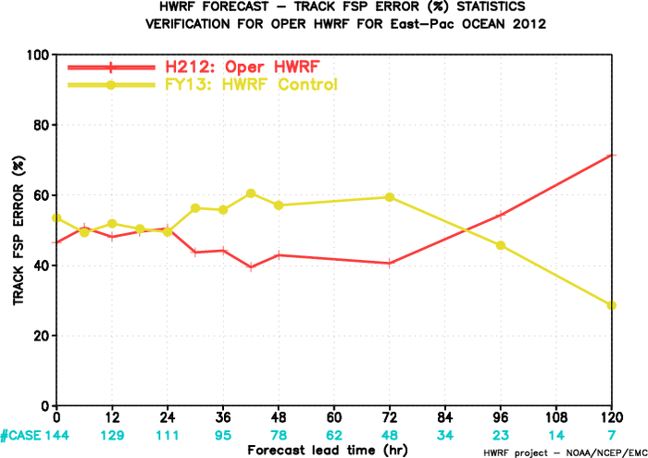
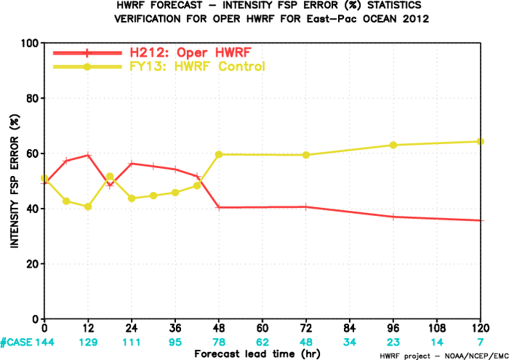
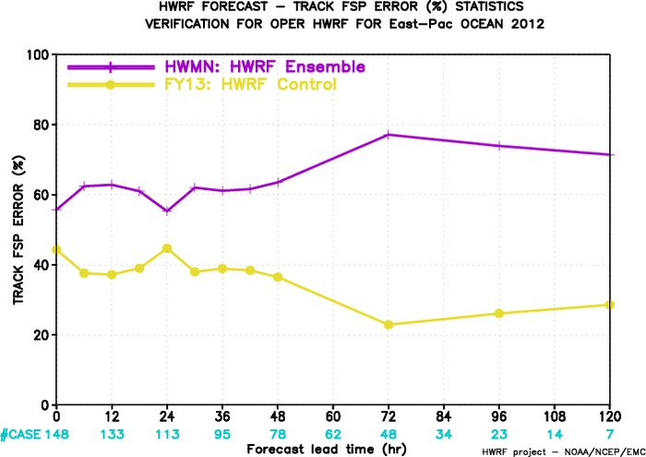
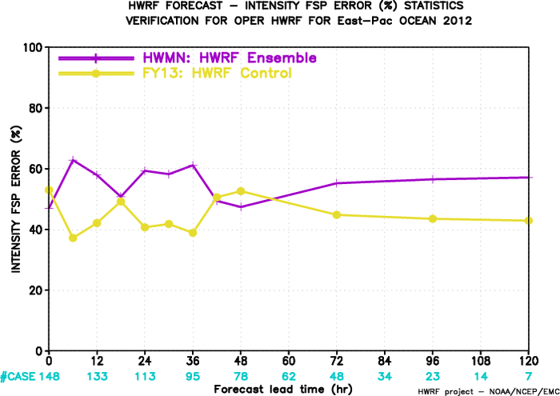
Frequency Superior Performance Verifications
(E-Pac Basin)
Track: FY13 vs. H212
Intensity: FY13 vs. H212
Intensity: HWMN vs. FY13
Track: HWMN vs. FY13

Slide 10
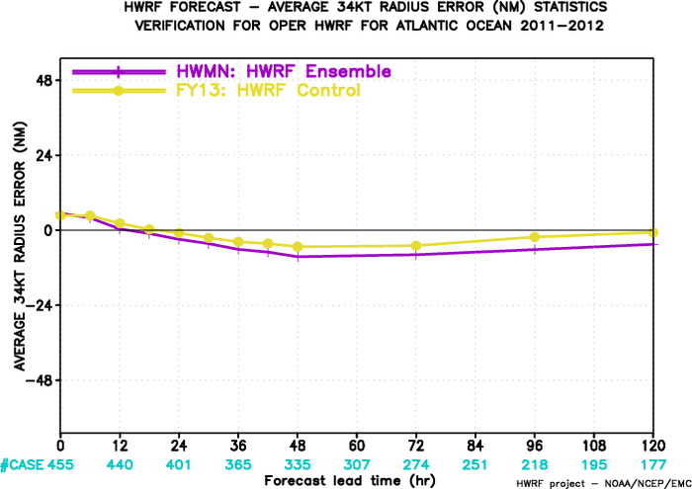
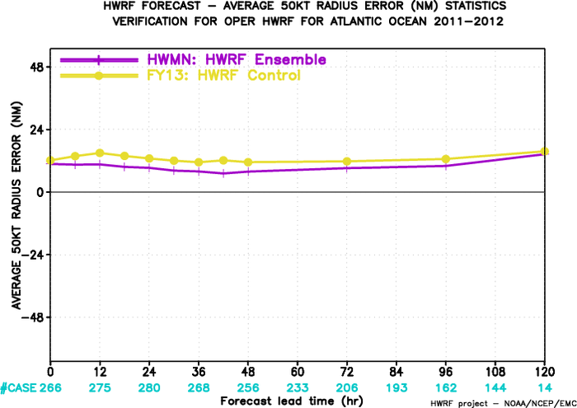
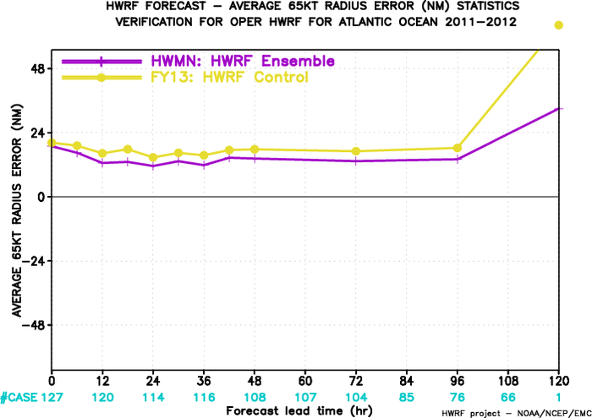
Storm Radii Verifications
(Atlantic Basin)
34kt
50kt
65kt

Slide 11
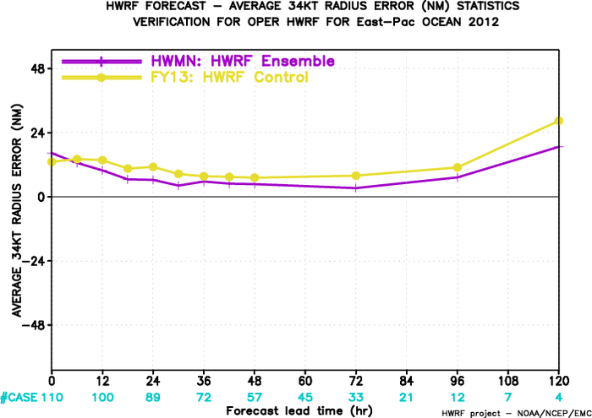
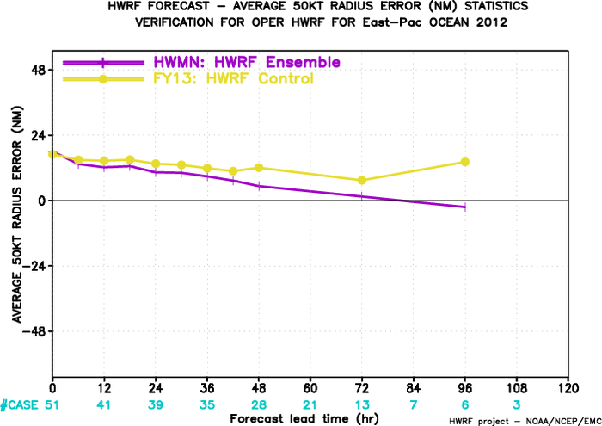
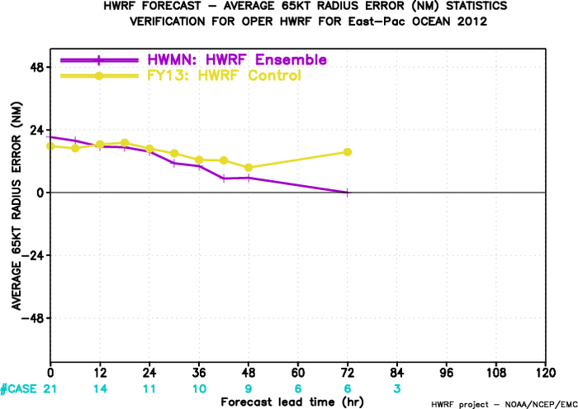
Storm Radii Verifications
(E-Pac Basin)
34kt
50kt
65kt

Slide 12
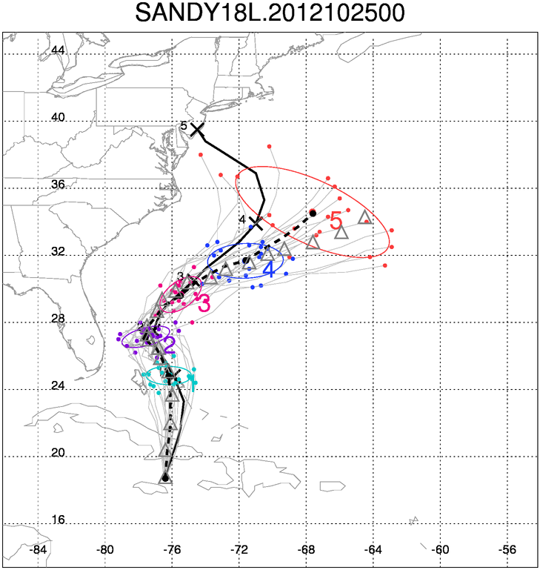
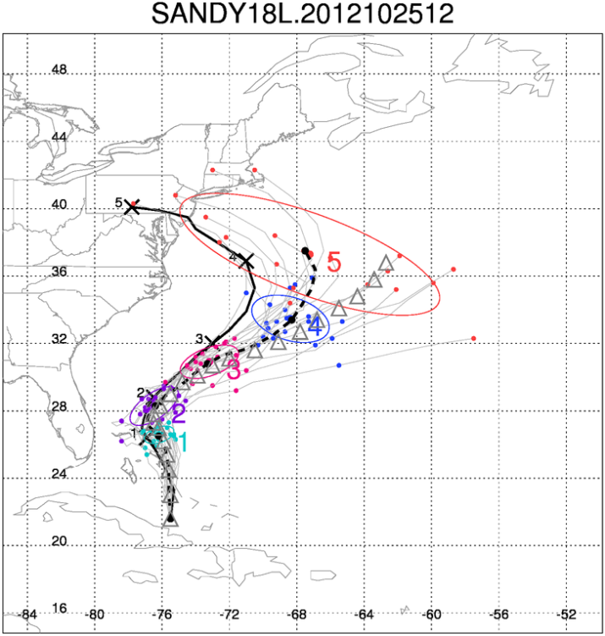
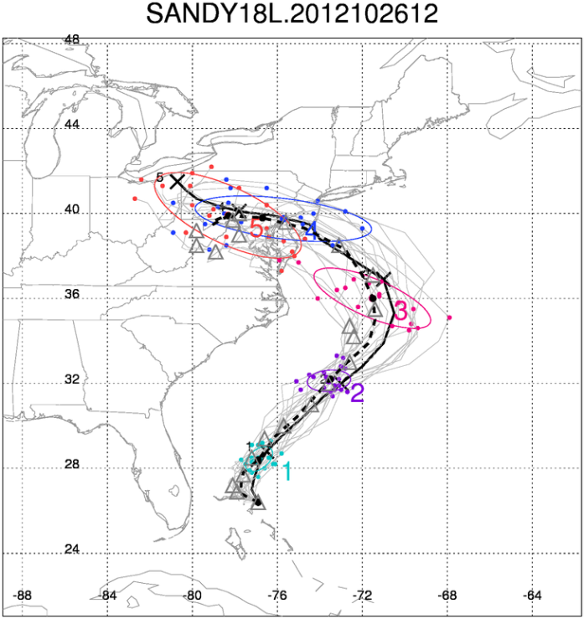
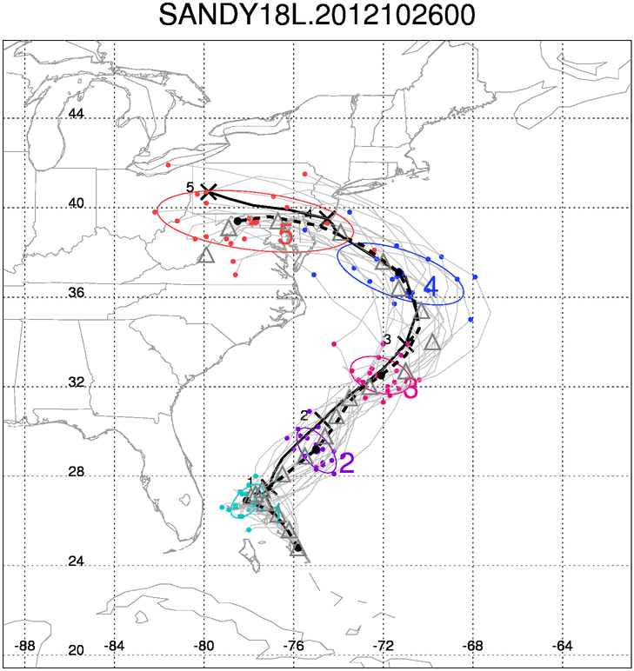
Track Probability Forecasts for Hurricane Sandy
Few members turned west
More members turned west
FY13
All members turned west

Slide 13
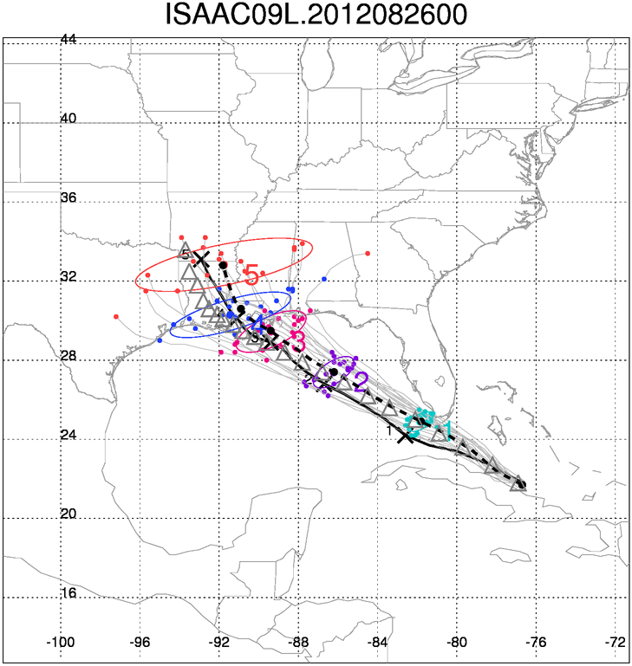
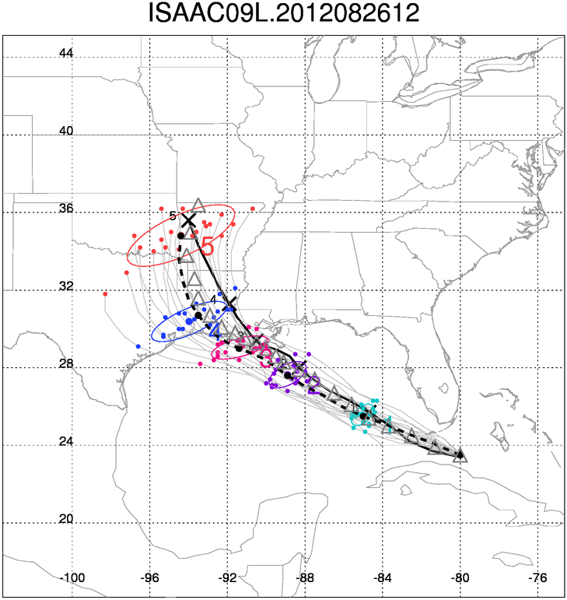
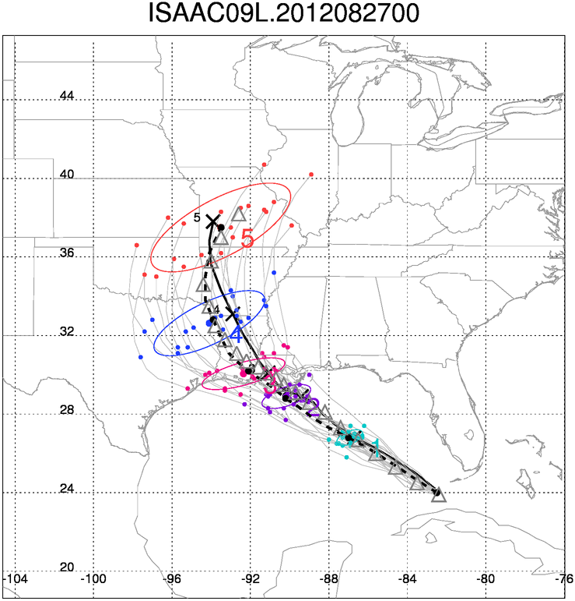
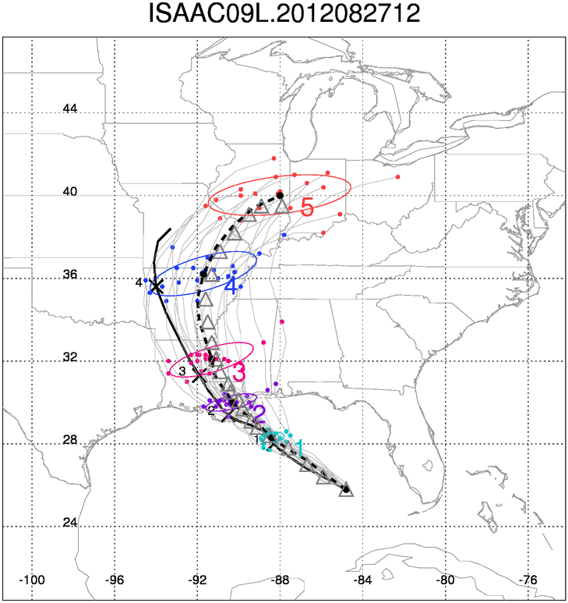
Track Probability Forecasts for Hurricane Isaac

Slide 14
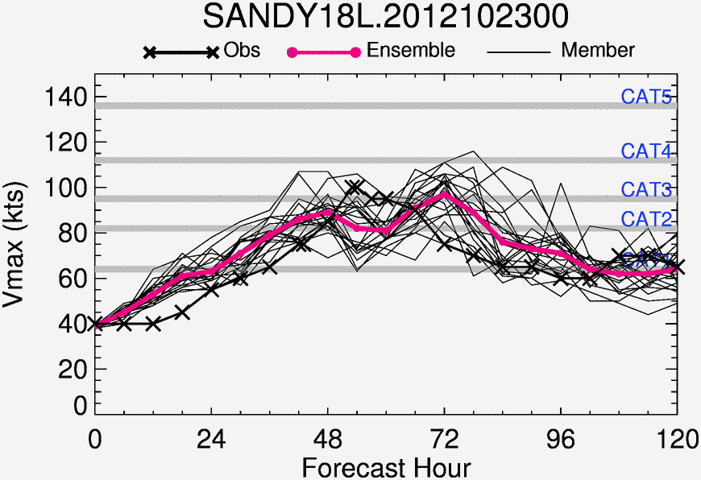
Ensemble Intensity Forecasts for Hurricane Sandy

Slide 15
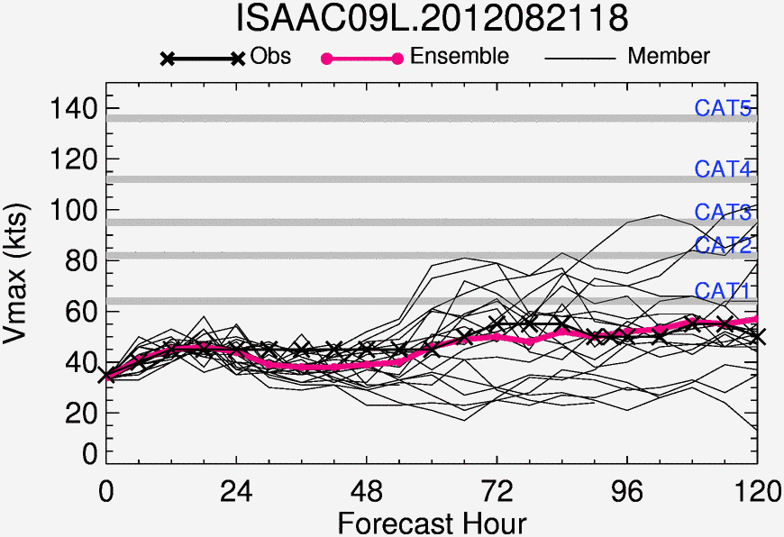
Ensemble Intensity Forecasts for Hurricane Issac

Slide 16
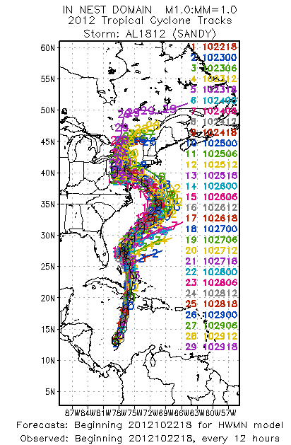
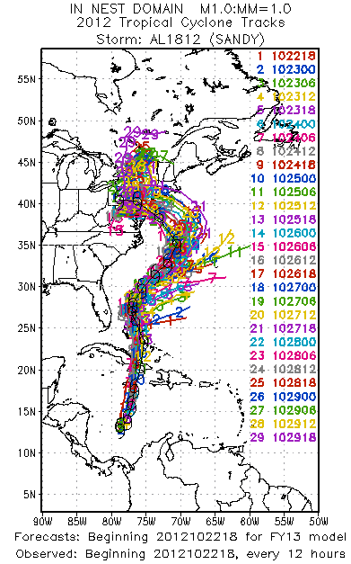
Spaghetti Plots Comparison for Track Forecasts Sandy, 2012
FY13
HWMN

Slide 17
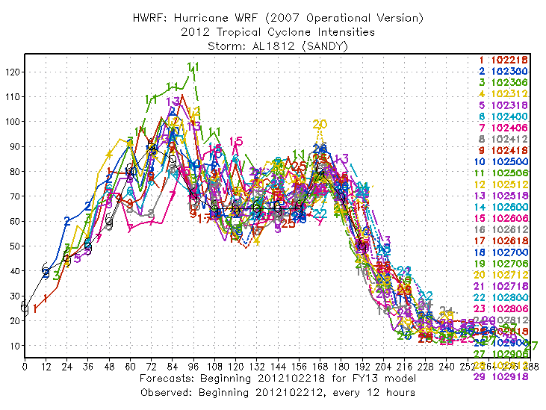
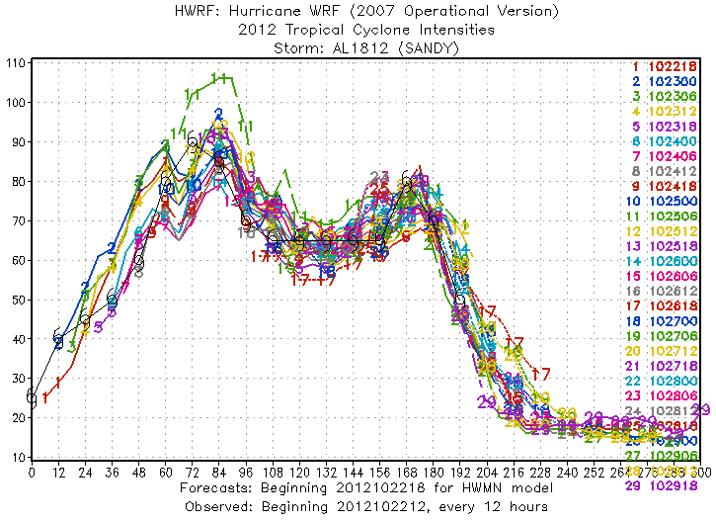
Spaghetti Plot Comparison for Intensity Forecasts Sandy, 2012
FY13
HWMN

Slide 18
Questions to be answered
Whether the large intensity variations are due to the stochastic convective trigger perturbations or the initial small errors grow through the model cycling process?
Why and how the stochastic convective trigger based ensemble has great impact on storm intensity forecasts?

Slide 19
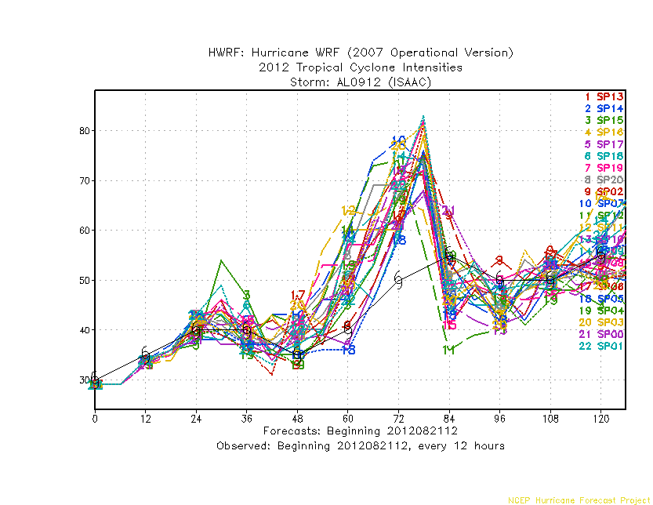
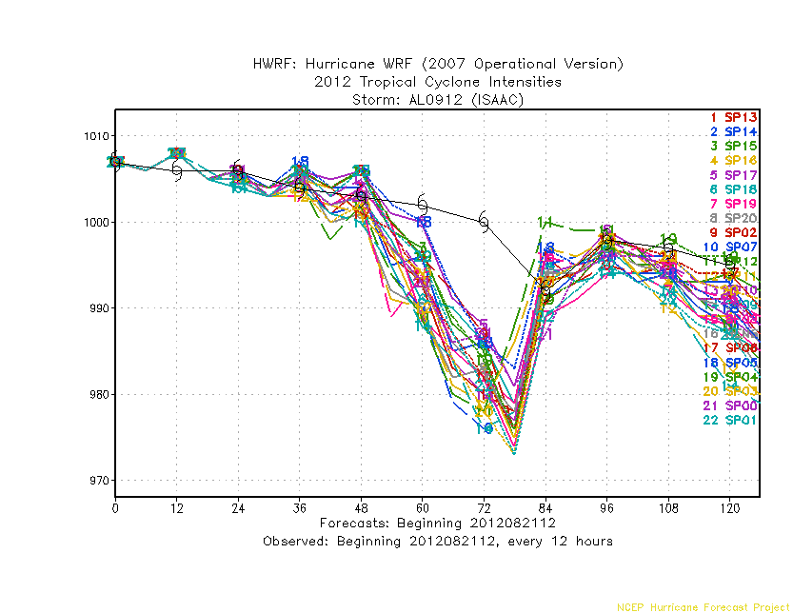
Cold-start Experiment
With GFS
Several cold-start experiments indicate there are large intensity forecast spread even without model cycling.
~20kt diff
~15hPa diff

Slide 20
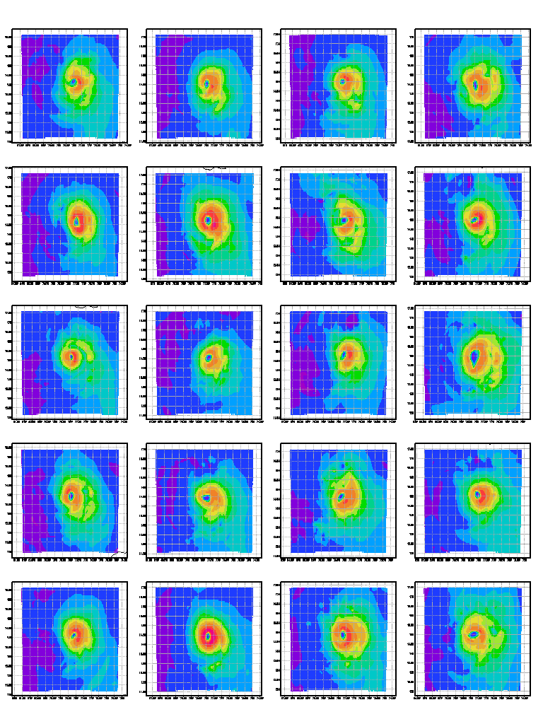
10m Wind Speed forecast at 24h from Individual Ensemble Members (Isaac, 2012)
Vortex scale variable,
Random feature
The maximum wind speed or intensity is the value at one single grid-point; It heavily depends on when and where the convection is happening.

Slide 21
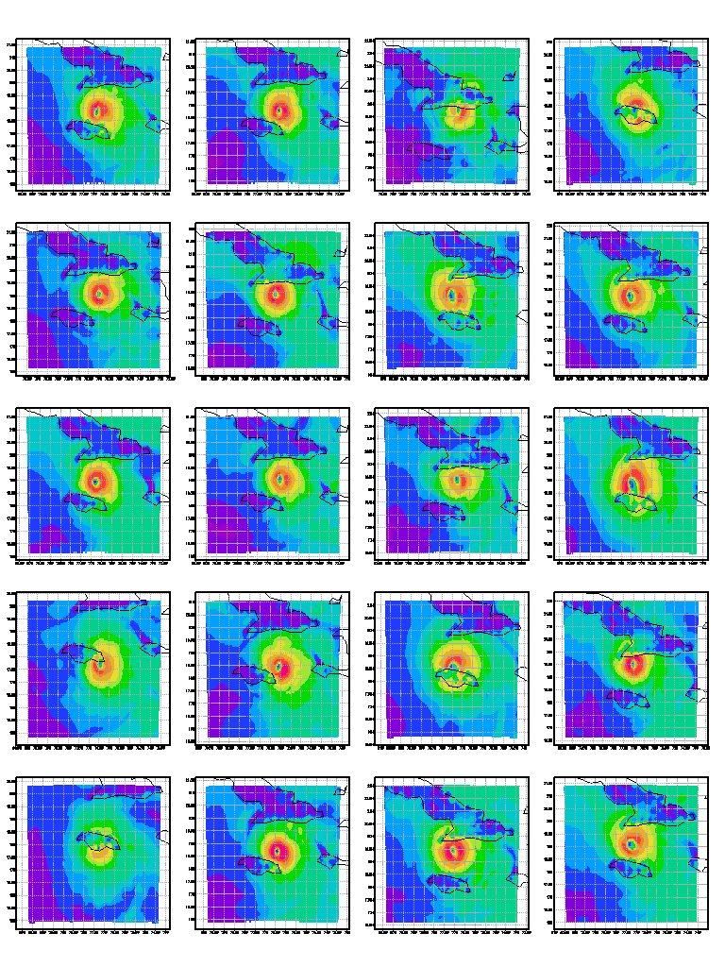
10m Wind Speed forecast at 48h from Individual Ensemble Members (Isaac, 2012)
Land interaction
Different predicted tracks for individual ensemble members due to land interaction, causing intensity variations.

Slide 22
Conclusion and Future Work
The intensity forecast skills are significantly improved for both AL and EP basins due to reduction of the vortex scale uncertainties in HWRF SAS convection scheme;
The method has positive impact on EP track forecasts, and neutral (slightly positive) impact on AL track forecast skills;
Large variation of storm intensity is caused by vortex scale uncertainty in the SAS scheme; Can be reduced by introducing SCT function;
The ensemble forecast skill will be further improved if the deterministic model is improved;
Future work: Develop an ensemble ranking system that identifies the optimal ensemble member based on their predicted storm centers, intensities, and storm structures.

