Slide 1


Diagnosing the Prediction of Tropical Cyclones and their Environments in Global Models (GFS and MPAS)
Chris Davis
National Center for Atmospheric Research
Boulder, CO
Collaborators: Bill Kuo, Tom Galarneau, Dave Ahijevych, Xingqin Fang, Wei Wang

Slide 2
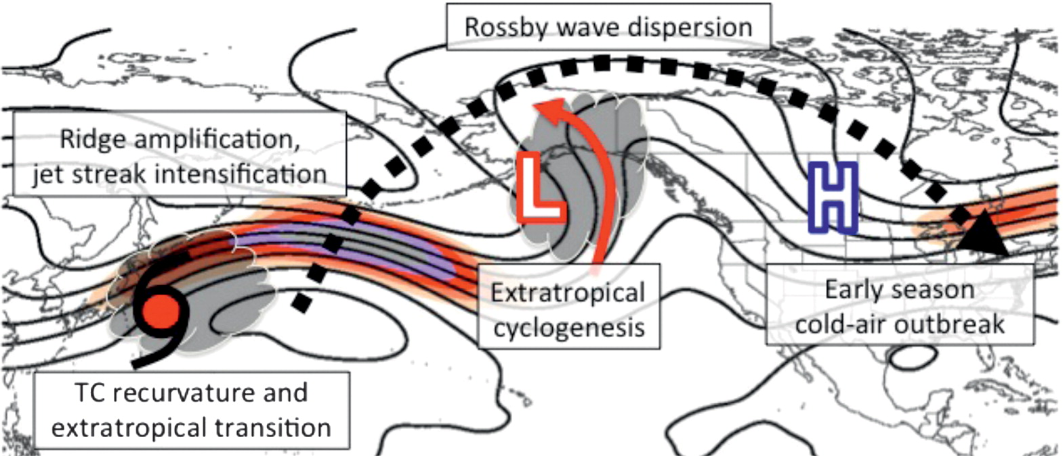
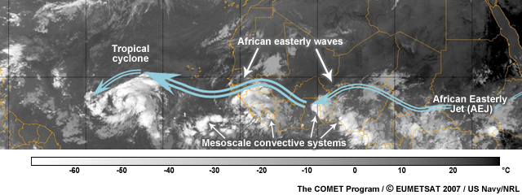
Global Modeling of Tropical Cyclones:
Benefits from global models at high resolution
Archambault et al. 2013, MWR

Slide 3
Outline of Talk
Part I: Diagnostics of GFS Forecasts in the Tropics (2012-2014)
Part II: The Model for Prediction Across Scales (MPAS)
  Comparison of GFS and MPAS TC and environment forecasts
  Plans for MPAS Tropical Cyclone Applications

Slide 4
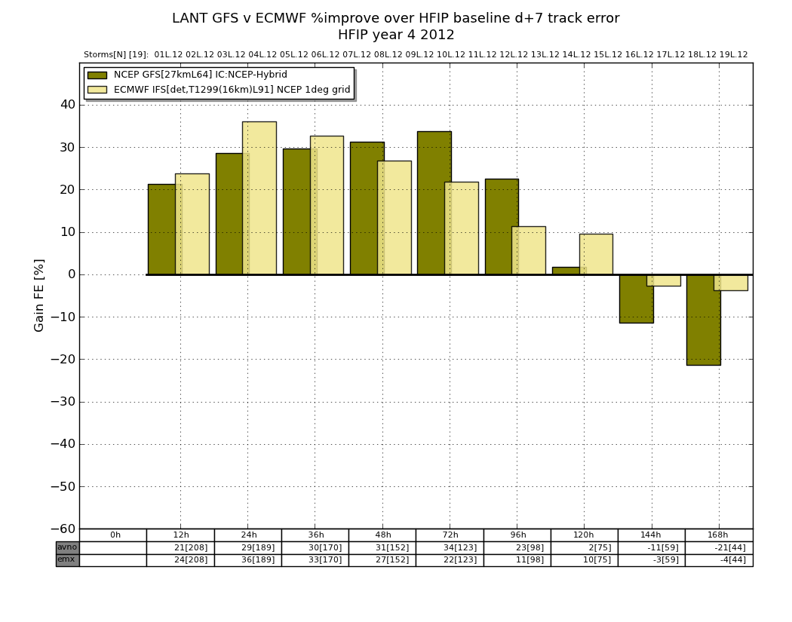
A Few Reminders from Bill Kuo’s NCEP Talk (Fall 2013)
GFS
ECMWF

Slide 5
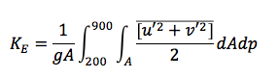
GFS Energetics: Eddy Kinetic Energy
Lorenz (1955):
Compute over latitude band 20°–85°N
Northern Hemisphere K_{E} increases during Aug-Oct
Systematic reduction in K_{E} in GFS forecasts
Reduction in K_{E} increases with forecast lead
Suggests synoptic-scale eddies too weak in GFS forecasts → more difficult to maintain amplified (or even blocked) flow
Consistent with time-mean DT jet/waveguide that is more zonal in GFS forecasts
GFS Forecast Northern Hemisphere Eddy Kinetic Energy
Date (mmddhh)

Slide 6
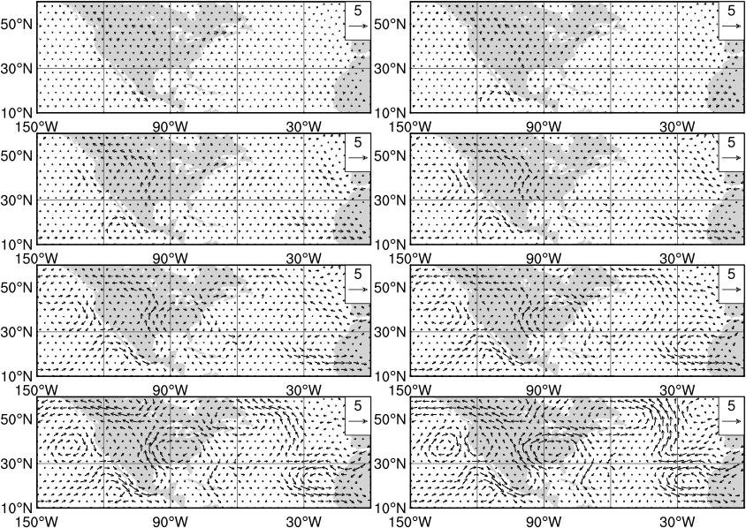
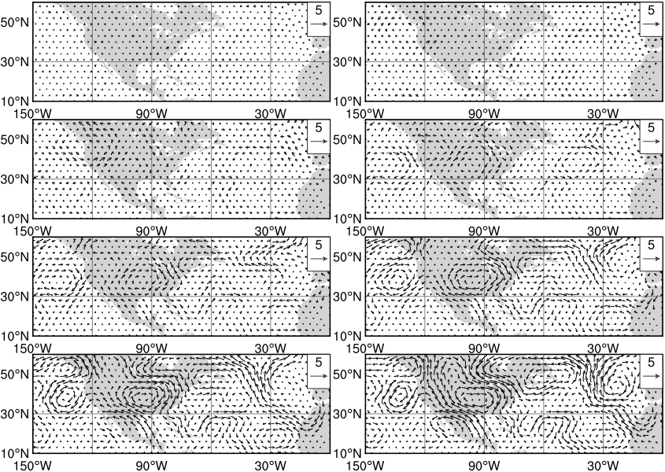
GFS forecast wind ME (Day 7)
92-day mean: Aug.1-Oct.31, 2012
850-500 mb
Rossby wave trains are coherent in error field
Emanate from Eastern Pacific, lower troposphere
Evidence of vertical wave propagation
Pattern will strongly influence TC motion and vertical shear near Gulf of Mexico
Note big error in eastern ATL anticyclone or African Easterly Jet displacement
500-200 mb
Low-level cyclonic anomaly location
Southern US anticyclone too strong: errors in moisture transport and TC steering in Gulf

Slide 7
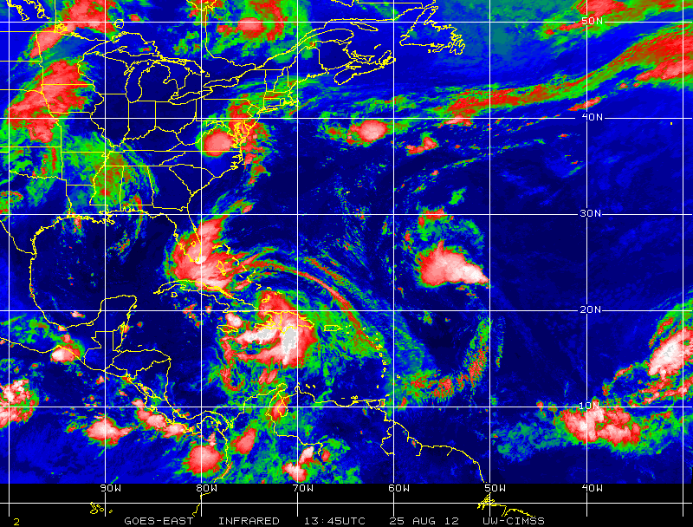
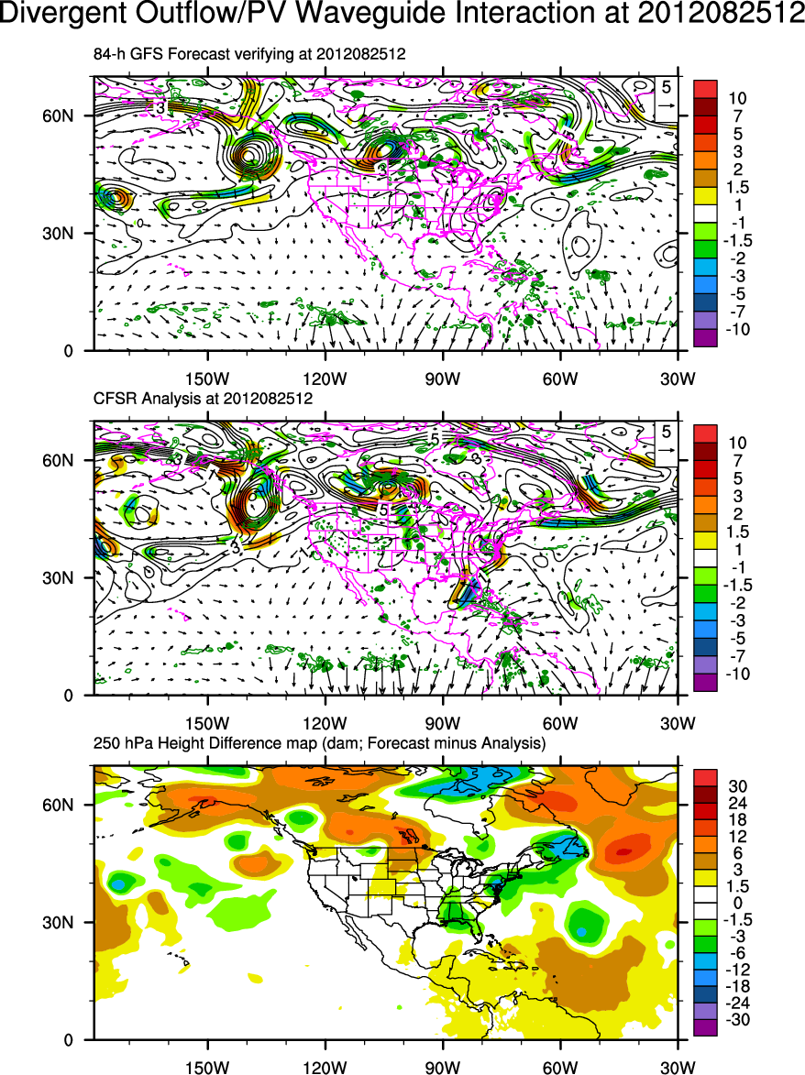
Trough Fracture due to Convection ahead of Isaac
(missed by GFS)
Analysis at 1200 UTC 25 Aug 2012
Precursor convection that
developed 24-h earlier
(not in GFS forecasts)
x
x
84-h GFS forecast (00Z/22 init)
1345Z/25 Aug 2012
Convective outbreak over Florida creates divergence that fractures (splits) trough
Split in trough allows Isaac to move westward
Black contours: 300–200 mb layer-mean PV (PVU)
Green contours: 600-400 mb (1 υb/s) layer-mean omega
Vectors: 300–200 hPa layer-mean irrotational wind (V_{ir}) (m/s)
Shading: 300–200 hPa layer-mean PV advection by V_{ir} (PVU/day)

Slide 8
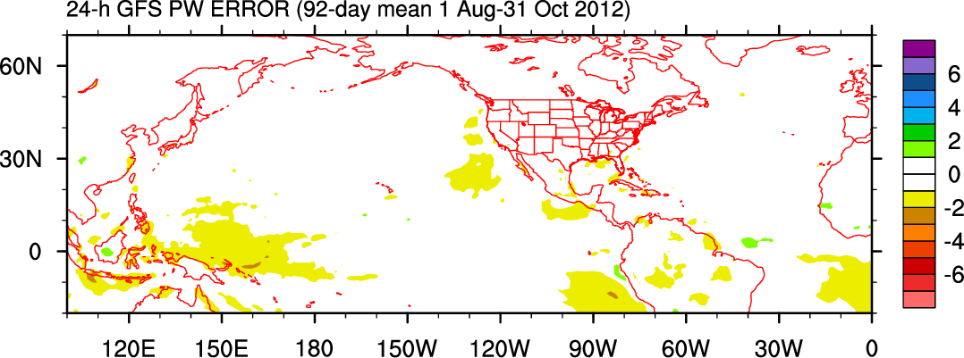
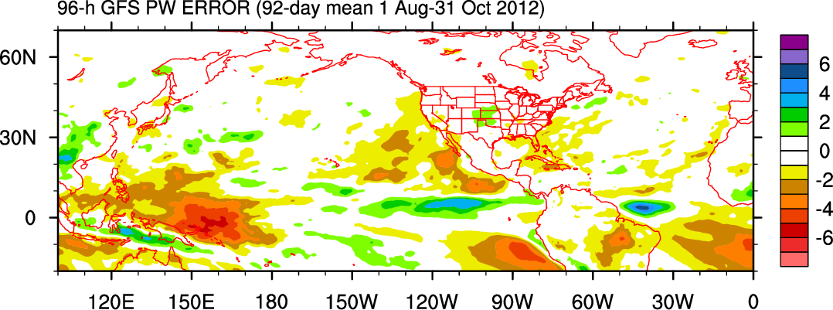
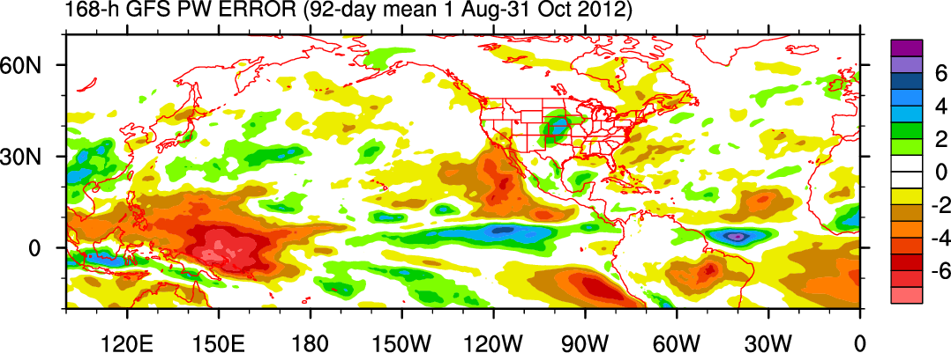
PW error (mm)
GFS PW
24-h error
96-h error
168-h error
mm

Slide 9
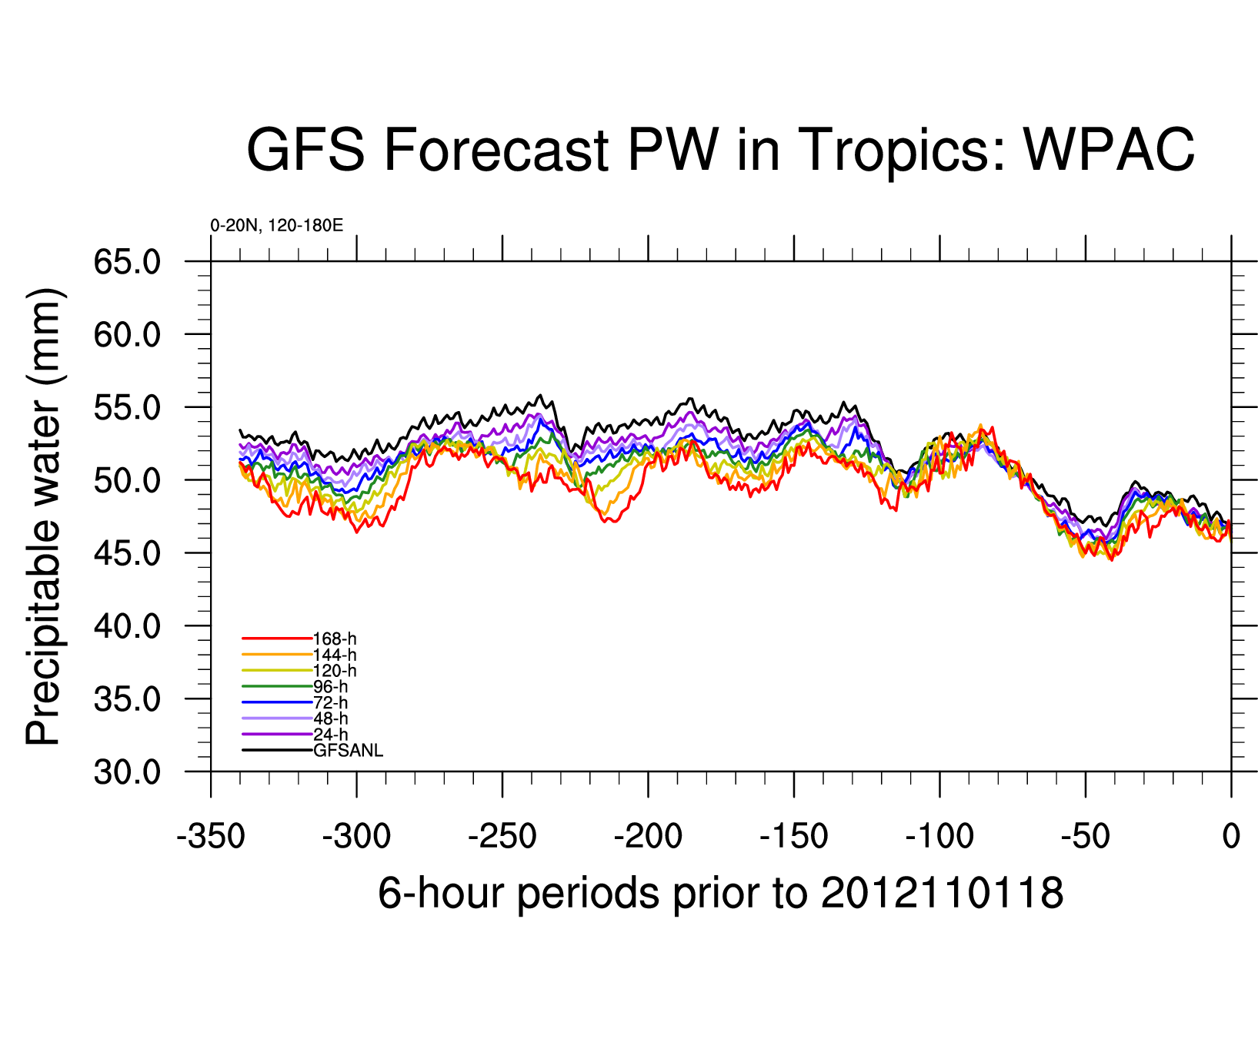
Aug 5 Aug 30 Sep 24 Oct 19
Date (2012)

Slide 10
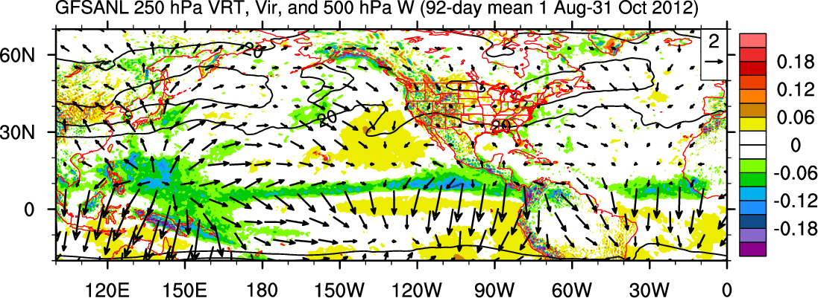
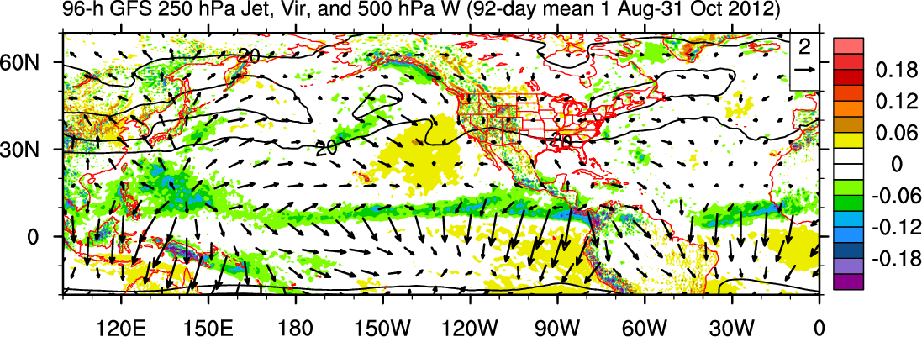
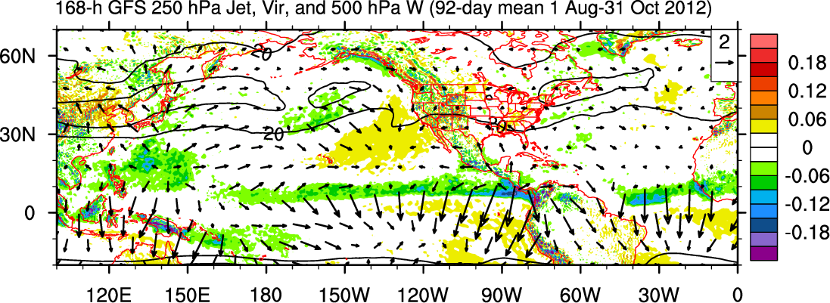
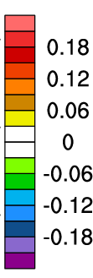
GFS 250 hPa ζ, V_{ir}, and 500 hPa ω: 92-day Mean 1 Aug–31 Oct 2012
Decrease in tropical convection overall with increasing lead; most notable over WPAC and EPAC
Decrease in irrotational wind connecting tropics and midlatitudes
Suggests connection between reduced tropical convection and decreased amplitude of midlatitude waveguide
Analysis
96-h
168-h
Pa s⁻¹

Slide 11
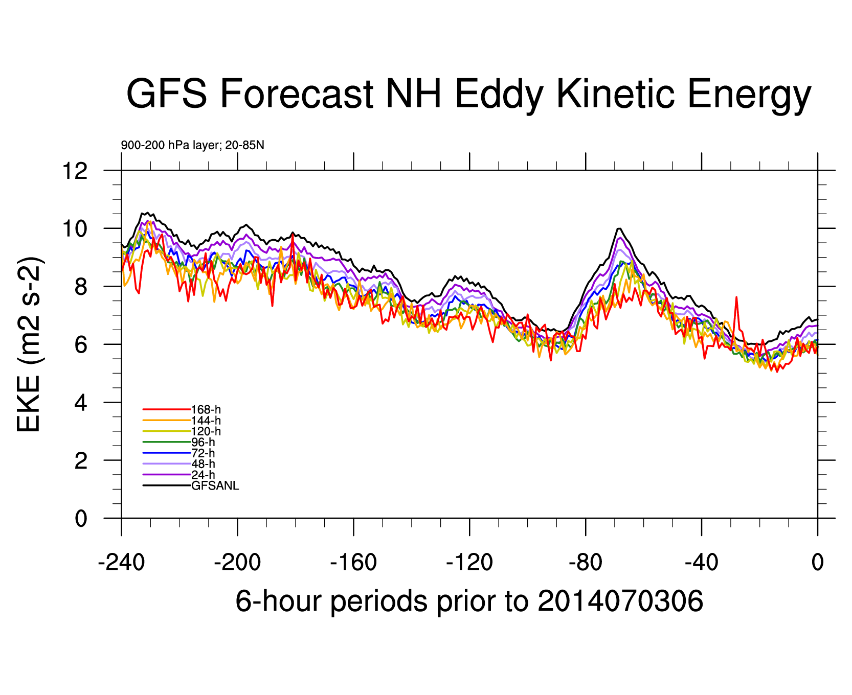
May 4 May 14 May 24 June 3 June 13 June 23 July 3

Slide 12
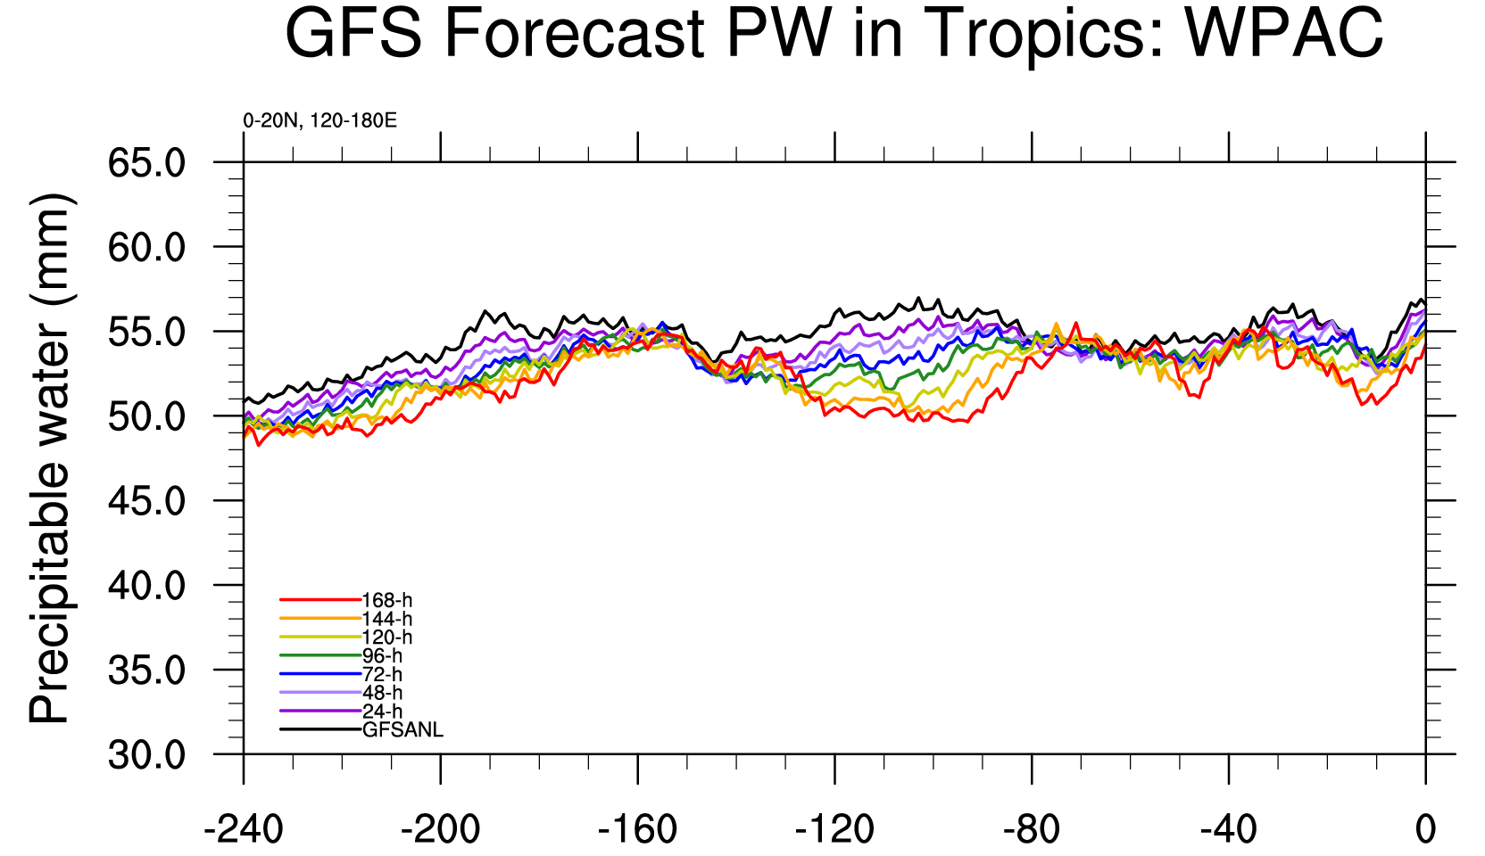
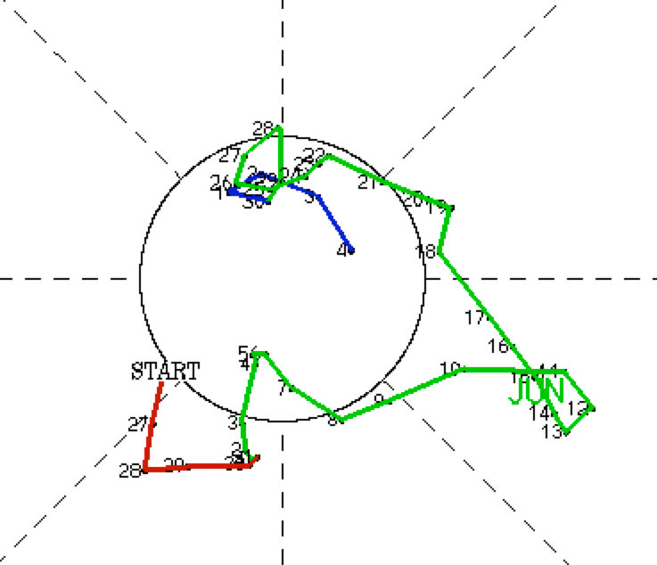
Recent Forecasts from 2014
W. Pac.
MJO Phase Diagram
(Wheeler and Hendon)
May 26 June 5 June 15 June 25 July 5 July 15 July 25

Slide 13
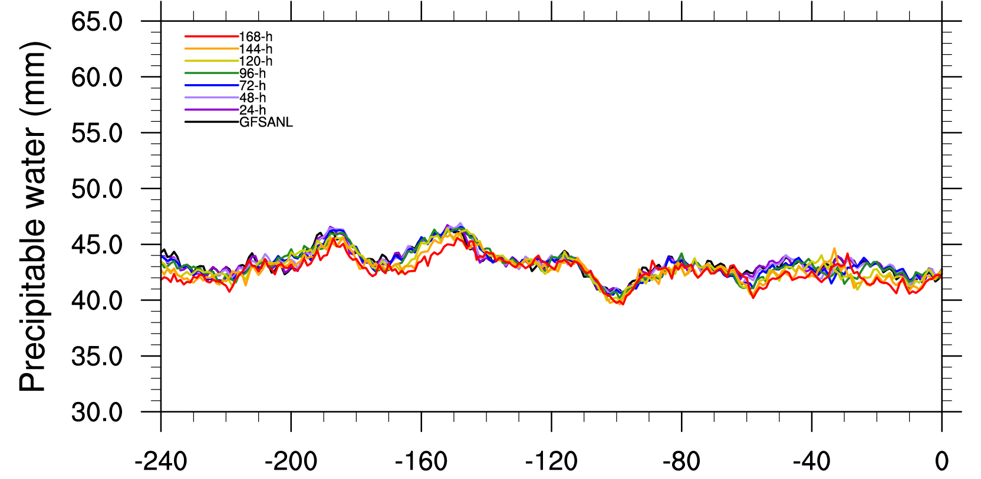
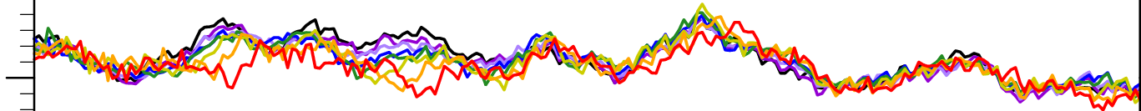
GFS PW: NATL and EPAC
Not bad in other basins
Eastern Pacific
North Atlantic
May 27 June 6 June 16 June 26 July 6 July 65 July 26

Slide 14
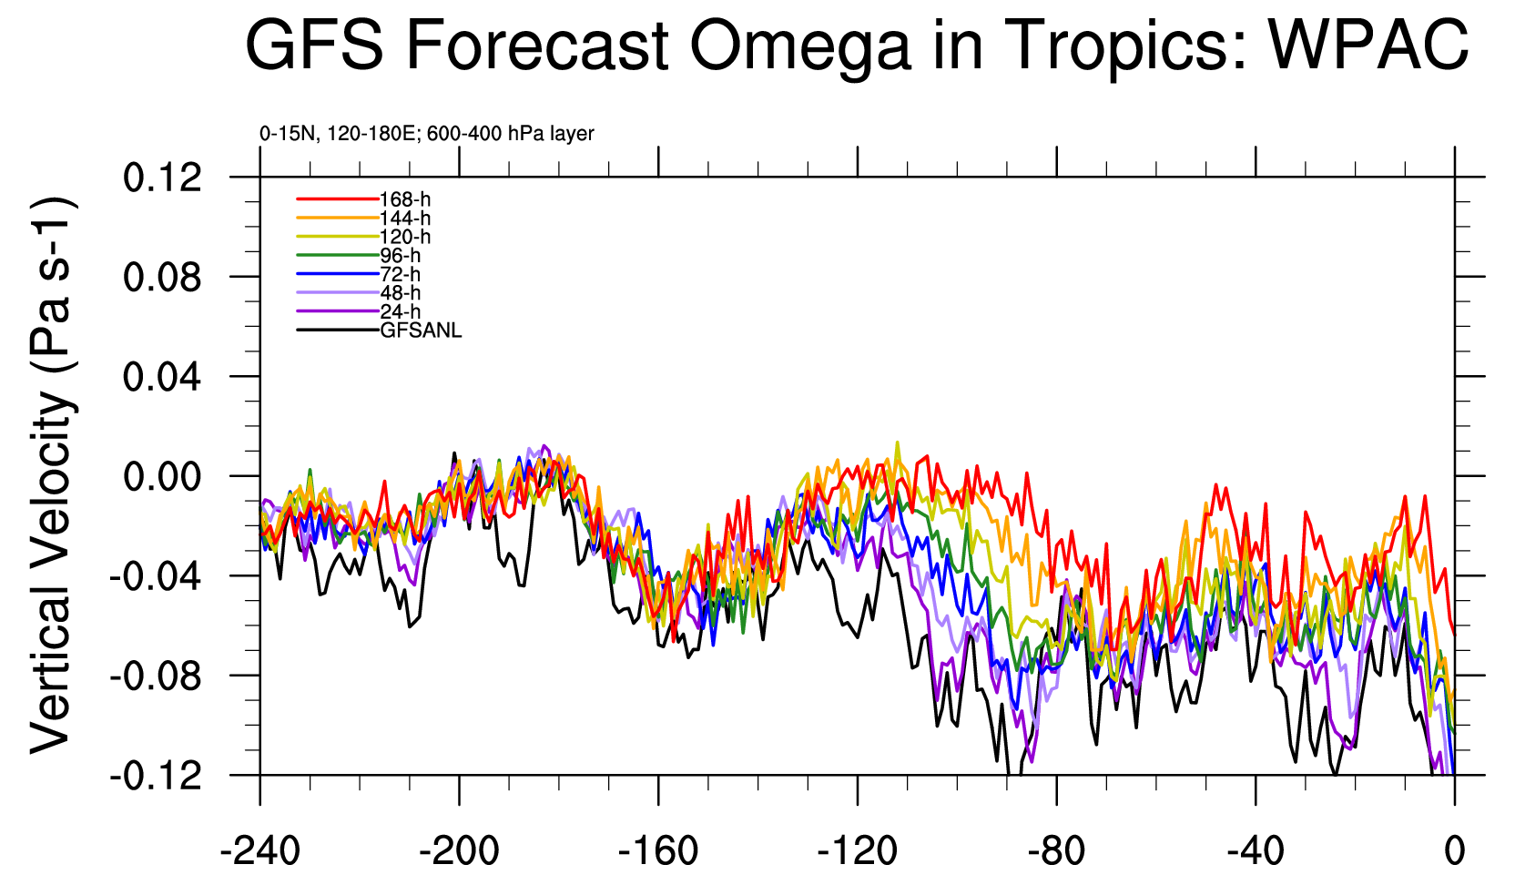
Neoguri
May 26 June 5 June 15 June 25 July 5 July 15 July 25

Slide 15
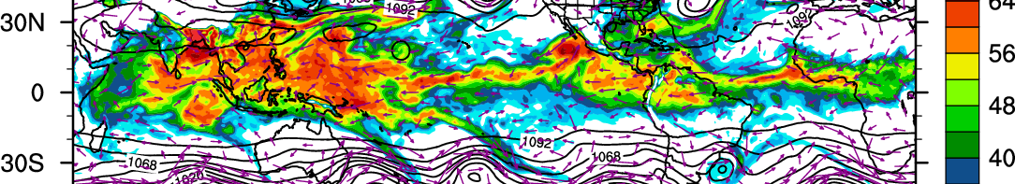
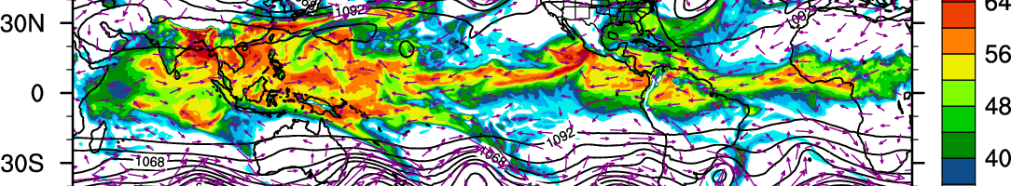
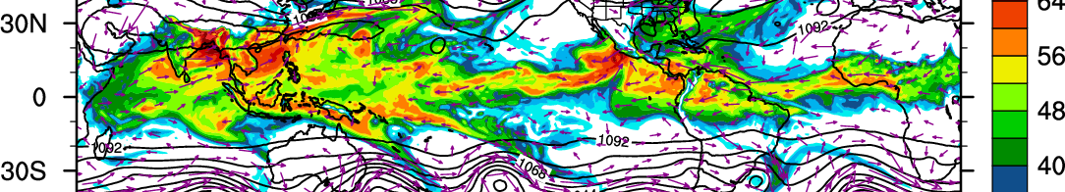
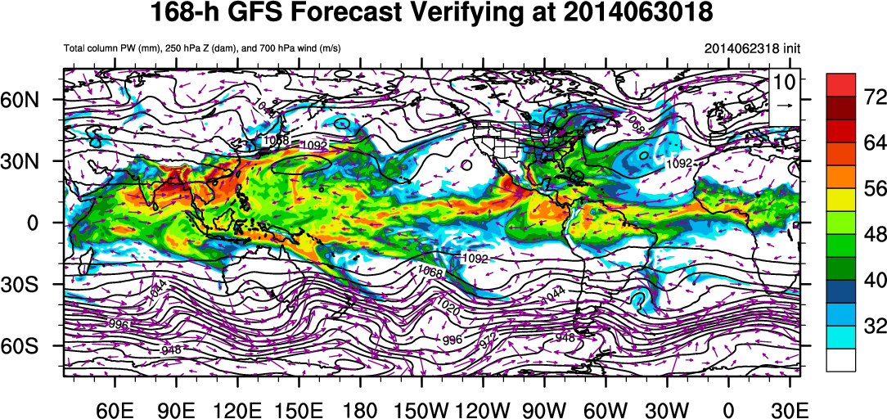
GFS Precipitable Water Behavior: Recent Forecasts
0 h
72 h
120 h
168 h
Valid 18 UTC 30 June

Slide 16
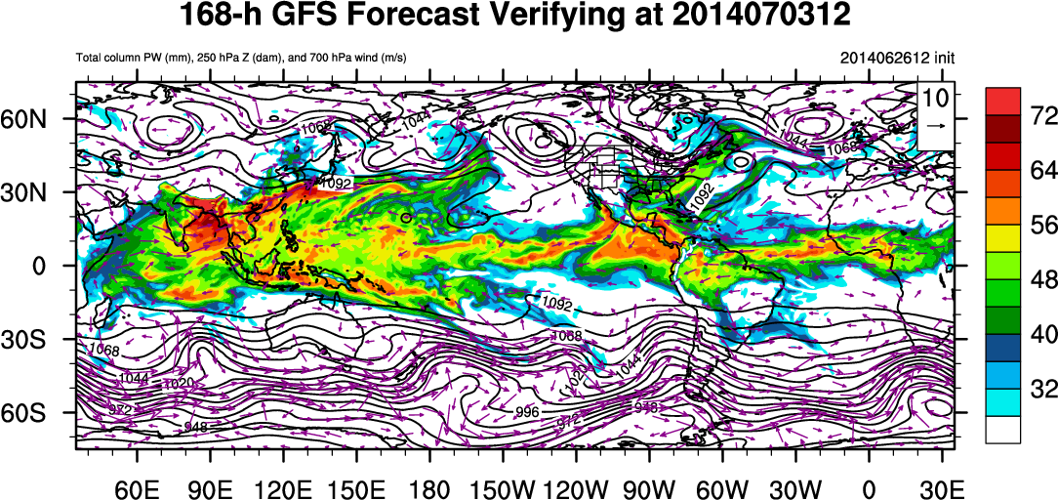
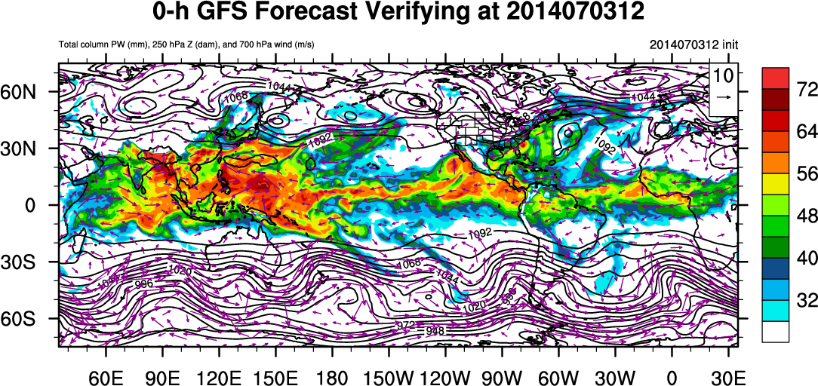
Tropical Disturbances:
Precipitable Water, 700 mb Wind and Height
168 h Fcst
Analysis
Valid 12 UTC 3 July
Douglas
Arthur
Neoguri
(only wind > 5 m/s plotted)

Slide 17
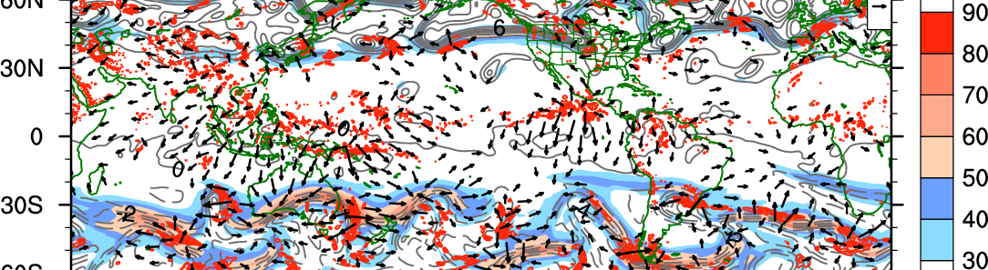
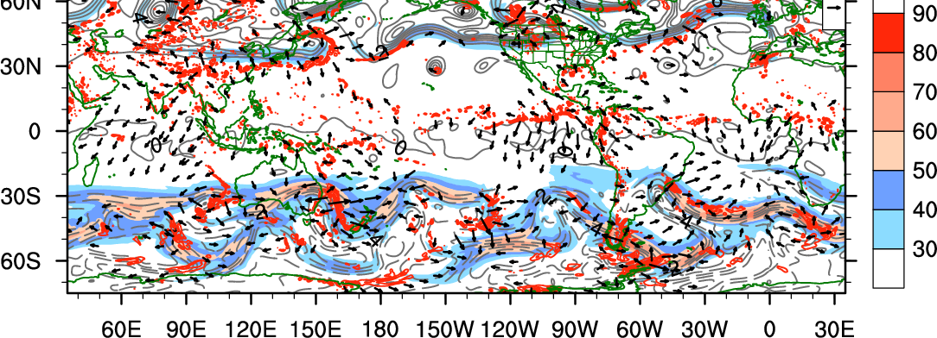
Upper troposphere: 18 UTC 28 June
Analysis
168 h
300-200 hPa layer-mean potential vorticity, irrotational wind, 250 hPa total wind speed, and 600-400 hPa layer-mean ascent

Slide 18
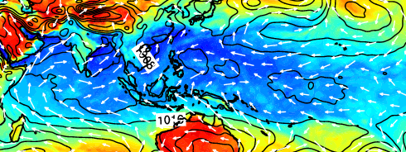
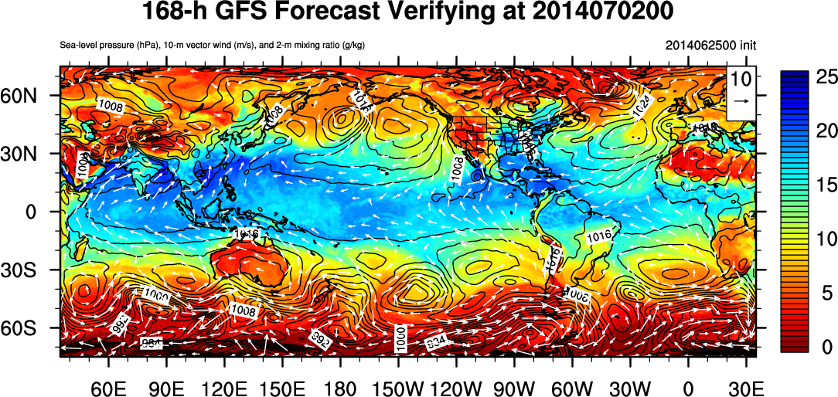
10-m Winds, 2-m Water Vapor and SLP
Analysis for
07/0200
168 h Forecast

Slide 19
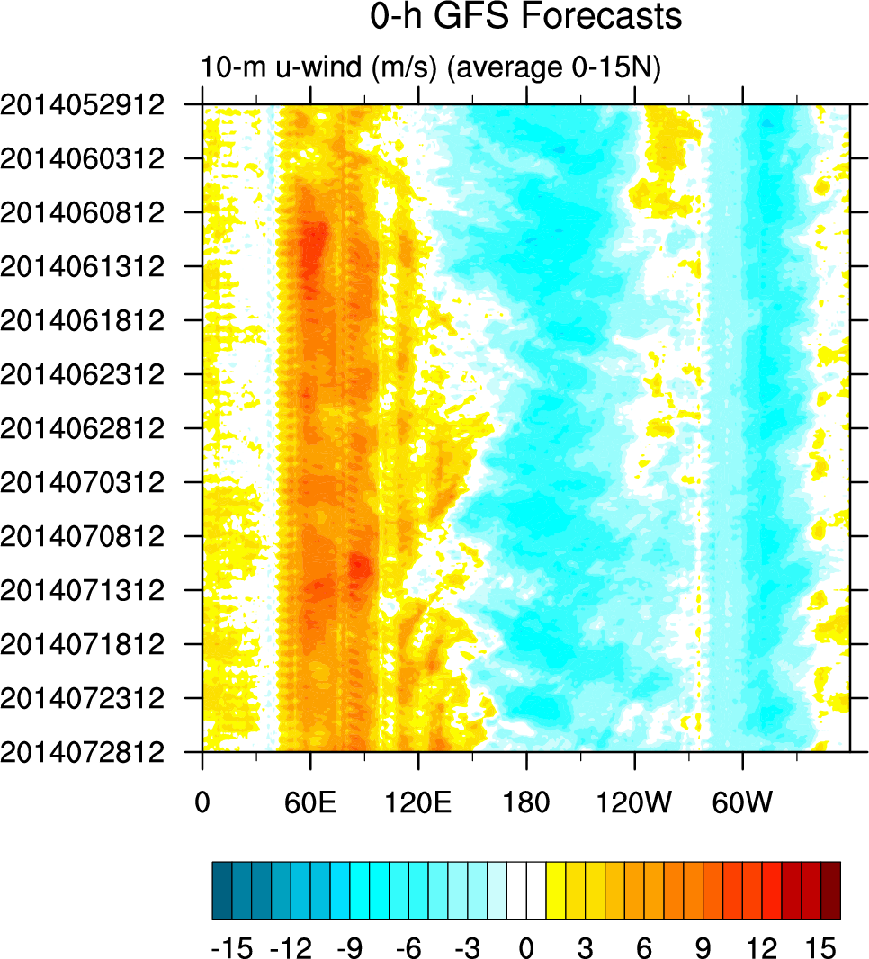
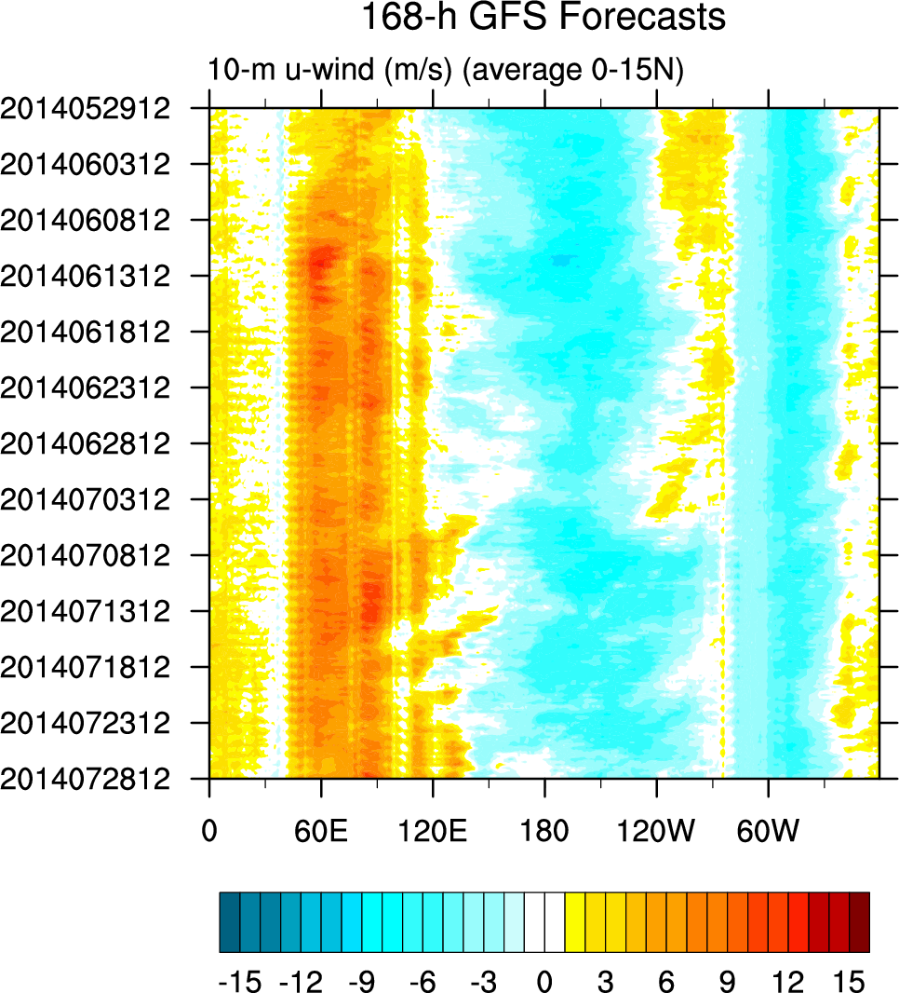
Time-Longitude Diagrams:
10-m Zonal Wind

Slide 20
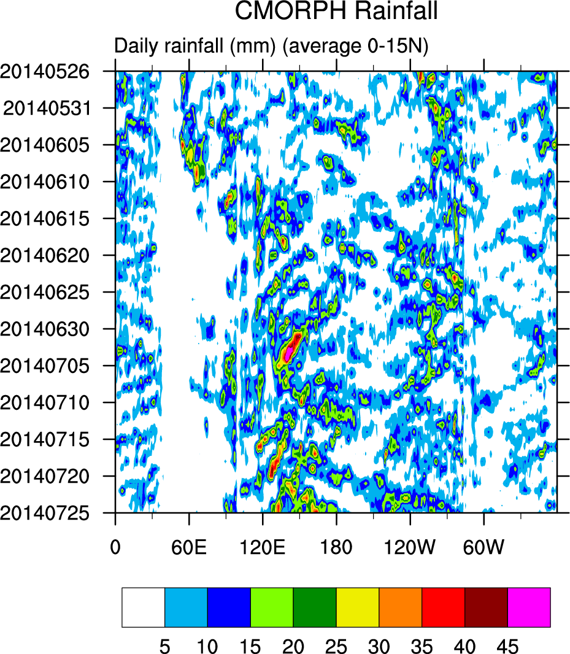
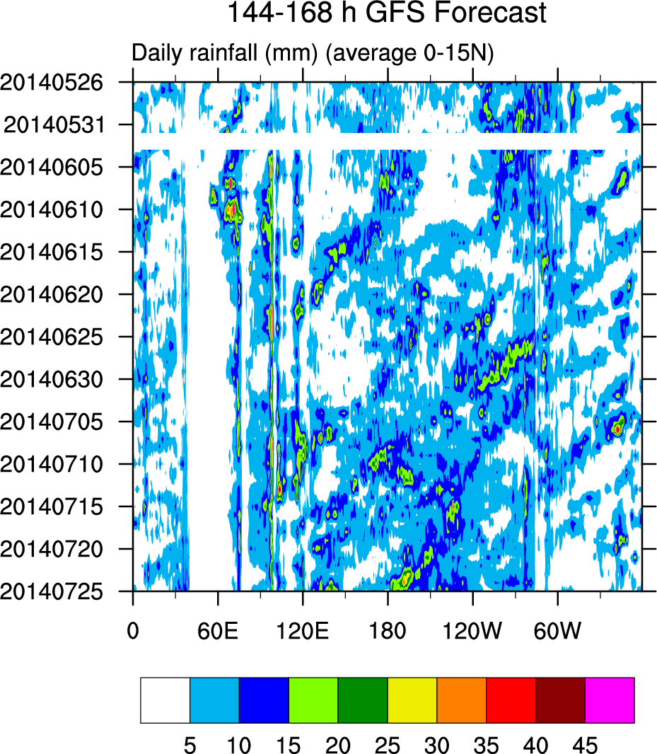
Precipitation Hovmoller
MJO
Surprisingly coherent westward propagating features

Slide 21
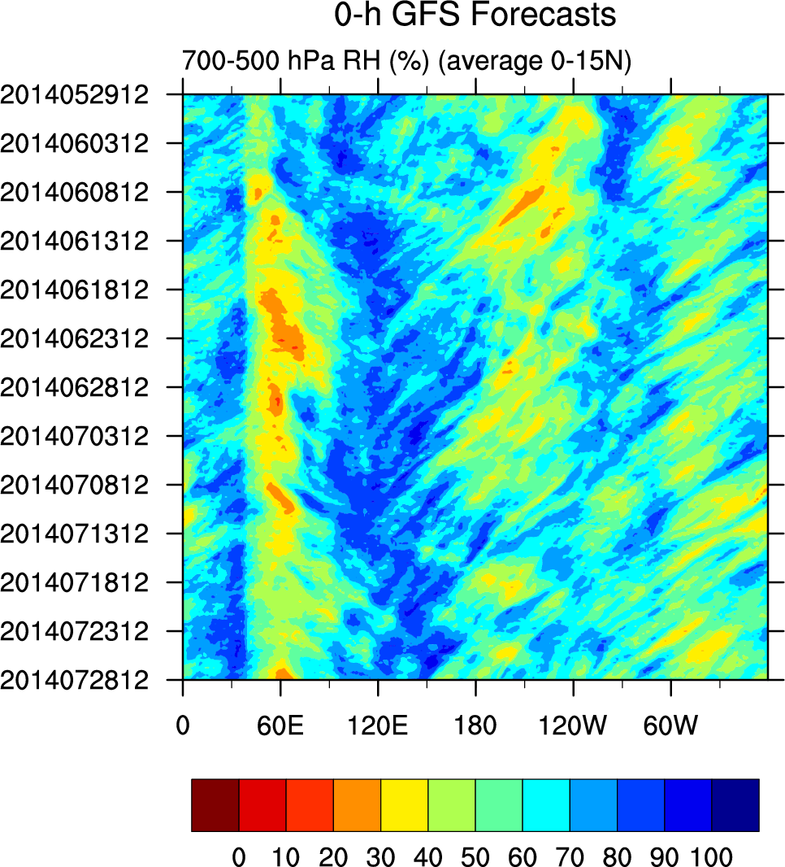
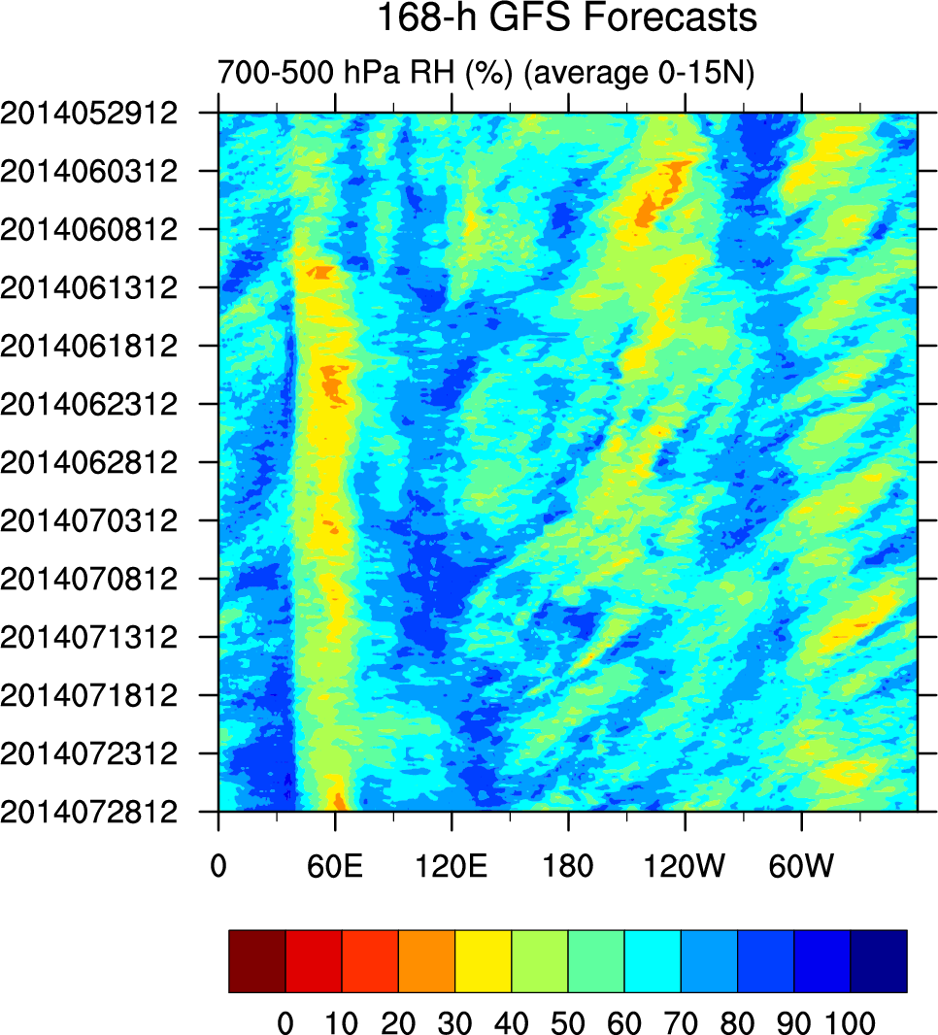
Relative Humidity 700-500 mb

Slide 22
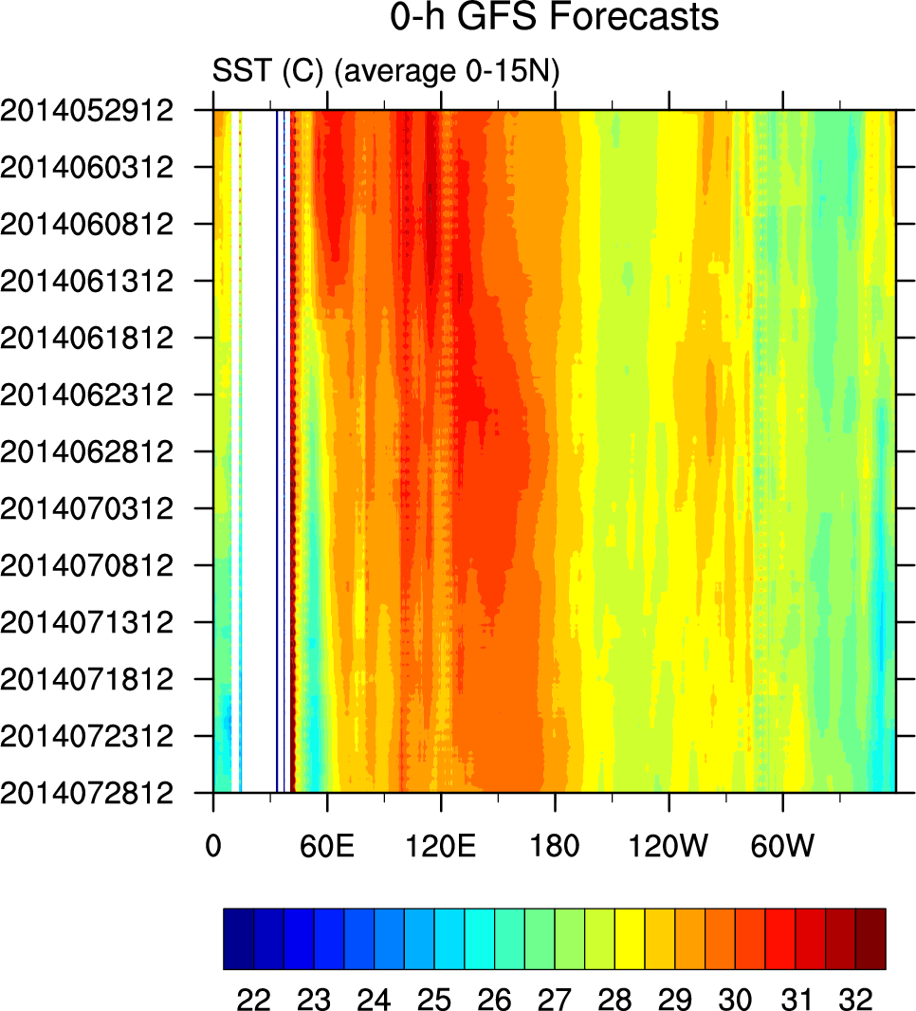
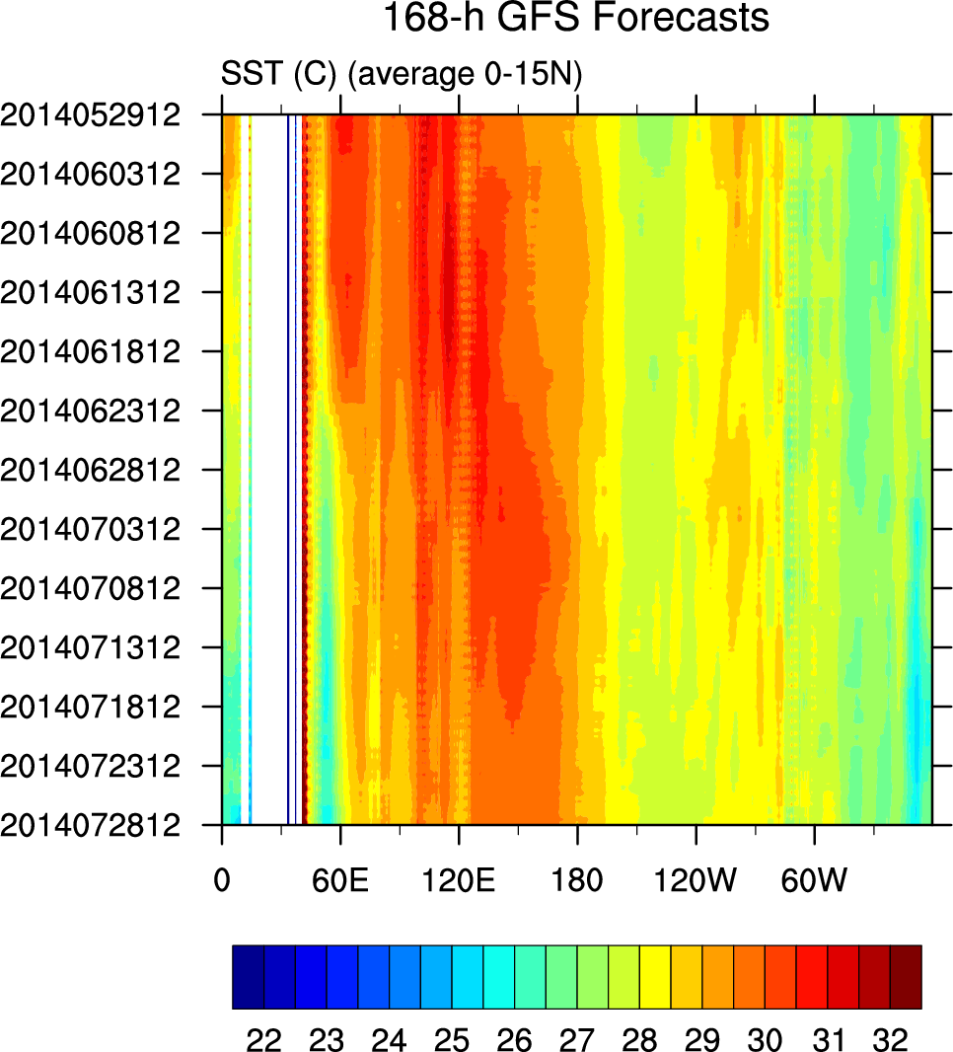
SST

Slide 23
Hypotheses
GFS struggles to progress MJO from MC into W. Pac.
  Poor forecasts begin as MJO moves into W. Pac in reality
  Role of lack of ocean coupling and suppression of convection over IO?
  Dominance of coherent westward moving disturbances in extended range forecasts – what are these? What role do they play?
7-day forecasts predict a persistent suppressed convective state over warm pool, with weak surface winds (and fluxes)
  Full reasons for stabilization are not known
  With weak surface winds, no focus for convection and weak recovery of convection-favoring thermodynamic state
Transition to pre-typhoon state (rotational dominance) appears to allow GFS to regain skill

Slide 24

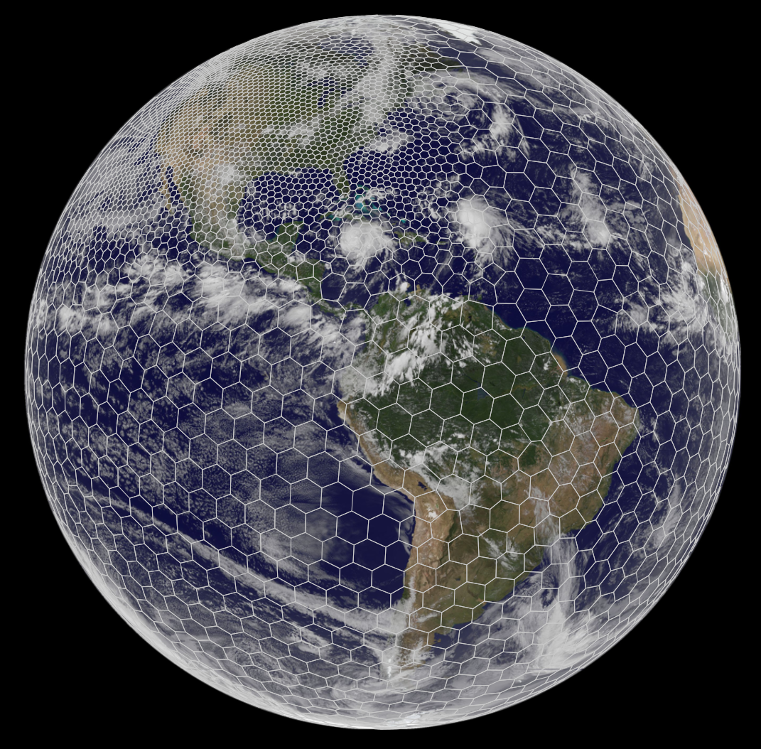
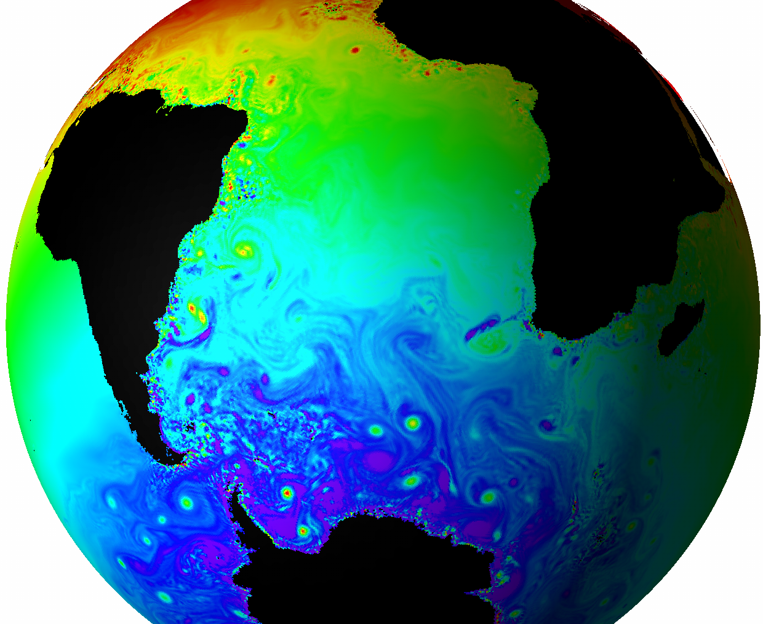




Based on unstructured centroidal Voronoi (hexagonal) meshes using C-grid staggering and selective grid refinement.
Non-hydrostatic
Jointly developed, primarily by NCAR and LANL/DOE
MPAS infrastructure - NCAR, LANL, others.
MPAS - Atmosphere (NCAR)
MPAS - Ocean (LANL)
MPAS - Ice, etc. (LANL and others)
Project leads: Todd Ringler (LANL)
Bill Skamarock (NCAR)

Slide 25

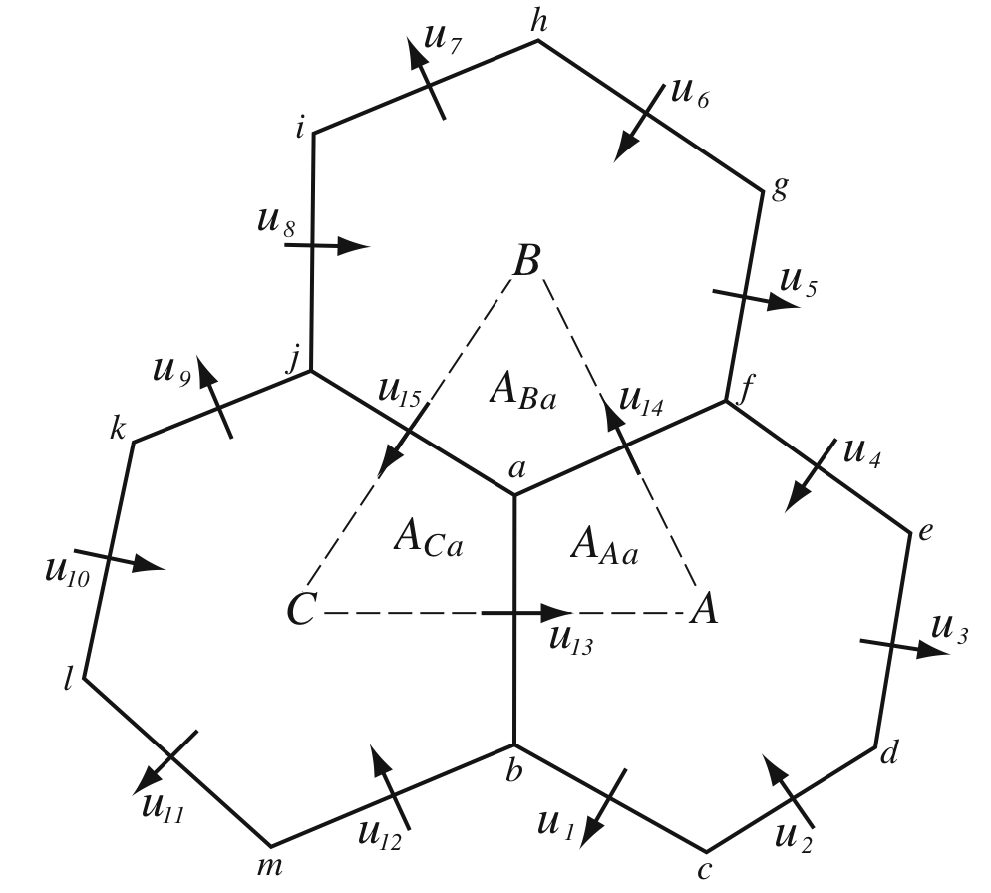
MPAS-Atmosphere
Unstructured spherical centroidal Voronoi meshes
Mostly hexagons, some pentagons and 7-sided cells.
Cell centers are at cell center-of-mass.
Lines connecting cell centers intersect cell edges at right angles.
Lines connecting cell centers are bisected by cell edge.
Mesh generation uses a density function.
Uniform resolution – traditional icosahedral mesh.
C-grid
Solve for normal velocities on cell edges.
Solvers
(1) hydrostatic equations (PEs)
(2) Fully compressible
nonhydrostatic equations
(explicit simulation of clouds)
Solver Technology
Integration schemes are
similar to WRF.

Slide 26
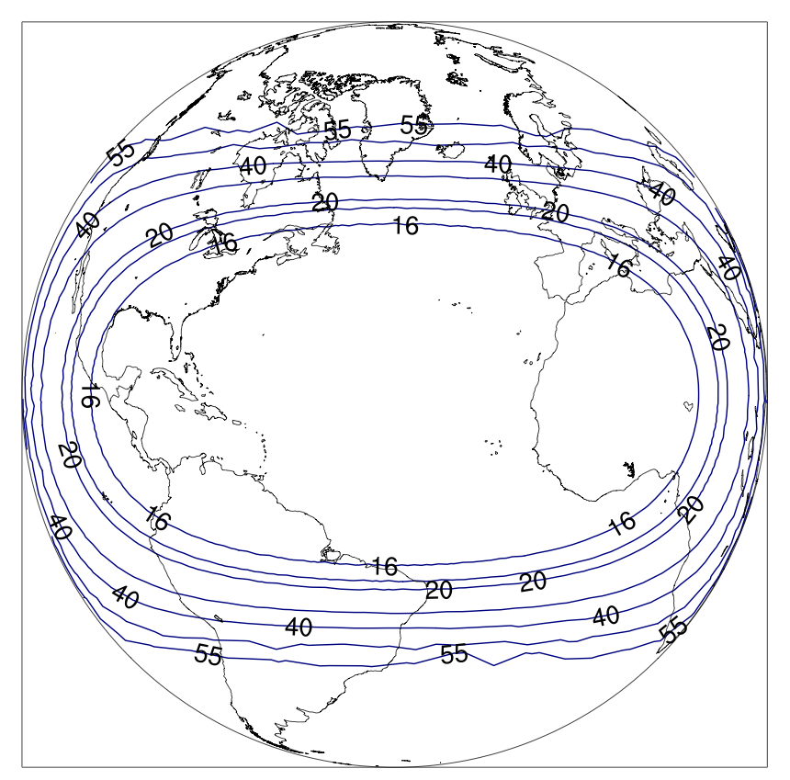
Model Configuration
15-km “uniform” MPAS versus 60/15 km variable resolution (MPS2)
Initialized with 00 UTC GFS
52 forecasts 10 Aug. – 30 Sep. 2013
27 TCs during period
Physics:
  Tiedtke cumulus
  WSM6 microphysics
  YSU PBL
  Noah LSM
  RRTMG l.w. and s.w. radiation
  41 levels: model top 30 km
15 km
60 km

Slide 27
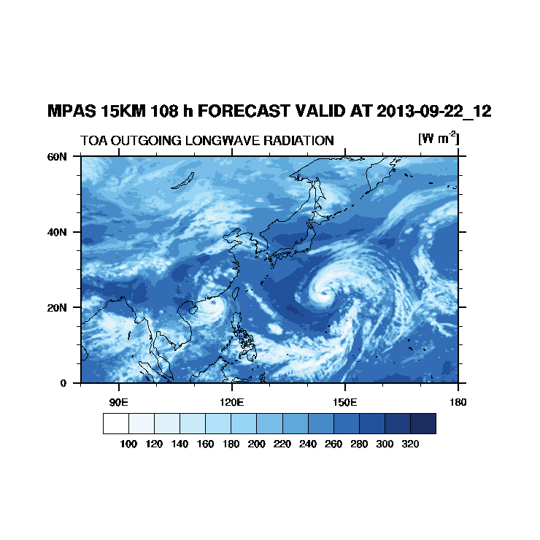
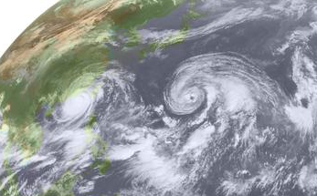
Tropical Cyclone Forecasts and Verification
GFDL tracker to track and match disturbances with observations
Compare MPAS and GFS in Atlantic and W. Pac.
Compare MPAS variable resolution with uniform resolution.
Pabuk
Usagi
Kochi University Archive

Slide 28
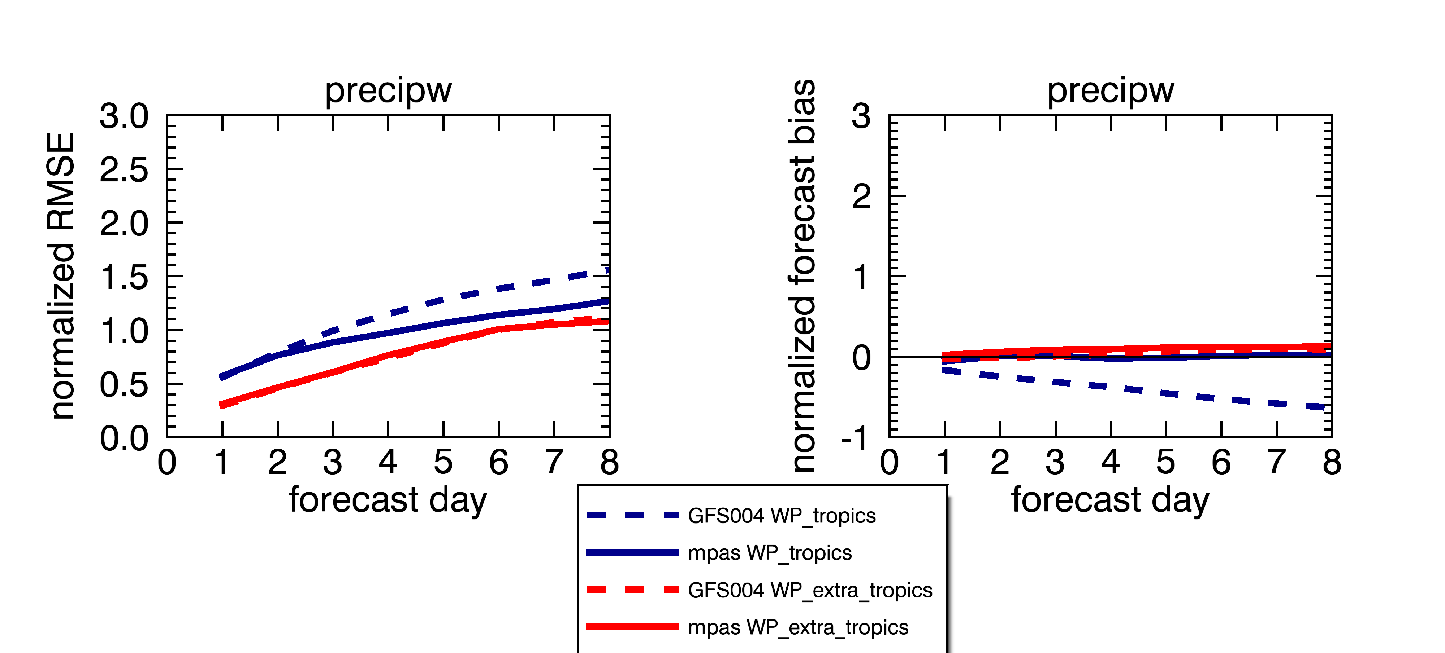
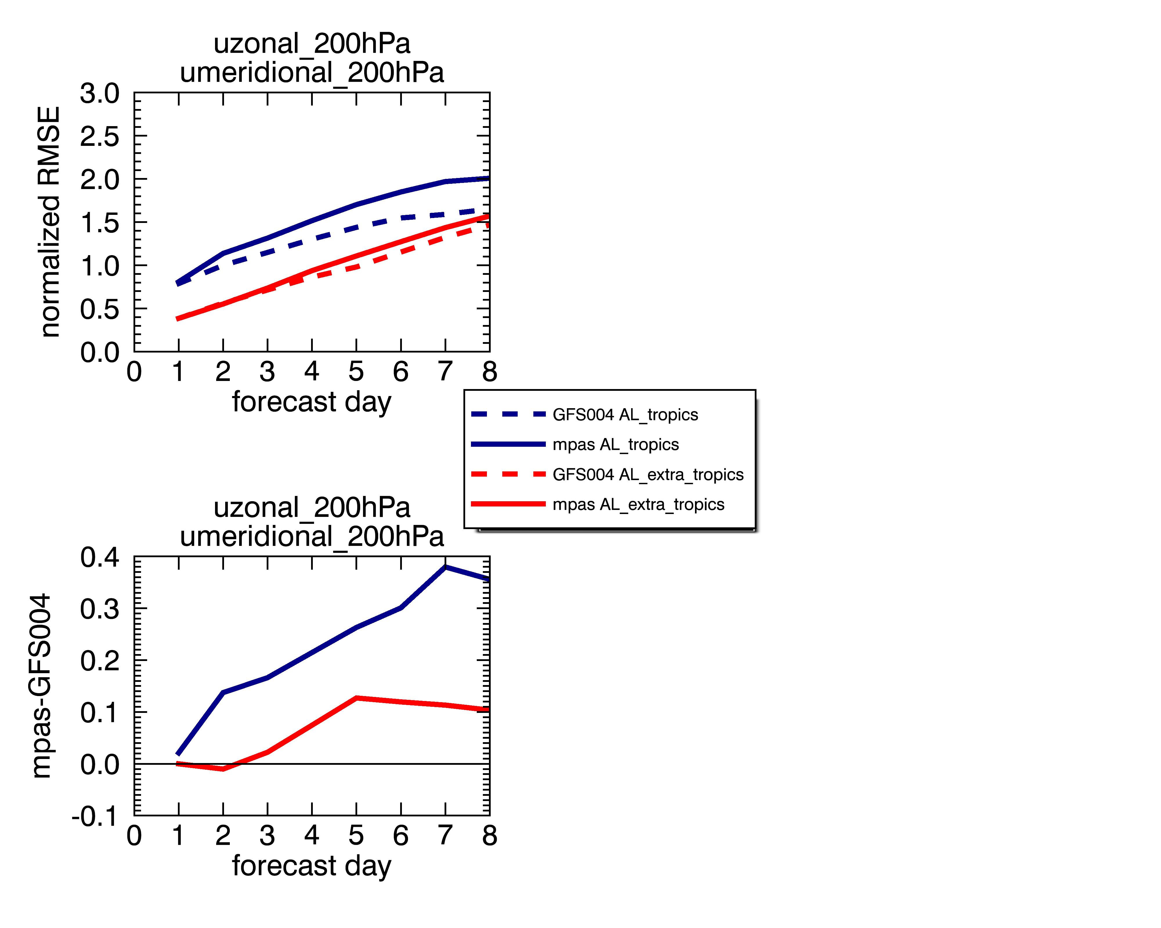
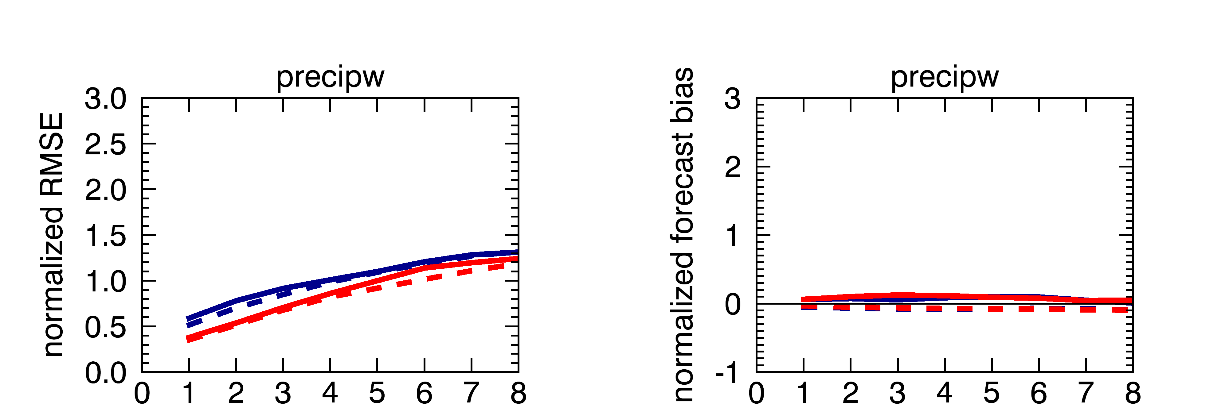
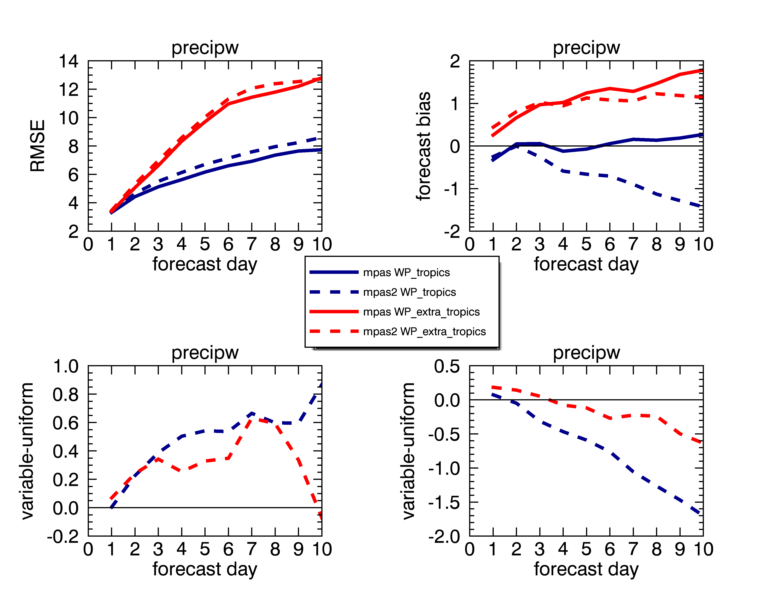
GFS and MPAS PW in 2013
Errors are normalized by the instantaneous spatial standard deviation
Compared with GFS Analysis
West Pac
120-180E
PBL too moist
GFS Tr
MPAS Tr
GFS Ex-Tr
MPAS Ex-Tr
Tropics: 0 - 23.5 N
Extra-Trop: 23.5 – 55 N
Atlantic
20-80W

Slide 29


Wind Errors at 200 mb
W PAC
N ATL
GFS Tr
MPAS Tr
GFS Ex-Tr
MPAS Ex-Tr
GFS Tr
MPAS Tr
GFS Ex-Tr
MPAS Ex-Tr
N ATL
GFS winds notably better than those from MPAS
MPAS variable res. matches uniform res. until day 8 in the tropics.
MPA2 Tr
MPAS Tr
MPS2 Ex-Tr
MPAS Ex-Tr

Slide 30
Tropical Cyclone Hits
Similar through day 7

Slide 31
MPAS Plans
Participate in HIWPP
Finish porting GFS phyiscs
  Compare with GFS using GFS initial conditions
Run MPAS experimentally for 2014 hurricane season
  Modified Tiedtke scheme
  Mixed-layer ocean

Slide 32

Unrealistic: still work to do

